Slide 1

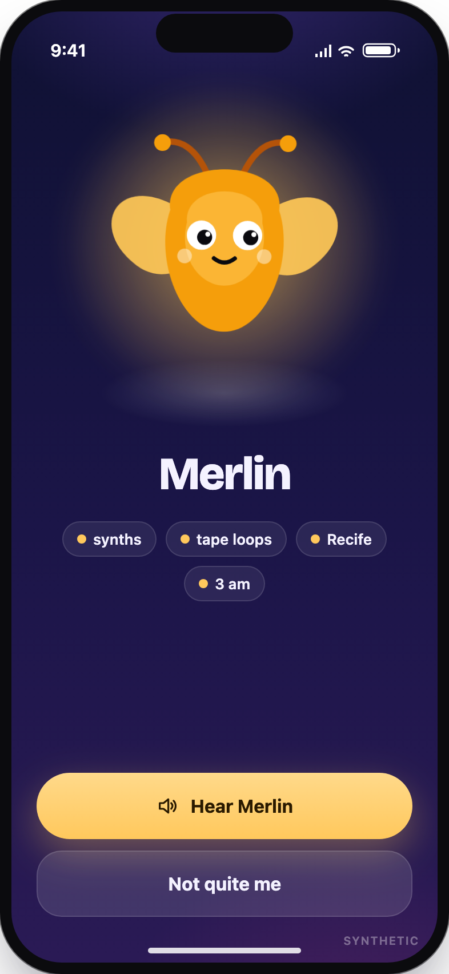
HACKCMU 2026 · MULTIPLAYER · IFM · ELEVENLABS
Familiars
Your familiar meets theirs first.
A small creature, hatched from your voice, that introduces you to people and finds you plans.
K2 Horizon 0.9B per person, 375B for the world
ElevenLabs voice in, voice out
Querit real events
Notes:
This is Familiars. Everyone gets a small creature, hatched from their own voice, that meets other people’s creatures first, so you never have to send the cold text.

Slide 2

THE PROBLEM
Everyone is in the same room. Nobody sends the first text.
57%
of 44,000 US college students report loneliness.
Trellis, 2024
65%
of students lonely in the latest national survey.
Active Minds · TimelyCare, 2025
70M
daily users at BeReal’s peak. A photo had nothing to say.
down to ~3M by 2025
76%
of group plans never leave the chat.
83 messages for the ones that do
“You can get a meal without talking to another human.” · The Tartan, CMU, 2024
Notes:
More than half of students say they are lonely, and it is not for lack of people. The problem is the first move. BeReal proved a synchronized moment brings people together, and died because a photo has nothing to say. Three out of four group plans die in the chat.

Slide 3
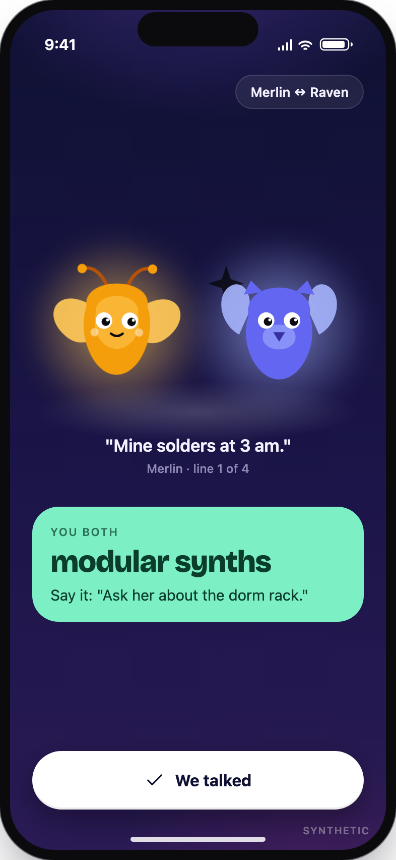
THE IDEA
Manufacture the introduction.
Each person gets a familiar: a small model that runs locally, on their side, and knows only them.
Two familiars meet first. You get one line worth saying.
K2 Horizon 0.9B one per person, local, your own agent
K2 Horizon 375B the shared world: matching, intros, recaps
Notes:
Our idea is to manufacture the introduction. Each person gets a familiar: a K2 Horizon 0.9B model that runs locally and knows only them. Two familiars meet first and hand you one line worth saying. The 375B model runs the shared world around them.

Slide 4
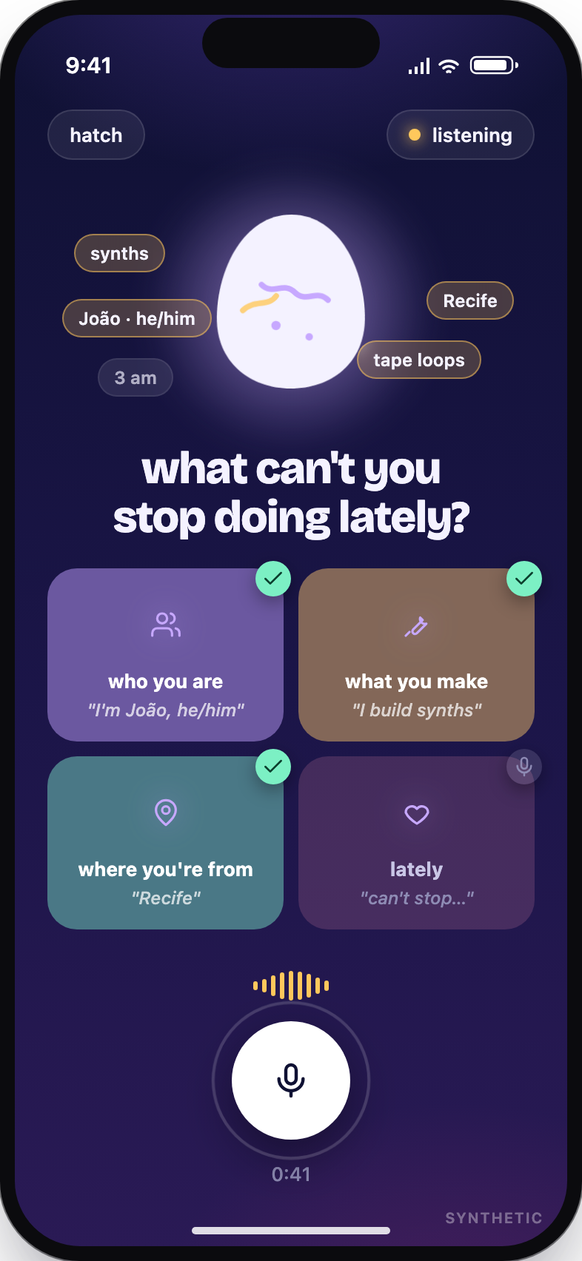
1 · HATCH
Say who you are. It hatches from that.
No typing. Name, pronouns, what you make, where you are from: spoken, stuck to the egg, hatched.
ElevenLabs Scribe speech to text while you talk
K2 375B hatches name, keywords, greeting
K2 0.9B your familiar from here on
Notes:
Onboarding is one screen and no typing. ElevenLabs Scribe transcribes as you talk, the 375B hatches a creature from the transcript, and from then on a 0.9B instance is your familiar.

Slide 5
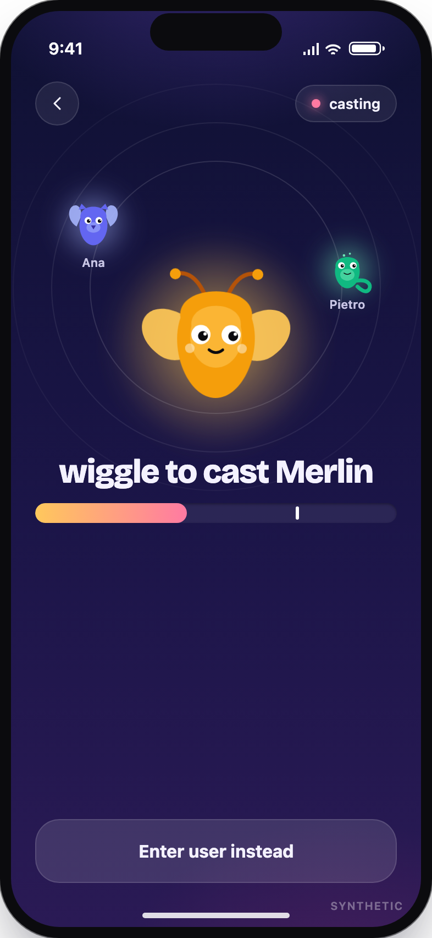
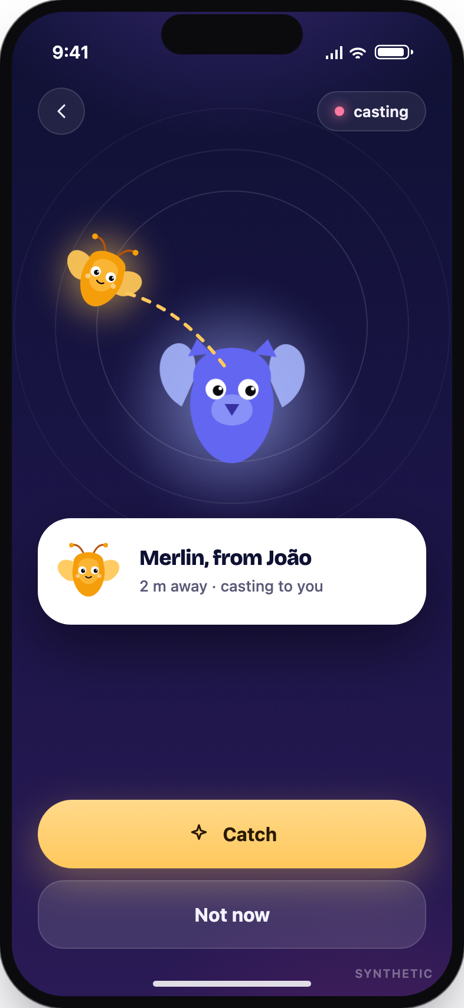
2 · MEET
Wiggle to cast. Tap to catch.
One phone wiggles, the other catches. The two familiars talk on a stage and hand you the one thing you share.
DeviceMotion the wiggle, matched server-side
K2 0.9B × 2 the two familiars write the duet
ElevenLabs TTS a voice per familiar
Notes:
This is the multiplayer core. Casting mode, one wiggle, one tap on the other phone. The two 0.9B familiars write the duet, ElevenLabs gives each a voice, and you both get the one thing you share. Then you talk, in person.

Slide 6
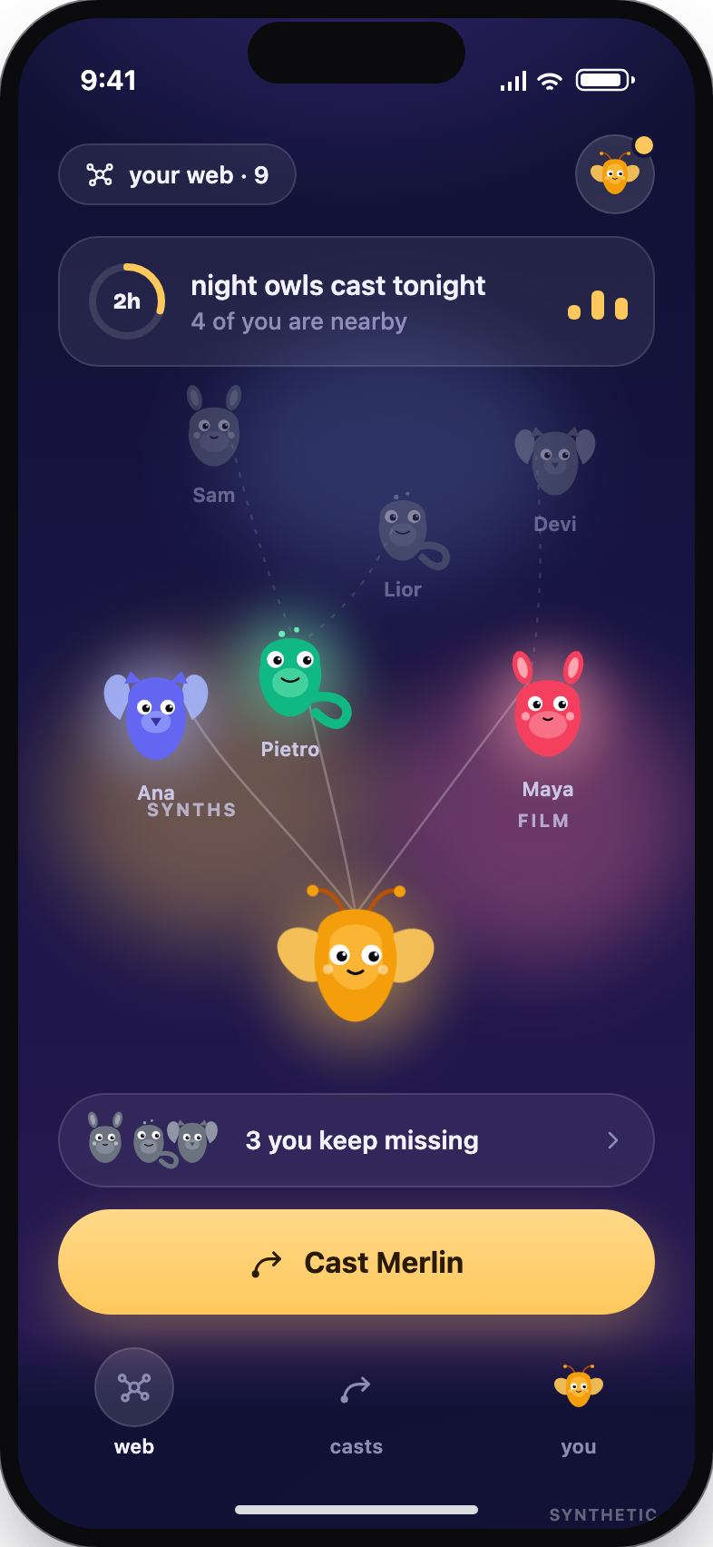
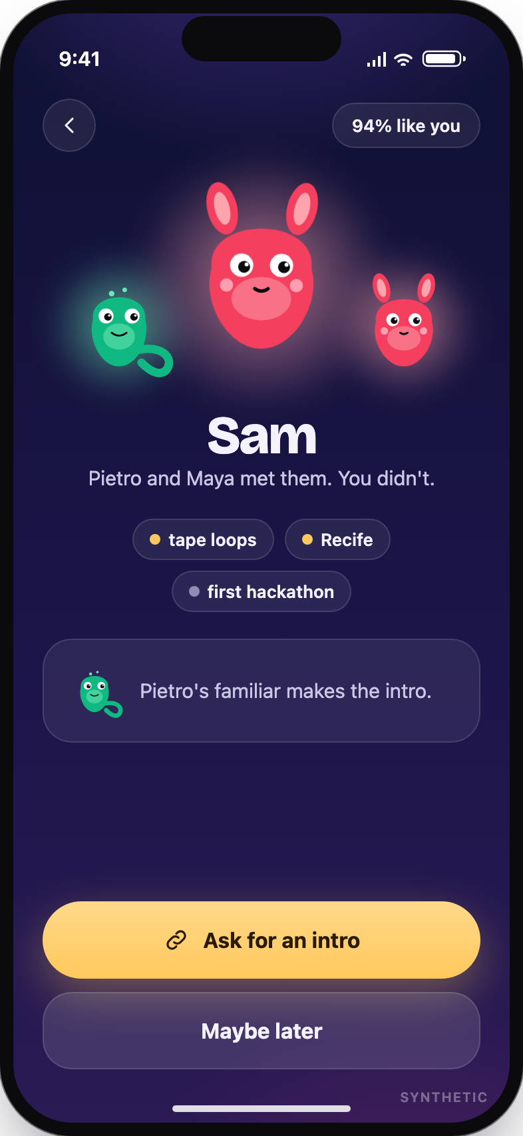
3 · WEB
Home is who you have met.
People stand in the interests you share. Friends of friends fade upward.
The ones you keep missing get an intro carried by a friend’s familiar.
K2 375B groups the web by shared interests, writes the intro line
Next.js · Vercel · Upstash one shared room for every phone
Notes:
Home is your web: the people you met, grouped by what you share, and friends of friends fading upward. The 375B writes the intro line, and a friend’s familiar carries it.

Slide 7
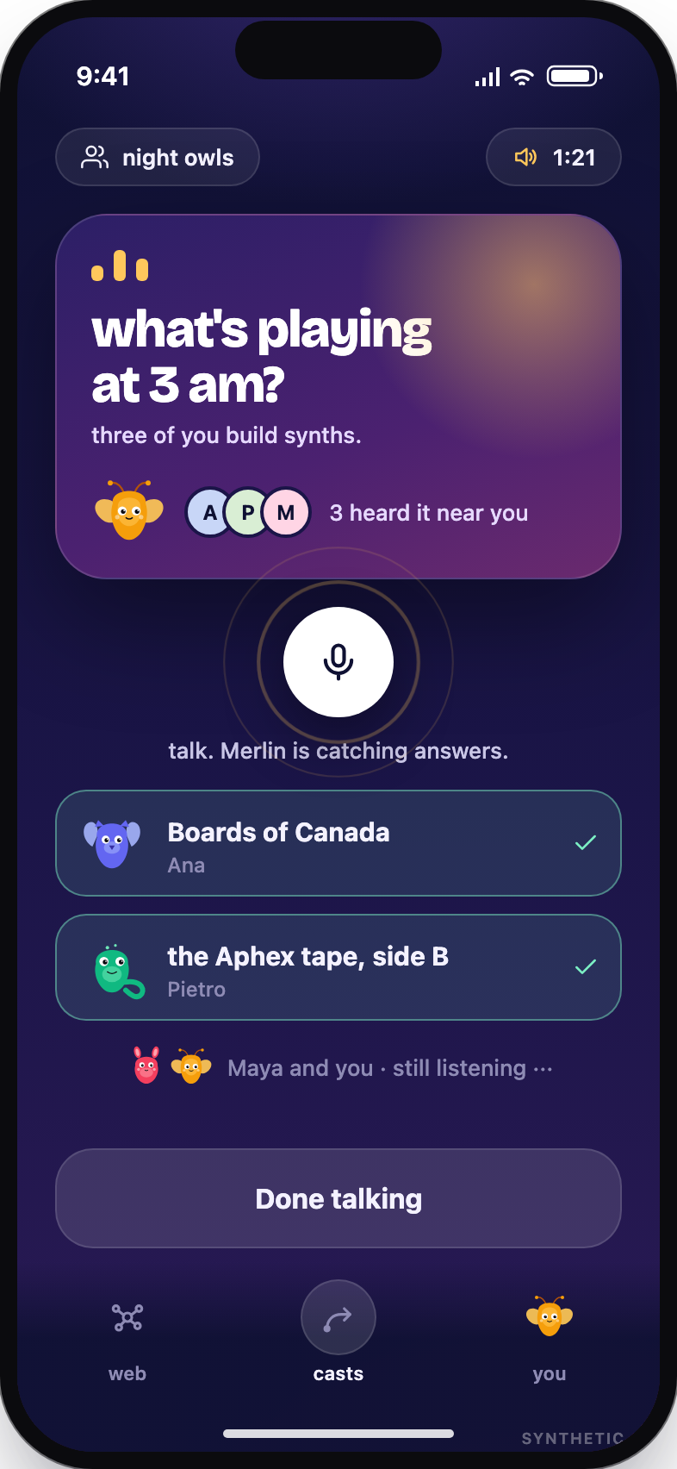
4 · THE DAILY CAST
One question a day, in your familiar’s voice.
It lands on every phone in the circle at the same second. You look up and talk.
Nobody types. The phone listens.
K2 375B writes the question from the circle’s interests
ElevenLabs TTS asks it, Scribe listens to the answers
Notes:
Every night one question lands on every phone in the circle at the same second, in the familiar’s voice. Nobody types: the phone listens while you talk.

Slide 8
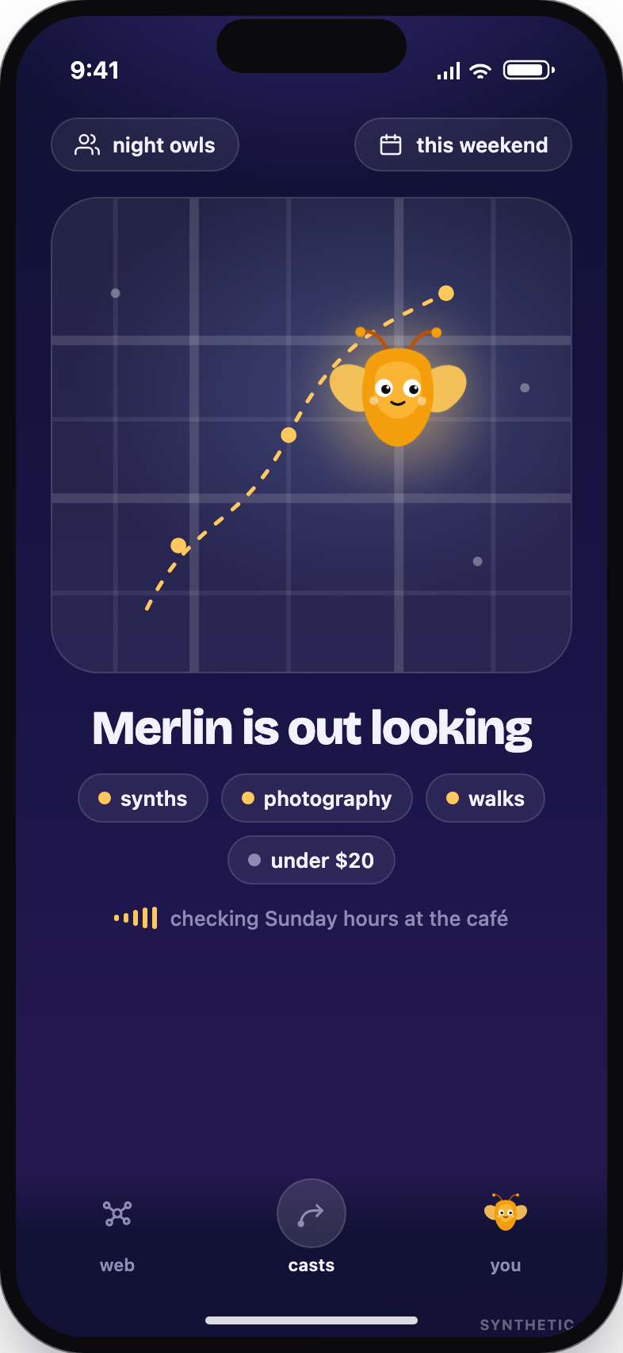
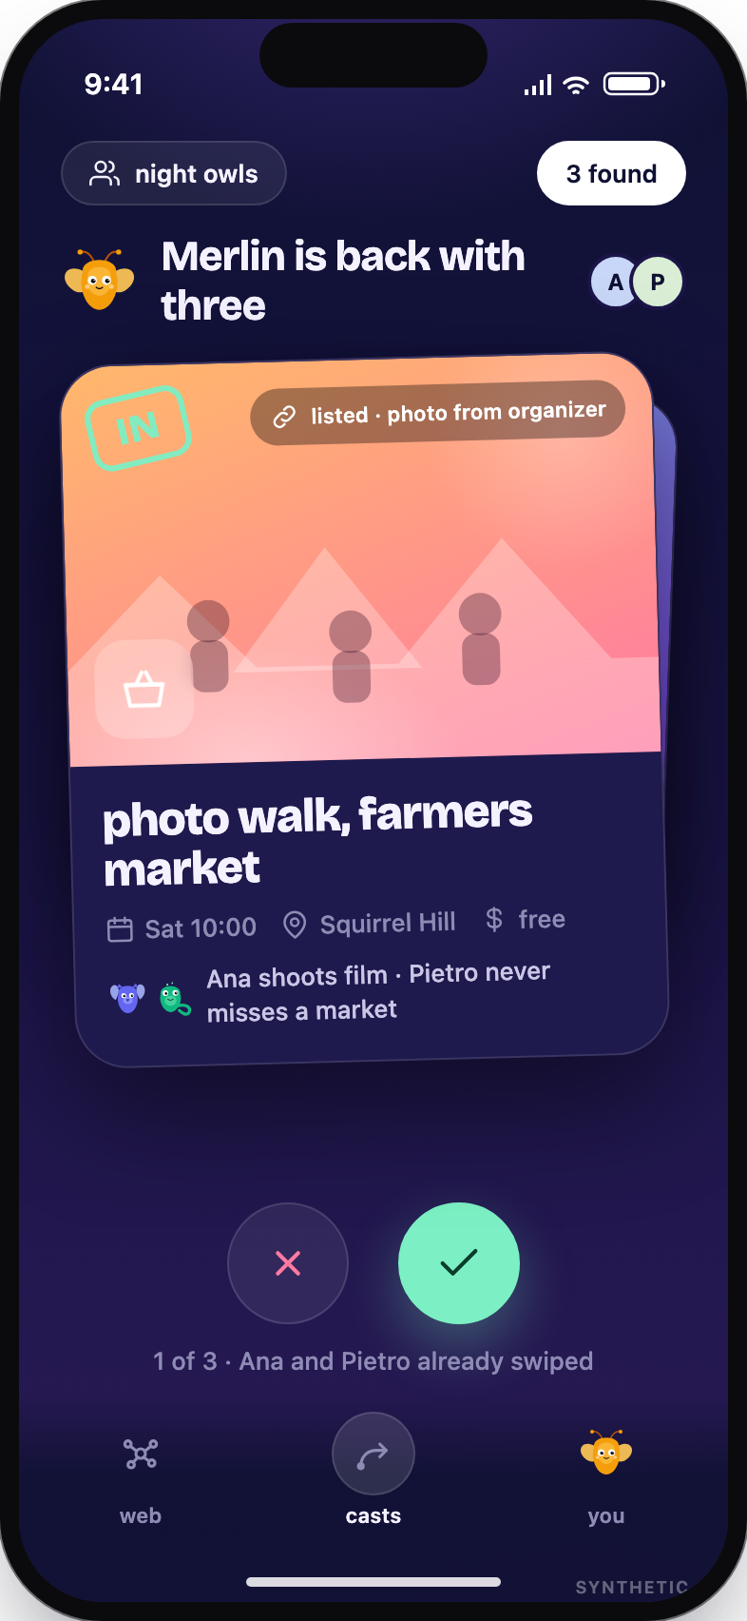
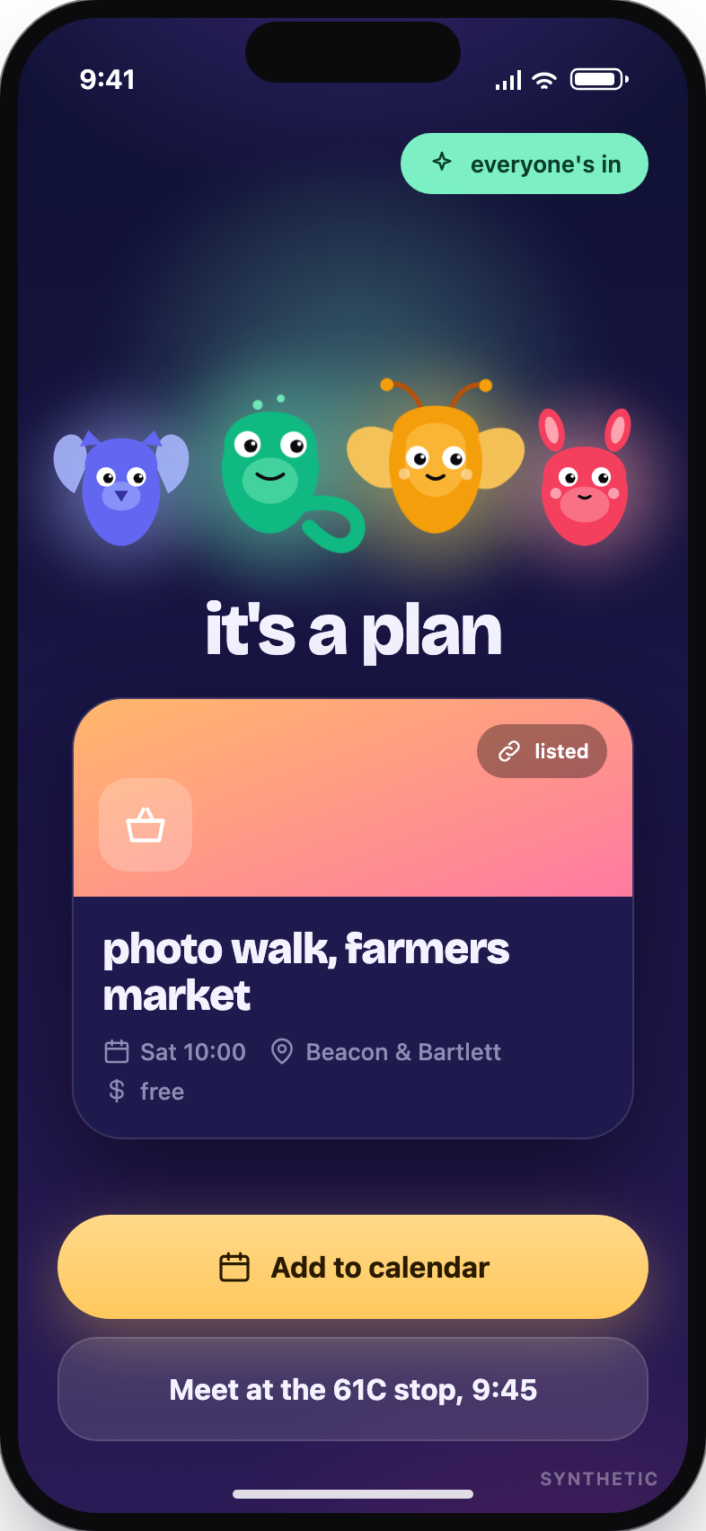
5 · OUT
Merlin goes out and finds three. Swipe.
Real events, with the source. When everyone swipes right on the same one, it is a plan.
Querit web search and page fetch for real events
K2 375B plans the queries, extracts the facts, never invents
Notes:
Send your familiar out. Querit searches and fetches real pages, the 375B plans the queries and extracts the facts, and it never invents an event. Three cards, swipe, and when everyone is in, it is a plan.

Slide 9
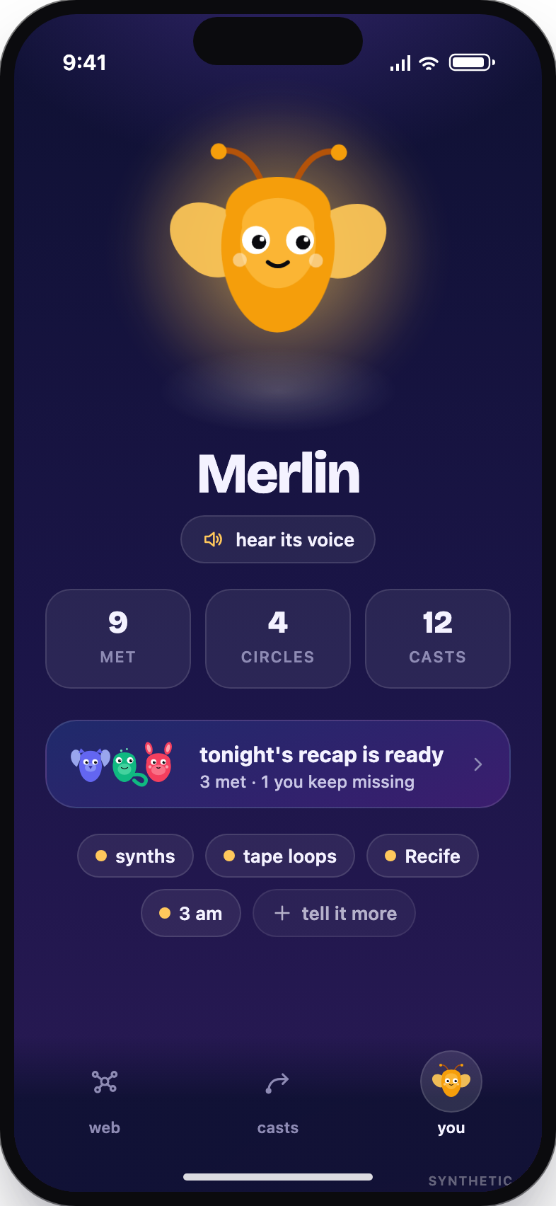
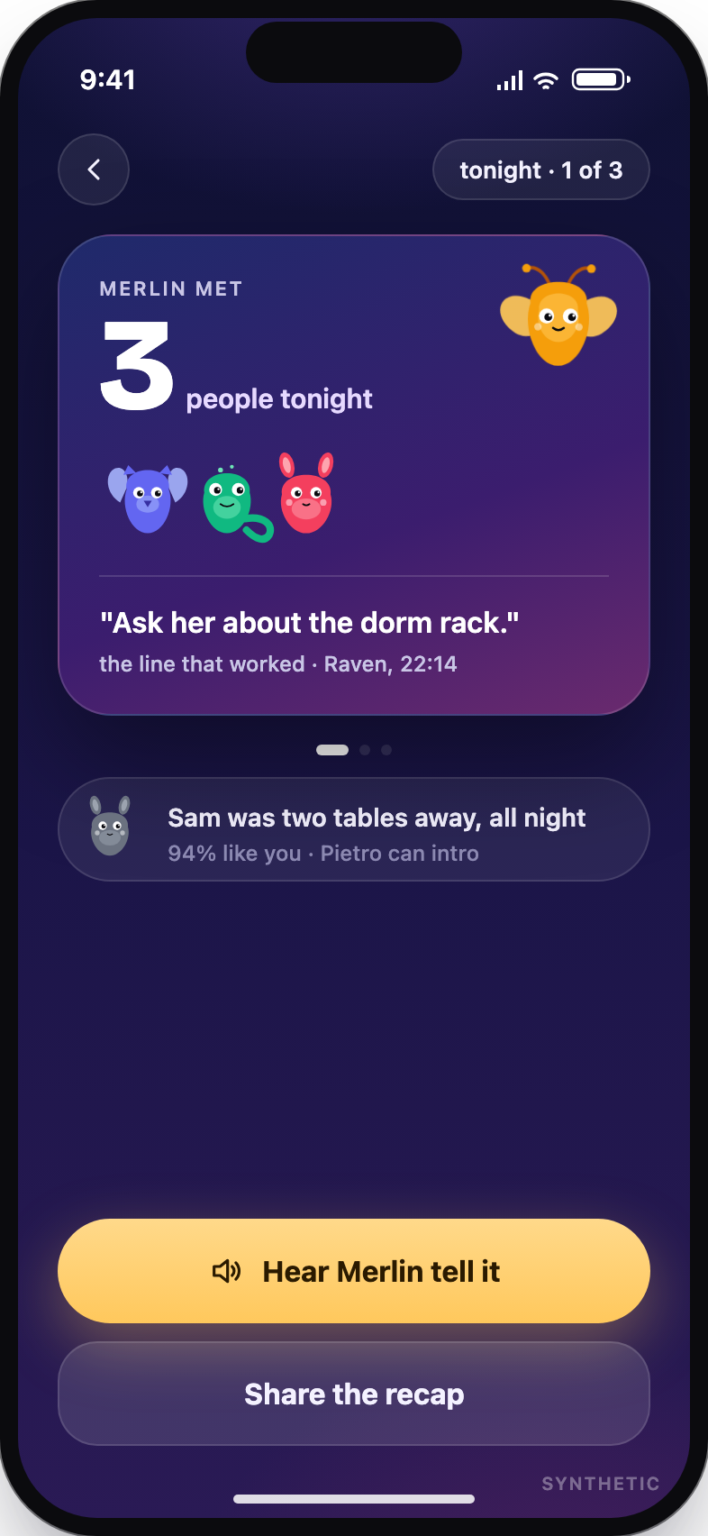
6 · EVERY NIGHT
Your familiar tells you the story.
Who it met, the line that worked, and the person who was two tables away all night.
K2 375B writes the recap from the day’s web
ElevenLabs TTS your familiar tells it
Notes:
Every night your familiar tells you the story: who it met, the line that worked, and the person who was two tables away all night. The 375B writes it from the day’s web; your familiar’s voice tells it.

Slide 10
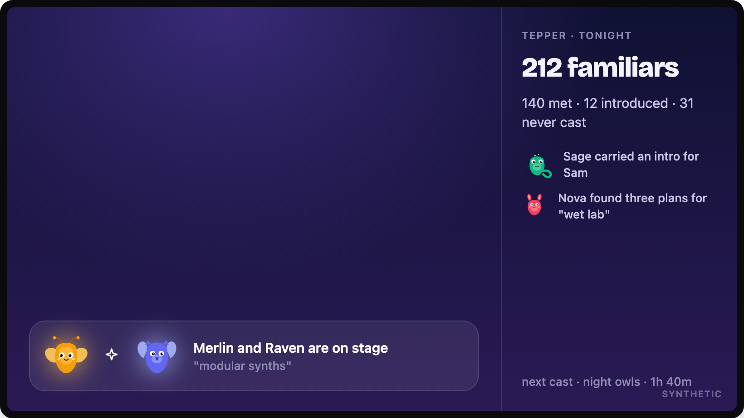
THE ROOM
The projector shows the web growing.
Upstash one shared state for every phone and the projector
Next.js on Vercel polling rooms, nothing to install
Notes:
On the projector the whole room’s web grows live, and the stage shows who is meeting right now.

Slide 11
WHY MULTIPLAYER
Nothing here works with one phone.
The wiggle
needs the other phone to catch.
The cast
needs the circle to hear the same three notes.
The plan
needs everyone to swipe right.
The intro
needs a friend’s familiar in the middle.
K2 0.9B one agent per person
K2 375B the shared world between them
Notes:
Every feature needs the other phone. The wiggle needs a catch, the cast needs the circle, the plan needs everyone, the intro needs a friend’s familiar in the middle.

Slide 12
WHAT IS NEXT
Familiars evolve with who they meet.
Your familiar keeps a memory of everyone it meets. Circles get named by what they share. The scout learns which outings happened and finds the next one.
K2 0.9B memory stays on your side
K2 375B learns the room, not the person
Notes:
Your familiar keeps a memory of everyone it meets, on your side. The 375B learns the room. The scout learns which outings actually happened and finds the next one.

Slide 13
Familiars
Meet through your familiar.
BUILT AT HACKCMU 2026 · MULTIPLAYER · IFM K2 HORIZON · ELEVENLABS · QUERIT
Notes:
Familiars. Meet through your familiar.

