Slide 1
Recreational Marijuana and State-Level Employment Rates
Oliver Reece

Slide 2
Existing Literature
“The Green Wave: Effects of Legal Marijuana on The Labor Markets.” - Sara Varon
Positive Impact on Wages and Employment Levels
For Marijuana-Related Industry Only
“The Impact of Recreational Cannabis Legalization on Cannabis Use and Associated Outcomes: A Systematic Review” - James MacKillop
Inconsistent Effects of Recreational Cannabis Legalisation
“Cannabis Use, Employment, and Income: Fixed-effects Analysis of Panel Data” - Ioana Popovici and Michael T French
Potential Negative Relationship

Slide 3
Guiding Question
Does legalising recreational marijuana have an impact on state-level employment?

Slide 4
Methodology
DiD Framework
Defining the treatment:
The passing of legislature making marijuana fully legal for recreational use
Defining the groups:
Control: Any state that never underwent treatment
Treated: Any state that underwent treatment (2013-2024)

Slide 5
What is Difference-in-Differences?

Slide 6
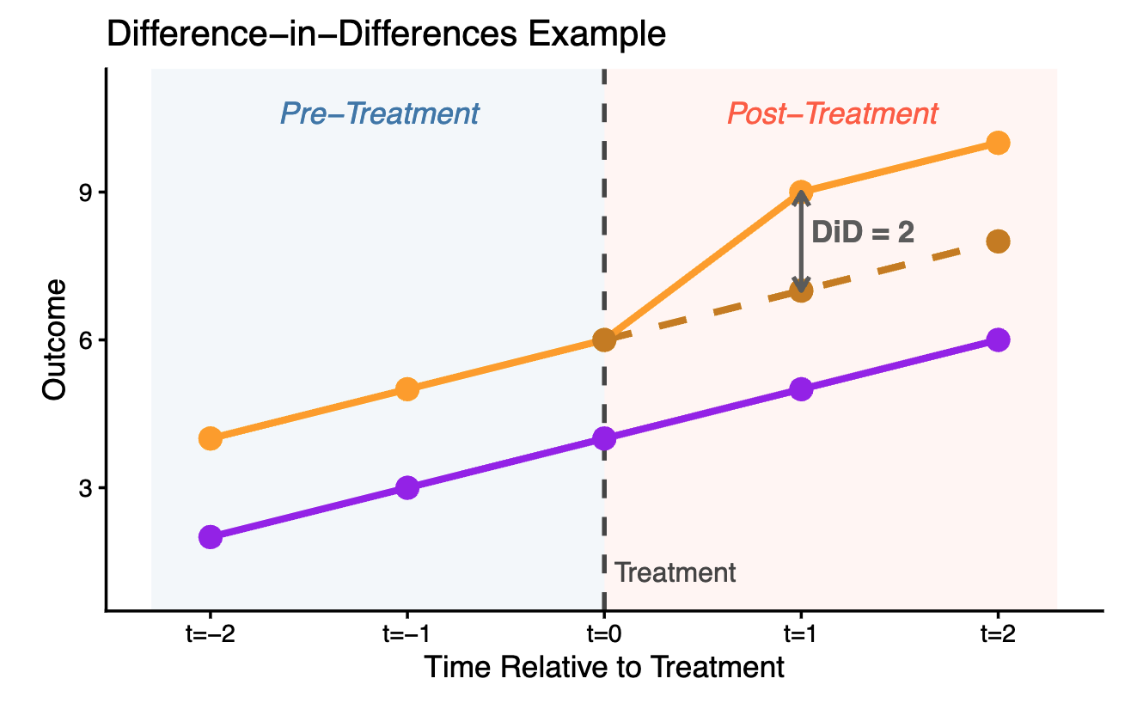

Slide 7
The Data:
Average State Employment Level
Total State Population
% State Population Male
% State Population Black
State Median Income
State GDP
*NOTE: All variables are on an annual scale
Notes:
1976-2022 just list them vertically, not a table. discuss how you include them
include whole pop and %male as 2 vars, not just male_pop raw.

Slide 8
Model 1- State-Year Fixed Effects (DiD)

Slide 9
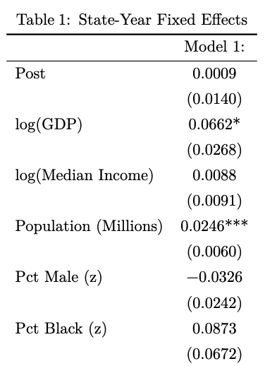

Slide 10
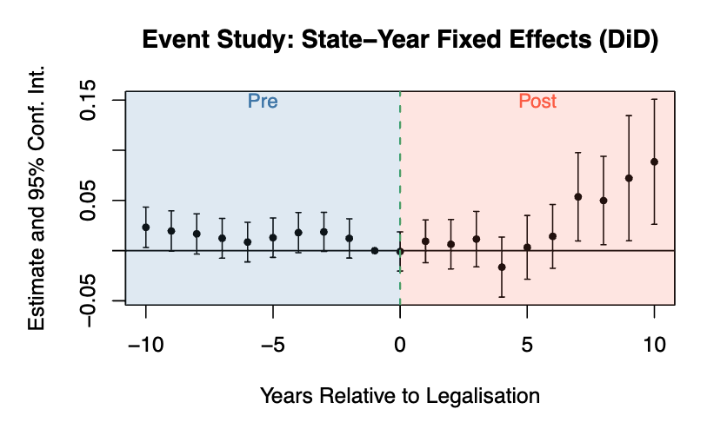
Notes:
This seems to be a solid finding, however we are not seeing any trend in the years immediately post treatment, so we need to look into this further in Model 2.

Slide 11
Model 2 – Double Interaction

Slide 12
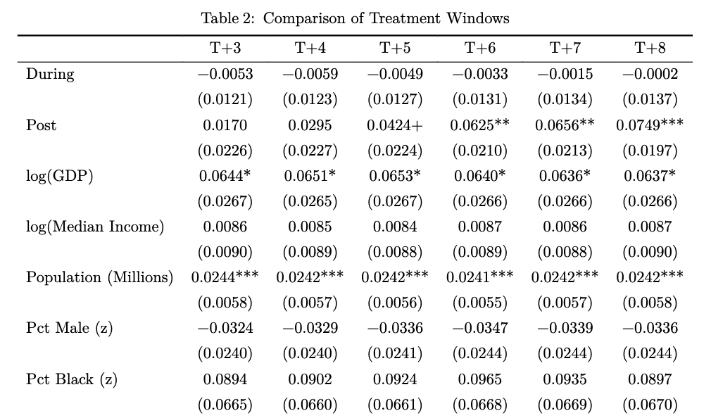
Notes:
mention how population is still a huge factor: need to try another model that accounts for this.

Slide 13
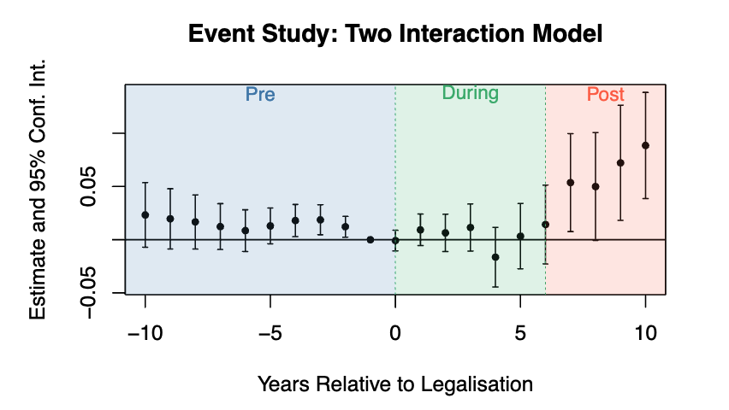
Notes:
While this seems to be a more robust finding, we noticed earlier that some variables, like population, are strong factors.
This means we are giving stronger weight in the model to big states. Model 3 accounts for this by adjusting the control group to best represent the treatment group

Slide 14
Model 3: Determining Propensity Scores
Where: Pr(Treated_{s} = 1) represents the estimated propensity score for state s
Notes:
Right side: we take each state's average pre-legalisation characteristics, feed them into this logistic regression, out comes a number between 0 and 1
Left side: result shows how likely that state was to legalise marijuana. We then use those probabilities to construct our weights in the next step.

Slide 15
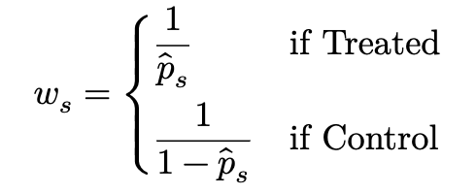
Model 3: Defining the Weights
Where: p_{s} represents the estimated propensity score for state s
Notes:
A control state that scores high gets a high weight and effectively acts as a stand-in for the treated group. A control state that scores low gets a low weight and barely influences the results. The treated states themselves are also reweighted, but in the opposite direction — a treated state that was always very likely to legalise gets down weighted
The end result is a control group that is more representative of the treatment group, therefore better satisfying the parallel trends assumption
Not trying to see if NY outperformed Wyoming, but rather if NY outperformed Pennsylvania (where marijuana is NOT legal recreationally)

Slide 16
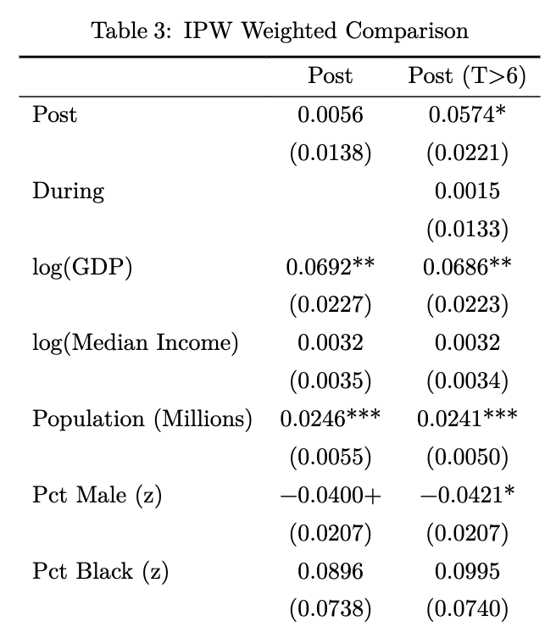

Slide 17
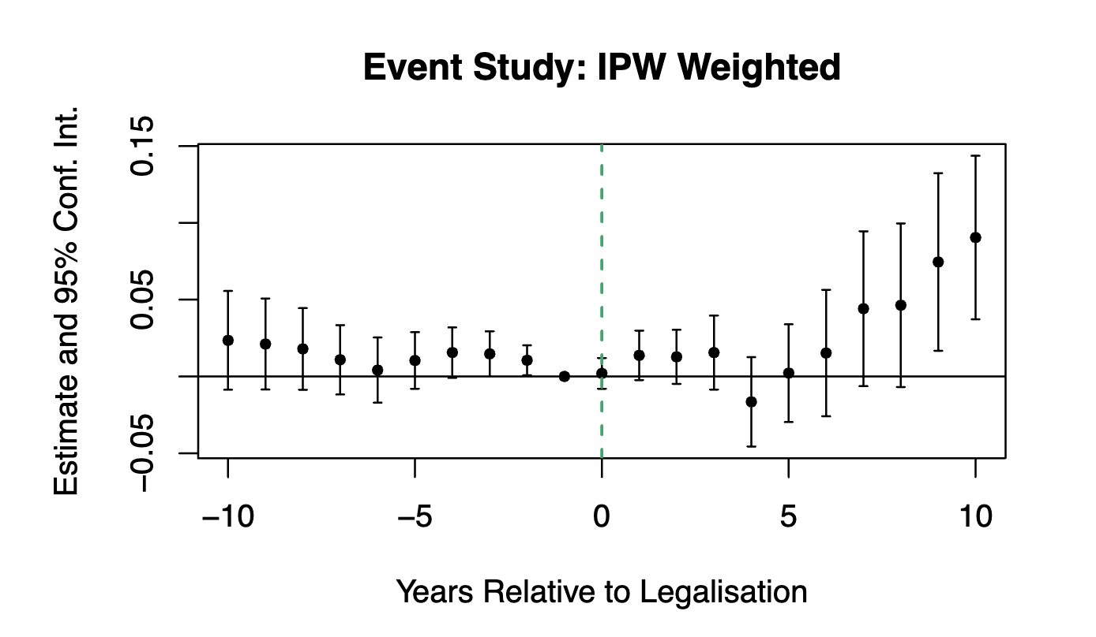
Notes:
While this is yet again more robust, we are still privy to representing national trends rather than the treatment
To resolve this, we will look at one more model….

Slide 18
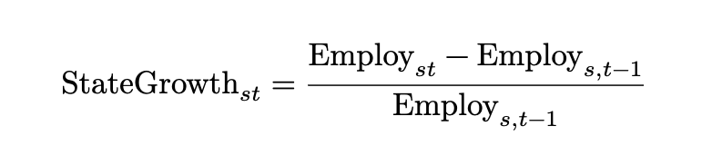

Model 4: Calculating State Deviation
Notes:
This model calculates the average % change for both states and the nation for any specific year and then calculates how each state deviates from that national change. This is our new response suppose that in 2018 national employment grew by 2.0%. Wyoming — a non-legalising state — grew by 1.8%, giving a deviation of−0.2%. New York grew by 3.1% in thesame year, giving a deviation of+1.1%. When we run this deviation as the outcome variablein our DiD, we are asking: did legalising states systematically outperform the national trendrelative to non-legalising states, and did that gap change around the time of legalisation?

Slide 19
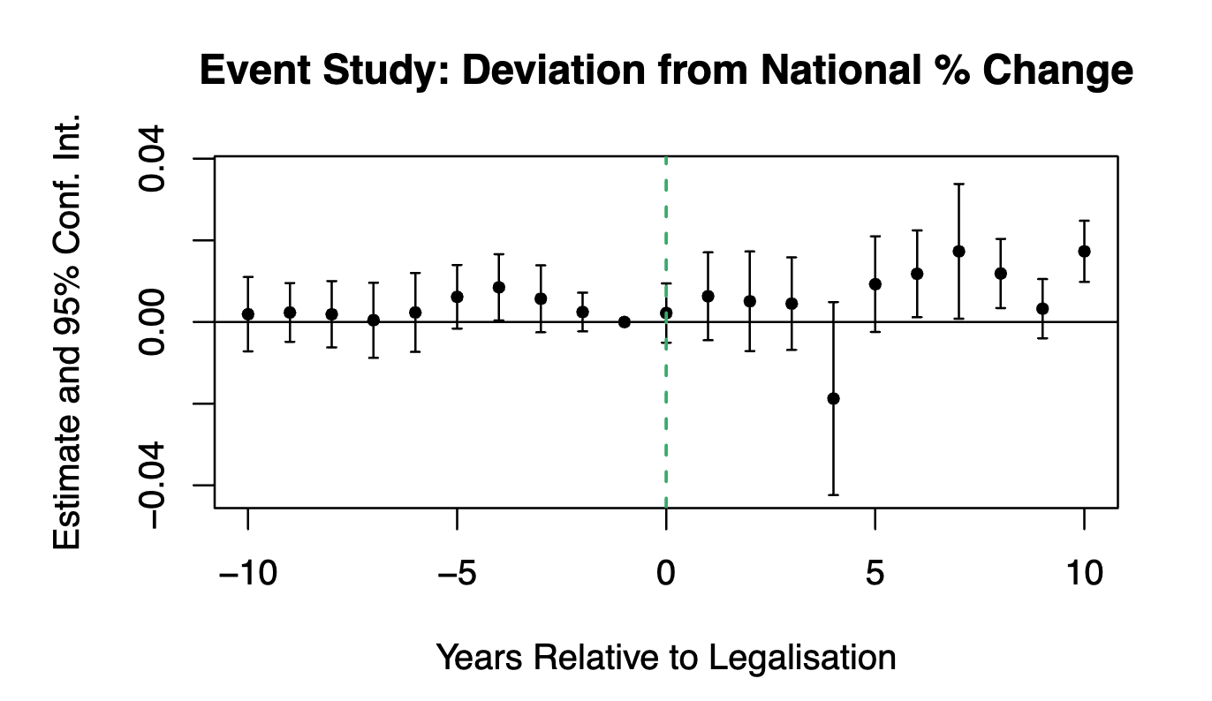
Notes:
This further confirms our theory that we do see a slight delayed effect. Year 4 most likely due to covid. So what does this mean? Well, remember this graph? > flip to next slide remove next two slides if need more time elsewhere

Slide 20
Notes:
Well our findings are similar, but look more like…..

Slide 21
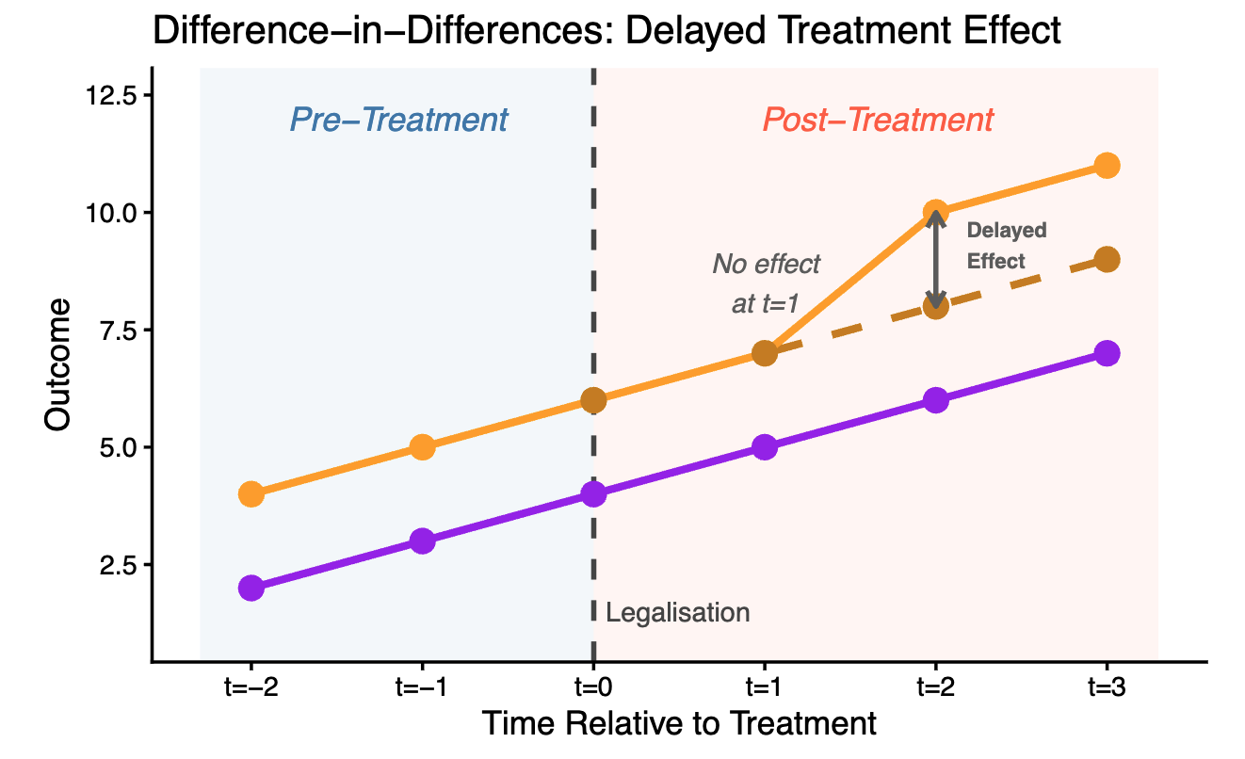
Notes:
…THIS We see delayed treatment effects. *explain how this graph is a simplified version of the graphs we just explored*

Slide 22
Conclusion
Treatment Effect is Delayed and Minor
Notes:
This may be due to the time it takes for states to set-up marijuana industry.

Slide 23
Limitations
State Average Data:
Missing Industry-Specific Trends
Delayed Treatment Effect:
Lack of Observations for Many Treated States at T>6
True Long Run Effects still unknown

Slide 24
Thank You!

