Slide 1
Recreational Marijuana and State-Level Employment Rates
Oliver Reece

Slide 2
Existing Literature
“The Green Wave: Effects of Legal Marijuana on The Labor Markets.” - Sara Varon
Positive Impact on Wages and Employment Levels
For Marijuana-Related Industry Only
“The Impact of Recreational Cannabis Legalization on Cannabis Use and Associated Outcomes: A Systematic Review” - James MacKillop
Inconsistent Effects of Recreational Cannabis Legalisation
“Cannabis Use, Employment, and Income: Fixed-effects Analysis of Panel Data” - Ioana Popovici and Michael T French
Potential Negative Relationship

Slide 3
Guiding Question
Does legalising recreational marijuana have an impact on state-level employment?

Slide 4
Methodology
DiD Framework
Define the treatment:
The passing of legislature making marijuana fully legal for recreational use
Define the groups:
Control: Any state that never underwent treatment
Treatment: Any state that underwent treatment (2013-2024)

Slide 5
Difference-In-Differences: Explained

Slide 6
The Data:
Annual Average Employment (State-Level)
Year (1976—2022) Population (18-64) Sex Race | GDP Minimum Wage Median Income Region

Slide 7

Simple FE (DiD) Model
(
)
(
)

Slide 8
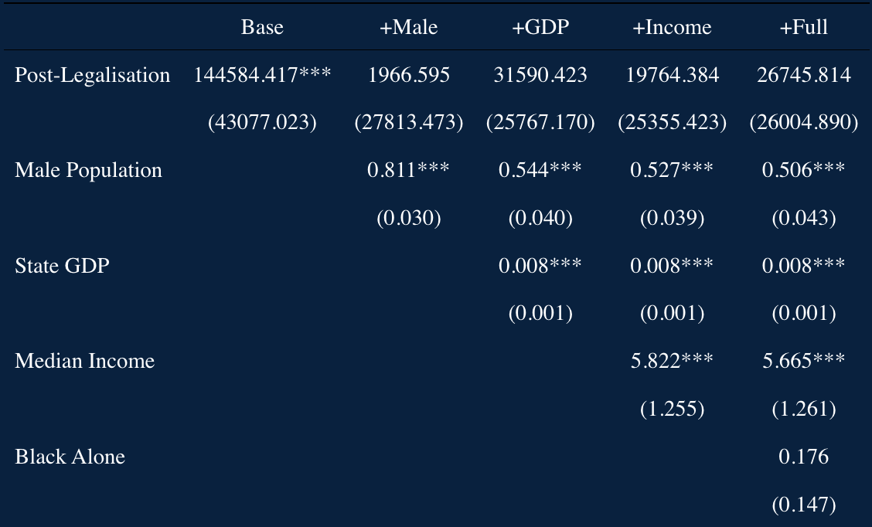
Notes:
Note that as soon as we account for variables outside of treatment, we see next to no effect. This means that while employment did increase, it most likely did not do so as a result of legalizing marijuana.

Slide 9
Two Interaction Terms
(
)
(
)

Slide 10
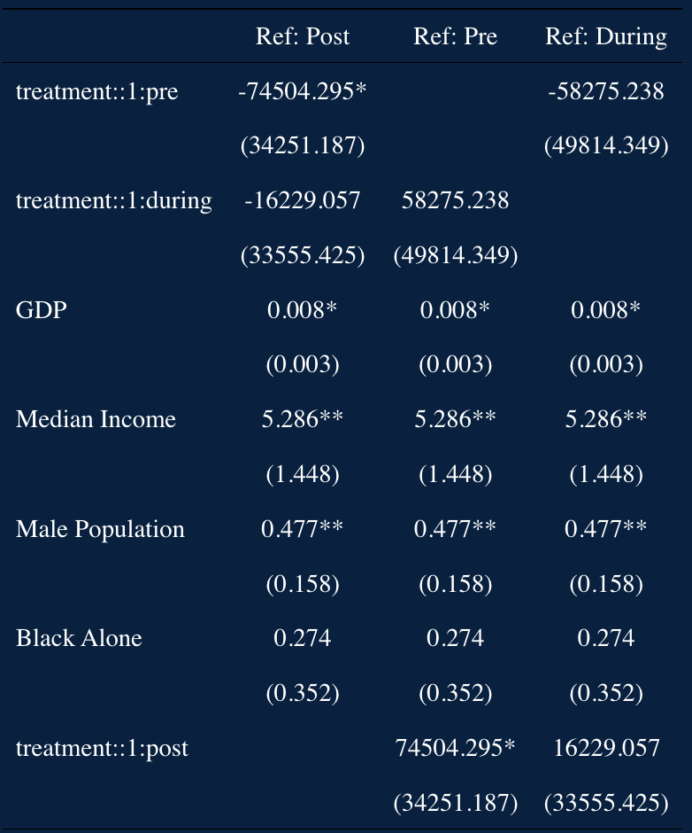
Notes:
Note SE: appears to be horrendous but remember we are looking at hundreds of thousands of people
Note: Standardising with z-scores does not change these results Note: I looked at zooming into just some specific years, but due to the “turning off” of the treatment, the number of states with an active treatment fluctuates
Good that there is no real effect pre and post. Not good that we see little effect during. Lets look at an event study to look into this further.

Slide 11
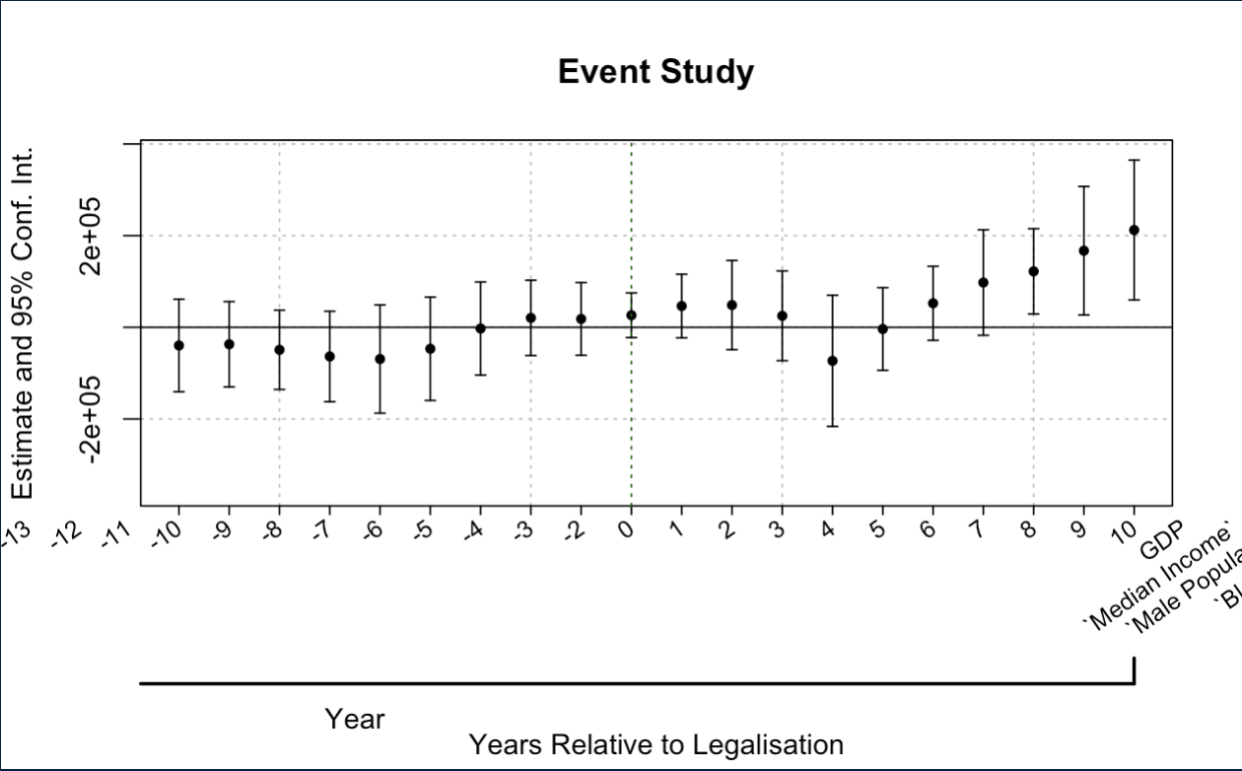
Notes:
Minimal effects, but still some positive
Why is this messed up? I’m working on it, tried asking AI for help, broke it further.

Slide 12
Limitations
Small data sample: only 50 states
Time: legalization occurred continuously between 2013 and present. The later the legislation was passed, the less data I have for post treatment analysis.

Slide 13
Conclusion
These observations are purely observational
Minimal effects, but not zero.
Convoluted
Continued analysis required
Notes:
While we saw an increase in employment, this is most likely due to other factors outside of legalisation policy. Can’t know for sure because so little data post-treatment year for a lot of the states. Further Investigation might include:
comparing to other countries that have legal recreational marijuana.
Maybe implement 2 treatments: one for when medical marijuana was legalised in a state, one for recreational
Explore differences between industries

