Slide 1
Coding best practices
good enough

Slide 2
Content
Readability
Object Oriented vs Procedural
Good OO Design
Maintainability
Testability
When it is done?

Slide 3
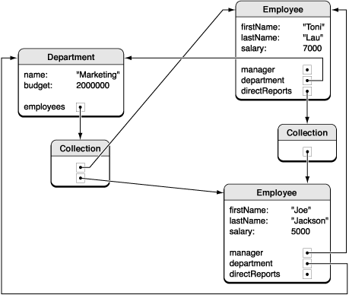
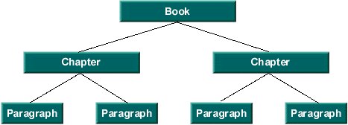
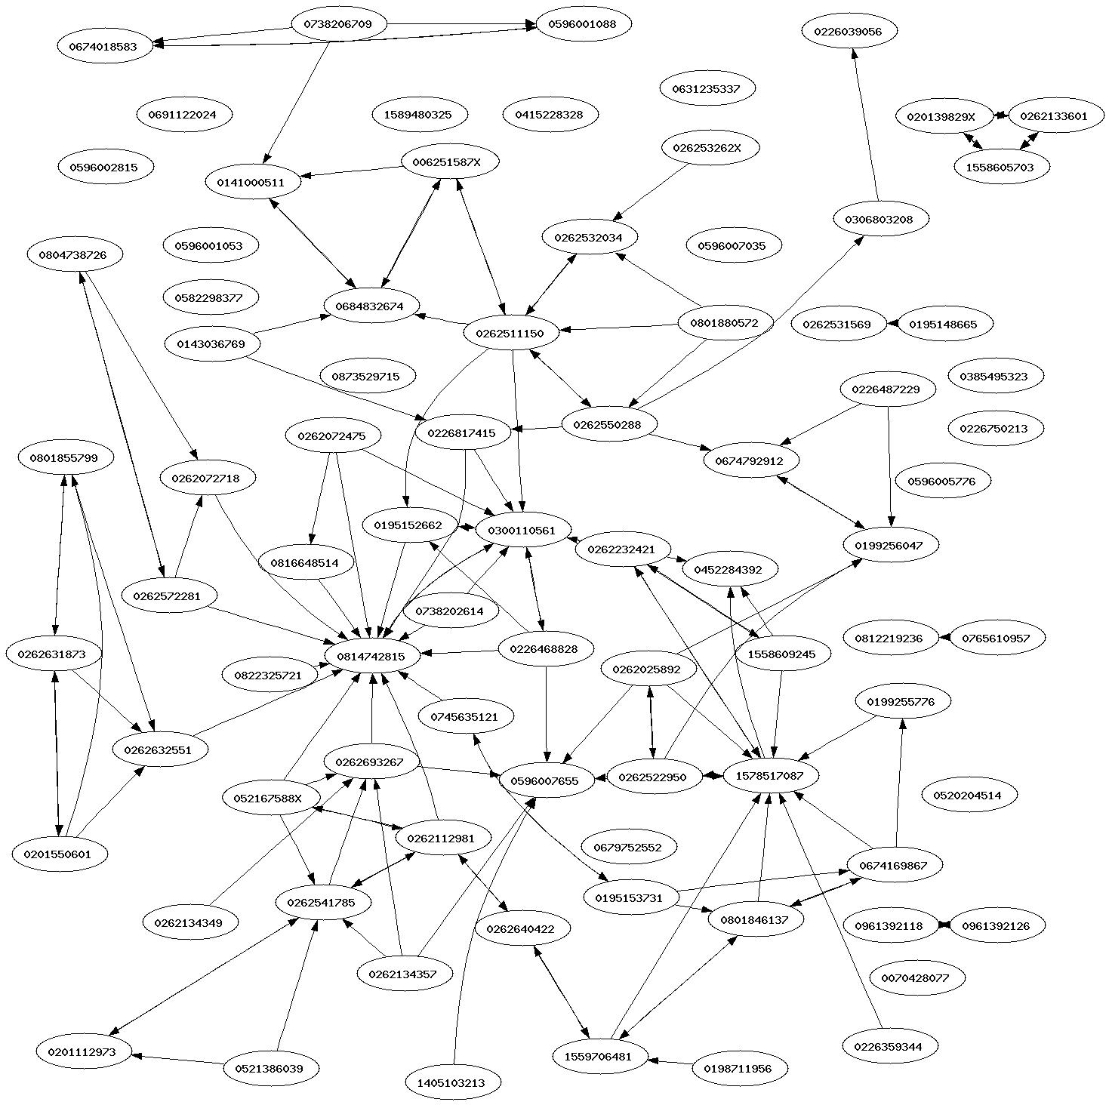
You are an author
Application
Class
Class
Field
Method
Field
Method
Copilote (nov 2014)
Files: 36 499
Lines: 7 149 786
Statements : 3 431 529
Method Call Statements: 3 062 602
Classes and Interfaces: 59 231
A la recherche du...: 1 267 069 words
Harry Potter (all): 1 084 170 words

Slide 4

Readability
Each line of code is likely to be read at least 10 times
Programming is the art of telling another human what one wants the computer to do.
Donald Knuth
Notes:
On passe plus de temps à lire, à essayer de comprendre et à modifier du code existant qu'à en ecrire du nouveau
La lisibilité est influencée le plus par le choix des noms des variables, methode et classes.

Slide 5
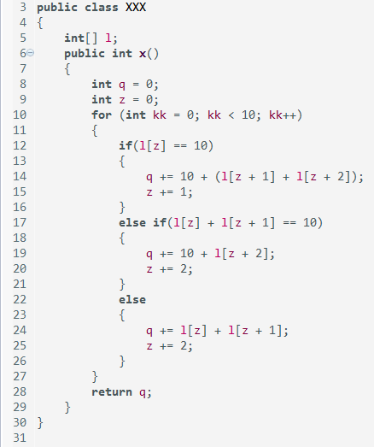
Names
Descriptive
  Useful as doc
  Avoid magic numbers
Short
  Length ∝ Scope
Positive
  Avoid double negation
Consistent
  Avoid surprises
The consumer of the code should never have to see its source code to use it, not even the comments.
Notes:
Etes vous capables de deviner la fonction de ce programme ?
Eclipse / side by side
C'est ca le pouvoir des noms...

Slide 6
Comments
Good comments
Bad comments
Notes:
Bad : redundant / noise
Bad : misleading, innacurate : confus/inexacte
Bad : mandated (javadoc @param title The title)
Bad: commented code
Bad : HTML & javadoc in non public API
Good : TODO
Good : Warning of consequences
Good : Clarification
Good : Intent / Why

Slide 7
Comments (2)
Comments should say things that the code cannot say for itself
  Delete redundant comments
  Replace block titles comments with methods
  Comments should explain WHY
Bad documentation is worse than no doc
  Delete obsolete comments
  Delete commented code
How many languages per file?
  Java, Javadoc, HTML, SQL, HQL, French, English, Velocity, CSS
Notes:
Si ce n'est pas evident, je veux savoir pourquoi on fait ca.
J'arrive à me rendre compte par moi meme qu'un constructeur est un constructeur. Pas besoin de m'insulter.
Eclipse comment

Slide 8
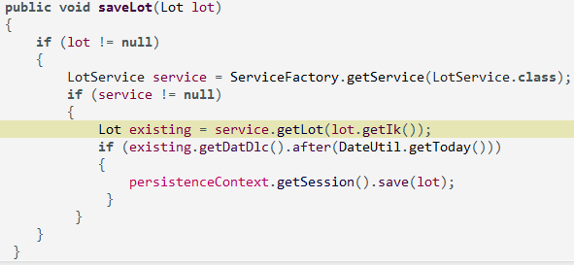
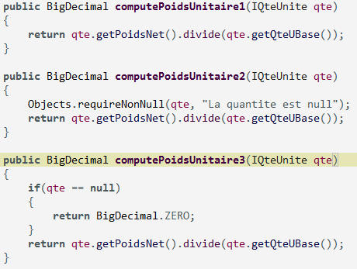
Nulls
Don't return null
  More work for ourselves
  How to deal with NPE ?
  Use emptyList()
  Use special case objects
Don't pass null
  Are null values valid?
Programming problem
Notes:
Il est important de decider si le null est une valeur valide.
Est-ce que ca a un sens d'avoir des nulls à cet endroit particulier dans le code ?
Si oui, decidement il faut le traiter.
Si non, il faudrait se poser la question pourquoi apparait-il ?
Est-ce qu'il s'agit d'un defaut de programmation dans le prg appelant ?
Si on decide de le traiter (exemple numerique), est-ce que mon choix est judicieux ? Est-ce qu'on fait partout pareil ?
Comment reagir à une NPE jetée dans les profondeurs de l'appli.
Dès fois, le pb n'est pas qu'il manque un test null, mais qu'il y en a trop. (test manquant dans le 1er)

Slide 9
Exceptions
Provide enough context
  You will read your own error messages
Think about the caller needs
  All catch blocks looks the same?
  Ifs inside a catch block?
Separate normal flow from error handling
  Simplify business logic code
Don't hide errors

Slide 10
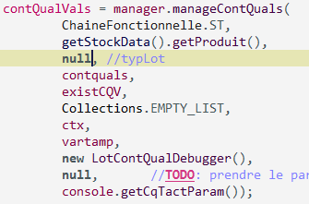
Number of arguments
0 better than 1
1 better than 2
2 better than 3
Avoid 4 or more arguments
Create argument objects and builders
Avoid flag arguments
Avoid output arguments / side effects /surprises
Avoid null

Slide 11
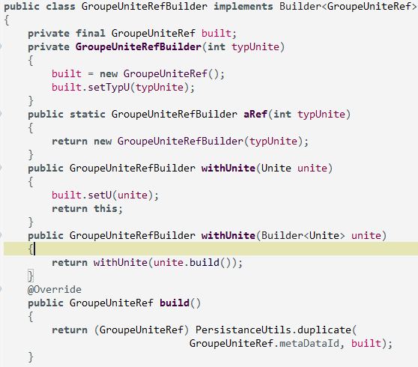
Fluent API & Builders
One argument
Method chaining
Return this
Define grammar
http://blog.jooq.org/2012/01/05/
the-java-fluent-api-designer-crash-course/
Chain builders

Slide 12
Size matters
Short classes / methods
Long classes / methods
Notes:
Long : cheaper to develop
Long : everything together
Long : low coupling / low cohesion
Short : high cohesion
Short : need to be changed least
Short : free documentation
Long : difficult to test
Long : duplication
Long : complex, only the author understands
Long : deep nesting

Slide 13
Style
Object Oriented
Objects
  Hide data
  Expose functions
Procedural
Data structures
  Expose data
  Have no functions
Procedural code gets information then makes decisions. Object-oriented code tells objects to do things.
Alec Sharp (Smalltalk)
Add new functions
Add new data types

Slide 14
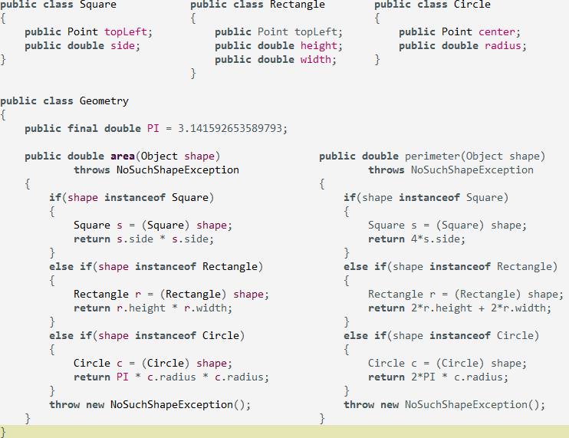
Procedural: add Triangle, add Center of Mass

Slide 15
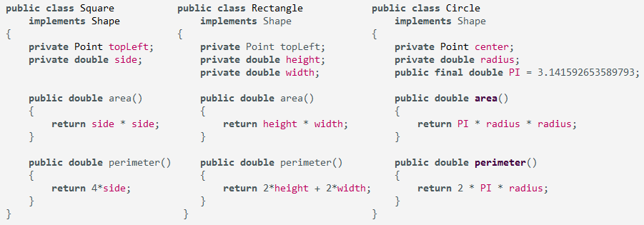
OOP: add Triangle, add Center of Mass

Slide 16

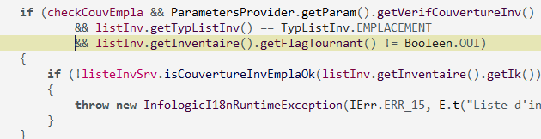
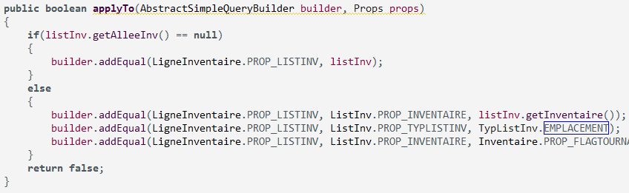
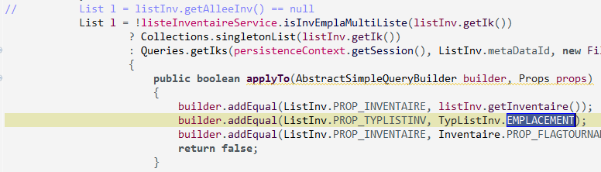
Switch / If vs Polymorphism

Slide 17
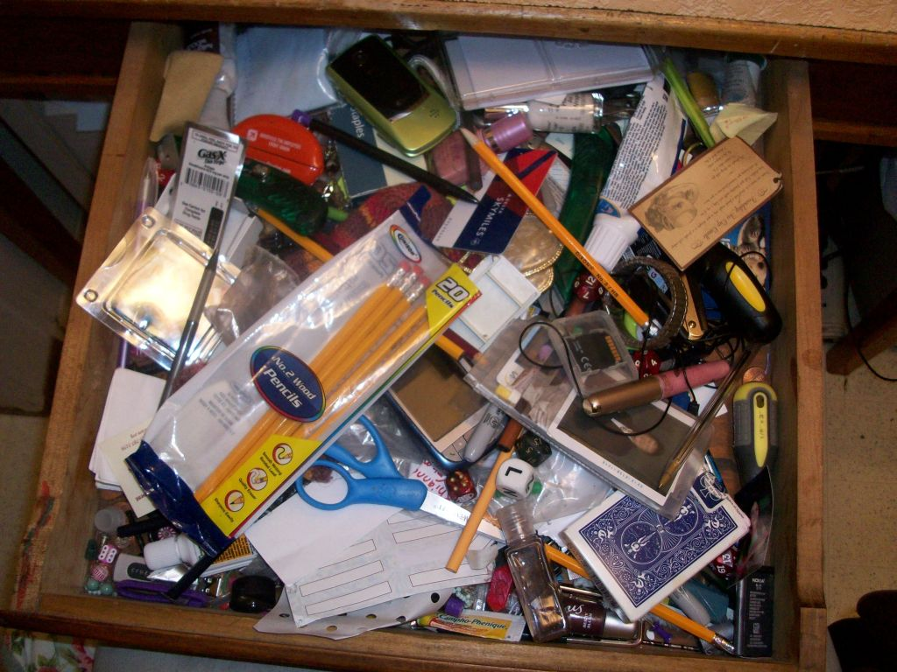
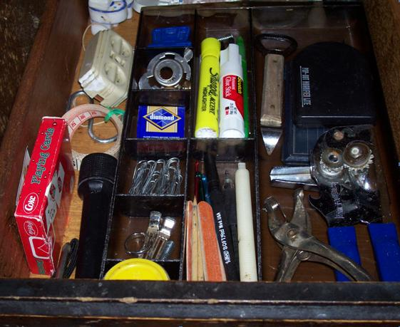
Single Responsibility Principle
A class should have only one reason to change
Look for ANDs and OR
Raise level of abstraction
Obsession with primitives
High cohesion
  Maintaining cohesion results in many small classes

Slide 18
Services
What is the responsibility of a service?
  Handler for client calls
  Manager for DB transactions (@hibernate)
  Holder for global variables (ServiceManager)
  Holder for session variables (PersistentContext)
Services force a procedural style
Keep ServiceImpl really simple
Implement functionality with POJOs
Notes:
Show EmplaRepositoryServiceImpl

Slide 19
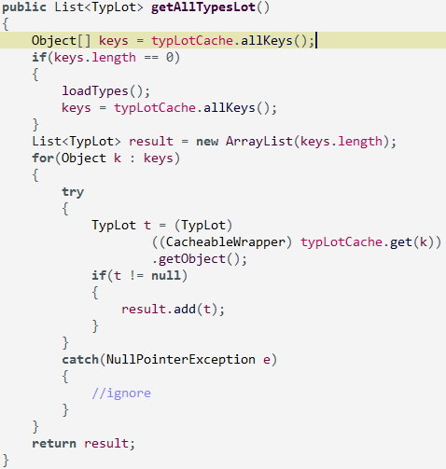
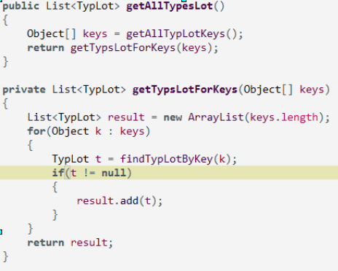
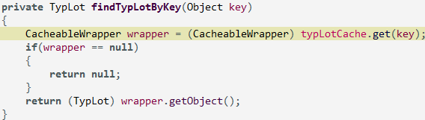
Level of abstraction

Slide 20
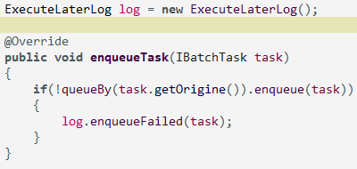
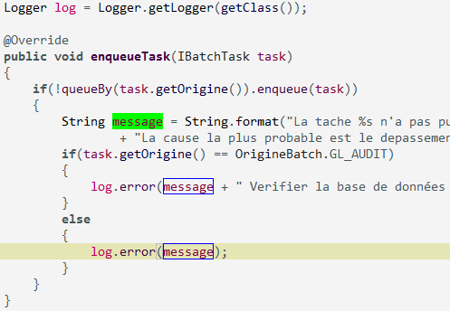
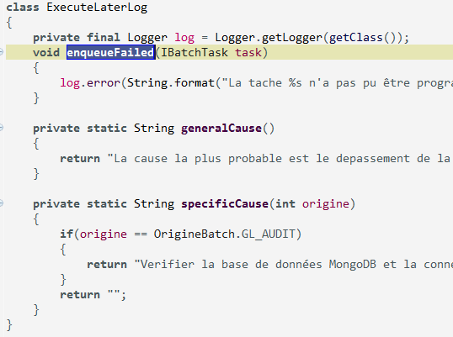
Logging
Logging is a separate responsibility
More so if it is a functional requirement
  LogU

Slide 21
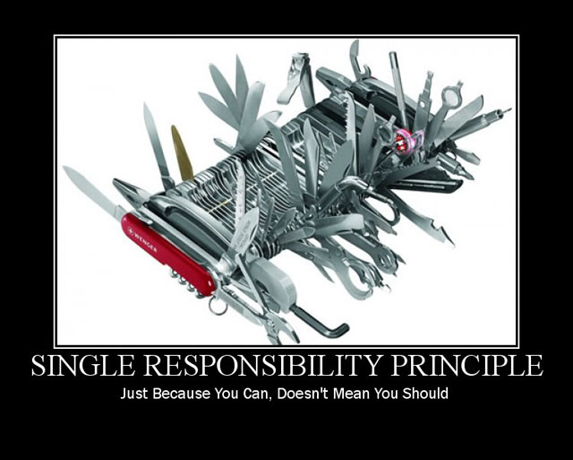
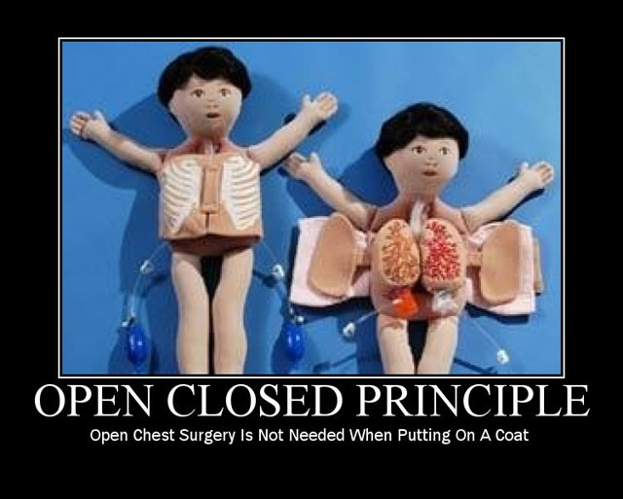
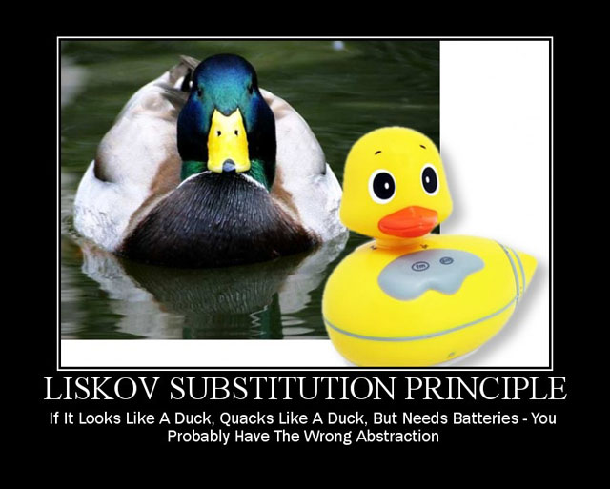
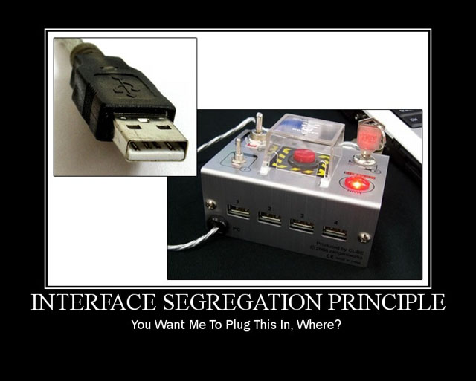
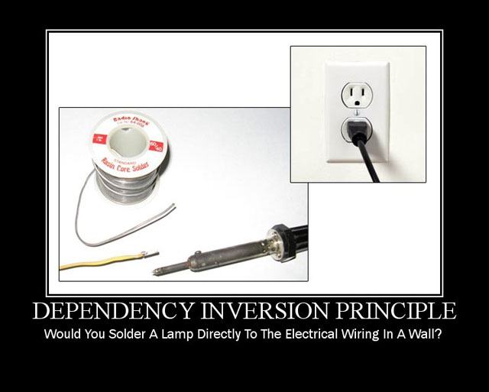
SOLID
Single Responsibility
  Only 1 reason to change
Open/Closed
  Extend behavior, without
  modifying content
Liskov Substitution
  Subtypes preserve behavior
Interface Segregation
  Small interfaces
Dependency Inversion
  High level modules should not
  depend upon low level modules

Slide 22
Duplication
Root of all evils in software
Don't Repeat Yourself (DRY)
Copy & Paste
  Extract method
Same if / switch
  Polymorphysm
Similar algorithms
  Strategy Pattern
  Template Method Pattern

Slide 23
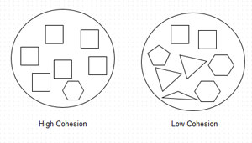
Cohesion
A class in which each variable is used by each method is maximally cohesive (utopic)
A class with low cohesion is not focused
A class with low cohesion has many responsibilities / many reasons to change

Slide 24
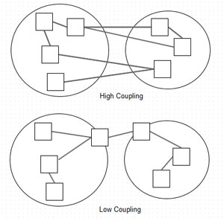
Coupling
Two classes A and B are coupled when:
  B breaks (and must change)
  only because A changed
Law of Demeter
  Don't talk to strangers
  Train wrecks
a.getB().getC().getD().doSomething()
Feature Envy / Data Envy
a.doSomething(a.getB(), a.getC())

Slide 25
Software Design for Maintainability (NASA)
Early planning: anticipating what and how programs might be modified at a later stage.
Modular design: defining subsets and simplifying functionality (i.e., one module performs only one function).
Object-oriented design: encapsulating both methods and data structures to achieve a higher level of independence than that of modular design.
Uniform conventions: facilitating error detection and debugging.
Naming conventions: providing understandable codes.
Coding standards, comments, and style: enhancing readability of the program.
Documentation standards, Common tool sets, Configuration Management

Slide 26
Maintainability
Probability of performing a successful repair action within a given time.
Fix defects
  21%
  Find root cause
  Reproduce bugs
Enhance functionality
  79%
  Complexity increases
    Big Ball of Mud
    or Refactoring
Main risk: regression or new bugs

Slide 27
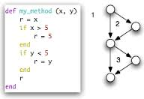
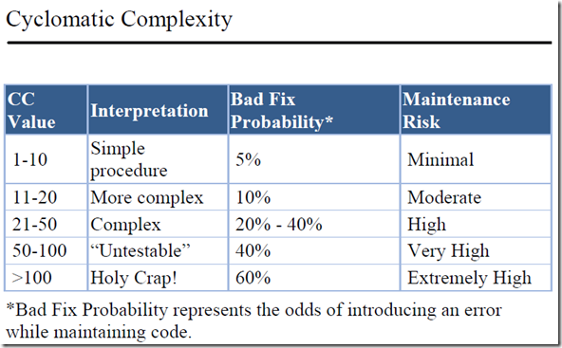
Cyclomatic Complexity
Number of decision points for a method + 1
Minimum number of test cases needed to travel through all branches of a method.

Slide 28
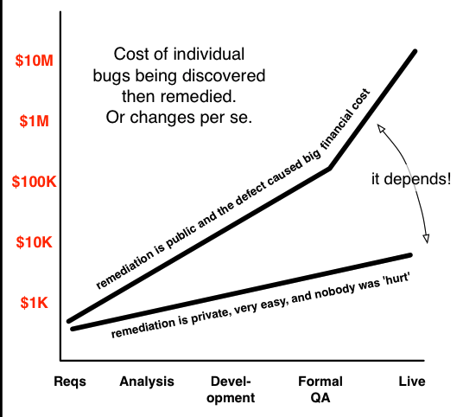
Cost of bugs

Slide 29
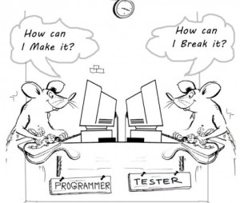
Tests
Evaluate an attribute or capability of a program
Determine that it meets its required results
System tests
  End-to-end
  Acceptance / Client
Integration tests
  Ventes + Stocks
Unit tests
  Developer tests
  Automated
  After or Before (TDD)

Slide 30
Unit Tests Goals
Executable documentation
  Tests must be (more) readable (than production code)
Confidence
  But, developers are not testers
  Exhaustive testing is imposible
  Tests should be deterministic & fast
Design: Tests exercise code you wish you had
  Instantiate: Given [context]
  Exercise: When [event]
  Verify: Then [outcome]

Slide 31
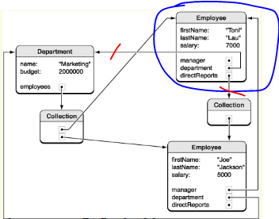
Testability
Control / isolate dependencies
  Test doubles / fake dependencies
Explicit dependencies
  Constructor or setters without side effects
Hidden dependencies
System.out.println or Logger.getLogger(..).error
ProduitCache.getCache() or ParametersProvider.getMainInstance()
Database
new InvisibleDependency()
Dependency of dependency (Train wrecks)
a.getB().getC().getD().doSomething()
Notes:
Eclipse HEAD
ParametersProviderInstantiationTest
CalcPrixStock

Slide 32
Code ownership
Boy scout rule
Try and leave this world a little better than you found it.
Robert Baden-Powell
Simple refactorings
  Improve names
  Improve comments
  Improve formatting
  Eliminate duplication
  Add tests

Slide 33
Why do we get dirty code?
Time pressure
  From mgmt / direction : really?
  From ourselves
    Think about cost of bugs / maintainability risks
    But avoid gold plating
Lack of specifications
  We should agree on a Definition of Ready
Lack of training
  Read books, blogs, code / Practice
Lack of motivation

Slide 34
When it is done-done?
Make It Work
  Explore and discover
  Hacks
Make It Right
  Refactor to get readable / maintainable code
  Tests are important
Make It Fast
  Focus on 20% of code you can tune
  To end up with 80% performance increase
  Tradeoffs between design and performance

Slide 35
Thank you
Questions?

Slide 36
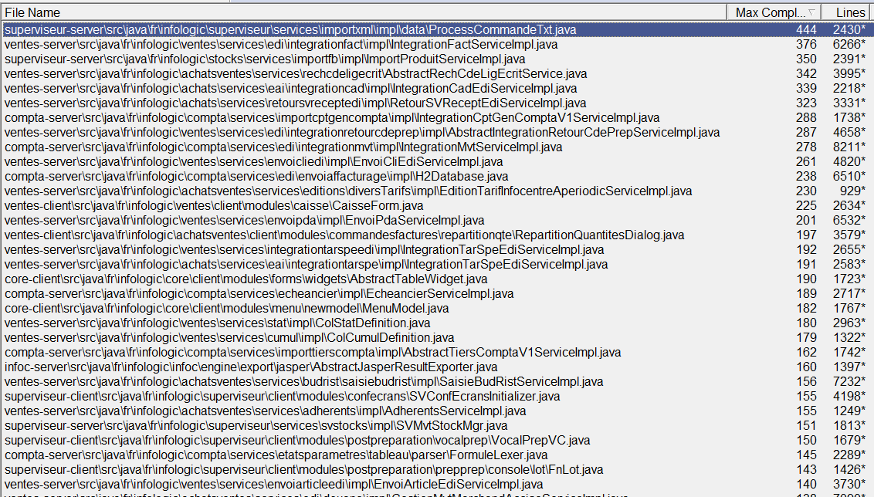
Max CC / Copilote

Slide 37
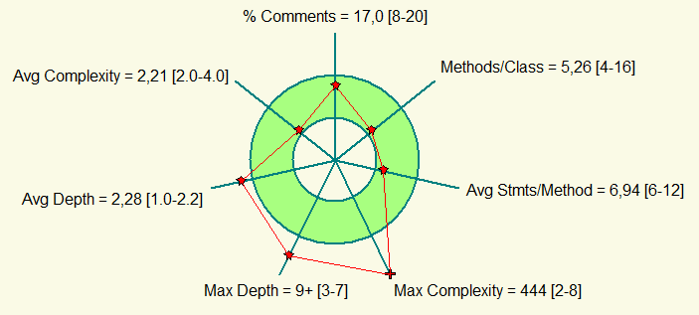
Code Metrics

Slide 38
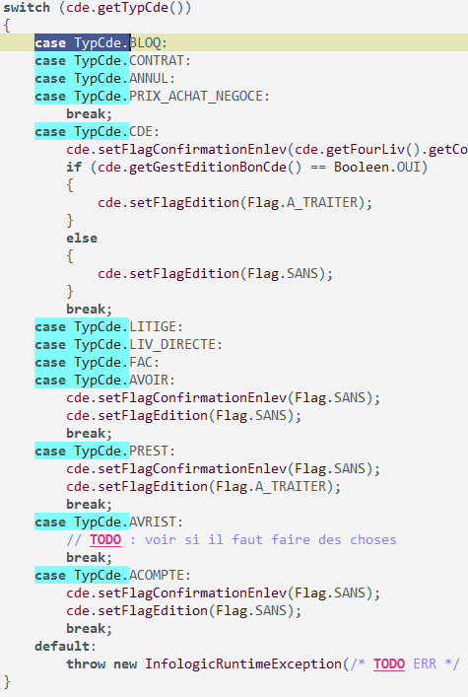
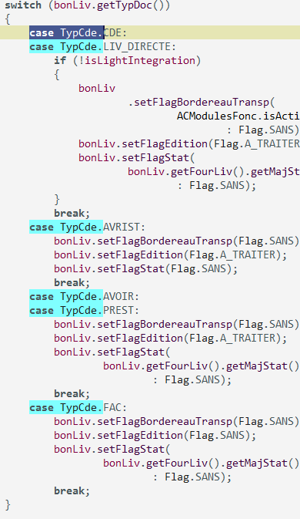
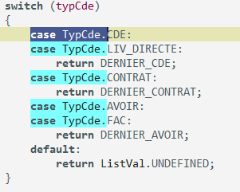
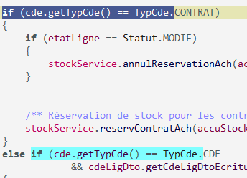
Switch vs Polymorphism
(bad example)

