Slide 1

THE HAPPIEST PLACES ON EARTH
A Data Analysis of the 2022 World Happiness Report
CSC 302 - Group 5 Alizia Hamilton, Olen Justice and Judy Wallace
Notes:
JW/Intro slide: In 2012, an initiative of the United Nations produced the first annual World Happiness Report and set March 20th as International World Happiness Day. The World Happiness Report chronicles on how the people in countries all around the world evaluate their own lives.
What is happiness and what contributes to being happy? The dictionary defines Happiness as “a state of well-being and contentment”. In this presentation, our group members, Alizia Hamilton, Olin Justice and myself - Judy Wallace look into which countries ranked as the happiest in 2022 and a few of the factors that might contribute to that happiness.

Slide 2

THE HAPPIEST PLACES ON EARTH
RANK | Country | Happiness score | Whisker-high | Whisker-low | Dystopia (1.83) + residual | Explained by: GDP per capita | Explained by: Social support | Explained by: Healthy life expectancy | Explained by: Freedom to make life choices | Explained by: Generosity | Explained by: Perceptions of corruption
1 | Finland | 7,821 | 7,886 | 7,756 | 2,518 | 1,892 | 1,258 | 0,775 | 0,736 | 0,109 | 0,534
2 | Denmark | 7,636 | 7,710 | 7,563 | 2,226 | 1,953 | 1,243 | 0,777 | 0,719 | 0,188 | 0,532
3 | Iceland | 7,557 | 7,651 | 7,464 | 2,320 | 1,936 | 1,320 | 0,803 | 0,718 | 0,270 | 0,191
4 | Switzerland | 7,512 | 7,586 | 7,437 | 2,153 | 2,026 | 1,226 | 0,822 | 0,677 | 0,147 | 0,461
5 | Netherlands | 7,415 | 7,471 | 7,359 | 2,137 | 1,945 | 1,206 | 0,787 | 0,651 | 0,271 | 0,419
DATASET FACTORS
Happiness Score
GDP
SOCIAL SUPPORT
HEALTHY LIFE EXPECTANCY
FREEDOM TO MAKE LIFE CHOICES
GENEROSITY
PERCEPTIONS OF CORRUPTION
Notes:
/AH Our Data set world happiness report 2022.
The World Happiness Report is based on answers to life questions asked in a poll.
Respondents are asked to rate their own current lives on a 0 to 10 scale, with 0 being the worst and 10 being the best. Factors that contributed to overall ranking were the Happiness Score, GDP, Social Support, Healthy Life Expectancy, Freedom to Make Life Choices, Generosity, and Perceptions of corruption. Here you can see a snippet of a dataset showcasing the first five countries but the survey consists of 146 countries overall.

Slide 3
THE HAPPIEST PLACES ON EARTH
What are the current happiest countries?
What influence does GDP have on happiness?
What influence does personal freedom have on happiness?
Does life expectancy affect overall happiness?
Notes:
/AH What are we trying to analyze with our World Happiness dataset? What are our expectations?

Slide 4
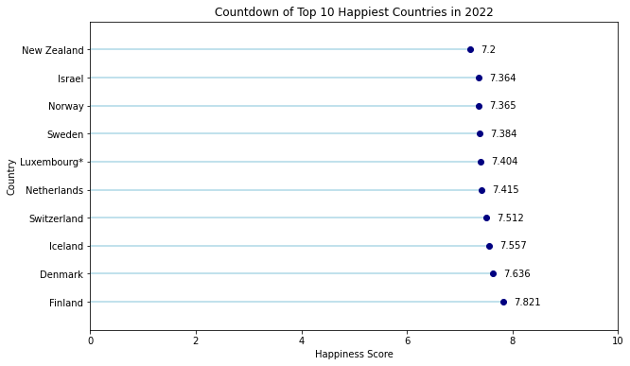
HAPPIEST COUNTRIES
Which Countries Rank Highest in Happiness?
Out of 146 countries, these countries ranked top 10 for happiness score.
Data indicates that majority are European countries with the exceptions of New Zealand and Israel.
All of these countries scored highest in factors of social welfare, economic stability, trust in government and social support.
Notes:
/jw
Where are the happiest places on earth? Out of the 146 countries surveyed last year, the top 10 in descending over are New Zealand, Israel, Norway, Sweden, Luxembourg, the Netherlands, Switzerland, Iceland, Denmark and in the number one spot is Finland. Finland ranks as the happiest place with a total score of 7.8 out of 10. All the countries on the top 10 scored high in the factors of social welfare, economic stability, trust in government and social support. In comparison, the United States scored 6.97 on the scale and ranked #16. The lowest happiness score was reported as 2.4 in Afghanistan.

Slide 5
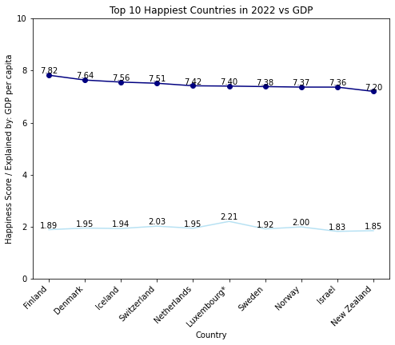
TOP 10 IN GDP
Does GDP Influence Happiness?
GDP per capita has a weak correlation with a countries happiness score.
Data shows that the growth rate of GDP and life satisfaction and happiness do not have a significant relationship.
As shown in the top 10 results, Finland has the 3rd lowest GDP out of the top 10 countries while Luxembourg has the highest GDP but ranks in the middle of the top 10 for happiness.
Notes:
/jw
does a country’s GDP per Capita affect a country’s happiness score?
Shown here, the highest ranked and happiest country, Finland has the 3rd lowest gdp out of the top 10. Of the countries surveyed, Luxembourg has the highest gdp but ranks in the middle of the top 10 for happiness. The second highest GDP in the report is Singapore, but it ranks #27 on the happiness index. The United States’ GDP is very similar to Finland, but ranked 15 spots below in happiness. The data shows that a country’s gdp has little effect on its happiness score, proving that money doesn’t equal happiness!

Slide 6
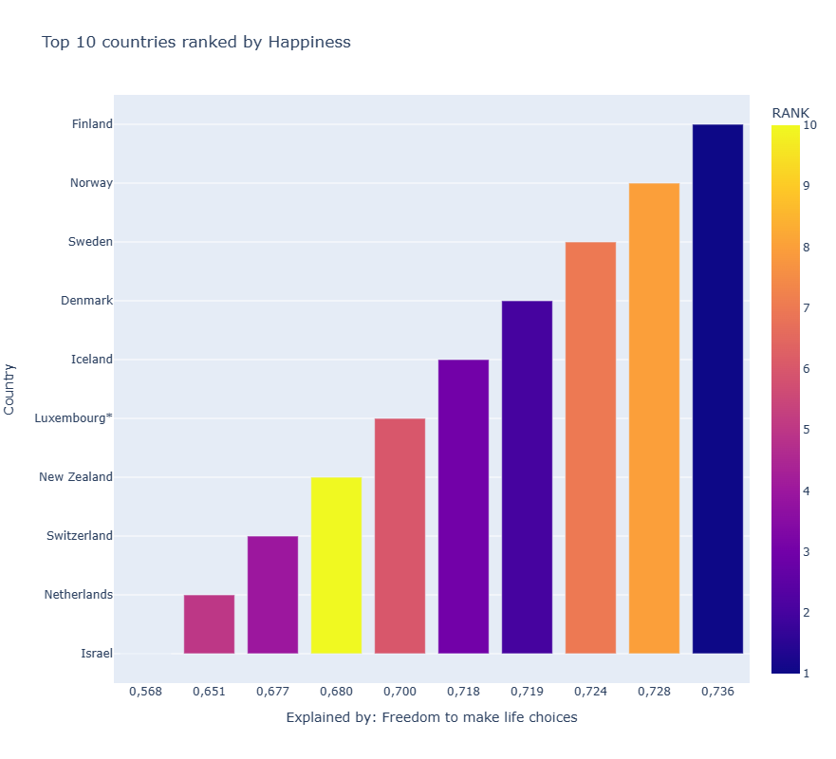
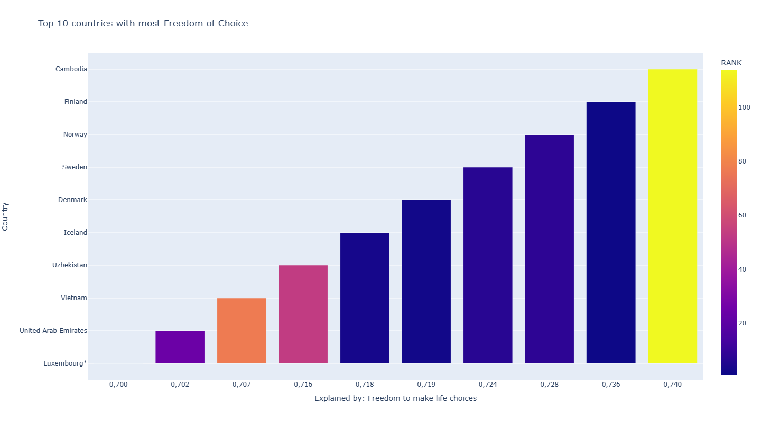
TOP 10 IN PERSONAL FREEDOM
What influence does personal freedom have on happiness?
Only a little more than half of the countries ranked as the happiest made the top 10 for most personal freedom
Cambodia ranked as the country with the most personal freedoms despite being ranked 114 out 146 for happiness.
Happiness may not be as dependent on personal freedom as we think.
Notes:
One of the criteria considered when the UN developed the list of the happiest places on earth was personal freedom. Citizens around the globe were asked ““Are you satisfied or dissatisfied with your freedom to choose what you do with your life?”. The answer to this question gives us the data set for “Explained by: Freedom to make life choices. As Americans we have a strong belief that personal freedom is one of the greatest influences on happiness, but is that true? As a group we were interested in to see what the data showed and we expected the countries that were deemed to have the greatest amount of freedom would be the highest ranking on the list of happiest countries. The bar graph on the top right it shows the top 10 happiest countries and their score on personal freedom. The color of each bar accounts for there happiness ranking with dark blue being the happiest and the yellow being the number 10 happiest country. As we were expecting the number 1 ranked happiest country was also the number one ranked for personal freedom, but what happens when we examine all the data and not just the top 10 happiest. The bottom bar graph shows top 10 countries with the most freedom of choice and the color still indicates their rank in overall happiness. We were fairly shocked to see that 40% of the countries rated to be top 10 countries in freedom of choice were not on the top 10 happiest countries list. In fact you can see that Cambodia has the highest rank for Freedom of Choice, but the bright yellow color indicates that it is very low on the list of happiest countries. It is actually number 114 out of a list of 146 the UN published in 2022 for happiest countries.

Slide 7
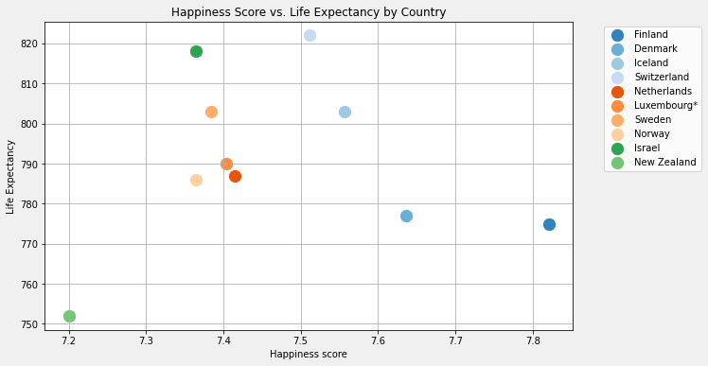
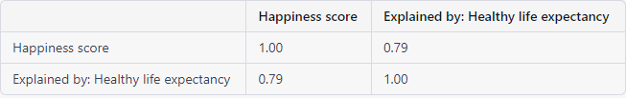
TOP 10 IN LIFE EXPECTANCY
Does life expectancy affect overall happiness?
There is a strong positive correlation between life expectancy and happiness score when comparing the data for the 146 countries which suggests that higher life expectancy is associated with higher happiness score.
This data shows the higher scoring of life expectancy also results in a high happiness score.
Notes:
/AH Does life expectancy have an affect on a country’s happiness score? Here you can see that data has shown that there is a positive correlation between life expectancy and the overall happiness score. The data visual here shows that in most cases, when the life expectancy score increases you can also see an increase in the happiness score.

Slide 8
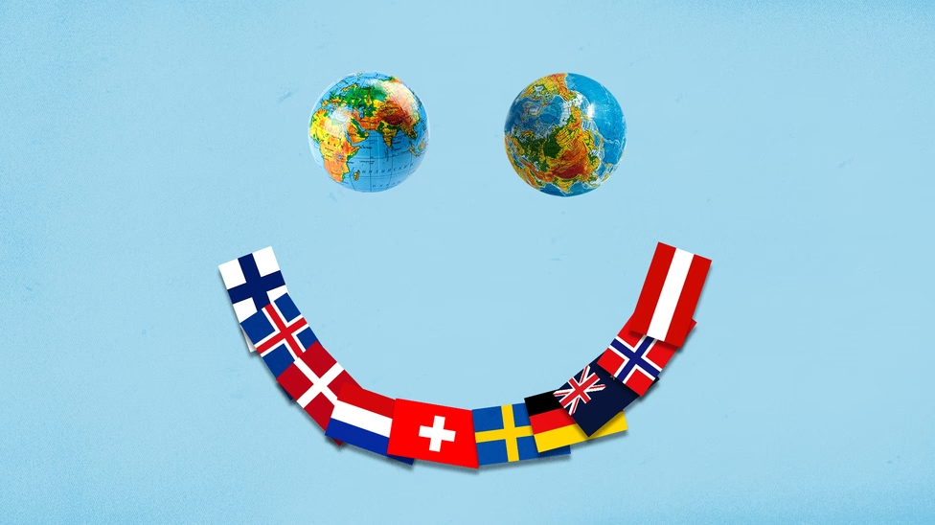
CONCLUSIONS: THE HAPPIEST PLACES ON EARTH
European countries rank highest in the top 10 for Happiest Places
Countries that had higher scores in factors of social welfare, economic stability, trust in government, and social support ranked higher for happiness.
GDP is found to not have a significant role in a countries overall happiness.
Life expectancy however does have a strong correlation and significance in a higher happiness score.
Freedom of Choice did not have as significant a role as we initially thought.
Notes:
In conclusion of our research, we’ve summarized our key points. European countries had a majority of the top 10 rankings with Finland securing the #1 Happiest Country title. These countries also ranked higher in all other factors of social welfare, economic stability, trust in government, and social support. While GDP by itself did not have a significance in a countries overall happiness it was found that health (life expectancy) did have a strong correlation.

Slide 9

Q&A
Happiest Places on Earth
Notes:
If you have any questions related to our data findings, world happiness, or a specific country ranking please let us know we'd be glad to answer!

