Slide 1





October 9, 2025
Lumo Playground
Interactive 3D Web Application with Gesture Control
(Department of Computer Science & Engineering)
Project-II: BTCS-703-18
Project Members:
Ojus (2224459)
Noordeep Kaur (2224457)
Project Mentor:
Ms. Poonam

Slide 2
Lumo Playground
Introduction
Problem Statement
1
Lumo-Playground is an interactive 3D web application.
  Traditional 3D software depends on:
  Keyboard shortcuts
  Mouse & toolbar controls
  These methods are complex and have a steep learning curve.
  Most solutions require desktop installation, reducing accessibility.
2
Integrates computer vision + 3D graphics for natural, immersive interaction.
3
Manipulate 3D models using hand gestures in real time.

Slide 3


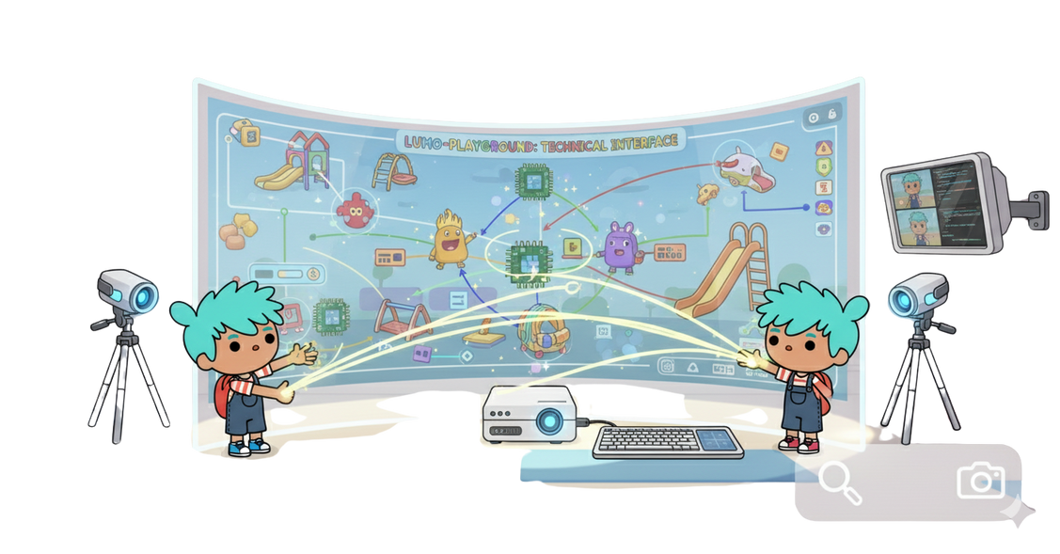
Lumo Playground
Your GLTF Avatar
Your hand gestures
Objectives / Scope
  Build an intuitive gesture-controlled 3D interface.
  Allow hands-free 3D model interaction via browser.
  Integrate voice commands for easy mode switching.
  Ensure cross-platform accessibility with no software install.

Slide 4




System Architecture
Lumo Playground
Latency: ~ 200ms
Choose/Upload your GLFT File
5
2
3
Model Response
MediaPipe Hand Tracking
Gestures Recognition
1
6
4
Camera
Watch it in your browser
3D Scenes
(Three.js)

Slide 5



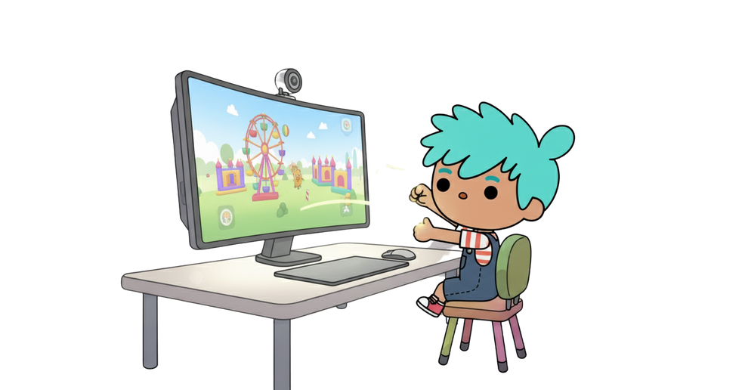

Technologies
Lumo Playground
Web Graphics
3D Rendering
Computer Vision
Gesture
Recognition
Three.js (v0.161.0)
Scene & model management
MediaPipe (v0.10.14)
Media Pipe Tasks Vision
WebGL, Canvas, JS framework
Hand Tracking
Hardware-accelerated rendering
Model Format
UI / Styling
CSS3
Responsive design, animations
GLTF / GLB Loaders

Slide 6
Lumo Playground
Thank You!
Good
Bye

