Slide 1

Classifying Heartbeat anomalies
Rastko Stojsin &
Teddy Weaver
VandyHacks 2020

Slide 2
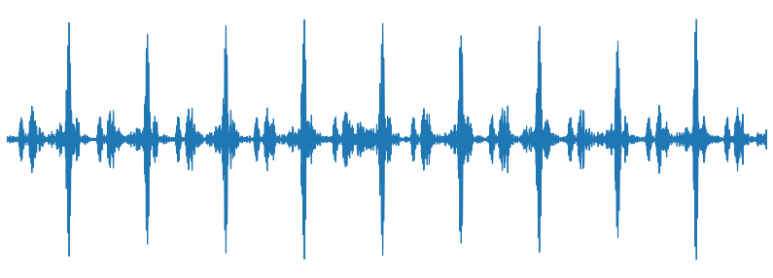

The Data
Set A (176 wav files)
From general public ~ iPhone app
1 to 30 second long audio files
Set B (656 wav files)
From hospitals ~ digital stethoscopes
sample
categories
murmur | normal
extra | artifact
Source: https://www.kaggle.com/kinguistics/heartbeat-sounds

Slide 3
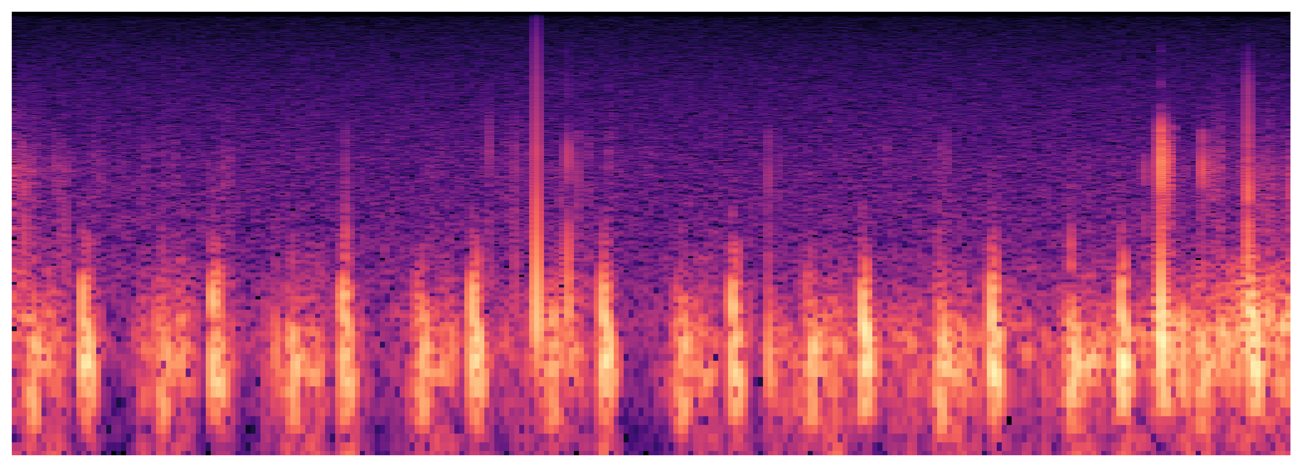
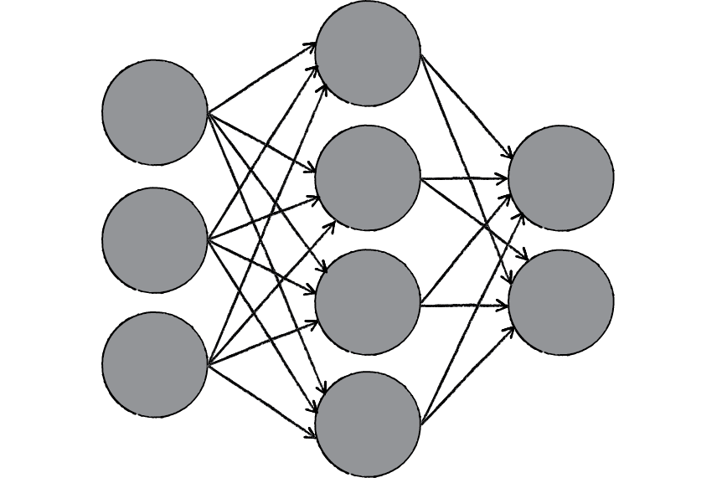
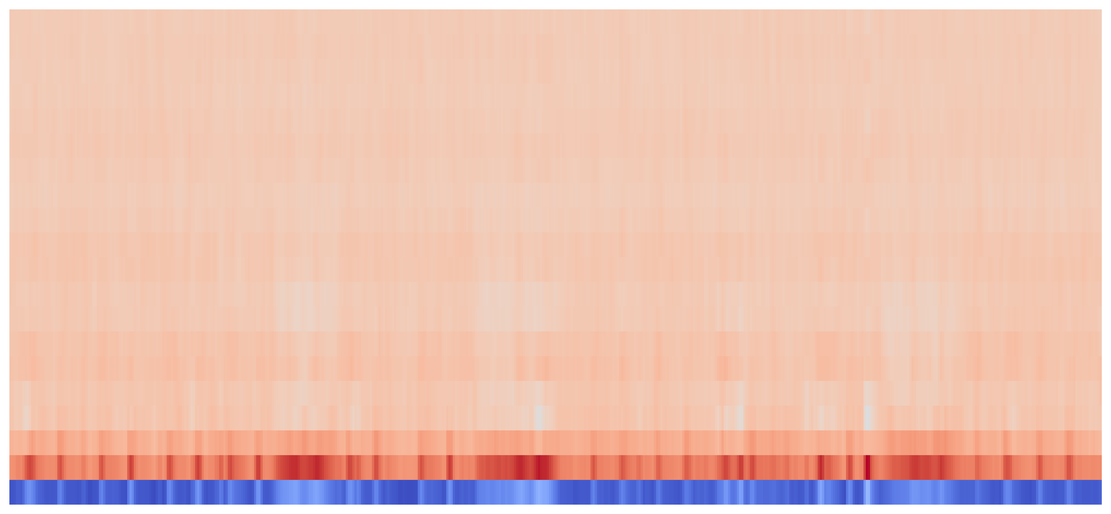
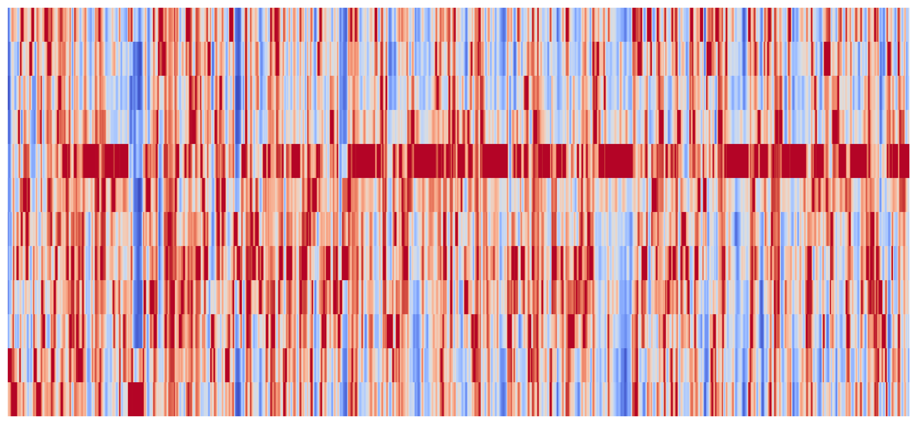
spectrogram
validation errors
75.2%
sample
mel-frequency cepstral coef.
70.1%
chroma feature
64.1%

Slide 4
spectrogram
mel-frequency cepstral coef.
accuracy
ensemble
72.1%
chroma feature

Slide 5
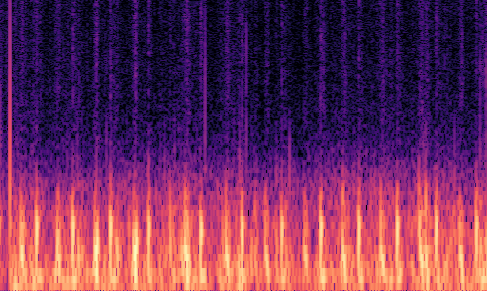
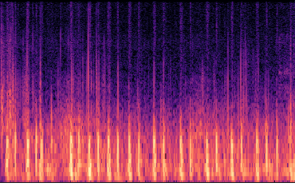
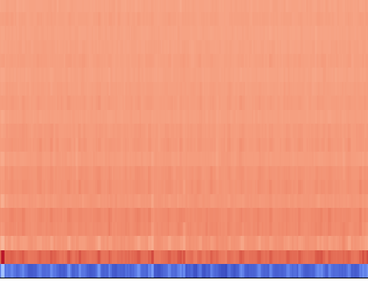
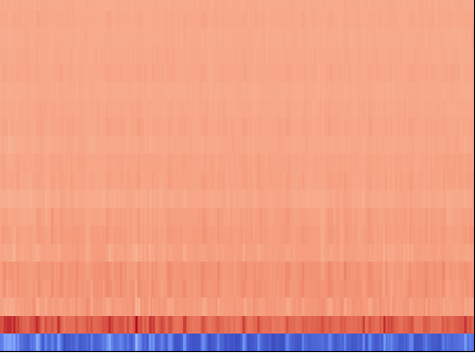
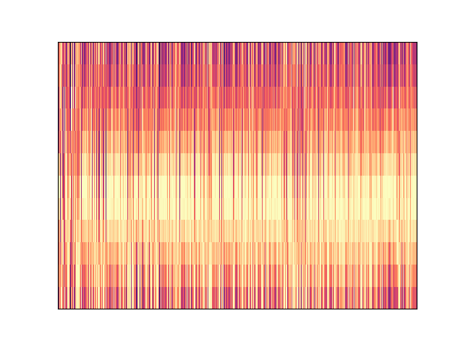
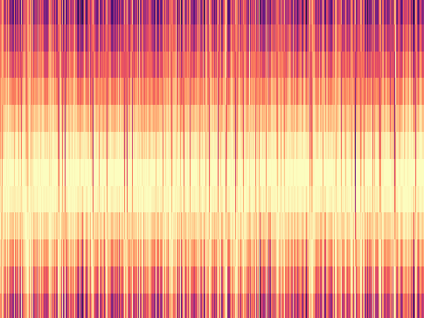
Rastko’s Heart
Teddy’s Heart
spectrogram
mel-frequency cepstral coef.
chroma feature
Normal ☺
Normal ☺

