Slide 1
Mongo DB vs. MySQL
Pokémon
岡 亮
田部 悠介
永山 裕人
和久井 拓

Slide 2
Mongo DB vs MySQL
Pokémon
おか りょう
たなべ ゆうすけ
ながやま ゆうと
わくい たく

Slide 3

What’s Pokémon ?
Pokémon is fictional creatures
Pokémon have various elements
  type(タイプ),moves(わざ)that can be acquired
  weight, height and more …
  (omitted in this report)
relationship between Pokémon and elements
  each Pokémon has 1 or 2 types.
  each Pokémon can acquire many moves
Notes:
Pokemon is fictional creatures.
most famous pokemon is Pikachu in the right picture.
pokemon have various elements. main elements are their types and moves, so we reserch between Pokemon and the main elements.
each Pokemon has 1 or 2 types. they can acquire many moves. there are example in next slide.

Slide 4
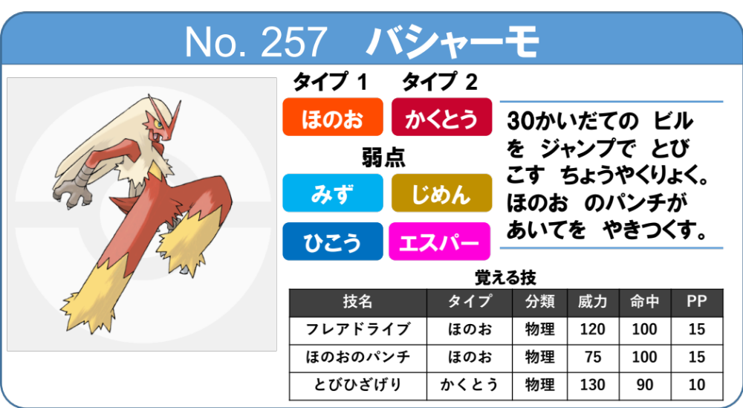
Example:Blaziken(バシャーモ)
element of pokemon:
no, name, type1, type2
element of move:
name,type,tech,power,acc,pp
Notes:
we show the example of what we deal with.
The reason why I choose this pokemon as an example is that I love this pokemon.
This pokemon named Blaziken has two type which is fire and fighting.
Blaziken can accuire many moves. these 3 moves are examples in a lot of moves.
all moves have the element of moves called name, type, power, acc, pp.
there are so many data so we collect these data by Web-scraping.

Slide 5
how to make MySQL
pokemon(id,name,type1,type2)
move(id,name,type,tech,power,acc,pp)
pokemon_move(pokemon,move)
pokemons
pokemon_move
| no | name |type1|type2|
| 001 | フシギダネ | 3 | 8 |
| 002 | フシギソウ | 3 | 8 |
| 003 | フシギバナ | 3 | 8 |
| 004 | ヒトカゲ | 2 | null|
| 005 | リザード | 2 | null|
| 006 | リザードン | 2 | 11 |
| pokeomn_no | move_id | | 019 | 1 |
| 020 | 1 |
| 025 | 1 |
| 026 | 1 |
| 029 | 1 |
| 030 | 1 |
moves
types
|id| name |type|tech|power|acc|pp|
| 1|10まんボルト| 4 |とくしゅ| 90 |100|15|
| 2|あおいほのお | 2 |とくしゅ| 130 | 85| 5|
| 3|あくうせつだん| 15 |とくしゅ| 100 | 95| 5|
| 4|あくのはどう | 16 |とくしゅ| 80 |100|15|
| 5|アシストパワー| 11 |とくしゅ| 20 |100|10|
| 6|アシッドボム | 8 |とくしゅ| 40 |100|20|
|id| name |
| 1| ノーマル |
| 2| ほのお |
| 3| みず |
| 4| でんき |
| 5| くさ |
| 6| こおり |
Notes:
In MySQL, there are 3 tables. Pokemon table has id, name, type1, and type2.move table has id, name, type, tech, power, acc, pp.poke_move table has a role that connects pokemon to move.

Slide 6
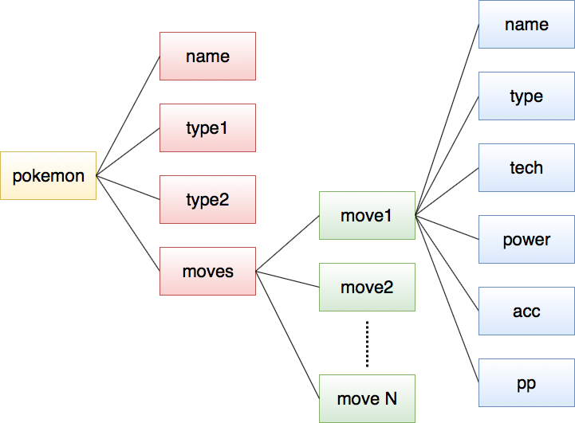
how to make Mongo DB
Example: バシャーモ (JSON-File)
{ "no": "257", "name": "バシャーモ", "type1": "ほのお", "type2": "かくとう",
“move”: [ { “m_name”: “ひのこ”,“m_type”: “ほのお”,“m_tech”: “特殊”
,"m_power": 40,"m_acc": 100, "m_pp": 25},
{"m_name": "いびき","m_type": "ノーマル", "m_tech": "特殊”
,"m_power": 50,"m_acc": 100, "m_pp": 15},
…..]}
Notes:
Mongo DB is tree-structure.pokemon has name, type1, type2 and moves. pokemon can learn many moves , so there are move1, move2, and more.each move has the element that is name, type, tech, power, acc, and pp.

Slide 7
Query 1.
Show only Fire Pokémon
MySQL
Mongo DB
query
select p.no, p.name
from pokemons p,types t
where(p.type1=t.id
or p.type2=t.id)
and t.name=‘ほのお’;
db.pokemon.find(
{{$or:[{type1:“ほのお”},
{type2:“ほのお”}]},
{_id:0,type1:0,
type2:0,move:0});
result
| 004 | ヒトカゲ |
| 005 | リザード |
| 006 | リザードン |
| 037 | ロコン |
| 038 | キュウコン |
| 059 | ウインディ |
...
{“no”:”004”,”name”: “ヒトカゲ”}
{“no”:”005”,”name”: “リザード”}
{“no”:”006”,”name”:”リザードン”}
{“no”:”037”,”name”: “ロコン”}
{“no”:”038”,”name”:”キュウコン”}
{“no”:”059”,”name”:”ウインディ”}
・・・

Slide 8
Query 2.
Fire Pokémon with Fighting Moves
MySQL
Mongo DB
query
select p.no, p.name
from pokemons p,
pokemon_move pm,
types pt,types mt,moves m
where (p.type1=t.id
or p.type2 = t.id)
and t.name=‘ほのお’ and
p.no=pm.pokemon_no and
pm.move_id=m.id and
m.type = mt.id
and mt.name = ‘かくとう’;
db.pokemon.find(
{$and:[{$or:[{"type1":"ほのお"}
,{"type2":"ほのお"}]}
,{"move.m_type":"かくとう"}]}
,{_id:0,type1:0
,type2:0,move:0});
result
| 004 | ヒトカゲ |
| 005 | リザード |
| 006 | リザードン |
| 058 | ガーディ |
| 059 | ウインディ |
| 077 | ポニータ |
...
{“no”:”004”,”name”: “ヒトカゲ”}
{“no”:”005”,”name”: “リザード”}
{“no”:”006”,”name”:”リザードン”}
{“no”:”059”,”name”:“ウインディ”}
{“no”:”058”,”name”: ”ガーディ”}
{“no”:”077”,”name”: ”ポニータ”}
・・・

Slide 9
Query 3.
Fire Pokémon with Fighting Moves
(power of move >= 100)
MySQL
Mongo DB
query
select p.no, p.name
from pokemons p,
pokemon_move pm,
types pt,types mt,moves m
where (p.type1=t.id
or p.type2 = t.id)
and t.name=‘ほのお’ and
p.no=pm.pokemon_no and
pm.move_id=m.id and
m.type = mt.id
and mt.name = ‘かくとう’ and
m.power >= 100;
db.pokemon.find(
{$and:[{move:{$elemMatch:
{m_type:"かくとう”
,m_power:{$gte: 100}}}}
,{$or:[{type1:"ほのお"}
,{type2:"ほのお"}]}]}
,{_id:0,type1:0
,type2:0,move:0});
result
| 004 | ヒトカゲ |
| 005 | リザード |
| 006 | リザードン |
| 058 | ガーディ |
| 059 | ウインディ |
| 126 | ブーバー |
...
{“no”:”004”,”name”: “ヒトカゲ”}
{“no”:”005”,”name”: “リザード”}
{“no”:”006”,”name”:”リザードン”}
{“no”:”059”,”name”:“ウインディ”}
{“no”:”058”,”name”: ”ガーディ”}
{“no”:”126”,”name”: ”ブーバー”}
・・・

Slide 10
Consideration about Type Effect
If we want to calculate type compatibilities ...
  MySQL is suitable
    make table about type compatibilities
  Mongo DB is not suitable
    It requires a lot of descriptions
    It’s hard to search with multi tables
type1|type2|rate
ほのお |でんき |1
ほのお |くさ |2
ほのお |こおり |2
ほのお |かくとう |1
ほのお is
stronger
than くさ !

Slide 11
Implement of
Type Effect
MySQL
Mongo DB
It can be executed
easily by using
“comps” table !
query
result
select te.name
from types t, types te
, comps c
where t.name = 'ほのお'
and t.id=c.m_type
and c.rate=2
and c.p_type=te.id;
|name |
| くさ |
| こおり |
| はがね |
| むし |
We have to add component
about type comp
under “type”

Slide 12


Feature of Each Other
MySQL
  Complex queries can be executed
  Data structure is strict
    Data types must be defined beforehand
Mongo DB
  JavaScript notation can be used
    Searchable from JS-File
  Easy to read
  Not good at complex queries
  Data and queries are redundant

