Slide 1
Collisions Data Analysis

Slide 2
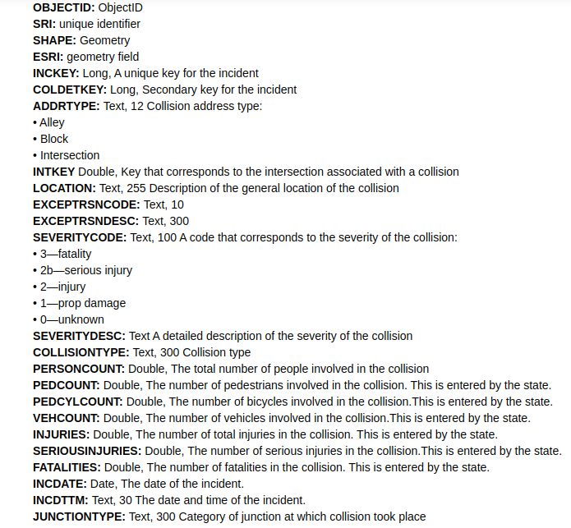
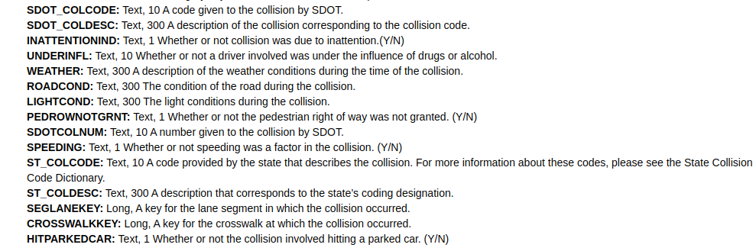
Data Information

Slide 3
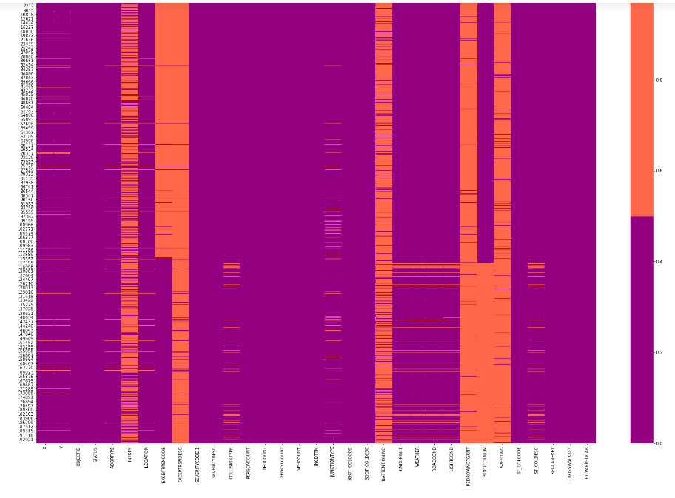
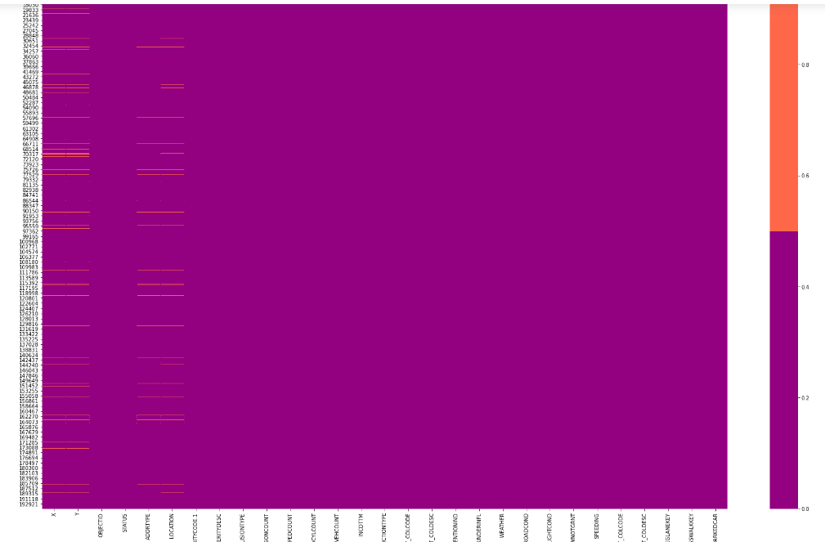
Before
After
Filled missing values with correct values for that independent variables. Methods for filling be varies to variables from variables. ex. “LIGHTCOND” and “WEATHER” is has different parameters.

Slide 4
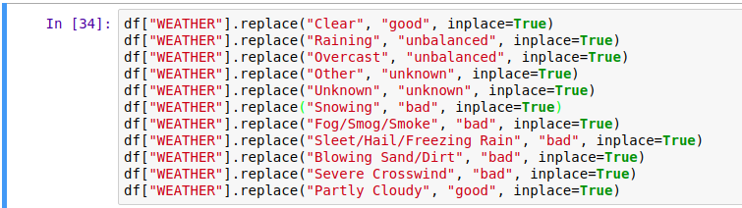
There is weather parameter to fill missing values. 4 condition that have. Good condition, bad condition, unbalanced condition and unknown. I did that because I will use that variable to machine learning as dummy variables. Purpose of that is decrease the categoric variable’s number. Same as here I use that to different variables ex. “LIGHTCOND”, “ROADCOND” etc.

Slide 5
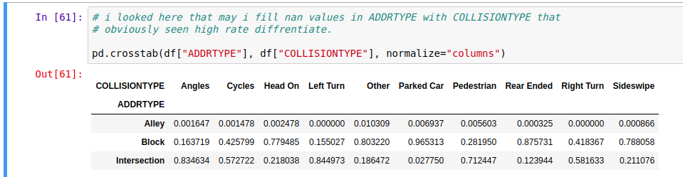
I looked here that which collision type’s associate with which addrtype. Addrtype means collision address type. And we can see here some high rate for example Intersection-Angles about at the rate of 84%. ıf examine the table for cautionsly you can see some high rate differentiate.

Slide 6
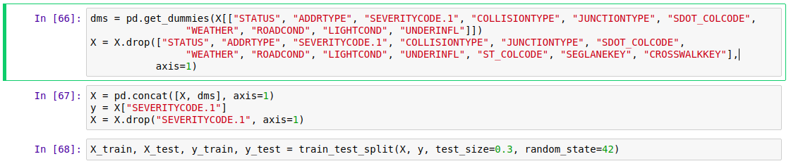
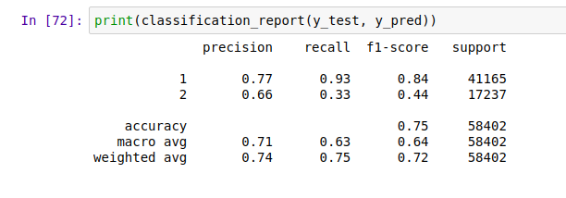
Train and test sets. Dummy variables for modeling and classification reports for decisiton tree.

Slide 7
