Slide 1

Case Study 2
Ousman kanteh
This Photo by Unknown Author is licensed under CC BY-NC-ND

Slide 2
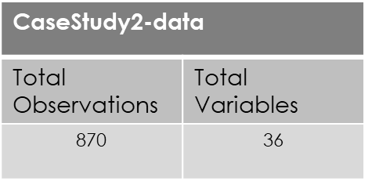
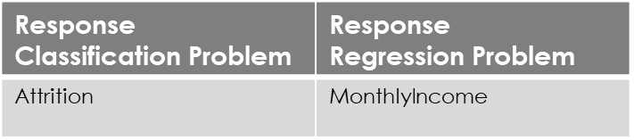
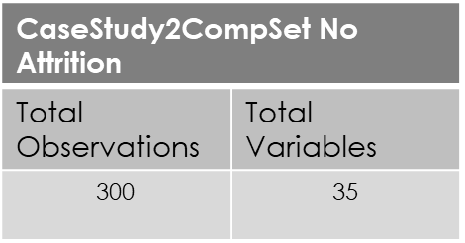
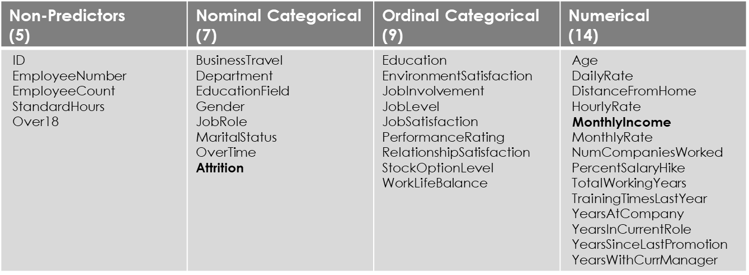
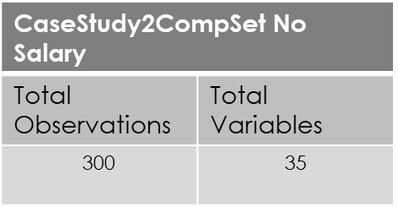
Introduction: The purpose of this project is to predict Employee rate and Attrition

Slide 3
Identify
Identify Top Predictors of Employee Turnover
Classify
Build Attrition Prediction Model
60% Specificity/ 60% Sensitivity
Predict
Build Income Prediction Model
RMSE Regression
Objectives

Slide 4
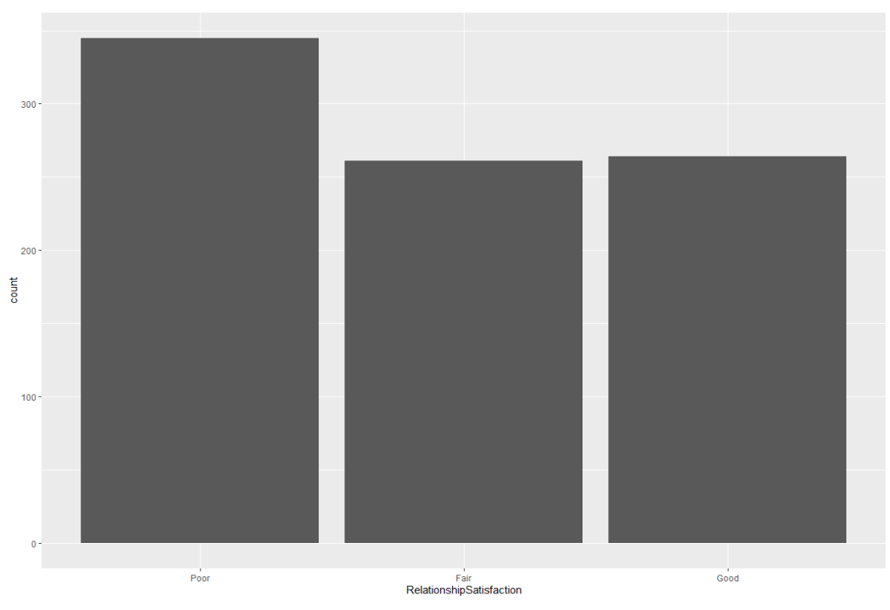
Relationship satisfaction

Slide 5
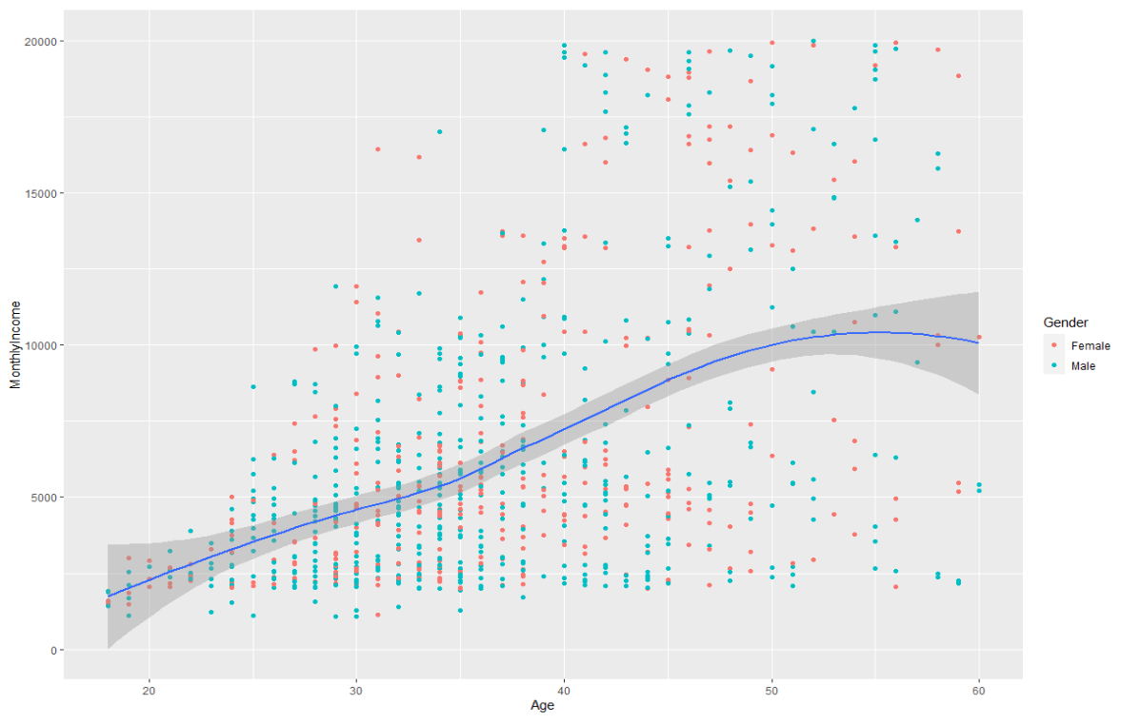
Relationship between age and income group by gender

Slide 6
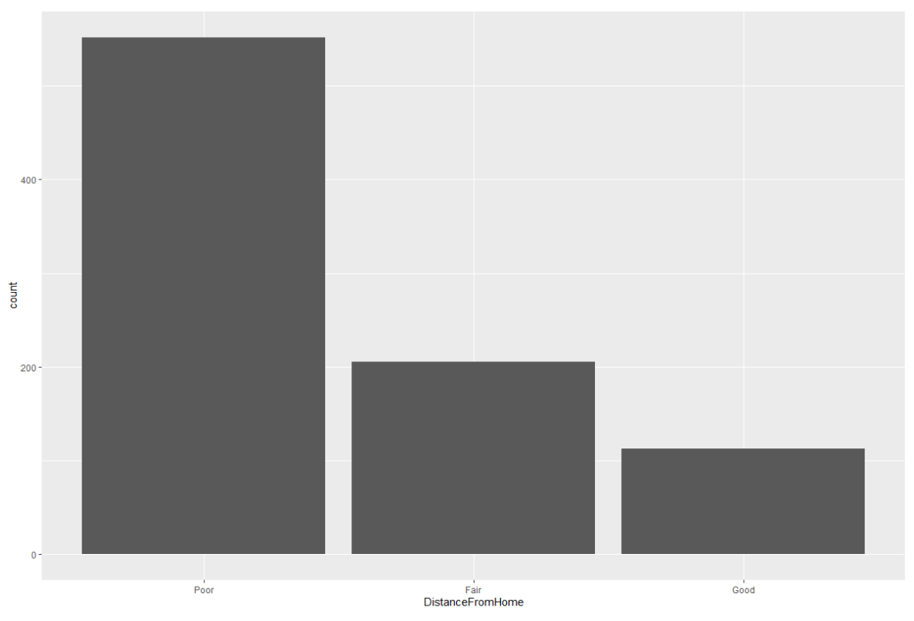
Distance from home

Slide 7
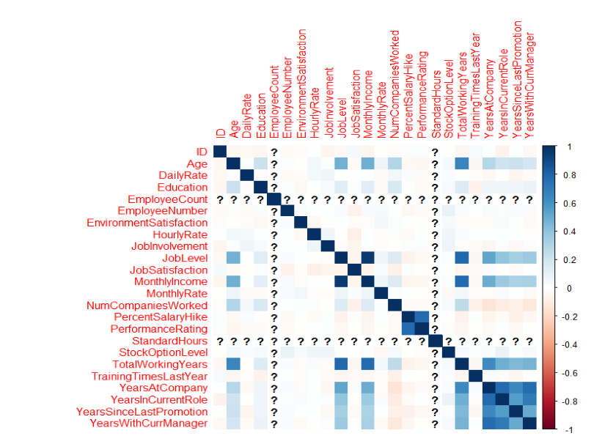
Checking correlation between variables

Slide 8
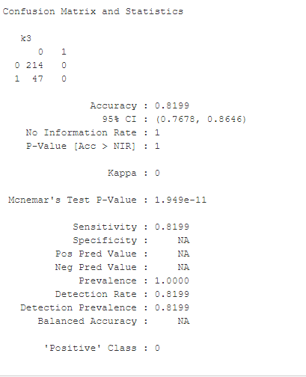

outcome

Slide 9
Top 6 factors that leads to attrition that determined by our models are as follows. Three of which are matching to EDA
Stock Options
Overtime
Job Level
Job Role
Age
MonthlyIncome
There seems to be some areas of dissatisfaction as it relates to specific Job Roles that could potentially contribute to attrition. Further analysis is required to uncover deeper stories and insights.
However, we were able to distinguish the most important factors that lead to attrition with a prediction accuracy of 82%.
conclusion

Slide 10
Thank you for your time!
https://github.com/okanteh24/CaseStudy2DDS.git
https://youtu.be/JcB3K_NhV4w

