Slide 2
Number of breweries present in each state

Slide 3

Missing values in each column

Slide 4
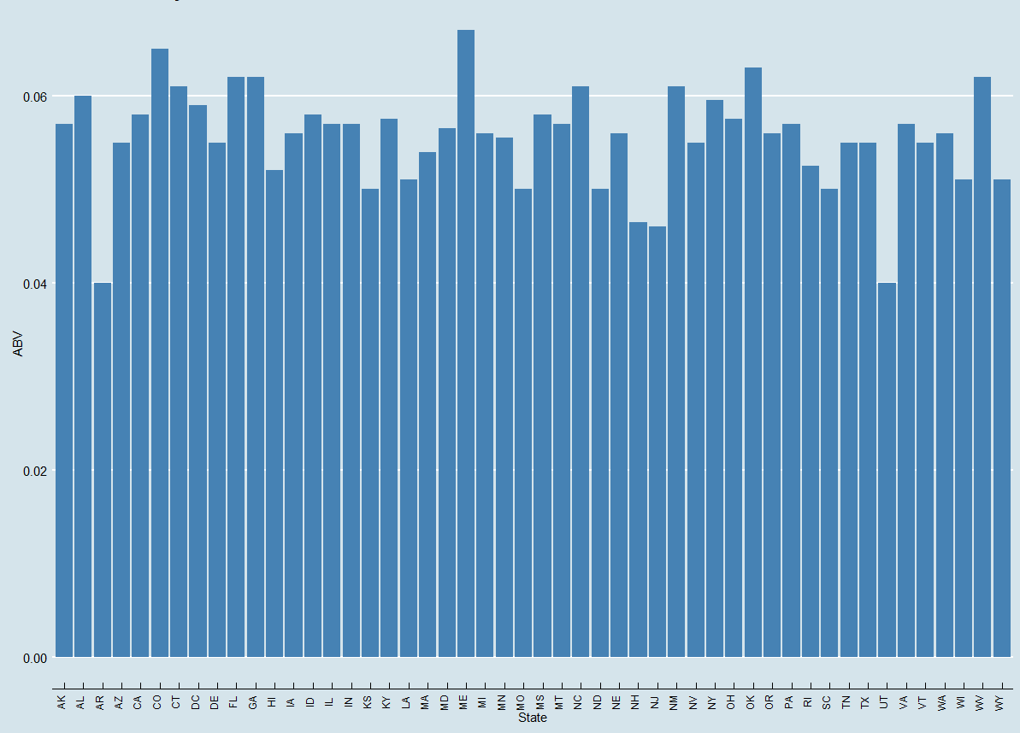
median alcohol content unit for each state

Slide 5
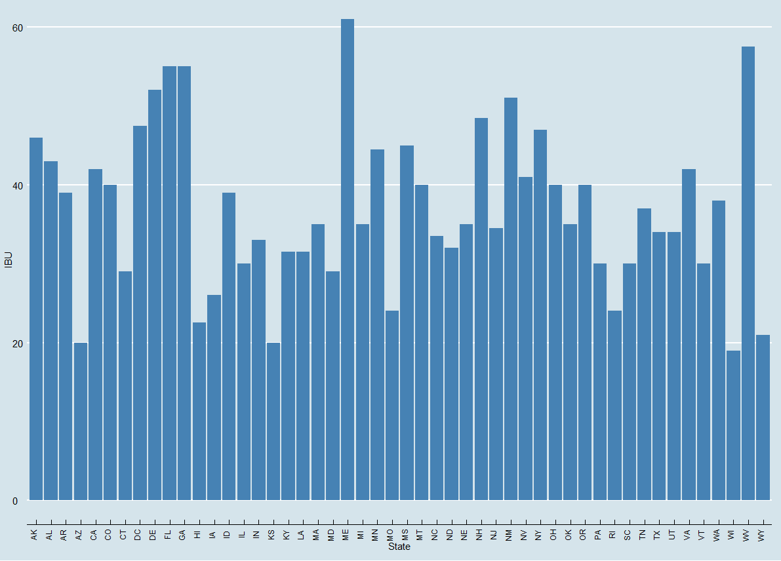
median international bitterness unit for each state

Slide 6
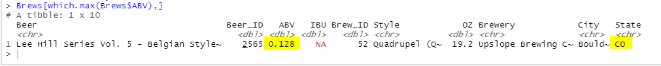
state has the maximum alcoholic (ABV) beer

Slide 7
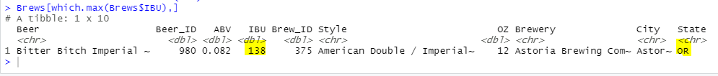
state has the most bitter (IBU) beer

Slide 8

distribution of the ABV variable

Slide 9
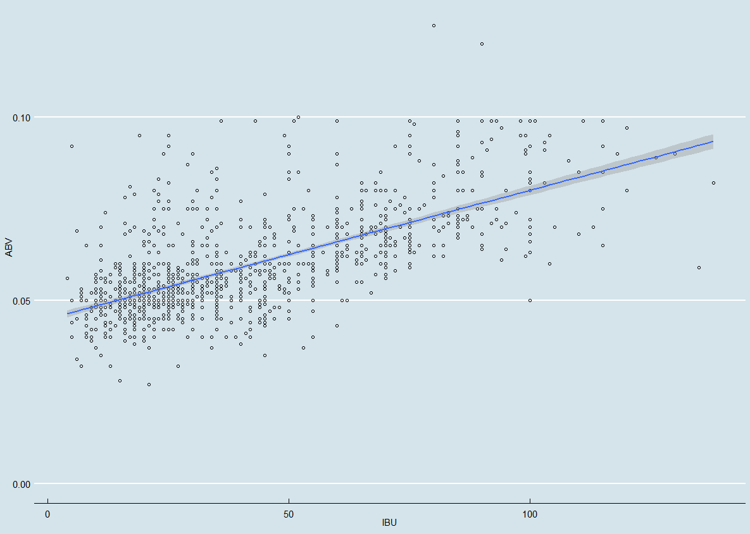
Correlation between IBU and ABV

