Slide 1
Data GLADIATORS
Author: Khawulani Thebe, Ousman Kanteh

Slide 2
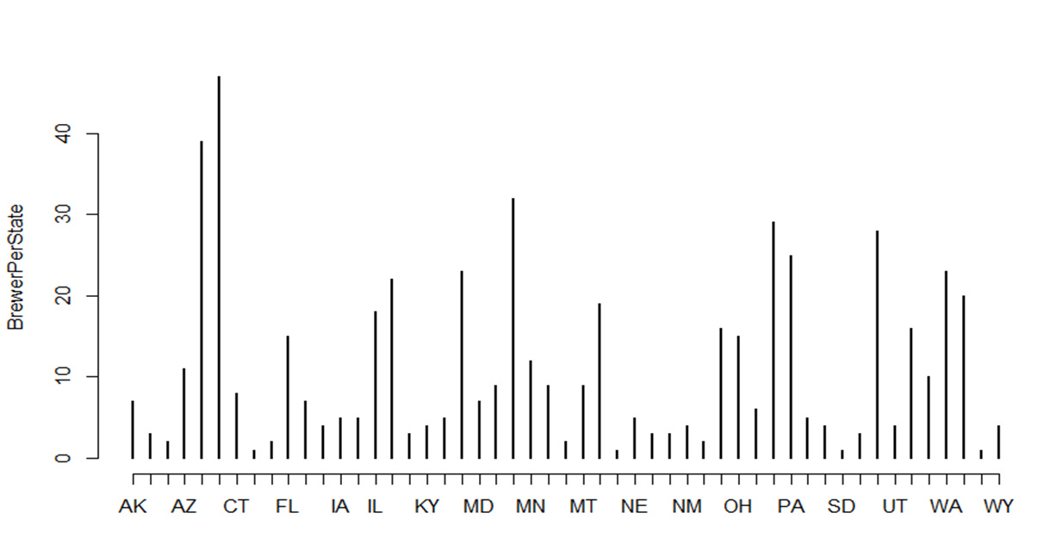
Number of breweries present in each state
Colorado state has the highest number of breweries
There are 13 States with 5 and above number of breweries
There are 19 States with less than 5 breweries

Slide 3

Missing values in each column
There are missing values in ABV,IBU and Style columns
Records with missing values will be dropped for analysis of complete data

Slide 4
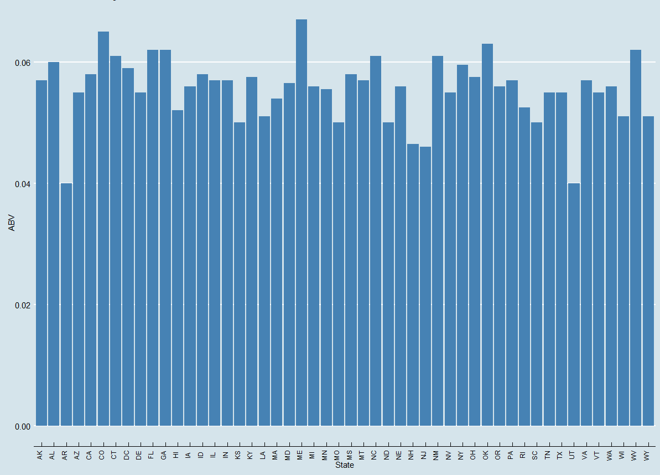
median alcohol content unit for each state
Maine has the highest Alcohol Content in their beer
National Alcohol average is over 0.4

Slide 5
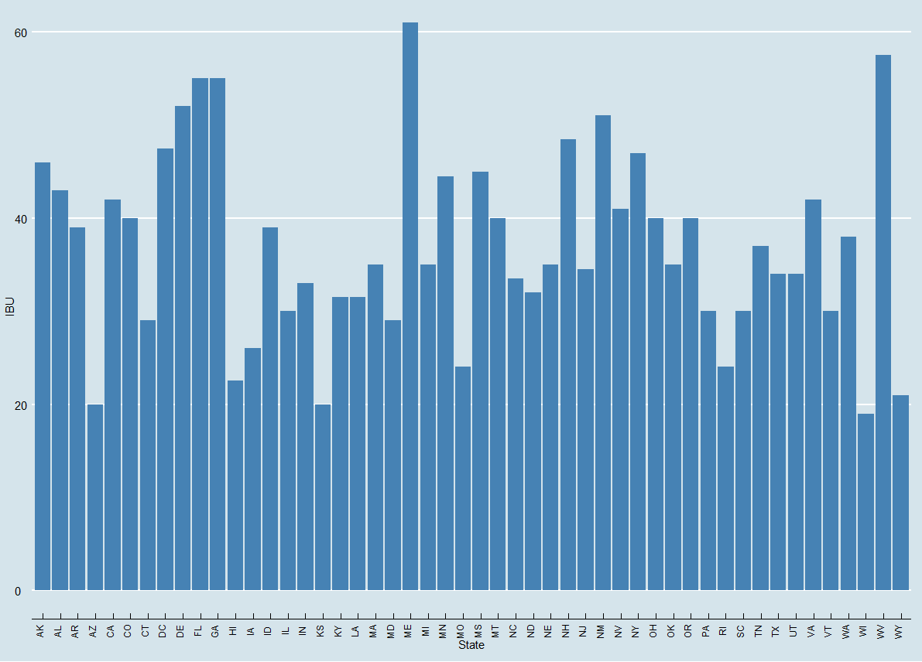
median international bitterness unit for each state
Maine has the highest national bitterness taste in their beer
The national Alcohol bitterness level is below 40

Slide 6
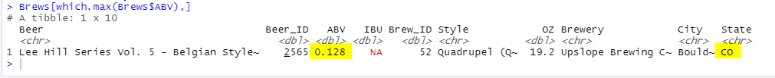
state has the maximum alcoholic (ABV) beer
Colorado state has the most alcoholic ABV
The ABV count of 0.128

Slide 7
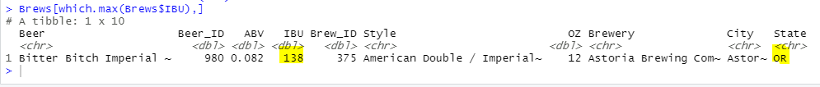
state has the most bitter (IBU) beer
Oregon state has the most bitter beer
Highest bitterness recorded at 138

Slide 8

distribution of the ABV variable
The spread of the data values varies from 0.001 to 0.128
The median and mean not far off from each other, confirming less outliers
Data is left skewed with substantial variability from minimum to first quarter

Slide 9
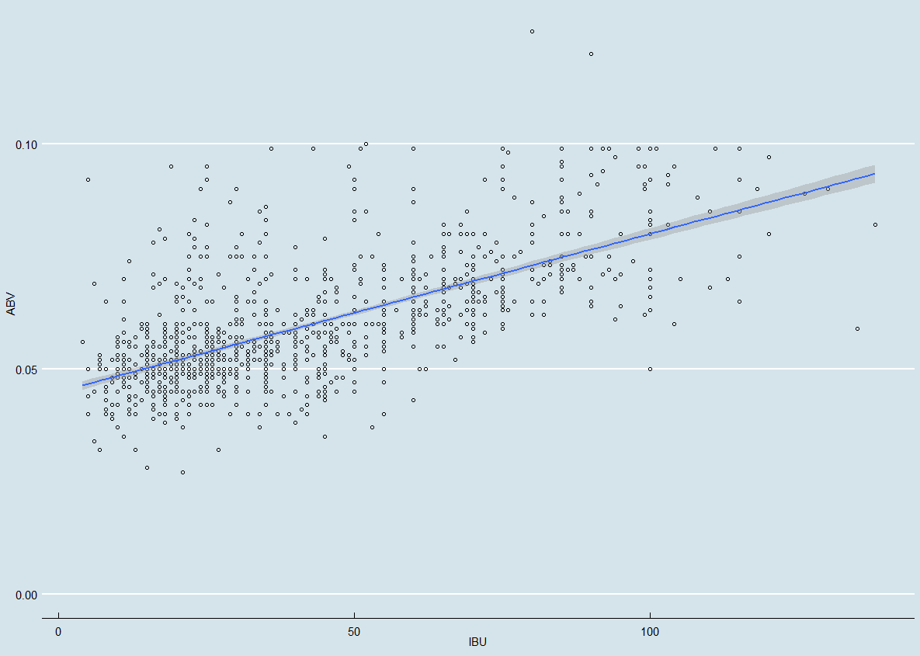
Correlation between IBU and ABV
IBU and ABV have a positive liner correlation
Data shows a positive association

Slide 10
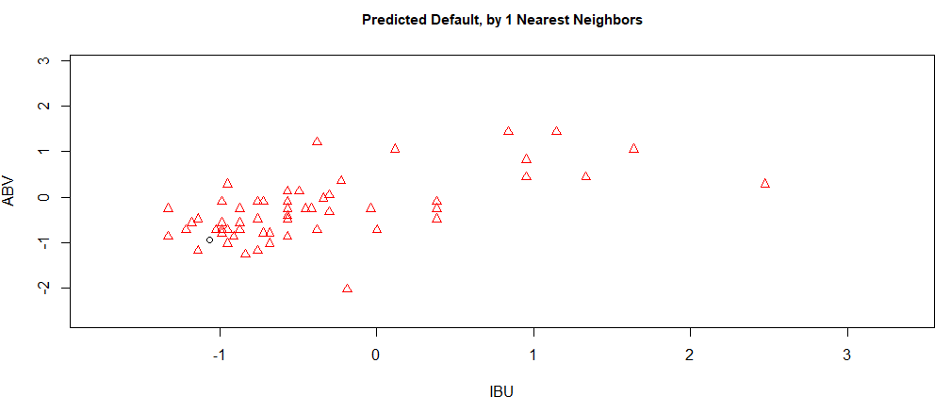
KNN 1 Analysis

Slide 11
Breweries present in each state
Addressed the missing values in each column.
Compare the median alcohol content and international bitterness unit for each state
Which state has the maximum alcoholic (ABV) beer. Which state has the most bitter (IBU) beer
Summary statistics and distribution of the ABV variable.
Relationship between the bitterness of the beer and its alcoholic content
Summary

