Slide 1
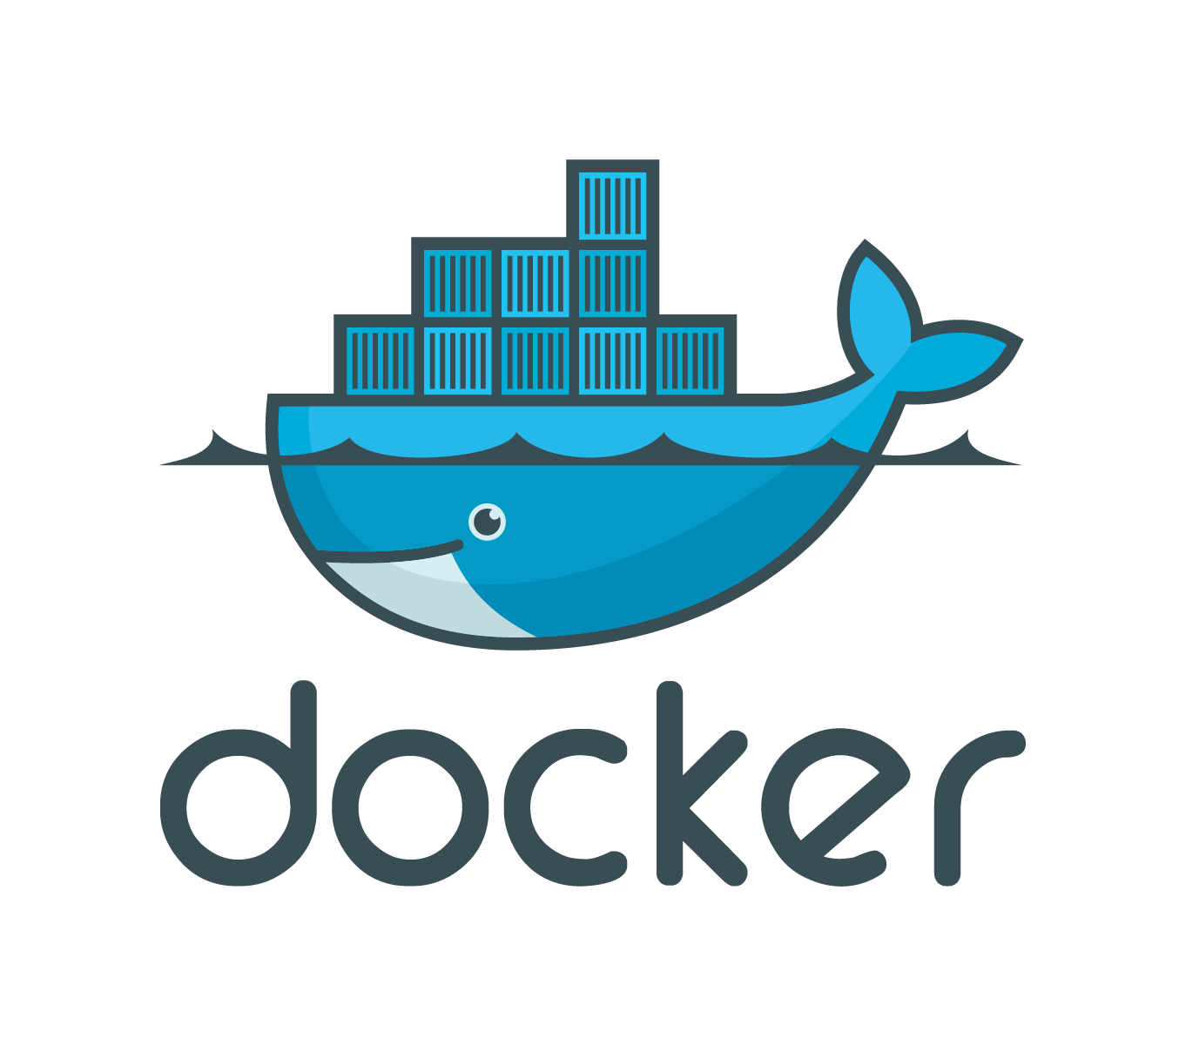

Slide 2
What is docker?
Docker is the company driving the container movement
Formerly dotCloud
Docker is an open source engine that makes it possible to pack, ship, and run any application as a lightweight container.

Slide 3
What are containers?
Containers are a method of operating system virtualization that allow you to run an application and its dependencies in resource-isolated processes.
Containers isolate software from its surroundings
Containers allow to share environments and help reduce conflicts between teams running different software

Slide 4
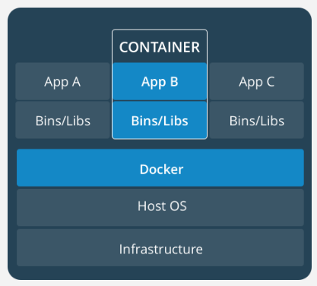
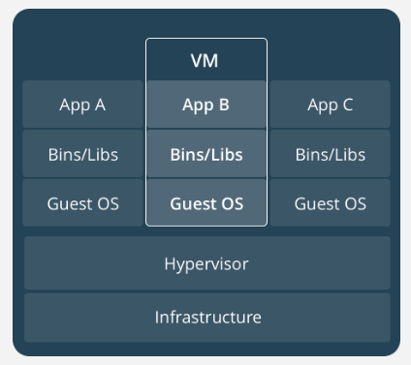
Docker vs VMs

Slide 5
Containers
abstraction at the app layer that packages code and dependencies together
share the OS kernel with other containers
running as isolated processes in user space
take up less space than VMs
start almost instantly

Slide 6
Virtual machines (VMs)
abstraction of physical hardware
includes a full copy of an operating system
can take up to tens of GBs
slow to boot

Slide 7
Container Benefits
Environment Consistency
Operational Efficiency
Developer Productivity
Version Control

Slide 8
Docker - basics

Slide 9
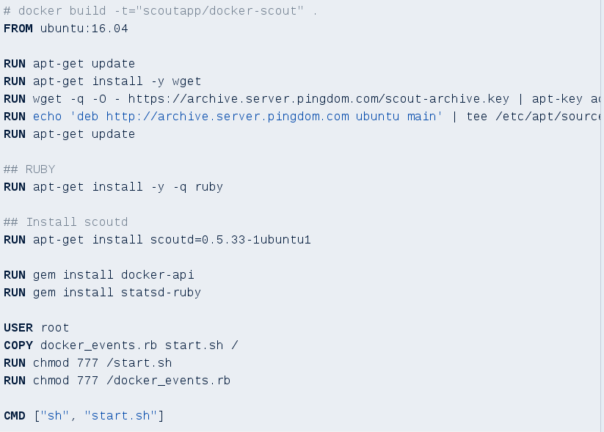
Dockerfile

Slide 10
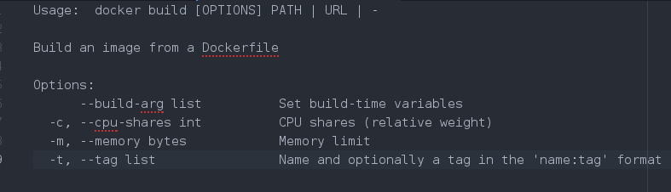
Building docker image

Slide 11
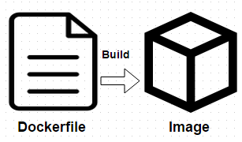
docker build . -t repository:tag

Slide 12

Docker images

Slide 13
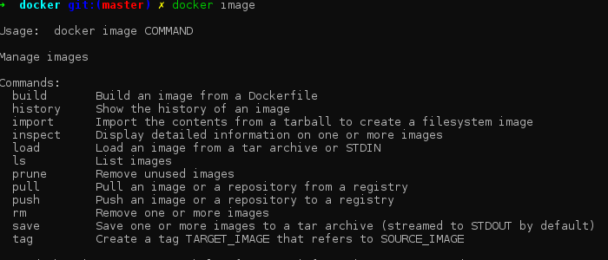

Slide 14
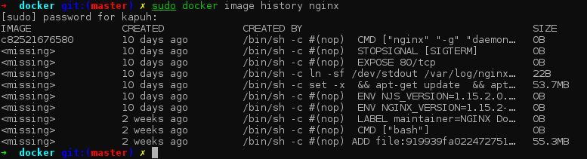

Slide 15
Docker registry
The Registry is a stateless, highly scalable server side application that stores and lets you distribute Docker images.
You should use the Registry if you want to:
  tightly control where your images are being stored
  fully own your images distribution pipeline
  integrate image storage and distribution tightly into your in-house development workflow

Slide 16
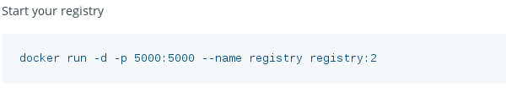
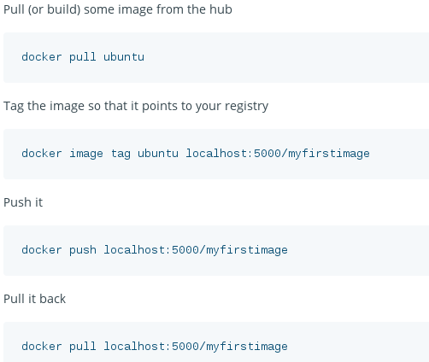

Slide 17
Amazon Elastic Container Registry
Fully Managed
Secure
  transfers your container images over HTTPS
  configure policies to manage permissions and control access to your images using IAM
Highly Available
Simplified Workflow
Amazon Elastic Container Registry integrates with Amazon ECS and the Docker CLI, allowing you to simplify your development and production workflows.

Slide 18
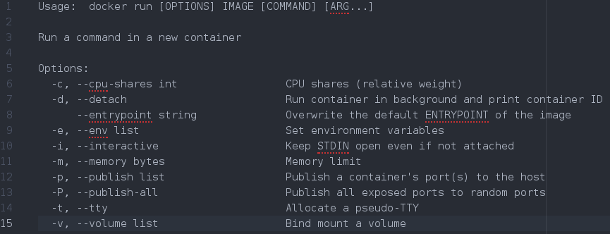
Running a container

Slide 19

Running container

Slide 20
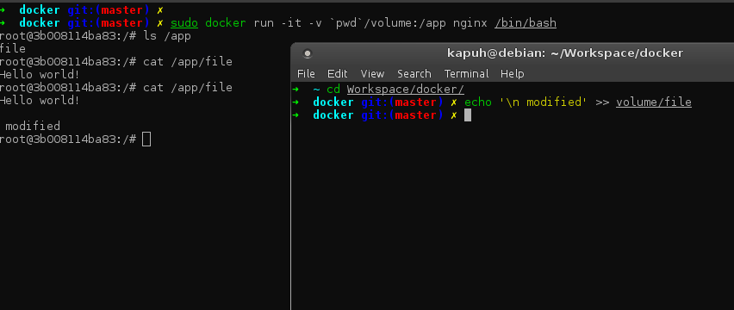
Volumes

Slide 21
Docker Compose

Slide 22
Docker compose is a tool for defining and running multi-container Docker applications. With Compose, you use a YAML file to configure your application’s services

Slide 23
Common use cases
Development environments
  When you’re developing software, the ability to run an application in an isolated environment and interact with it is crucial. The Compose command line tool can be used to create the environment and interact with it.
Automated testing environments
Single host deployments

Slide 24
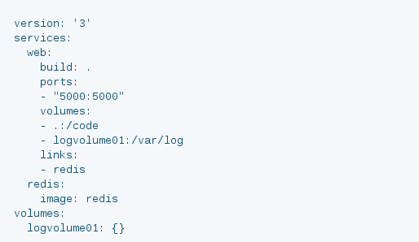
docker-compose.yml

Slide 25
docker-compose.override.yml
By convention, the docker-compose.yml contains your base configuration. The override file, as its name implies, can contain configuration overrides for existing services or entirely new services.

Slide 26
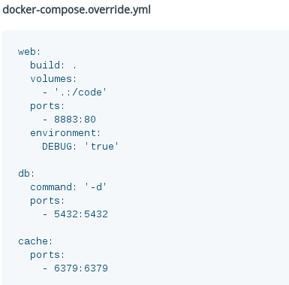

Slide 27
Example

Slide 28
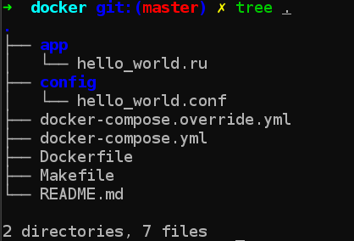

Slide 29
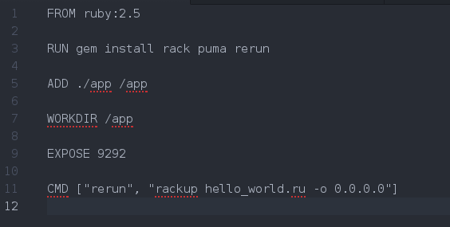
Dockerfile

Slide 30
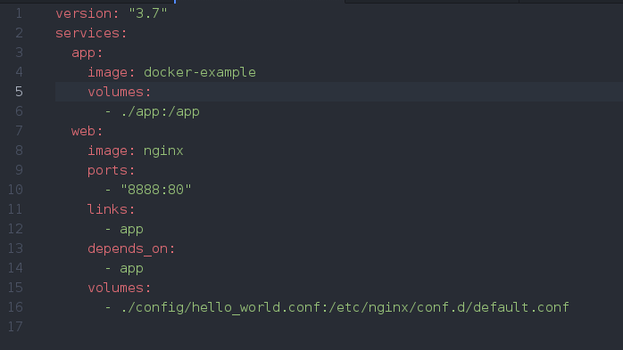
docker-compose.yml

Slide 31
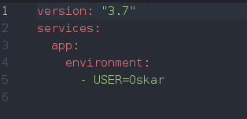
docker-compose.override.yml

Slide 32
Useful commands
Running docker-compose stack
  docker-compose up [-d]
Attaching to running container
  docker-compose exec [container] /bin/bash
Logs
  docker-compose logs -f [container]

Slide 33


Slide 34
https://github.com/okapusta/docker-example

Slide 35


