Slide 1
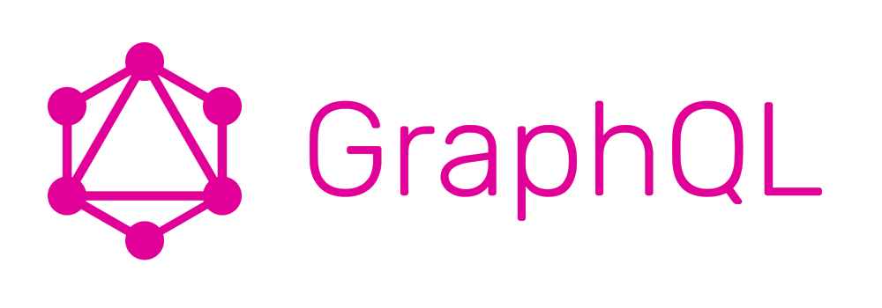

Slide 2
What is GraphQL?
GraphQL is a query language for APIs
Created by Facebook
In a nutshell, GraphQL is a syntax that describes how to ask for data
It lets the client specify exactly what data it needs
It makes it easier to aggregate data from multiple sources
It uses a type system to describe data

Slide 3
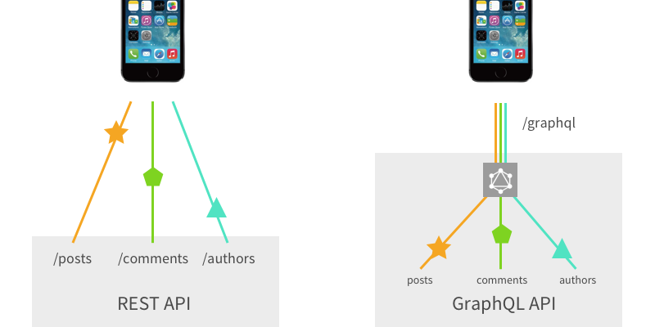
Why GraphQL?

Slide 4
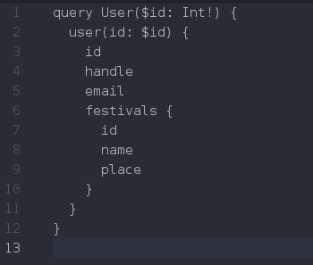
REST vs GraphQL
REST
GET /users/1
GET /users/1/festivals
GraphQL
POST /graph

Slide 5
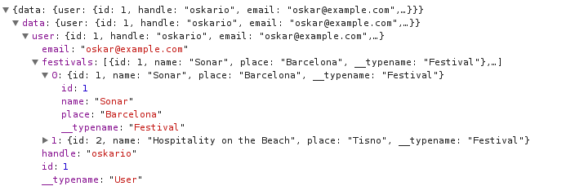

Slide 6

Types
GraphQL object types are the bread and butter of GraphQL APIs. Each object has fields which expose data and may be queried by name. For example, we can query a User like this:

Slide 7
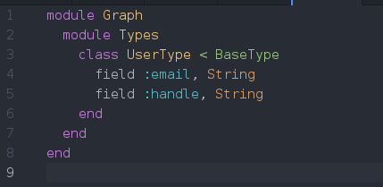
UserType

Slide 8
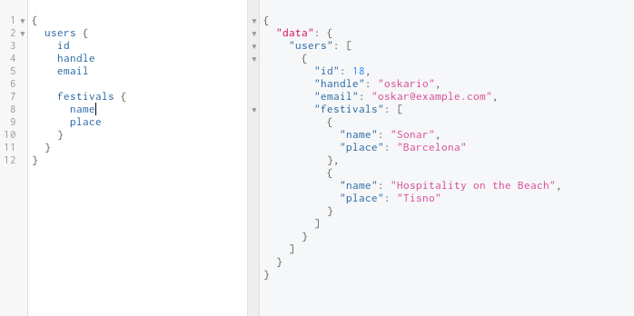
Query

Slide 9
Schema

Slide 10
Resolvers

Slide 11
Unions

Slide 12
Interfaces

Slide 13
Relays

Slide 14
Mutations

Slide 15
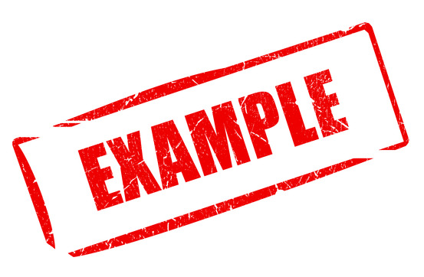

Slide 16
oskar@librato.com
https://github.com/okapusta/graphql-example

Slide 17


