Slide 1
Introduction to Databases

Slide 2

Basic Definitions
Database (DB) - collection of data
DBMS - generic program to manage databases
DB Application - App with specific purpose that accesses one database
Notes:
Questions for students
- What DB applications do you use ? likely answers - Banner, Amazon, ...
- What DBMSs they use ? Oracle, MS Access, MS SQL Server, ...

Slide 3
Data etc
Data - basic facts
Information - processed data
Metadata - data about data
  Computer and Human metadata
Schema (intension) - description of data (metadata)
Instance (extension) - actual data
Notes:
When designing a db app, we want to enter data, but we want information out of it (plus maybe the original data :)
Computer metadata is the one directly usable by the computer (data type, size etc) while human metadata is for people (how to get that field, who decides the value etc)

Slide 4
DB vs File System Apps
Apps that deal directly with files have program-data dependence
  the program needs to know the format of the data
  if the format changes, the program changes too !
DBMS provides program-data independence
  DBMS knows data format, programs do not !
DB Apps usually include
  SQL - Standard query language
  Client-Server - remote access, centralization

Slide 5
DB Apps Advantages
Advantages
  Program-data independence
    which entails Reduced program maintenance
  And enables data centralization, and so
    Less data redundancy
    Improved data consistency, quality, standards
    Improved Data sharing
    Improved data accessibility and ad-hoc queries

Slide 6
DB Apps Disadvantages
Special software, DBMS
  But simple nowadays
Entails DBA
  But most sysadmins can do it, not perfectly but ...
Specialized backups etc
  But again, no big deal usually

Slide 7
DB Application size
Personal DB Apps - one person, no network
Workgroup DB Apps - small group, LAN
Enterprise DB Apps - mission critical, many users, WAN
Internet DB Apps - many users, probably casual users, over the internet
Notes:
We don’t do personal apps anymore, maybe for PDAs (but even iPhone apps do internet nowadays :), sharing is too useful

Slide 8
Client-Server
DBMS server, controls access to database
Clients use network connection to send SQL, receive data
General clients (GUI or Text) - for programmers or DBAs
DB Apps are just another client - used by end-users

Slide 9
Three-Tier apps
Add another layer between client and server
Middle tier is business logic
Client can be very simple (browser)
As far as DBMS, client is business tier
Updating business logic tier is easy

Slide 10
Three-Schema architecture
3 levels of abstraction
  Conceptual - high-level, technology independent
  Logical - for specific technology (relational)
  Physical - full info for computer
Completeness:
  external schemas (subsets of internal)

Slide 11
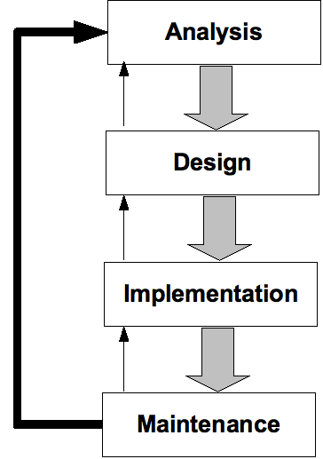
Development Process
Analysis
  Conceptual Modeling
Design
  Logical DB Design
  Physical DB Design
Implementation
  DB Implementation
Maintenance
Waterfall vs Iterative

