Slide 1
Conceptual Modeling
Entity Relationship Diagrams

Slide 2

Business Rules
Business Rule: Statement that constrains certain aspects of the business
  Assert business structure or
  Control business processes
  Basically, Requirements from Business
Our DB App will (hopefully) automate business rules

Slide 3
ER modeling
An ER Model is based on Entities, Relationships among entities, and attributes of entities and relationships
An ER Diagram is a graphical representation of an ER Model

Slide 4
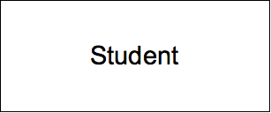
Entities
Things in the real world, physical or not
Entity type is set of entities that share properties or characteristics
Entity Instance is each of the instances of an entity type
Represented by rectangle

Slide 5
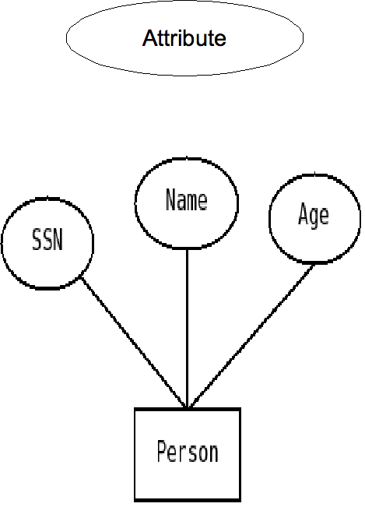
Attributes
Properties of entities or relationships
Represented by oval
Can be (at the same time)
  Optional or mandatory
  Simple or composite
  Single- or multivalued
  Stored or Derived
We also need to define an identifier which is a set of attributes for which no two entities of a given type will have the same value

Slide 6
Optional vs Mandatory
For optional attributes, some entities may have no value at all.
For mandatory attributes, a value has to be entered in DB.
Not represented in ER diagram.
By default, consider all attributes optional
Examples of Mandatory: SSN, Name (for many applications)

Slide 7
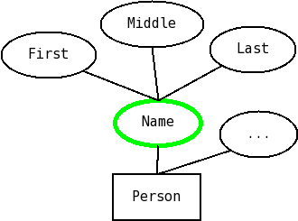
Simple vs Composite
Composite attributes can be broken-up into meaningful parts.
Each part has a name, and they could be of different types.

Slide 8
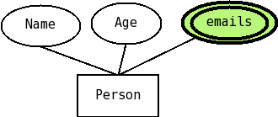
Single-valued vs multi-valued
For some attributes, we may have more than one value for the same entity.
Here, all values are of the same type, and they are not identified by name; similar to an array or a set.
Represented by double lines

Slide 9

Derived vs Stored
Many times we can calculate an attribute from some other attributes stored in the database
We call those derived attributes (and use dash-lines around them).
Sometimes you can choose which ones to store or derive

Slide 10

Practice: Person
Produce an ER diagram for the following situation:
We have only one entity, called Person (everything else is represented as attributes), with the following attributes: Id (the identiﬁer); Name, which is composed of one or more given names and one or more family names; One or more aliases, an address (composed of street, city, state,zip); date-of-birth; and age, which can be calculated from the date of birth.

Slide 11
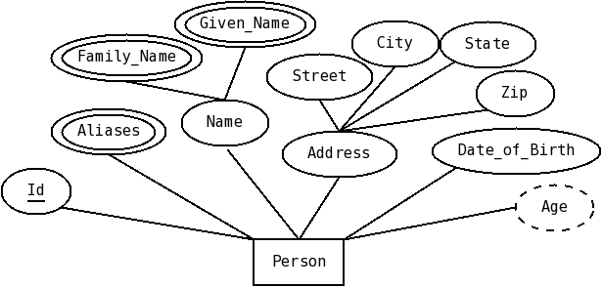
Solution: Person

Slide 12
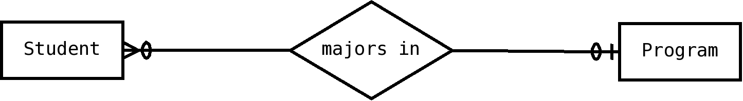
Relationships
Association between two or more entities
Represented by diamond
Degree: number of entity types that participate (mostly binary)
Cardinality constraints

Slide 13
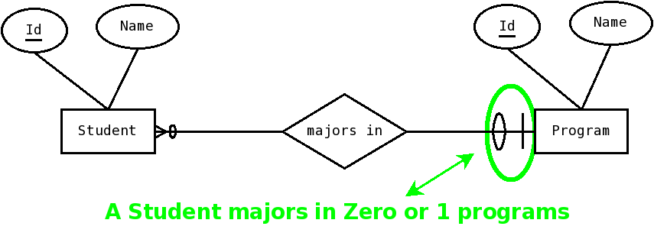
Interpreting Cardinalities

Slide 14
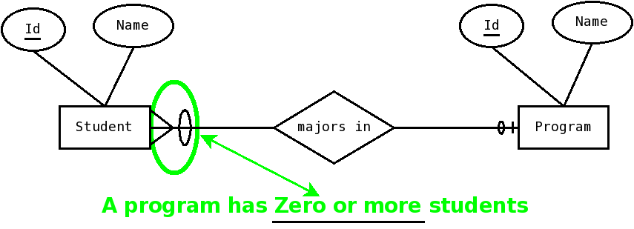
Interpreting Cardinalities

Slide 15

Cardinality Constraints
Constrain the number of other entities a given entities can be related with, for a given relationship.
Program has 0+ students
Student majors in 0 or 1 programs

Slide 16
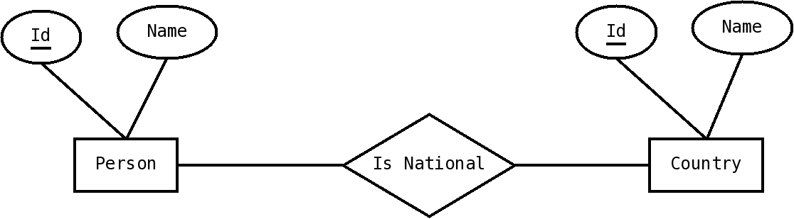
Quick Check
Add cardinality constrains:
  A person is a national of zero or more countries;
  A country has one or more people.

Slide 17
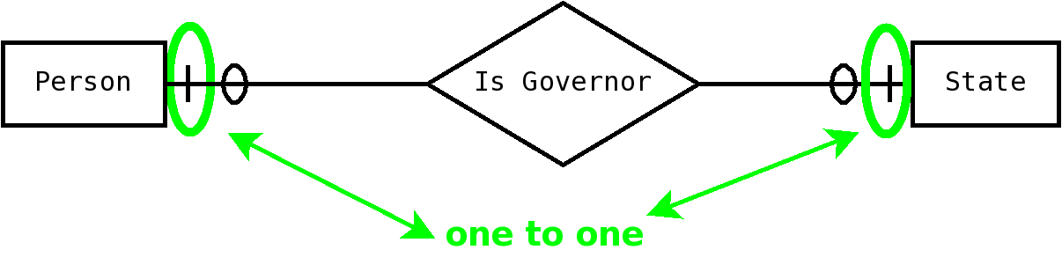
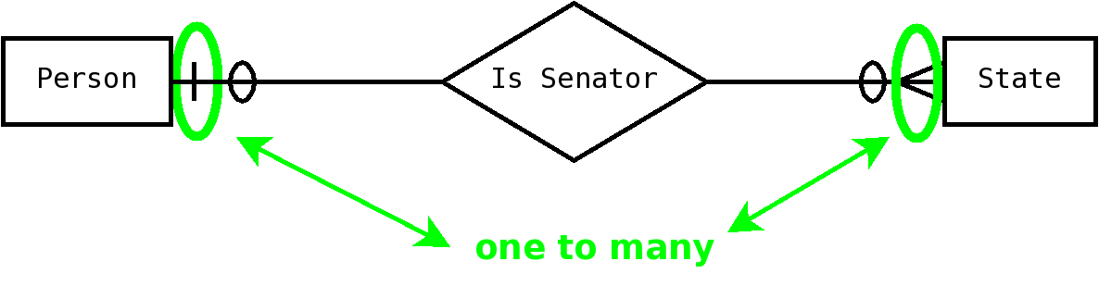
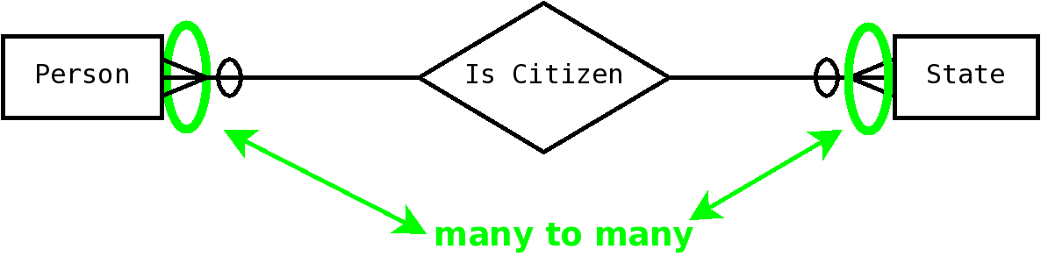
Maximum cardinalities
Looking at the MAXIMUM cardinality on BOTH sides, we classify relationships as:
  one-to-one
  one-to-many
  many-to-many

Slide 18
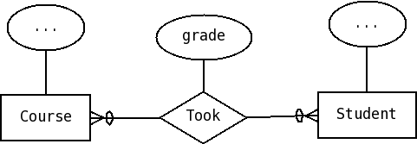
Relationships and Attributes
Relationships can have attributes
These attributes are not associated with the related entities but with their relationship

Slide 19
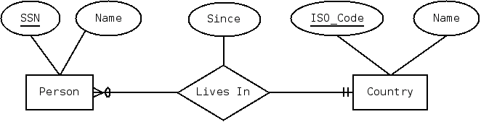
Relationships recap
Association between two or more entities
Represented by diamond
Degree
May have attributes
Cardinality constraints
1 to Many etc (use MAX on both sides)

Slide 20
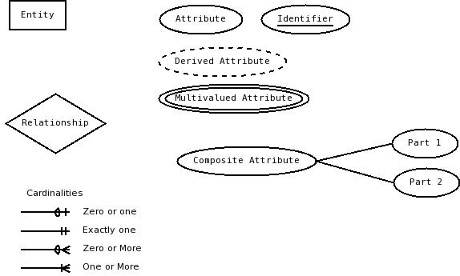
What we’ve covered

Slide 21
Practice: Products
We have two kinds of entities: Products and Categories. For each product we keep its id (the identiﬁer), name, price, wholesale price, and profit margin, which is calculated from the price and wholesale price. For each category we keep its id (the identifier) and its name. Each product belongs to zero or more categories and each category can have zero or more products.

Slide 22
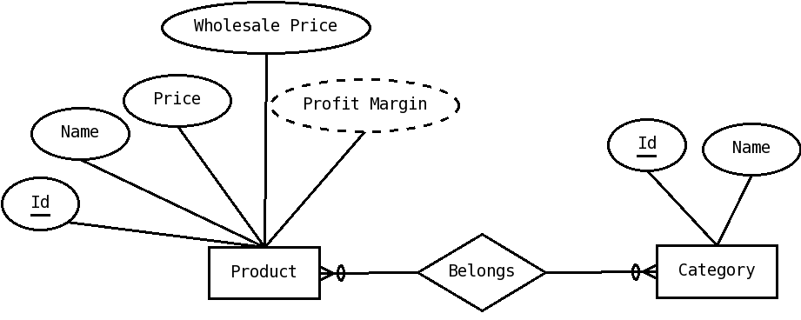
Solution: Products

Slide 23
Practice: CD 1
We want to model a CD as an entity. The only entity is the CD and everything else is modeled as attributes.
  a) A CD has a number, which is its identifier.
  b) A CD has a title.
  c) A CD has zero or more performers; for each performer we keep their first and last name.
  d) A CD has zero or more songs. For each song we keep its title and the name of its author (with name divided into first and last)

Slide 24
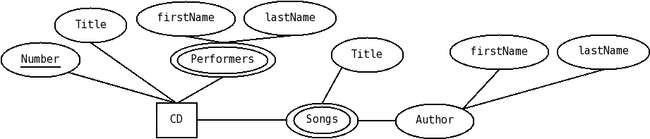
Practice: CD 1

Slide 25
Practice: CD 2
Now let’s model a CD, but with Person and Song as entities. So:
  A CD has a number, which is its identifier, and a title.
  A person has an id, and a name, divided in first and last.
  A song has an id, a title and a length.
  We keep track of which person is a song's author. A person can author many songs and a song has exactly one author.
  We keep track of which people perform on a CD. Zero or more people perform on a CD and people can perform on zero or more CDs.
  We keep track of which songs are included on a CD. One or more songs are included on a CD, and a song is included in one or more CDs.

Slide 26
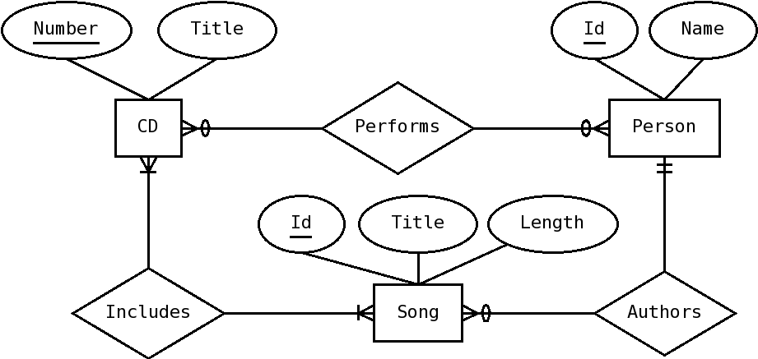
Practice: CD 2

