Slide 1
Advanced ER Concepts

Slide 2

Weak Entities
Don’t have an identifier (identification-dependent)
Different from existence-dependent
Normally, don’t care about entities except as attached to strong
Could add id to make strong
Double lines (also for identifying relationship)
Discriminator is dash-underlined

Slide 3
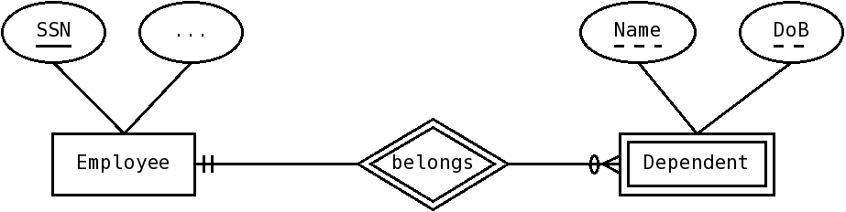
Example: Dependent
Imagine we want to represent an Employee’s kids or dependents,employee may not want to give us the kids SSN
Can represent dependent as weak entity; they don’t have an identifier, but need to distinguish among dependents of same employee

Slide 4
Example: Dependent
Since employee is weak, we use double lines to draw it.
Name and Dob, together, distinguish among dependents of same employee, they’re its discriminator and go dash-underlined
Belongs is the identifying relationship, so has double lines too

Slide 5
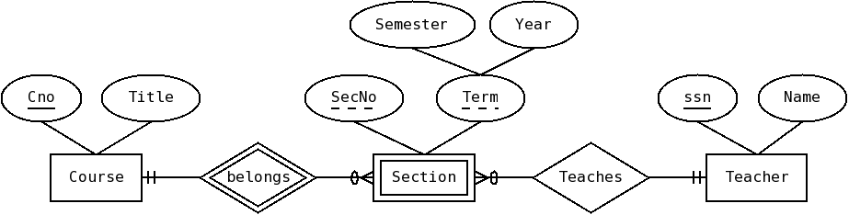
Example: Section
Sections of a course can be represented as weak entities
Weak entities can have other relationships

Slide 6
Quick Check
We want to model information about TV series and their episodes.
  For each series, we keep its id (identifier) and title.
  We keep track of episodes of a series.
  For each episode we keep its number (which is unique among all episodes of the same series, but not among all episodes), title, and the date it first aired.

Slide 7
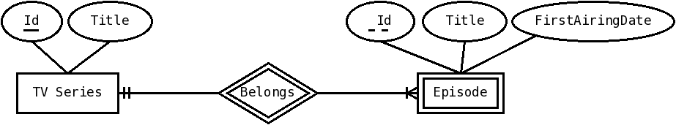
Solution
We want to model information about TV series and their episodes.
  For each series, we keep its id (identifier) and title.
  We keep track of episodes of a series.
  For each episode we keep its number (which is unique among all episodes of the same series, but not among all episodes), title, and the date it first aired.

Slide 8
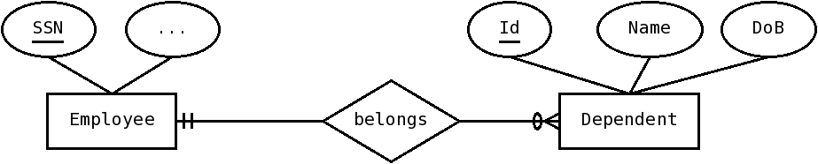
Can make weak strong
Sometimes, it is useful to transform a weak entity into a strong entity
We can just create an identifier for it

Slide 9
Should we make strong ?
Advantages
  Conceptual simplicity (weak entities are harder to understand)
  Eventually, simpler keys (for relational model)
Disadvantages
  Extra attribute
  Extra work (generating it)
  Need to keep track of the constraints separately (the discriminator is unique among weak entities related to the same strong entity)

Slide 10
Associative Entities
Entity that represents an association
Kind of between entity and relationship
Kind of weak entity, depending on more than one entity
Useful mainly for ternary relationships
Notation: Diamond inside square, the associating relationships are just lines

Slide 11
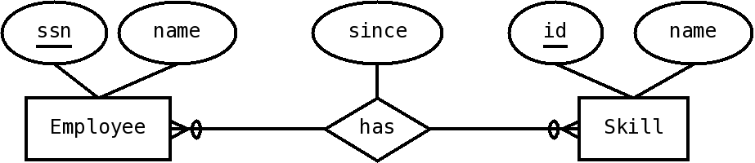
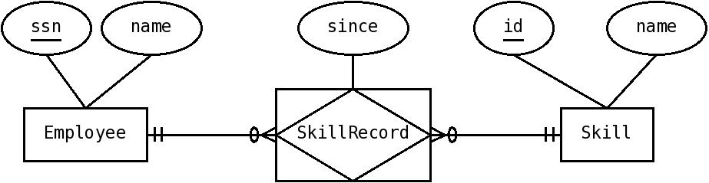
Simple example
Can become

Slide 12
Simple Example
Mechanics
  Associative entity is rectangle with diamond inside
  Name changes from verb to noun
  Lines from associative entity to the entities it associates now represent relationships (with no diamond, to mark them as special)
  Cardinality for those relationships for the associative entity is always exactly one, since each instance represents one association instance

Slide 13
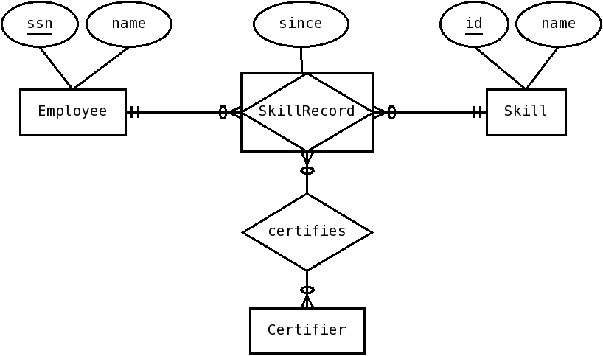
Why ?
Associative entity is an entity, so it can now have other relationships !
Certifies is a normal relationship, so it has a diamond
At most one SkillRecord per Employee-Skill pair

Slide 14
Ternary Relationships
Most relationships are binary, but sometimes we need to relate three (or more :) entities at the same time
Ternary relationships associate 3 entities at the same time
Represent different information that having 3 binary relationships among the pairs of entities
To represent them, we use associative entities
At most ONE relationship instance for each trio of entity instances

Slide 15
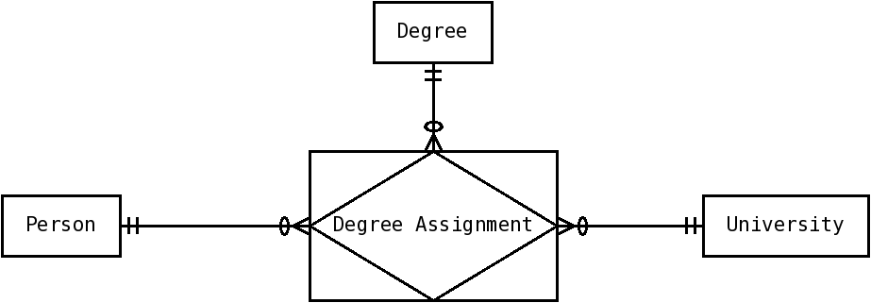
Example: Degree
A person gets a specific Degree from a University
Degree assignment associates, at the same time, the person, degree and university

