Slide 1
From ER to Tables

Slide 2

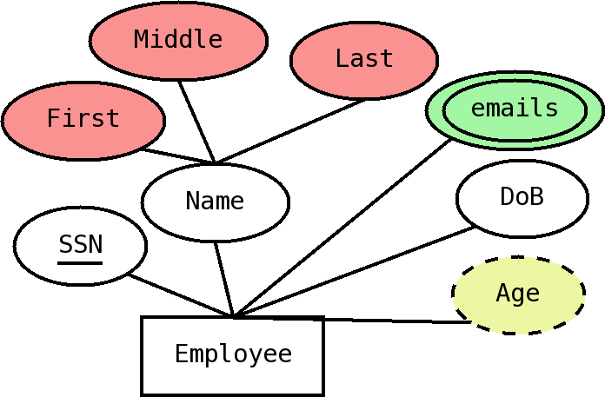
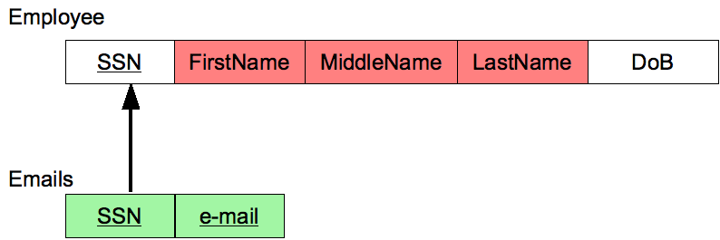
Transforming Entities
Create a new table for each entity
Remember to underline identifier
For composite attributes, map only the basic pieces
Derived attributes disappear
For multivalued attributes we need a new table
  We may need to create several tables for independent multivalued attributes

Slide 3
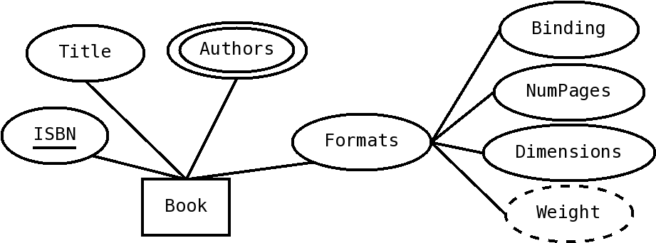
You try

Slide 4
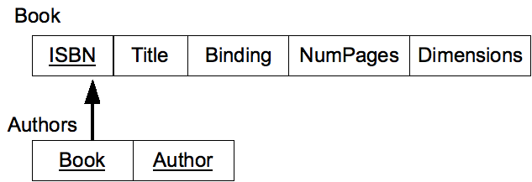
Solution

Slide 5
Corresponding SQL
Notice how we do composite primary key for Authors table
Notice that naming conventions may vary
CREATE TABLE Book (
ISBN NUMERIC(13) PRIMARY KEY,
Title VARCHAR(50),
Binding CHAR(1),
NumPages NUMERIC(4),
Dimensions varchar(20)
);
CREATE TABLE Authors (
Book NUMERIC(13) REFERENCES BOOK(ISBN),
Author VARCHAR(20) ,
PRIMARY KEY(Book,Author)
);

Slide 6
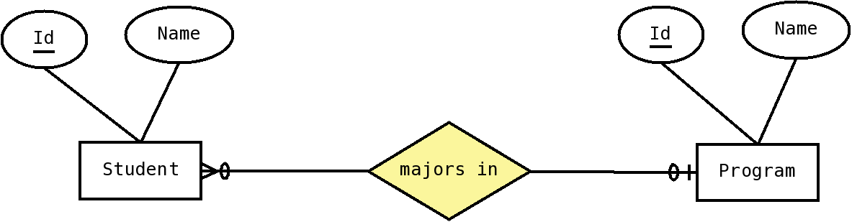
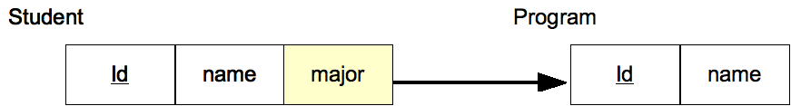
one-to-many relationships
For one-to-many (or one-to-one)relationships, put a foreign key on the side that relates to just one entity
Put any relationship attributes on that same table too.
CREATE TABLE Program (
Id INT PRIMARY KEY,
Name VARCHAR(20)
);
CREATE TABLE Student (
Id INT PRIMARY KEY,
Name VARCHAR(50),
Major INT REFERENCES Program(Id)
);

Slide 7
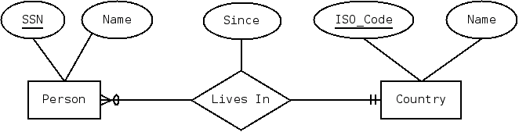
You try it

Slide 8

Solution

Slide 9
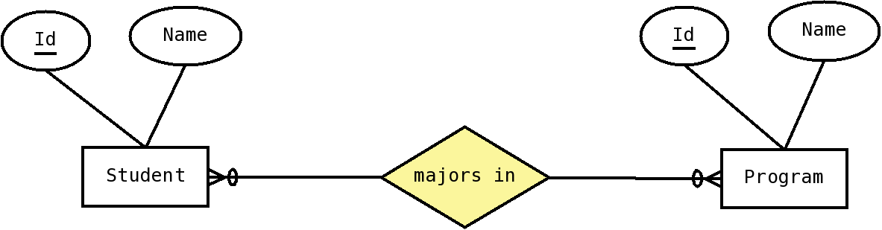
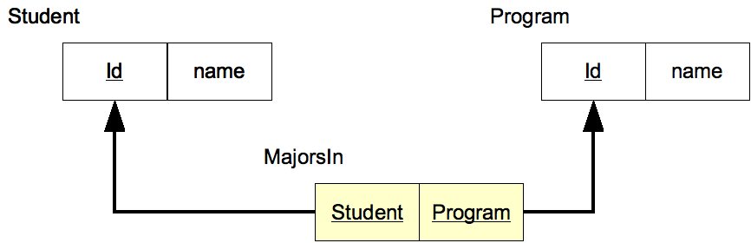
many-to-many relationships
For many-to-many, we need a new table representing the relationship
This table has FKs to both entities

Slide 10
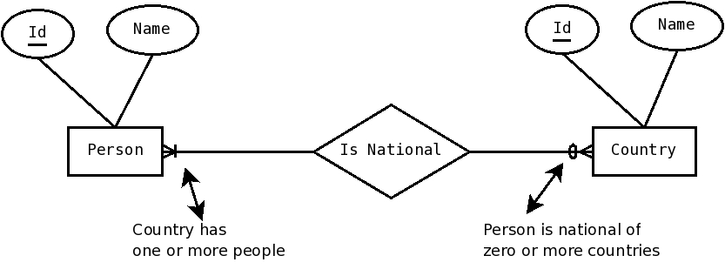
You try

Slide 11
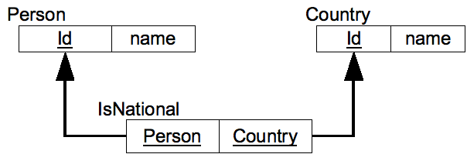
Solution

Slide 12
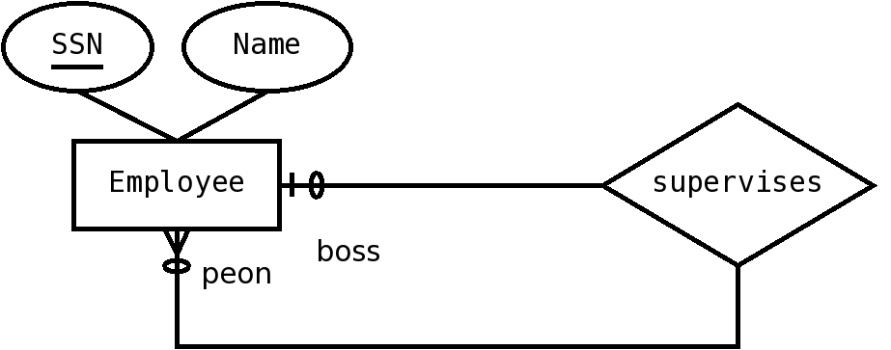
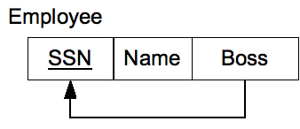
Recursive relationships
Same as other relationships, except that FKs may go to the same table
For one-to-many, the table has a reference to other rows of the same table.
For many-to-many, the extra table has two FKs, both to the same table

Slide 13
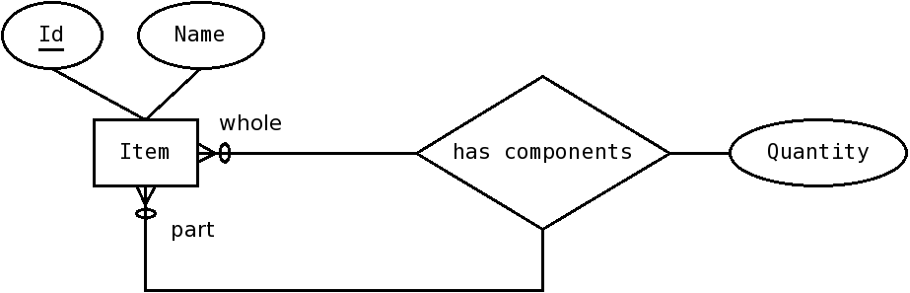
You try

Slide 14
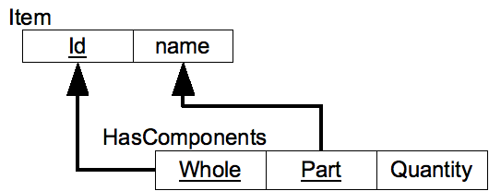
Solution

Slide 15
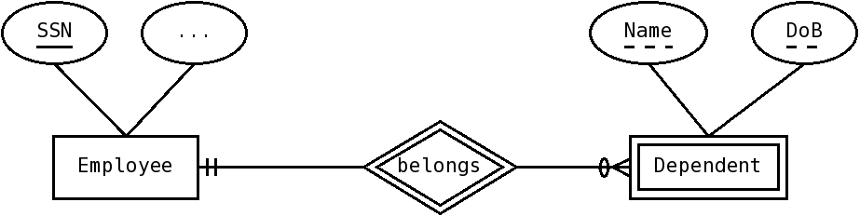
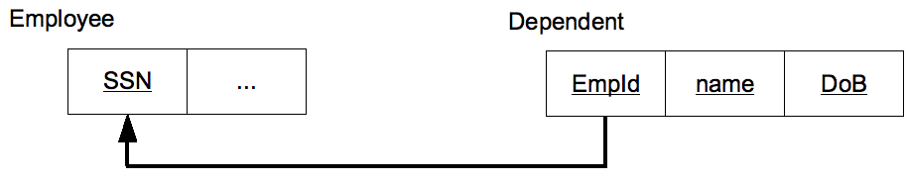
Weak Entities
Transform the strong entity normally
For the weak entity, the primary key becomes the identifier, plus the primary key of the identifying entity
Notice this takes care of the identifying relationship

Slide 16
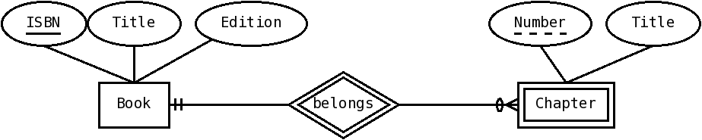
You try it

Slide 17
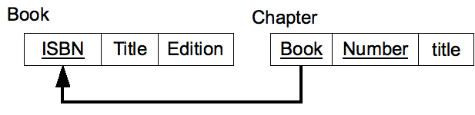
Solution

Slide 18
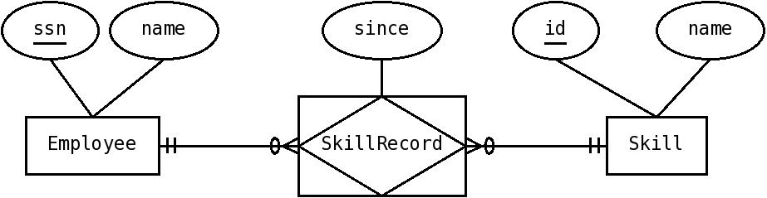
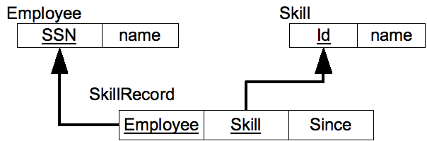
Associative Entities
Make a table for the associative entity
Has FKs to the tables it associates
Its primary key is the combination of the FKs to the entities it associates

Slide 19
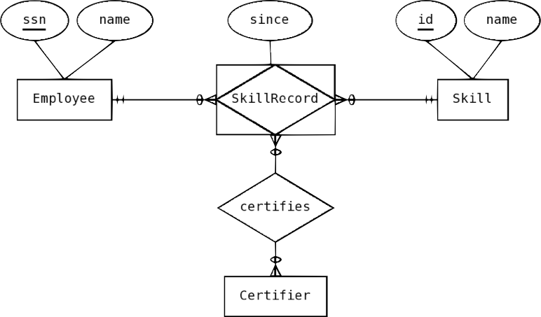
You try

Slide 20
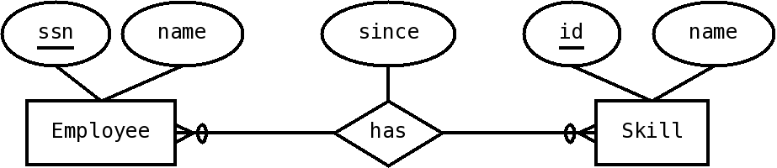
Exercise

Slide 21
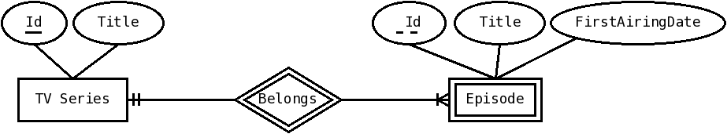
Exercise

Slide 22
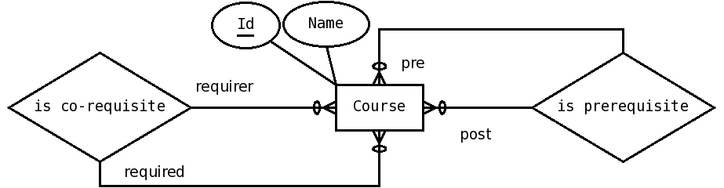
Exercise

Slide 23
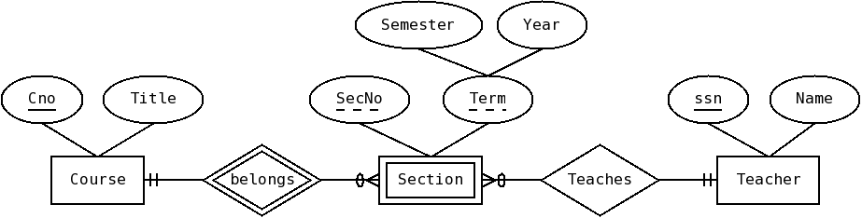
Exercise

Slide 24
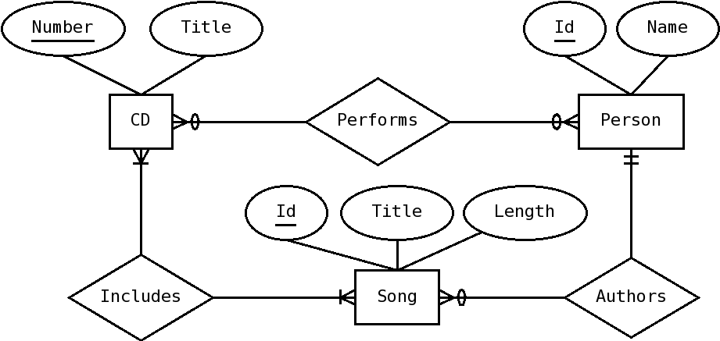
Exercise

