Slide 1




Rehnuma
Interactive chatbot for admission inquiries in ROMAN URDU.
F20-57-R
1

Slide 2

MEET THE TEAM
Rehnuma
OKASHA KHAN
USMAN ZAFAR
i170176@nu.edu.pk
CGPA – 3.43
i160430@nu.edu.pk
CGPA – 3.46
ZAIN-UL-ABIDEEN
i160064@nu.edu.pk
CGPA – 2.76
F20-57-R
2

Slide 3

SUPERVISOR
Rehnuma
CO-SUPERVISOR
MR. UMAIR ARSHAD
umair.arshad@nu.edu.pk
DR. OMER BEG
omer.beg@nu.edu.pk
F20-57-R
3

Slide 4
Research Problem
Project Goals
01
02
03
Rehnuma
OUTLINE
Research gap in Roman Urdu
Intelligent admission inquiries chatbot in Roman Urdu
FYP - 01
Work done in FYP-1
F20-57-R
4

Slide 5
FYP - 02
Methodology
04
05
06
Rehnuma
OUTLINE
Work done in FYP-2
Different techniques and methods used
Results
Accuracy, Precision & F1-Scores
F20-57-R
5

Slide 6
RESEARCH PROBLEM and Goals
Rehnuma
Existing Chatbots are only for resourceful languages
EXISTING CHATBOTS
SCARCITY OF RESOURCES
NLP resources are scarce for resource poor languages
An Intelligent chatbot is required in Roman Urdu
RESEARCH GAP TO BE COVERED
F20-57-R
6

Slide 7
Work Done in FYP - 01
Rehnuma
F20-57-R
7

Slide 8
Rehnuma
No previously available data in Roman Urdu
Intent classification using DIET Classifier and CRF Tagging
Data Collection and Cleaning
Intent Classification
Offensive Lang. & Out of Scope Detection
Static Response Generation
Detection of offensive language and out of scope queries
Giving Pre-Defined answers to user queries
F20-57-R
8

Slide 9
Work done in FYP - 02
Rehnuma
F20-57-R
9

Slide 10
Rehnuma
“Admission ka procedure kia hai?”
“Admision ka procedure kya ha?”
Extracting Entities and giving response according to that entity.
“CS ki total seats kitni hoti hain”
Spell Variation Handling
Dynamic Queries
Follow-Up Questions
Remembering the Context
Will ask user to give more information
Remembers the conversation state
F20-57-R
10

Slide 11
METHODLOGY
Rehnuma
F20-57-R
11

Slide 12
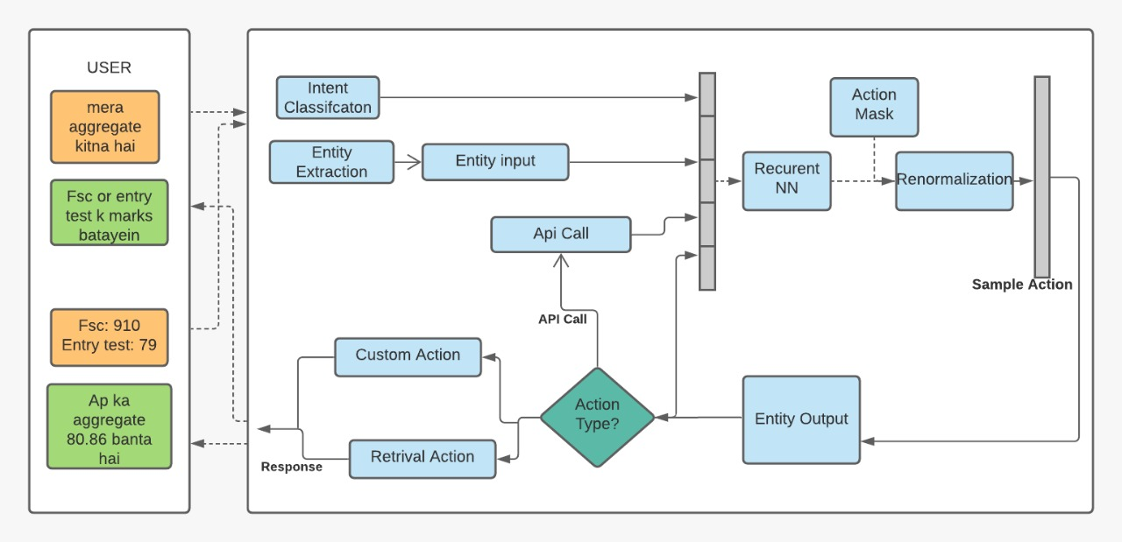
Rehnuma
WhiteSpace Tokanization
LexicalSyntactic Featurization
Regex Featurization
CountVector Featurization
DIET Classification
CRF-Tagging
Synonym Mapping
F20-57-R
12

Slide 13
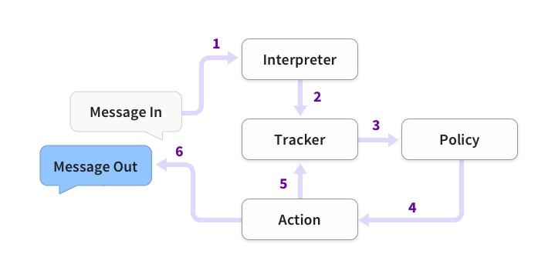
Rehnuma
F20-57-R
13

Slide 14
RESULTS
Rehnuma
F20-57-R
14

Slide 15
INTENTS | 1 | 2 | 3 | 4 | 5 | 6 | 7 | 8 | 9 | 10 | 11
1) Fee | 7
2) Admission Req. |  | 8
3) List Date |  |  | 9 | 1 | 1
4) Closing Merit |  |  | 1 | 9
5) Admission Open |  |  |  |  | 8 |  |  | 1
6) Test |  |  |  |  |  | 6 |  | 1
7)Scholarship | 1 |  |  |  |  |  | 8
8) Programs |  |  |  |  | 1 | 1 |  | 8
9) Hostel |  |  |  |  |  |  |  |  | 10
10) Transport |  |  |  |  |  |  |  |  |  | 9
11) Out of Scope | 2 | 2 |  |  |  | 3 | 2 |  |  | 1 | 10
Rehnuma
F20-57-R
6

Slide 16
Rehnuma
INTENTS | Accuracy | Precision | Recall | F1-Scores
Fee | 0.97 | 1 | 0.7 | 0.82
Admission Req. | 0.98 | 1 | 0.8 | 0.89
List Date | 0.97 | 0.82 | 0.9 | 0.86
Closing Merit | 0.98 | 0.9 | 0.9 | 0.9
Admission Open | 0.97 | 0.89 | 0.8 | 0.84
Test Pattern | 0.95 | 0.86 | 0.6 | 0.71
Scholarship | 0.97 | 0.89 | 0.8 | 0.84
Programs | 0.96 | 0.8 | 0.8 | 0.8
Hostel | 1 | 1 | 1 | 1
Transport | 0.98 | 1 | 0.8 | 0.89
Out of Scope | 0.9 | 0.48 | 1 | 0.65
F20-57-R
16

Slide 17
Rehnuma
F20-57-R
17

Slide 18
Demonstration of the WORK DONE!
Rehnuma
F20-57-R
18

Slide 19
THANKS!
Rehnuma
Do you have any questions?
F20-57-R
19

