Slide 1
Greedy Algorithms
CS 4102: Algorithms
Spring 2011
Aaron Bloomfield

Slide 2
Overview

Slide 3
Inventory of greedy algorithms
Coin change
Knapsack algorithm
Interval scheduling
Prim’s MST
Kruskal’s MST
Dijkstra’s shortest path
Huffman Codes

Slide 4
Greedy Method: Overview
Optimization problems: terminology
A solution must meet certain constraints: A solution is feasible
Example: All edges in solution are in graph, form a simple path
Solutions judged on some criteria: Objective function
Example: Sum of edge weights in path is smallest
One (or more) feasible solutions that scores best (by the objective function) is the optimal solution(s)

Slide 5
Greedy Method: Overview
Greedy strategy:
Build solution by stages, adding one item to partial solution found so far
At each stage, make locally optimal choice based on the greedy rule (sometimes called the selection function)
Locally optimal, i.e. best given what info we have now
Irrevocable, a choice can’t be un-done
Sequence of locally optimal choices leads to globally optimal solution (hopefully)
Must prove this for a given problem!
Approximation algorithms, heuristics

Slide 6
Proving them correct
Given a greedy algorithm, how do you show it is optimal?
As opposed to other types of algorithms (divide-and-conquer , etc.)
One common way is to compare the solution given with an optimal solution

Slide 7
Making Change

Slide 8
Making change: algorithm description
The problem:
Give back the right amount of change, and…
Return the fewest number of coins!
Inputs: the dollar-amount to return
Also, the set of possible coins. (Do we have half-dollars? That affects the answer we give.)
Output: a set of coins

Slide 9
Making change: algorithm solution
Problem description: providing coin change of a given amount in the fewest number of coins
Inputs: the dollar-amount to return. Perhaps the possible set of coins, if it is non-obvious.
Output: a set of coins that obtains the desired amount of change in the fewest number of coins
Assumptions: If the coins are not stated, then they are the standard quarter, dime, nickel, and penny. All inputs are non-negative, and dollar amounts are ignored.
Strategy: a greedy algorithm that uses the largest coins first
Description: Issue the largest coin (quarters) until the amount left is less than the amount of a quarter ($0.25). Repeat with decreasing coin sizes (dimes, nickels, pennies).

Slide 10
Making Change
Inputs:
Value N of the change to be returned
An unlimited number of coins of values d1, d2,.., d_{k}
Output: the smallest possible set of coins that sums to N
Objective function? Smallest set
Constraints on feasible solutions? Must sum to N
Greedy rule: choose coin of largest value that is less than N - Sum(coins chosen so far)
Always optimal? Depends on set of coin values

Slide 11
Algorithm for making change
This algorithm makes change for an amount A using coins of denominations
denom[1] > denom[2] > ··· > denom[n] = 1.
Input Parameters: denom, A
Output Parameters: None
greedy_coin_change(denom, A) {
i = 1
while (A > 0) {
c = A/denom[i]
println(“use ” + c + “ coins of denomination ” + denom[i])
A = A - c * denom[i]
i = i + 1
}
}

Slide 12
Making change proof
Prove that the provided making change algorithm is optimal for denominations 1, 5, and 10
Via induction, and on board -->

Slide 13
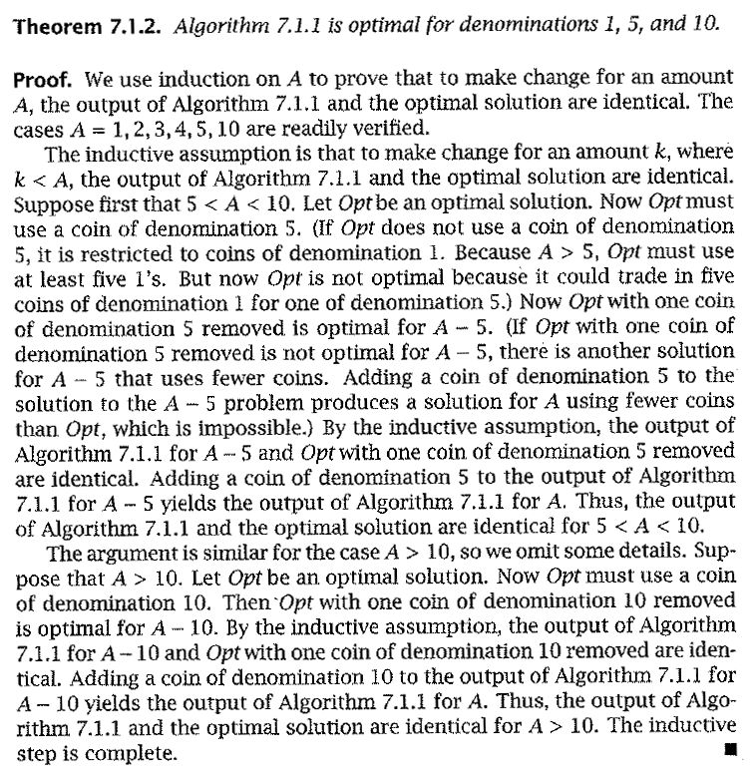
Formal proof
Formal proof of the change problem
Algorithm 7.1.1 is what is presented two slides previously

Slide 14
How would a failed proof work?
Prove that the provided making change algorithm is optimal for denominations 1, 6, and 10
Via induction, and on board -->

Slide 15
Knapsack Algorithm

Slide 16
Knapsack Problems
Inputs:
n items, each with a weight w_{i} and a value v_{i}
capacity of the knapsack, C
Output:
Fractions for each of the n items, x_{i}
Chosen to maximize total profit but not to exceed knapsack capacity

Slide 17
Two Types of Knapsack Problem
0/1 knapsack problem
Each item is discrete. Must choose all of it or none of it. So each x_{i} is 0 or 1
Greedy approach does not produce optimal solutions
But another approach, dynamic programming, does
Continuous knapsack problem
Can pick up fractions of each item
The correct selection function yields a greedy algorithm that produces optimal results

Slide 18
Greedy Rule for Knapsack?
Build up a partial solution by choosing x_{i} for one item until knapsack is full (or no more items). Which item to choose?
There are several choices. Pick one and try on this:
n = 3, C = 20
weights = (18, 15, 10)
values = (25, 24, 15)
What answer do you get?
The optimal answer is: (0, 1, 0.5), total=31.5
Can you verify this?

Slide 19
Possible Greedy Rules for Knapsack
Build up a partial solution by choosing x_{i} for one item until knapsack is full (or no more items). Which item to choose?
Maybe this: take as much as possible of the remaining item that has largest value, v_{i}
Or maybe this: take as much as possible of the remaining items that has smallest weight, w_{i}
Neither of these produce optimal values! The one that does “combines” these two approaches.
Use ratio of profit-to-weight

Slide 20
Example Knapsack Problem
For this example:
n = 3, C = 20
weights = (18, 15, 10)
values = (25, 24, 15)
Ratios = (25/18, 24/15, 15/10) = (1.39, 1.6, 1.5)
The optimal answer is: (0, 1, 0.5)

Slide 21
Continuous knapsack algorithm
a is an array containing the items to be put into the knapsack. Each element has the following fields:
p: the profit for that item
w: the weight for that item
id: the identifier for that item
C is the capacity of the knapsack
What is the running time?
continuous_knapsack(a, C)
n = a.last
for i = 1 to n
ratio[i] = a[i].p / a[i].w
sort (a,ratio)
weight = 0
i = 1
while ( i ≤ n && weight < C )
if ( weight + a[i].w ≤ C )
println (“select all of object “ + a[i].id)
weight = weight + a[i].w
else
r = (C – weight) / a[i].w
println (“select “ + r + “ of object “ + a[i].id)
weight = C
i++

Slide 22
How do we know it’s correct?
Proof time!!!
On board -->

Slide 23
Prim’s MST

Slide 24
Prim’s algorithm
Idea: Grow a tree by adding an edge from the “known” vertices to the “unknown” vertices. Pick the edge with the smallest weight.
G
v
known
Notes:
Pick one node as the root,
Incrementally add edges that connect a “new” vertex to the tree.
Pick the edge (u,v) where u is in the tree, v is not AND
where the edge weight is the smallest of all edges (where u is in the tree and v is not).

Slide 25
Prim’s Algorithm for MST
Pick one node as the root,
Incrementally add edges that connect a “new” vertex to the tree.
Pick the edge (u,v) where:
u is in the tree, v is not AND
where the edge weight is the smallest of all edges (where u is in the tree and v is not).

Slide 26
MST
v1
{v1, v4}
{v1, v2}
{v4, v3}
{v4, v7}
{v7, v6}
{v7, v5}
2
v₂
v₁
4
1
3
10
v₃
2
v₄
7
v₅
5
8
4
6
v₂
v₁
v₆
1
v₇
v₃
v₄
v₅
v₇
v₆

Slide 27
Minimum Spanning Tree
MSTs satisfy the optimal substructure property
If S is an optimal solution to a problem, then the components of S are optimal solutions to sub-problems
Here: an optimal tree is composed of optimal subtrees
Let T be an MST of G with an edge (u,v) in the middle
Removing (u,v) partitions T into two trees T₁ and T₂
Claim: T₁ is an MST of G₁ = (V₁,E₁), and T₂ is an MST of G₂ = (V₂,E₂)
Proof: w(T) = w(u,v) + w(T₁) + w(T₂)
There can’t be a better tree than T₁ or T₂, or T would be suboptimal

Slide 28
Prim’s MST Algorithm
Greedy strategy:
Choose some start vertex as current-tree
Greedy rule: Add edge from graph to current-tree that
has the lowest weight of edges that…
have one vertex in the tree and one not in the tree.
Thus builds-up one tree by adding a new edge to it
Can this lead to an infeasible solution? (Tell me why not.)
Is it optimal? (Yes. Need a proof.)

Slide 29
Tracking Edges for Prim’s MST
Candidates edges: edge from a tree-node to a non-tree node
Since we’ll choose smallest, keep only one candidate edge for each non-tree node
But, may need to make sure we always have the smallest edge for each non-tree node
Fringe-nodes: non-trees nodes adjacent to the tree
Need data structure to hold fringe-nodes
Priority queue, ordered by min-edge weight
May need to update priorities!

Slide 30
Prim’s Algorithm
MST-Prim(G, wt)
init PQ to be empty;
PQ.Insert(s, wt=0);
parent[s] = NULL;
while (PQ not empty)
v = PQ.ExtractMin();
for each w adj to v
if (w is unseen) {
PQ.Insert(w, wt(v,w));
parent[w] = v;
}
else if (w is fringe && wt[v,w] < fringeWt(w)){
PQ.decreaseKey(w, wt[v,w]);
parent[w] = v;
}

Slide 31
Cost of Prim’s Algorithm
(Assume connected graph)
Clearly it looks at every edge, so Ω(n+m)
Is there more?
Yes, priority queue operations
ExtractMin called n times
How expensive? Depends on the size of the PQ
descreaseKey could be called for each edge
How expensive is each call?

Slide 32
Worst Case
If all nodes connected to start, then size of PQ is n-1 right away.
Decreases by 1 for each node selected
Total cost is O(cost of extractMin for size n-1)
Note use of Big-Oh (not Big-Theta)
Could descreaseKey be called a lot?
Yes! Imagine an input that adds all nodes to the PQ at the first step, and then after that calls descreaseKey every possible time. (For you to do.)

Slide 33
Priority Queue Costs and Prim’s
Simplest choice: unordered list
PQ.ExtractMin() is just a “findMin”
Cost for one call is Θ(n)
Total cost for all n calls is Θ(n²)
PQ.decreaseKey() on a node finds it, changes it.
Cost for one call is Θ(n)
But, if we can index an array by vertex number, the cost would be Θ(1). If so, worst-case total cost is Θ(m)
Conclusion: Easy to get Θ(n²)

Slide 34
Better PQ Implementations
Consider using a min-heap for the Priority Queue
PQ.ExtractMin() is O(lg n) each time
Called n times, so like Heap’s Construct: efficient!
What about PQ.decreaseKey() ?
Our need: given a vertex-ID, change the value stored
But our basic heap implementation does not allow look-ups based on vertex-ID!
Solution: Indirect heaps
Heap structure stores indices to data in an array that doesn’t change
Can increase or decrease key in O(lg n) after O(1) lookup

Slide 35
Better PQ Implementations (2)
Use Indirect Heaps for the PQ
PQ.decreaseKey() is O(lg n) also
Called for each edge encountered in MST algorithm
So O(m lg n)
Overall: Might be better: Θ(n²) than if m << n²
Fibonacci heaps: an even more efficient PQ implementation. We won’t cover these.
Θ(m + n lg n)

Slide 36
Kruskal’s MST

Slide 37
Kruskal’s MST Algorithm
Prim’s approach:
Build one tree. Make the one tree bigger and as good as it can be.
Kruskal’s approach
Choose the best edge possible: smallest weight
Not one tree – maintain a forest!
Each edge added will connect two trees. Can’t form a cycle in a tree!
After adding n-1 edges, you have one tree, the MST

Slide 38
Kruskal’s MST Algorithm
Idea: Grow a forest out of edges that do not create a cycle. Pick an edge with the smallest weight.
G=(V,E)
v

Slide 39
MST
2
v₂
v₁
4
1
3
10
v₃
2
v₄
7
v₅
5
8
4
6
v₆
1
v₇
v₁
v₂
v₃
v₄
v₅
v₇
v₆

Slide 40
Kruskal code
void Graph::kruskal(){
int edgesAccepted = 0;
DisjSet s(NUM_VERTICES);
while (edgesAccepted < NUM_VERTICES – 1){
e = smallest weight edge not deleted yet;
// edge e = (u, v)
uset = s.find(u);
vset = s.find(v);
if (uset != vset){
edgesAccepted++;
s.unionSets(uset, vset);
}
}
}
|E| heap ops
2|E| finds
|V| unions

Slide 41
Strategy for Kruskal’s
EL = sorted set of edges ascending by weight
Foreach edge e in EL
T1 = tree for head(e)
T2 = tree for tail(e)
If (T1 != T2)
add e to the output (the MST)
Combine trees T1 and T2
Seems simple, no?
But, how do you keep track of what trees a node is in?
Trees are sets. Need to findset(v) and “union” two sets

Slide 42
kruskal(edgelist,n) {
sort(edgelist)
for i = 1 to n
makeset(i)
count = 0
i = 1
while (count < n - 1) {
if (findset(edgelist[i].v) !=
findset(edgelist[i].w)) {
println(edgelist[i].v + “ ” + edgelist[i].w)
count = count + 1
union(edgelist[i].v,edgelist[i].w)
}
i = i + 1
}
}

Slide 43
Union/Find and Disjoint Sets
Sets stored as a parent array
findset(v): trace upward in parent array
union(i,j): make one tree a child of a node it the other
Improvements!
Union by rank
Path compression

Slide 44
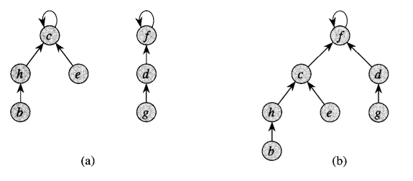
Union by rank

Slide 45
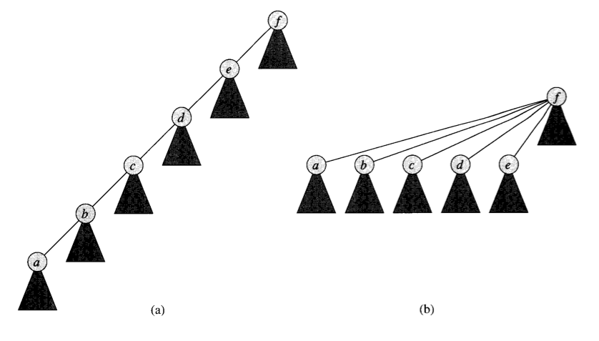
Path Compression

Slide 46
Complexity for Kruskal’s
A basic analysis leads us to Θ(n²)
But with the optimizations presented here, it can be reduced to Θ(m lg m)

Slide 47
Interval Selection

Slide 48
Activity-Selection Problem
Problem: You and your classmates go on Semester at Sea
Many exciting activities each morning
Each starting and ending at different times
Maximize your “education” by doing as many as possible. (They’re all equally good!)
Welcome to the activity selection problem
Also called interval scheduling

Slide 49
The Activities!
Id | Start | End | Activity
1 | 9:00 | 10:45 | Fractals, Recursion and Crayolas
2 | 9:15 | 10:15 | Tropical Drink Engineering with Prof. Bloomfield
3 | 9:30 | 12:30 | Managing Keyboard Fatigue with Swedish Massage
4 | 9:45 | 10:30 | Applied ChemE: Suntan Oil or Lotion?
5 | 9:45 | 11:15 | Optimization, Greedy Algorithms, and the Buffet Line
6 | 10:15 | 11:00 | Hydrodynamics and Surfing
7 | 10:15 | 11:30 | Computational Genetics and Infectious Diseases
8 | 10:30 | 11:45 | Turing Award Speech Karaoke
9 | 11:00 | 12:00 | Pool Tanning for Engineers
10 | 11:00 | 12:15 | Mechanics, Dynamics and Shuffleboard Physics
11 | 12:00 | 12:45 | Discrete Math Applications in Gambling

Slide 50
Generalizing Start, End
Id | Start | End | Len | Activity
1 | 0 | 6 | 7 | Fractals, Recursion and Crayolas
2 | 1 | 4 | 4 | Tropical Drink Engineering with Prof. Bloomfield
3 | 2 | 13 | 12 | Managing Keyboard Fatigue with Swedish Massage
4 | 3 | 5 | 3 | Applied ChemE: Suntan Oil or Lotion?
5 | 3 | 8 | 6 | Optimization, Greedy Algorithms, and the Buffet Line
6 | 5 | 7 | 3 | Hydrodynamics and Surfing
7 | 5 | 9 | 5 | Computational Genetics and Infectious Diseases
8 | 6 | 10 | 5 | Turing Award Speech Karaoke
9 | 8 | 11 | 4 | Pool Tanning for Engineers
10 | 8 | 12 | 5 | Mechanics, Dynamics and Shuffleboard Physics
11 | 12 | 14 | 3 | Discrete Math Applications in Gambling

Slide 51
Greedy Approach
Select a first item.
Eliminate items that are incompatible with that item. (i.e. they overlap.)
Apply the greedy rule (AKA selection function) to pick the next item.
Go to Step 2
What is a good greedy rule for selecting the next item?

Slide 52
Some Possibilities
Pick the next compatible one that starts earliest
Pick the shortest one
Pick the one that has the least conflicts (i.e. overlaps)

Slide 53
Activity-Selection
Formally:
Given a set S of n activities
s_{i} = start time of activity I
f_{i} = finish time of activity i
Find max-size subset A of compatible activities
Assume (wlog) that f₁ ≤ f₂ ≤ … ≤ f_{n}
3
4
6
2
1
5

Slide 54
Activity Selection: A Greedy Algorithm
So actual algorithm is simple:
Sort the activities by finish time
Schedule the first activity
Then schedule the next activity in sorted list which starts after previous activity finishes
Repeat until no more activities
Intuition is even more simple:
Always pick next activity that finishes earliest

Slide 55
Activity Selection: Optimal Substructure
Let k be the minimum activity in A (i.e., the one with the earliest finish time). Then A - {k} is an optimal solution to S’ = {i ∈ S: s_{i} ≥ f_{k}}
In words: once activity #1 is selected, the problem reduces to finding an optimal solution for activity-selection over activities in S compatible with #1
Proof: if we could find optimal solution B’ to S’ with |B| > |A - {k}|,
Then B U {k} is compatible
And |B U {k}| > |A|, which is a contradiction

Slide 56
Back to Semester at Sea…
Id | Start | End | Len | Activity
2 | 1 | 4 | 4 | Tropical Drink Engineering with Prof. Bloomfield
4 | 3 | 5 | 3 | Applied ChemE: Suntan Oil or Lotion?
1 | 0 | 6 | 7 | Fractals, Recursion and Crayolas
6 | 5 | 7 | 3 | Hydrodynamics and Surfing
5 | 3 | 8 | 6 | Optimization, Greedy Algorithms, and the Buffet Line
7 | 5 | 9 | 5 | Computational Genetics and Infectious Diseases
8 | 6 | 10 | 5 | Turing Award Speech Karaoke
9 | 8 | 11 | 4 | Pool Tanning for Engineers
10 | 8 | 12 | 5 | Mechanics, Dynamics and Shuffleboard Physics
3 | 2 | 13 | 12 | Managing Keyboard Fatigue with Swedish Massage
11 | 12 | 14 | 3 | Discrete Math Applications in Gambling
Solution: 2, 6, 9, 11

Slide 57
Visualizing these Activities
ID | Start | End |  | 0 | 1 | 2 | 3 | 4 | 5 | 6 | 7 | 8 | 9 | 10 | 11 | 12 | 13 | 14
1 | 0 | 6
2 | 1 | 4
3 | 2 | 13
4 | 3 | 5
5 | 3 | 8
6 | 5 | 7
7 | 5 | 9
8 | 6 | 10
9 | 8 | 11
10 | 8 | 12
11 | 12 | 14

Slide 58
Visualizing these Activities
ID | Start | End |  | 0 | 1 | 2 | 3 | 4 | 5 | 6 | 7 | 8 | 9 | 10 | 11 | 12 | 13 | 14
1 | 0 | 6
2 | 1 | 4
3 | 2 | 13
4 | 3 | 5
5 | 3 | 8
6 | 5 | 7
7 | 5 | 9
8 | 6 | 10
9 | 8 | 11
10 | 8 | 12
11 | 12 | 14

Slide 59
Sorted, Then Showing Selection and Incompatibilities
ID | Start | End |  | 0 | 1 | 2 | 3 | 4 | 5 | 6 | 7 | 8 | 9 | 10 | 11 | 12 | 13 | 14
2 | 1 | 4
4 | 3 | 5
1 | 0 | 6
6 | 5 | 7
5 | 3 | 8
7 | 5 | 9
8 | 6 | 10
9 | 8 | 11
10 | 8 | 12
3 | 2 | 13
11 | 12 | 14
Select solid-colored item,
Eliminates activities X’d
out of same color

Slide 60
Interval selection algorithm
greedy-interval (s, f)
n = s.length
A = {a₁}
k = 1
for m = 2 to n
if s[m] ≥ f[k]
A = A U {a_{m}}
k = m
return A
s is an array of the intervals’ start times
f is an array of the intervals’ finish times
A is the array of the intervals to schedule
How long does this take?

Slide 61
Proving a greedy algorithm is correct
Show that it fulfills the greedy-choice property
Does making a greedy choice at any arbitrary point yield an optimal solution?
Consider an optimal solution to a sub-problem
Show that making the greedy choice will yield an optimal solution to the overall problem
Show that it has optimal sub-structure
Show that a solution to a problem contains optimal solutions to sub-problems

Slide 62
Warning!
Proving that an algorithm makes a greedy choice at each stage is NOT the same as showing that the algorithm has the greedy choice property
The first is a property of the algorithm designed
The second shows that making the greedy choice will yield an optimal solution to the overall problem

Slide 63
The proof…
The theorem we’ll prove (Cormen 16.1):
Consider any nonempty subproblem S_{k}, and let a_{m} be an activity in S_{k} with the earliest finish time. Them a_{m} is included in some maximum-size subset of mutually compatible activities of S_{k}.
This shows that it fulfills the greedy choice property
The optimal substructure property is shown in slide 30
On board -->

Slide 64
Huffman Codes

Slide 65
Compression Phase
Determine the frequencies of the characters stored in the source file.
Read the source file
Then store the character frequencies in a min-heap
Build a tree of prefix codes (a Huffman code) that determines the unique bit codes for each character.
Write the prefix codes or code tree to the output file.
Re-read the source file and for each character read, write its prefix code into the output file.
You must WRITE the prefix code/tree and the encoded file to the SAME output file

Slide 66
Huffman coding example
From Weiss, page 416
Uses 5 letters (a, e, i, s, t), plus the space and the newline
Total of 58 characters
Normal ASCII encoding is 8 bits per character
58*8 = 464 bits
Which is 58 bytes, obviously
Straight encoding is 3 bits per character
58*3 = 174 bits
Which is 21.75 bytes

Slide 67
Compression step 1 (a)
Determine frequencies of letters
Character | Frequency
a | 10
e | 15
i | 12
s | 3
t | 4
(space) | 13
(newline) | 1
Total | 58

Slide 68
Compression step 1 (b)
Build a min-heap
Sorted by frequency
Character | Frequency
a | 10
e | 15
i | 12
s | 3
t | 4
(space) | 13
(newline) | 1
Total | 58
1: nl
4: t
3: s
15: e
10: i
13: sp
12: i

Slide 69
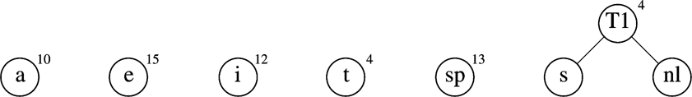
Compression step 2
Build the tree
Start with a “forest” of trees:
Repeat
Take the two trees that have the lowest frequency
The next two removals from the heap
Make them children of a new node
Keep track of the total frequency of that node
And stick that tree back into the heap

Slide 70
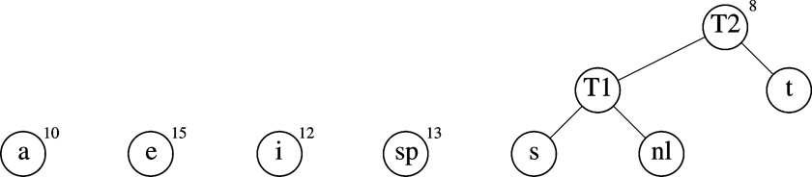
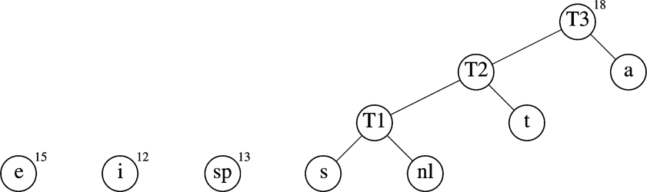

Slide 71
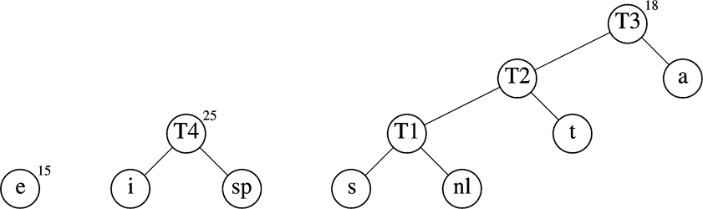
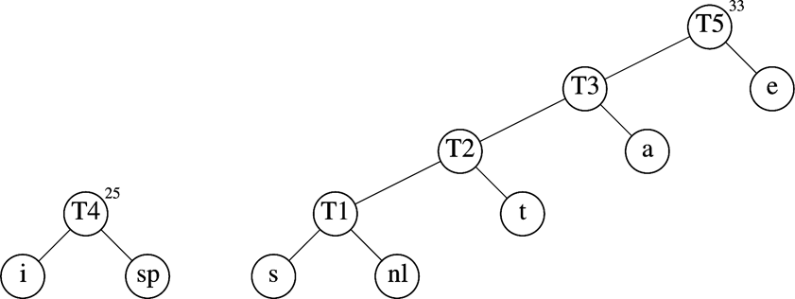

Slide 72
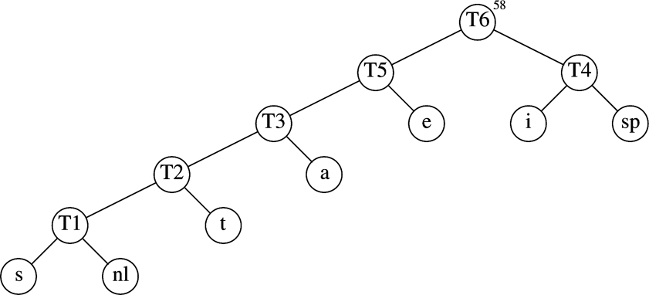
The final Huffman coding tree
Character | Code
a | 001
e | 01
i | 10
s | 00000
t | 0001
(space) | 11
(newline) | 00001

Slide 73
Resulting encoding table
Total encoding is 146 bits
ASCII was 464 bits: compression ratio of 3.2:1
Straight encoding was 174 bits: compression ratio of 1.2:1
Character | Code | Frequency | Total bits
a | 001 | 10 | 30
e | 01 | 15 | 30
i | 10 | 12 | 24
s | 00000 | 3 | 15
t | 0001 | 4 | 16
(space) | 11 | 13 | 26
(newline) | 00001 | 1 | 5
Total |  | 58 | 146

Slide 74
Is Huffman encoding optimal?
First define what optimal means:
The Huffman code for a given alphabet achieves the minimum average number of bits per letter of any prefix code
To prove this, we must first two things:
Optimal sub-structure
Greedy choice property
We’ll show the second one first

Slide 75
Step 1
Lemma 16.2: Let C be an alphabet in which each character c ∈ C has frequency c.freq. Let x and y be two characters in C having the lowest frequencies. Then there exists an optimal prefix code for C in which the codewords for x and y have the same length and differ only in the last bit.
Rephrased: the greedy choice property (of picking the two lowest-frequency nodes) will yield an optimal tree
On board -->
Notes:
Pages 433-435 of Cormen

Slide 76
Step 2
Lemma 16.3: Let C be a given alphabet with frequency c.freq defined for each character c ∈ C. Let x and y be two characters in C with minimum frequency. Let C’ be the alphabet C with the characters x and y removed and a new character z added, so that C’ = C-{x,y}∪{z}. Define f for C’ as for C, except that x.freq = x.freq + y.freq. Let T’ be any tree representing an optimal prefix code for the alphabet C’. Then the tree T, obtained from T’ by replacing the leaf node for z with an internal node having x and y as children, represnts an optimal prefix code for the alphabet C.
Rephrased: constructing prefix codes has the optimal sub-structure property
On board -->
Notes:
Pages 433-435 of Cormen

Slide 77
Dijkstra’s Shortest Path

Slide 78
Weighted Shortest Path
no negative weight edges.
Dijkstra’s algorithm: uses similar ideas as the unweighted case.
Greedy algorithms:
do what seems to be best at every decision point.
v
s
S
“known”
V - S
“unknown”

Slide 79
Dijkstra’s algorithm
Initialize each vertex’s distance as infinity
Start at a given vertex s
Update s’s distance to be 0
Repeat
Pick the next unknown vertex with the shortest distance to be the next v
If no more vertices are unknown, terminate loop
Mark v as known
For each edge from v to adjacent unknown vertices w
If the total distance to w is less than the current distance to w
Update w’s distance and the path to w

Slide 80
v₀
2
v₁
2
1
5
1
1
1
v₂
v₃
v₄
6
5
3
V | Known | Dist | path
v0
v1
v2
v3
v4
v5
v6
2
10
v₅
v₆

Slide 81
void Graph::dijkstra(Vertex s){
Vertex v,w;
s.dist = 0;
while (there exist unknown vertices, find the unknown v with the smallest distance)
v.known = true;
for each w adjacent to v
if (!w.known)
if (v.dist + Cost_VW < w.dist){
w.dist = v.dist + Cost_VW;
w.path = v;
}
}
}

Slide 82
Analysis
How long does it take to find the smallest unknown distance?
simple scan using an array: O(v)
Total running time:
Using a simple scan: O(v²+e) = O(v²)
Optimizations?
Use adjacency graphs and heaps
Assuming that the graph is connected (i.e. e > v-1), then the running time decreases to O(e + v log v)
We can simplify this to O(e log v)

Slide 83
Negative Cost Edges?
Perhaps the graph weights are the amount of fuel expended
Positive means fuel was used
And passing by a fuel station is a refueling, which is a negative cost edge
Dijkstra’s algorithm does not work for negative cost edges
Others do, but are much less efficient
What about negative cost cycles?

Slide 84
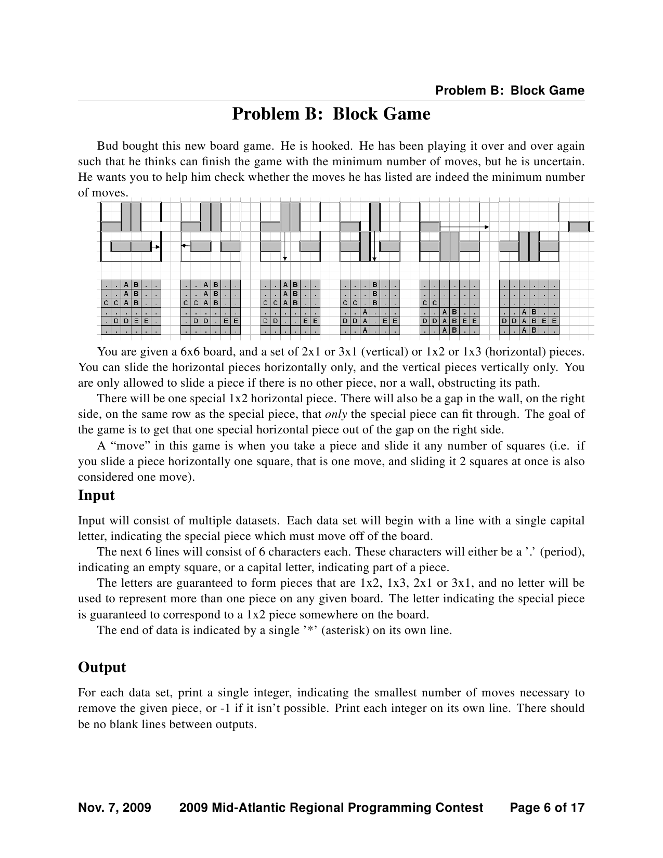
Shortest Path Example Problem (from the ICPC Mid-Atlantic Regionals, 2009)

Slide 85
Dijkstra’s Shortest Path Algorithm
Identical in structure to Prim’s MST algorithm
Of course it solves a different problem!
Same time complexity
Additional input parameter(s)
Start node v
Destination node w (if needed)
Different output: a path from v to w and a cost (or sets of paths and costs)
The tree is the sets of shortest paths to nodes
Different greedy strategy:
Store shortest paths to fringe-nodes in priority queue
Store path-distance to node, not just the one edge-weight

Slide 86
Reminder: Prim’s Algorithm
MST-Prim(G, wt)
init PQ to be empty;
PQ.Insert(s, wt=0);
parent[s] = NULL;
while (PQ not empty){
v = PQ.ExtractMin();
for each w adj to v
if (w is unseen) {
PQ.Insert(w, wt(v,w));
parent[w] = v;
}
else if (w is fringe && wt[v,w] < fringeWt(w)){
PQ.decreaseKey(w, wt[v,w]);
parent[w] = v;
}

Slide 87
Dijkstra' Algorithm
dijkstra(G, wt, s)
init PQ to be empty;
PQ.Insert(s, dist=0);
parent[s] = NULL; dist[s] = 0;
while (PQ not empty)
v = PQ.ExtractMin();
for each w adj to v
if (w is unseen) {
dist[w] = dist[v] + wt(v,w)
PQ.Insert(w, dist[w] );
parent[w] = v;
}
else if (w is fringe && dist[v] + wt(v,w) < dist[w] ) {
dist[w] = dist[v] + wt(v,w)
PQ.decreaseKey(w, dist[w]);
parent[w] = v;
}

Slide 88
Notes on Dijkstra’s Algorithm
Use dist[] to store distances from start to any fringe or tree node
Store and calculate using distances instead of edge-weights (like in Kruskal’s MST)
What’s the output?
Tree captured in the parent[] array
Shortest distance to each node in dist[] array
Trace shortest path in reverse by using parent[] to move from target back to start node, s

Slide 89
dijkstra(adj, start, parent) {
n = adj.last
for i = 1 to n { key[i] = ∞} // key is a local array
key[start] = 0; predecessor[start] = 0
// the following statement initializes the
// container h to the values in the array key
h.init(key,n)
for i = 1 to n {
v = h.min_weight_index()
min_cost = h.keyval(v)
v = h.del()
ref = adj[v]
while (ref != null) {
w = ref.ver
if (h.isin(w) && min_cost + ref.weight < h.keyval(w)) {
predecessor[w] = v
h.decrease(w, min_cost+ref.weight)
} // end if
ref = ref.next
} // end while
} // end for
}

Slide 90
Correctness of These Greedy Algorithms
Recall that the greedy approach may or may not guarantee an optimal result
Do these produce optimal solutions?
The min weight spanning tree? Kruskal’s, Prim’s
The shortest path from s? Dijkstra’s
Answer: Yes, they do.

Slide 91
Proof of Dijkstra’s algorithm
Via induction and contradiction
On board -->

Slide 92
Conclusion

Slide 93
Greedy algorithm summary
Algorithms we saw:
Coin change
Knapsack algorithm
Interval scheduling
Prim’s MST
Kruskal’s MST
Dijkstra’s shortest path
Huffman Codes

Slide 94
Greedy Method: Overview
Optimization problems: terminology
Solutions judged on some criteria: Objective function
Example: Sum of edge weights in path is smallest
A solution must meet certain constraints: A solution is feasible
Example: All edges in solution are in graph, form a simple path
One (or more) feasible solutions that scores highest (by the objective function) is the optimal solution(s)

Slide 95
Greedy Method: Overview
Greedy strategy:
Build solution by stages, adding one item to partial solution found so far
At each stage, make locally optimal choice based on the greedy rule (sometimes called the selection function)
Locally optimal, i.e. best given what info we have now
Irrevocable, a choice can’t be un-done
Sequence of locally optimal choices leads to globally optimal solution (hopefully)
Must prove this for a given problem!
Approximation algorithms, heuristics

Slide 96
Proving them correct
Given a greedy algorithm, how do you show it is optimal?
As opposed to other types of algorithms (divide-and-conquer , etc.)
One way is to compare the solution given with an optimal solution
Another way is through induction

Slide 97
Proving a greedy algorithm is correct
Show that it fulfills the greedy-choice property
Does making a greedy choice at any arbitrary point yield an optimal solution?
Consider an optimal solution to a sub-problem
Show that making the greedy choice will yield an optimal solution to the overall problem
Show that it has optimal sub-structure
Show that a solution to a problem contains optimal solutions to sub-problems
Or induction!

Slide 98
Warning!
Proving that an algorithm makes a greedy choice at each stage is NOT the same as showing that the algorithm has the greedy choice property
The first is a property of the algorithm designed
The second shows that making the greedy choice will yield an optimal solution to the overall problem

