Slide 1
Dynamic Programming
CS 4102
Spring 2011
Aaron Bloomfield

Slide 2
Introduction

Slide 3
Dynamic programming
Old “bad” name (see Wikipedia or textbook)
It is used, when the solution can be recursively described in terms of solutions to sub-problems (optimal substructure)
Algorithm finds solutions to sub-problems and stores them in memory for later use
More efficient than “brute-force methods”, which solve the same sub-problems over and over again

Slide 4
Optimal Substructure Property
Definition
If S is an optimal solution to a problem, then the components of S are optimal solutions to subproblems
Examples:
True for knapsack
True for coin-changing
True for single-source shortest path
Not true for longest-simple-path

Slide 5
Dynamic Programming
Works “bottom-up”
Finds solutions to small sub-problems first
Stores them
Combines them somehow to find a solution to a slightly larger sub-problem
Compare to greedy approach
Also requires optimal substructure
But greedy makes choice first, then solves
Greedy looks only at the current situation, not at a past ‘history’

Slide 6
Problems Solved with Dyn. Prog.
Coin changing with non-easy coin selection
Longest common subsequence
All-pairs shortest paths (Floyd’s algorithm)
Knapsack problem (we’ll do 0/1)
And ones we might not get to:
Constructing optimal binary search trees
Multiplying a sequence of matrices
Can do in various orders: (AB)C vs. A(BC)
Pick order that does fewest number of scalar multiplications

Slide 7
Memoization
Before talking about dynamic programming, another general technique: Memoization
AKA using a memory function
Simple idea:
Calculate and store solutions to sub-problems
Before solving it (again), look to see if you’ve remembered it

Slide 8
Memoization
Use a Table abstract data type
Lookup key: whatever identifies a sub-problem
Value stored: the solution
Could be an array/vector
E.g. for Fibonacci, store fib(n) using index n
Need to initialize the array
Could use a map / hash-table

Slide 9
Fibonacci

Slide 10
Remember Fibonacci numbers?
Recursive code: long fib(int n) { assert( >= 0); if ( n == 0 ) return 0; if ( n == 1 ) return 1; return fib(n-1) + fib(n-2); }
What’s the problem?
Repeatedly solves the same sub-problems
“Obscenely” exponential

Slide 11
Memoization and Fibonacci
Before recursive code below called, must initialize results[] so all values are -1
long fib_mem(int n, long results[]) { if ( results[n] != -1 ) return results[n]; // return stored value longval; if ( n == 0 || n ==1 ) val = n; // odd but right else val = fib_mem(n-1, results) + fib_mem(n-2, results); results[n] = val; // store calculated value return val; }

Slide 12
Observations on fib_mem()
Same elegant top-down, recursive approach based on definition
Without repeated subproblems
Memory function: a function that remembers
Save time by using extra space
Can show this runs in Θ(n)

Slide 13
Memoization and Functional Languages
Languages like Lisp and Scheme are functional languages
How could memoization help?
What could go wrong? Would this always work?
Side effects
Haskell does this (call-by-need)
Notes:
From:
http://en.wikipedia.org/wiki/Dynamic_programming
Some functional programming languages, most notably Haskell, can automatically memoize the result of a function call with a particular set of arguments, in order to speed up call-by-name evaluation (this mechanism is referred to as call-by-need). This is only possible for a function which has no side-effects, which is always true in Haskell but seldom true in imperative languages.

Slide 14
General Strategy of Dyn. Prog.
Structure: What’s the structure of an optimal solution in terms of solutions to its sub-problems?
Give a recursive definition of an optimal solution in terms of optimal solutions to smaller problems
Usually using min or max
Use a data structure (often a table) to store smaller solutions in a bottom-up fashion
Optimal value found in the table
(If needed) Reconstruct the optimal solution
I.e. what produced the optimal value

Slide 15
Dyn. Prog. vs. Divide and Conquer
Remember divide and conquer?
Divide into sub-problems. Solve each. Combine.
Good when sub-problems do not overlap, when they’re independent
No need to repeat them
Divide and conquer: top-down
Dynamic programming: bottom-up

Slide 16
0/1 Knapsack

Slide 17
Knapsack Problem
Recall the Knapsack problem
You are given a number of items, each with a weight and a value
And a container (knapsack) that has a maximum capacity
How can you best pick the items to put in the knapsack?
There are two variations:
Continuous knapsack: you can pick parts of each tiem
0/1 knapsack: you must choose all or none of each item

Slide 18
Continuous knapsack
Greedy solution:
Starting at the item with the highest ratio of value to weight, pick as much of that item as you can
Continue until the knapsack is filled
Consider a knapsack with capacity 4 and the items in the table shown
Greedy solution: pick all of item 1 (ratio 3), then all of item 2 (ratio 2.5), then as
much of item 3 as will fit (1/3)
Total value is 10
Item | Value | Weight | Ratio
1 | 3 | 1 | 3
2 | 5 | 2 | 2.5
3 | 6 | 3 | 2

Slide 19
0/1 knapsack
Using the greedy solution with the 0/1 version
Capacity is still 4
Greedy solution: pick all of item 1 (ratio 3), then all of item 2 (ratio 2.5), and then no (complete) more items will fit
Total value is 8
But picking items 1 and 3 will fit, and will give a total value of 4
Thus, the greedy solution does not produce an optimal solution to the 0/1 knapsack algorithm
Item | Value | Weight | Ratio
1 | 3 | 1 | 3
2 | 5 | 2 | 2.5
3 | 6 | 3 | 2

Slide 20
Dynamic programming solution to 0/1
A dynamic programming solution can be designed that produces the optimal answer. To do this, we must:
Identify a recursive definition of how a larger solution is built from optimal results for smaller sub-problems.
Create a table that we can build bottom-up to calculate results for sub-problems and eventually solve the entire problem.
How can we break an entire problem down into sub-problems in a way that uses optimal results of sub-problems?
First we need to make sure we have a clear idea of what a sub-problem solution might look like.

Slide 21
Some assumptions and observations
Given a set S of the objects and a capacity W
We assume the optimal solution is O, a subset of S
For example, the items in O could be the bolded ones: S = { s₁, s₂, s₃, …, s_{k-1}, s_{k}, …, s_{n} }
Note that O – { s_{k} } is an optimal solution for S_{k-1} = { s₁, …, s_{k-1} } and knapsack capacity W-w_{k}
Or the value calculated for S_{k-1} plus v_{k}
We assume W and all w_{i} are integer values

Slide 22
The dynamic programming
Our table will contain the optimal solutions of the sub-problems of the first k items with capacity w
In other words, we are computing V[k,w]
k ranges from 0 to n
w ranges from 0 to W
V[k,w] | w = 0 | w = 1 | w = 2 | … | w = W
k = 0
k = 1
k = 2
…
k = n

Slide 23
Initial values
If k = 0 (i.e. there are no items to place in the backpack), then the value of the (zero) items in the knapsack is 0
If w = 0 (i.e. there is zero backpack capacity), then we can’t place any items inside, and the value of the items in the knapsack is 0
V[k,w] | w = 0 | w = 1 | w = 2 | … | w = W
k = 0 | 0 | 0 | 0 | 0 | 0
k = 1 | 0
k = 2 | 0
… | 0
k = n | 0

Slide 24
Three cases to calculate V[k,w]
Three cases for calculating V[k,w]:
There is sufficient capacity to add item sk to the knapsack, and that creates an optimal solution for k items
There is sufficient capacity to add item sk to the knapsack, and that does NOT creates an optimal solution for k items
There is insufficient capacity to add item sk to the knapsack
Case 3 is easy to determine; we’ll have to compute whether 1 or 2 is optimal

Slide 25
Case 1: sufficient capacity, optimal
There is sufficient capacity to add item sk to the knapsack, and that creates an optimal solution for k items
Thus, our solution for the first k items is when we add item s_{k} to the solution for the first k-1 items
But by adding item s_{k} to the knapsack, we have less weight
In particular, w-w_{k}
So the value for V[k,w] = v_{k} + V[k-1, w-w_{k}]

Slide 26
Case 2: sufficient capacity, non-optimal
There is sufficient capacity to add item sk to the knapsack, and that does NOT creates an optimal solution for k items
Thus, our solution for the first k items is when we do NOT add item s_{k} to the solution for the first k-1 items
Since we are not adding item s_{k} to the knapsack, the solution is the same as the first k-1 items with the same weight
So V[k,w] = V[k-1,w]

Slide 27
Case 3: insufficient capacity
There is insufficient capacity to add item s_{k} to the knapsack
This is because w-w_{k} < 0 (i.e. w < w_{k})
Then V[k,w] = V[k-1,w]
Since we can’t add item s_{k} to the knapsack, the solution is the same as the first k-1 items with the same weight
Note that this is the same as case 2

Slide 28
Determining the cases
To determine between cases 1 and 2
Simply compute both values, and take the higher
if (w-w_{k}< 0) // not room for item k
V[k,w] = V[k-1,w] // best result for k-1 items
else {
val_with_kth = v_{k} + V[k-1, w-w_{k}] // Case 1 above
val_for_k-1 = V[k-1,w] // Case 2 above
V[k,w] = max( val_with_kth, val_for_k-1 )
}

Slide 29
Filling in the table
The table fills in one row at a time, moving rightwards and downwards
V[k,w] | w = 0 | w = 1 | w = 2 | … | w = W
k = 0 | 0 | 0 | 0 | 0 | 0
k = 1 | 0
k = 2 | 0
… | 0
k = n | 0

Slide 30
Pseudo-code
Knapsack(v, w, W) {
for (w = 0 to W) V[0,w] = 0
for (k = 0 to n) V[k,0] = 0
for (k = 1to n) {
for (w = 1 to W) {
if (w-wk< 0) // not room for item k
V[k,w] = V[k-1,w] // best result for k-1 items
else {
val_with_kth = vk + V[k-1, w-wk] // Case 1 above
val_for_k-1 = V[k-1,w] //best result for k-1 items
V[k,w] = max( val_with_kth, val_for_k-1 )
}
}
}
return V[n,W]
}

Slide 31
But our solution is only the value!
We don’t know the items in the knapsack
To figure this out, we have to trace backward through the table
If V[k,w] = V[k-1,w], then s_{k} is not an item in the knapsack (this was from cases 2 and 3)
Otherwise, s_{k} is an item in the knapsack, and we look at V[k-1,w-w_{k}] next (this was from case 1)

Slide 32
Longest Common Subsequence

Slide 33

Application: DNA testing
A DNA sequence is a series of nucleotides (ACGT)
One compares DNA for:
Maternity/paternity testing
Finding how similar a newly found gene is to existing known genes
Find what breeds are in your dog through DNA testing
One way to do this is by finding the longest common set of nucleotides
And that algorithm better be efficient, since there are a lot of DNA nucleotides…

Slide 34
Longest Common Subsequence (LCS)
Application: comparison of two DNA strings
Ex: X= {A B C B D A B }, Y= {B D C A B A}
Longest Common Subsequence:
X = A B C B D A B
Y = B D C A B A
Brute force algorithm would compare each subsequence of X with the symbols in Y

Slide 35
LCS Algorithm
if |X| = m, |Y| = n, then there are 2^{m} subsequences of X; we must compare each with Y (n comparisons)
So the running time of the brute-force algorithm is O(n 2^{m})
Notice that the LCS problem has optimal substructure: solutions of sub-problems are parts of the final solution.
Sub-problems: “find LCS of pairs of prefixes of X and Y”
Notes:
Illustration:
From previous slide:
X = A B C B D A B
Y = B D C A B A
X_3, a prefix of X: ABC
Y_4, a prefix of Y: BDCA
Optimal solution for these is: BC

Slide 36
LCS Algorithm
First we’ll find the length of LCS. Later we’ll modify the algorithm to find LCS itself.
Define X_{i}, Y_{j} to be the prefixes of X and Y of length i and j respectively
Define c[i,j] to be the length of LCS of X_{i} and Y_{j}
Then the (integer) length of LCS of X and Y will be c[m,n]

Slide 37
LCS recursive solution
We start with i = j = 0 (empty substrings of x and y)
Since X₀ and Y₀ are empty strings, their LCS is always empty (i.e. c[0,0] = 0)
LCS of empty string and any other string is empty, so for every i and j: c[0, j] = c[i,0] = 0

Slide 38
LCS recursive solution
When we calculate c[i,j], we consider two cases:
First case: x[i]=y[j]: one more symbol in strings X and Y matches, so the length of LCS X_{i} and Y_{j} equals to the length of LCS of smaller strings X_{i-1} and Y_{i-1} , plus 1

Slide 39
LCS recursive solution
Second case: x[i] != y[j]
As symbols don’t match, our solution is not improved, and the length of LCS(X_{i} , Y_{j}) is the same as before (i.e. maximum of LCS(X_{i}, Y_{j-1}) and LCS(X_{i-1},Y_{j})
Why not just take the length of LCS(X_{i-1}, Y_{j-1}) ?

Slide 40
LCS Length Algorithm
LCS-Length(X, Y)
m = length(X) // get the # of symbols in X
n = length(Y) // get the # of symbols in Y
for i = 1 to m c[i,0] = 0 // special case: Y₀
for j = 1 to n c[0,j] = 0 // special case: X₀
for i = 1 to m // for all X_{i}
for j = 1 to n // for all Y_{j}
if ( X_{i} == Y_{j} )
c[i,j] = c[i-1,j-1] + 1
else
c[i,j] = max( c[i-1,j], c[i,j-1] )
return c[m,n] // return LCS length for X and Y

Slide 41
LCS Example
We’ll see how LCS algorithm works on the following example:
X = ABCB
Y = BDCAB
What is the Longest Common Subsequence of X and Y?
LCS(X, Y) = BCB
X = A B C B
Y = B D C A B

Slide 42
LCS Example (0)
ABCB
BDCAB
j 0 1 2 3 4 5
i
Yj
B
D
C
A
B
0
Xi
A
1
2
B
3
C
4
B
X = ABCB; m = |X| = 4
Y = BDCAB; n = |Y| = 5
Allocate array c[5,4]

Slide 43
LCS Example (1)
ABCB
BDCAB
j 0 1 2 3 4 5
i
Yj
B
D
C
A
B
0
Xi
0
0
0
0
0
0
A
1
0
2
B
0
3
C
0
4
B
0
for i = 1 to m c[i,0] = 0
for j = 1 to n c[0,j] = 0

Slide 44
LCS Example (2)
ABCB
BDCAB
j 0 1 2 3 4 5
i
Yj
B
D
C
A
B
0
Xi
0
0
0
0
0
0
A
1
0
0
2
B
0
3
C
0
4
B
0
if ( X_{i} == Y_{j} )
c[i,j] = c[i-1,j-1] + 1
else c[i,j] = max( c[i-1,j], c[i,j-1] )

Slide 45
LCS Example (3)
ABCB
BDCAB
j 0 1 2 3 4 5
i
Yj
B
D
C
A
B
0
Xi
0
0
0
0
0
0
A
1
0
0
0
0
2
B
0
3
C
0
4
B
0
if ( X_{i} == Y_{j} )
c[i,j] = c[i-1,j-1] + 1
else c[i,j] = max( c[i-1,j], c[i,j-1] )

Slide 46
LCS Example (4)
ABCB
BDCAB
j 0 1 2 3 4 5
i
Yj
B
D
C
A
B
0
Xi
0
0
0
0
0
0
A
1
0
0
0
0
1
2
B
0
3
C
0
4
B
0
if ( X_{i} == Y_{j} )
c[i,j] = c[i-1,j-1] + 1
else c[i,j] = max( c[i-1,j], c[i,j-1] )

Slide 47
LCS Example (5)
ABCB
BDCAB
j 0 1 2 3 4 5
i
Yj
B
D
C
A
B
0
Xi
0
0
0
0
0
0
A
1
0
0
0
0
1
1
2
B
0
3
C
0
4
B
0
if ( X_{i} == Y_{j} )
c[i,j] = c[i-1,j-1] + 1
else c[i,j] = max( c[i-1,j], c[i,j-1] )

Slide 48
LCS Example (6)
ABCB
BDCAB
j 0 1 2 3 4 5
i
Yj
B
D
C
A
B
0
Xi
0
0
0
0
0
0
A
1
0
0
0
0
1
1
2
B
0
1
3
C
0
4
B
0
if ( X_{i} == Y_{j} )
c[i,j] = c[i-1,j-1] + 1
else c[i,j] = max( c[i-1,j], c[i,j-1] )

Slide 49
LCS Example (7)
ABCB
BDCAB
j 0 1 2 3 4 5
i
Yj
B
D
C
A
B
0
Xi
0
0
0
0
0
0
A
1
0
0
0
0
1
1
2
B
0
1
1
1
1
3
C
0
4
B
0
if ( X_{i} == Y_{j} )
c[i,j] = c[i-1,j-1] + 1
else c[i,j] = max( c[i-1,j], c[i,j-1] )

Slide 50
LCS Example (8)
ABCB
BDCAB
j 0 1 2 3 4 5
i
Yj
B
D
C
A
B
0
Xi
0
0
0
0
0
0
A
1
0
0
0
0
1
1
2
B
0
1
1
1
1
2
3
C
0
4
B
0
if ( X_{i} == Y_{j} )
c[i,j] = c[i-1,j-1] + 1
else c[i,j] = max( c[i-1,j], c[i,j-1] )

Slide 51
LCS Example (10)
ABCB
BDCAB
j 0 1 2 3 4 5
i
Yj
B
D
C
A
B
0
Xi
0
0
0
0
0
0
A
1
0
0
0
0
1
1
2
B
0
1
1
1
1
2
3
C
0
1
1
4
B
0
if ( X_{i} == Y_{j} )
c[i,j] = c[i-1,j-1] + 1
else c[i,j] = max( c[i-1,j], c[i,j-1] )

Slide 52
LCS Example (11)
ABCB
BDCAB
j 0 1 2 3 4 5
i
Yj
B
D
C
A
B
0
Xi
0
0
0
0
0
0
A
1
0
0
0
0
1
1
2
B
0
1
1
1
1
2
3
C
0
1
1
2
4
B
0
if ( X_{i} == Y_{j} )
c[i,j] = c[i-1,j-1] + 1
else c[i,j] = max( c[i-1,j], c[i,j-1] )

Slide 53
LCS Example (12)
ABCB
BDCAB
j 0 1 2 3 4 5
i
Yj
B
D
C
A
B
0
Xi
0
0
0
0
0
0
A
1
0
0
0
0
1
1
2
B
0
1
1
1
1
2
3
C
0
1
1
2
2
2
4
B
0
if ( X_{i} == Y_{j} )
c[i,j] = c[i-1,j-1] + 1
else c[i,j] = max( c[i-1,j], c[i,j-1] )

Slide 54
LCS Example (13)
ABCB
BDCAB
j 0 1 2 3 4 5
i
Yj
B
D
C
A
B
0
Xi
0
0
0
0
0
0
A
1
0
0
0
0
1
1
2
B
0
1
1
1
1
2
3
C
0
1
1
2
2
2
4
B
0
1
if ( X_{i} == Y_{j} )
c[i,j] = c[i-1,j-1] + 1
else c[i,j] = max( c[i-1,j], c[i,j-1] )

Slide 55
LCS Example (14)
ABCB
BDCAB
j 0 1 2 3 4 5
i
Yj
B
D
C
A
B
0
Xi
0
0
0
0
0
0
A
1
0
0
0
0
1
1
2
B
0
1
1
1
1
2
3
C
0
1
1
2
2
2
4
B
0
1
1
2
2
if ( X_{i} == Y_{j} )
c[i,j] = c[i-1,j-1] + 1
else c[i,j] = max( c[i-1,j], c[i,j-1] )

Slide 56
LCS Example (15)
ABCB
BDCAB
j 0 1 2 3 4 5
i
Yj
B
D
C
A
B
0
Xi
0
0
0
0
0
0
A
1
0
0
0
0
1
1
2
B
0
1
1
1
1
2
3
C
0
1
1
2
2
2
4
B
3
0
1
1
2
2
if ( X_{i} == Y_{j} )
c[i,j] = c[i-1,j-1] + 1
else c[i,j] = max( c[i-1,j], c[i,j-1] )

Slide 57
LCS Algorithm Running Time
LCS algorithm calculates the values of each entry of the array c[m,n]
So what is the running time?
O(m*n)
since each c[i,j] is calculated in constant time, and there are m*n elements in the array

Slide 58
How to find actual LCS
So far, we have just found the length of LCS, but not LCS itself.
We want to modify this algorithm to make it output Longest Common Subsequence of X and Y
Each c[i,j] depends on c[i-1,j] and c[i,j-1]
or c[i-1, j-1]
For each c[i,j] we can say how it was acquired:
For example, here c[i,j] = c[i-1,j-1] +1 = 2+1=3
2
2
2
3

Slide 59
How to find actual LCS - continued
Remember that
So we can start from c[m,n] and go backwards
Look first to see if second case above was true
If not, then c[i,j] = c[i-1, j-1]+1, so remember x[i] (because x[i] is a part of LCS)
When i=0 or j=0 (i.e. we reached the beginning), output remembered letters in reverse order

Slide 60
Algorithm to find actual LCS
Here’s a recursive algorithm to do this: LCS_print(x, m, n, c){ if (c[m][n] == c[m-1][n]) // go up? LCS_print(x, m-1, n, c); else if (c[m][n] == c[m][n-1] // go left? LCS_print(x, m, n-1, c); else { // it was a match! LCS_print(x, m-1, n-1, c); print(x[m]); // print after recursive call } }

Slide 61
Finding LCS
j 0 1 2 3 4 5
i
Yj
B
D
C
A
B
0
Xi
0
0
0
0
0
0
A
1
0
0
0
0
1
1
2
B
0
1
1
1
1
2
3
C
0
1
1
2
2
2
4
B
3
0
1
1
2
2

Slide 62
Finding LCS (2)
j 0 1 2 3 4 5
i
Yj
B
D
C
A
B
0
Xi
0
0
0
0
0
0
A
1
0
0
0
0
1
1
2
B
0
1
1
1
1
2
3
C
0
1
1
2
2
2
4
B
3
0
1
1
2
2
LCS (reversed order):
B
C
B
B C B
(this string turned out to be a palindrome)
LCS (straight order):

Slide 63
Weighted Interval Scheduling

Slide 64
Weighted Interval Scheduling
Recall Interval Scheduling:
Given a list of intervals pick a schedule of non-overlapping intervals that maximizes the number chosen
i.e. each one has the same value
Weighted interval scheduling is similar, but…
Each interval has a different value

Slide 65
Greedy solution to interval scheduling
The algorithm:
Sort the activities by finish time
Schedule the first activity
Then schedule the next activity in sorted list which starts after previous activity finishes
Repeat until no more activities
Intuition is even more simple:
Always pick next activity that finishes earliest

Slide 66
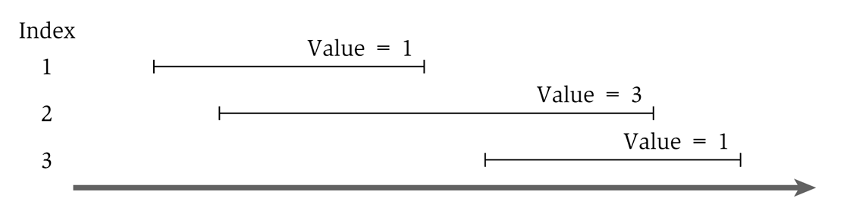
Greedy solution to the weighted version
What would the greedy algorithm pick for this example?
And is that answer optimal?
We can see that the greedy algorithm does not work for the weighted version

Slide 67
Weighted interval algorithm basics
Sort all intervals by their finish time
And number them sequentially
We define interval i is less than interval j if i finishes before j (i.e. is before it in the sort)
Define p(j) to be the highest numbered interval i<j such that i and j are disjoint
Define OPT(j) to be the value of an optimal solution for j

Slide 68
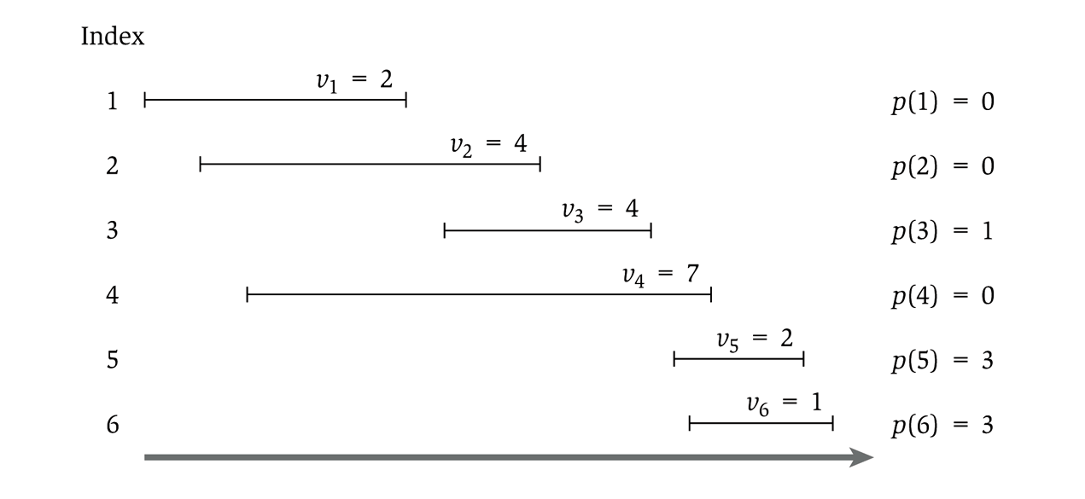
Showing p(j)

Slide 69
Analyzing an optimal solution
Is interval n in the optimal solution?
Maybe so: then we need to find the optimal solution to {1, …, p(n)}
As p(n) is the highest interval that is compatible with n
Then OPT(n) = v_{n} + OPT(p(n))
But maybe not: then we need to find the optimal solution to {1, …, n-1}
Since n is not in the solution
Then OPT(n) = OPT(n-1)
At this point, we have broken down our problem into smaller sub-problems; but which one to use?
OPT(j) = max(v_{j} + OPT(p(j)), OPT(j-1))
And OPT(0) = 0

Slide 70
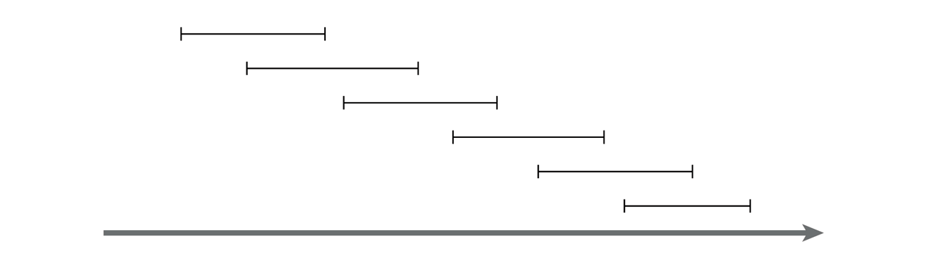
Recursive solution
OPT(j) = max(v_{j} + OPT(p(j)), OPT(j-1))
And OPT(0) = 0
This is similar in running time to the Fibonacci sequence
And similarly exponential
Consider a simple example:

Slide 71
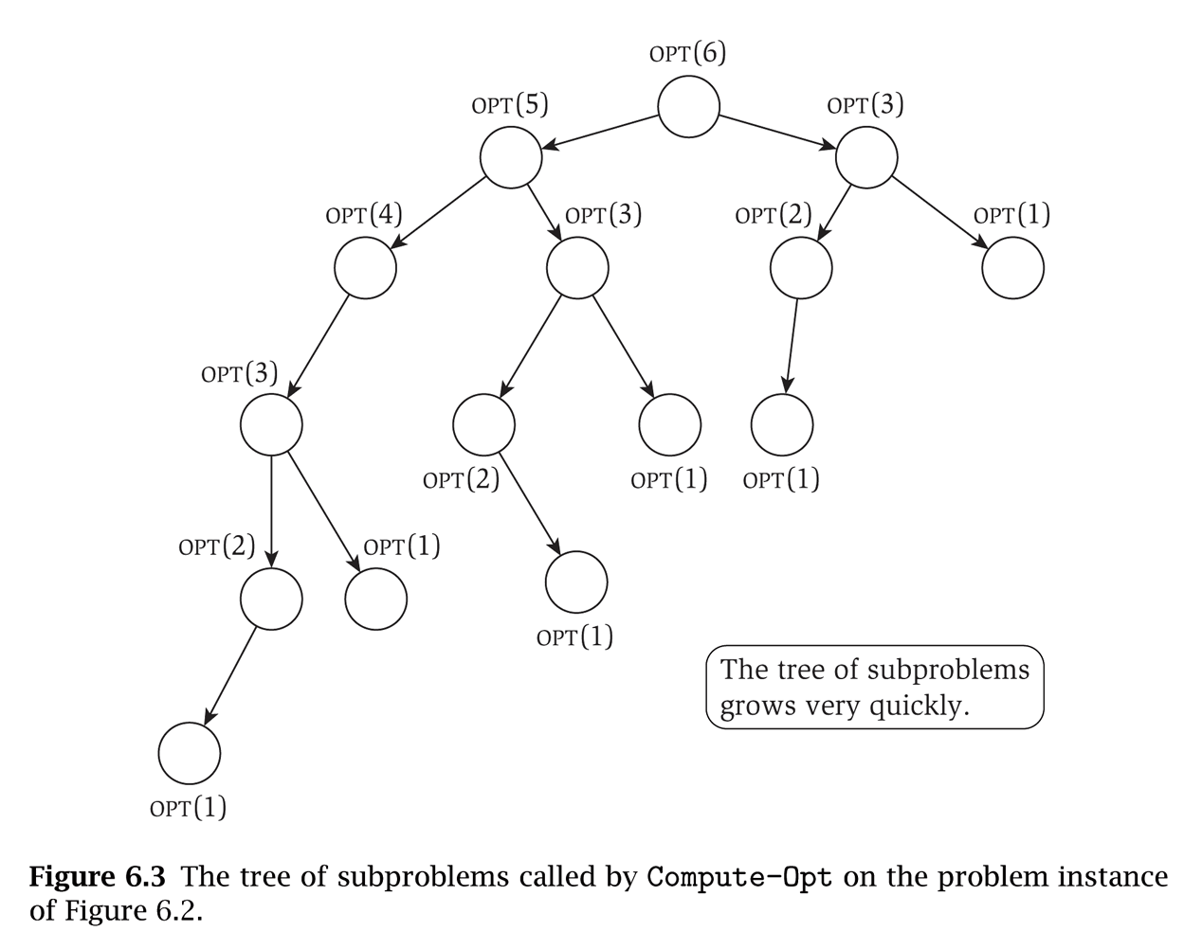
That example will take exponential time
Notice that the sub-problems are being re-computed each time

Slide 72
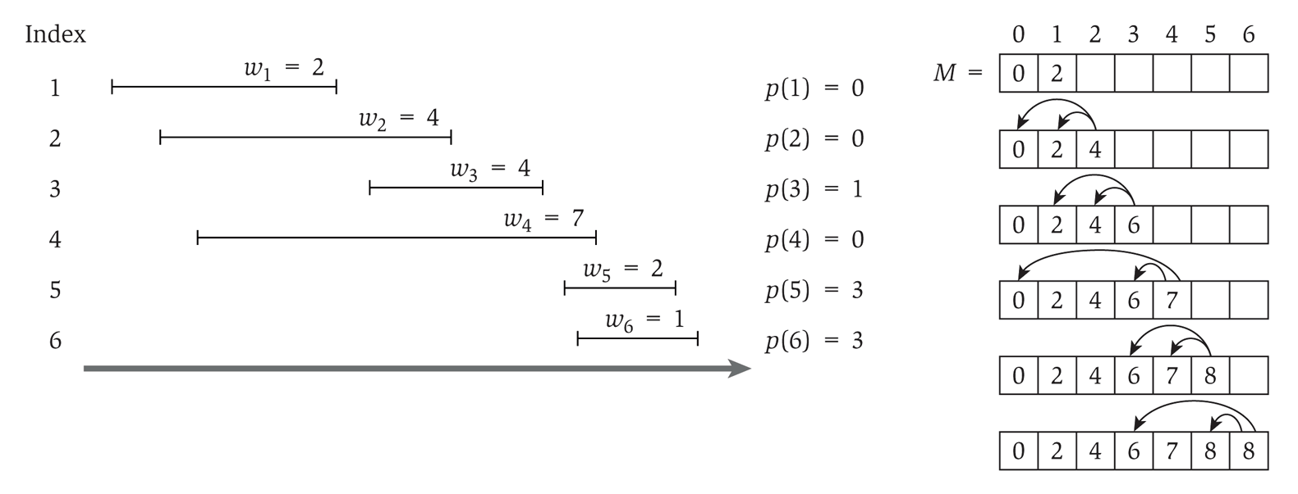
So we add memoization…
This runs in linear time

Slide 73
Computing the intervals
The solution only gives us the final value
Computing a sub-array each step would make it quadratic running time
To determine the intervals:
If v_{j} + M[p(j)] ≥ M[j-1]
Then j is part of the solution, and consider p(j)
Else
Then j is NOT part of the solution, and consider j-1

Slide 74
Coin Change

Slide 75
Recall coin change
Given an amount A, pick the minimum amount of coins that yield A
Recall the greedy algorithm:
Use the biggest coin possible, and use as many of those as possible
Repeat with successively smaller denominations
This algorithm won’t work with non-standard denominations

Slide 76
Greedy algorithm
Given coin cent amounts of 10, 6, 5, and 1
Compute the coins needed for 12 cents
The greedy algorithm picks 10, 1, 1
But 6, 6 is more optimal (fewer coins)

Slide 77
Definitions
We define an array denom which holds the denominations of the coins such that:
denom[1] > denom[2] > … > denom[n] = 1
In other words, we sort the coin denominations in decreasing order, ending with a penny
We are obtaining change for an amount A
Consider the i,j problem:
The available denominations are denom[i] through denom[n], where i ≥ 1 (i.e. the smaller n-i coins)
The amount we are looking for is j, where j ≤ A (i.e. the remaining amount of money)

Slide 78
The i,j problem
Consider the i,j problem:
The available denominations are denom[i] through denom[n], where i ≥ 1 (i.e. the smaller n-i coins)
The amount we are looking for is j, where j ≤ A (i.e. the remaining amount of money)
Given coins of denominations 10, 6, and 1, how to create change up to 12 cents:
j
 | 0 | 1 | 2 | 3 | 4 | 5 | 6 | 7 | 8 | 9 | 10 | 11 | 12
1 | 0 | 1 | 2 | 3 | 4 | 5 | 1 | 2 | 3 | 4 | 1 | 2 | 2
2 | 0 | 1 | 2 | 3 | 4 | 5 | 1 | 2 | 3 | 4 | 5 | 6 | 2
3 | 0 | 1 | 2 | 3 | 4 | 5 | 6 | 7 | 8 | 9 | 10 | 11 | 12
i

Slide 79
Solving the problem
How to solve the i,j problem
If denom[i] > j, then we don’t use this coin
Then the solution is the same as the (i+1)-j problem
Is this making the problem simpler?
We could use a coin of denomination i
Then the solution is 1 more than the i,(j-denom[i]) problem
i doesn’t change because there could be multiple coins of denomination i used in the solution
We could NOT use a coin of denomination i
Then the solution is the same as the (i+1)-j problem

Slide 80
The formulaic solution
The solution becomes:
Where C[i][0] = 0 for all values of i
If we have a penny, then C[n][j] = j
This is required to get all amounts, so we assume a penny is the smallest denomination

Slide 81
Recursive solution
The solution:
Note that a given problem (C[i][j]) is expressed in terms of sub-problems
We can write a solution now using recursion

Slide 82
The (non-recursive) algorithm
dynamic_coin_change1 (denom, A, C) {
n = denom.last
for j = 0 to A
C[n][j] = j
for i = n-1 downto 1
for j = 0 to A
if ( denom[j] > j ||
C[i+1][j] < 1+C[i][j-denom[i]] )
C[i][j] = C[i+1][j]
else
C[i][j] = 1 + C[i][j-denom[i]]
}

Slide 83
But how to record the answers?
We’ll keep a used Boolean array
If used[i][j] is true, then the solution for i,j does use a coin of denom[i] for amount j
If false, it does not
j
 | 0 | 1 | 2 | 3 | 4 | 5 | 6 | 7 | 8 | 9 | 10 | 11 | 12
1 | F | F | F | F | F | F | F | F | F | F | T | T | F
2 | F | F | F | F | F | F | T | T | T | T | T | T | T
3 | T | T | T | T | T | T | T | T | T | T | T | T | T
10 cents
6 cents
1 cent
i

Slide 84
Recording the answers
dynamic_coin_change2 (denom, A, C, used) {
n = denom.last
for j = 0 to A
C[n][j] = j
used[n][j] = true
for i = n-1 downto 1
for j = 0 to A
if ( denom[j] > j ||
C[i+1][j] < 1+C[i][j-denom[i]] )
C[i][j] = C[i+1][j]
used[i][j] = false
else
C[i][j] = 1 + C[i][j-denom[i]]
used[i][j] = true
}

Slide 85
Obtaining the coin set
optimal_coins_set (i, j, denom, used) {
if ( j == 0 )
return
if ( used[i][j] )
println (“Use coin of denomination “ + denom[i])
optimal_coins_set (i, j-denom[i], denom, used)
else
optimal_coins_set (i+1, j, denom, used)
}

Slide 86
Rod Cutting

Slide 87
Dynamic programming
Determine a recursive solution (presumably inefficient)
A problem should be able to be split into sub-problems
Design the dynamic programming algorithm to compute the final answer
Figure out how to reconstruct the solution
Perhaps by tracing backwards through the DP table
Or by modifying the algorithm to store a bit more information (while not increasing the running time)
We’ll go through an example of this process

Slide 88
Rod cutting problem
You are given a rod of length n inches
We assume all lengths are integer
Different lengths of the rod are worth different amounts:
Given this, there are 8 ways to cut a rod of length 4
length i | 1 | 2 | 3 | 4 | 5 | 6 | 7 | 8 | 9 | 10
price p_{i} | 1 | 5 | 8 | 9 | 10 | 17 | 17 | 20 | 24 | 30

Slide 89
Design of a DP solution
How do you break a problem down into sub-problems?
Given an arbitrary length i (where 0 < i ≤ n), how do we determine the maximum value for length i?
First, let’s work through a recursive solution
In pairs, work on said recursive solution
What is it’s running time?

Slide 90
Recursive solution
Cut-Rod (p,n)
if n == 0
return 0
q = -∞
for i = 1 to n
q = max(q, p[i] + Cut-Rod (p,n-i))
return q

Slide 91
Recursive running time
It is greater than Fibonacci
fib(n) = fib(n-1) + fib(n-2)
cutrod(n) = cutrod(n-1) + cutrod(n-2) + … + cutrod(1)
So it’s exponential
But we can do better…

Slide 92
Recursive running time
We’ll develop a recurrence for the running time
This won’t work with the Master theorem or the Main Recurrence theorem
And iteration will be very messy

Slide 93
Recursive running time
So we work iteration from the bottom-up:
T(0) = 1 (a safe assumption that we can make)
T(1) = 1+T(0) = 1+1 = 2
T(2) = 1+T(0)+T(1) = 1+1+2 = 4
T(3) = 1+T(0)+T(1)+T(2) = 1+1+2+4 = 8
T(4) = 1+T(0)+T(1)+T(2)+T(3) = 1+1+2+4+8 = 16
The pattern is 2^{n}
So the running time is Θ(2^{n})

Slide 94
Designing the DP solution
Given the recursive solution to the right, design a DP solution that runs in polynomial time
In pairs, work on said DP solution
What is it’s running time?
Cut-Rod (p,n)
if n == 0
return 0
q = -∞
for i = 1 to n
q = max(q, p[i] +
Cut-Rod (p,n-i))
return q

Slide 95
Dynamic programming solution
Bottom-Up-Cut-Rod (p,n)
let r[0..n] be a new array
r[0] = 0
for j = 1 to n
q = -∞
for i = 1 to j
q = max (q,
p[i]+r[j-i])
r[j] = q
return r[n]
Array r is the optimal profit
We have two nested loops, each which can run a total of n steps
So the running time is Θ(n²)
When run on the example given a few slides ago, this will generate the table shown below
index | 0 | 1 | 2 | 3 | 4 | 5 | 6 | 7 | 8 | 9 | 10
optimal profit | 0 | 1 | 5 | 8 | 10 | 13 | 17 | 18 | 22 | 25 | 30

Slide 96
Reconstructing the solution
We now have the maximum profit obtainable
But what rod lengths were used to obtain this?
Recall the two ways to reconstruct the solution
Perhaps by tracing backwards through the DP table
Or by modifying the algorithm to store a bit more information (while not increasing the running time)
In pairs, work on how to reconstruct the DP solution
What is it’s running time?

Slide 97
Dynamic programming solution
Array r is the optimal profit
Array s is the optimal size of the first piece to cut off
Inside the for loop has a different structure, but does the same thing as the max() call in the previous solution
When run on the example given a few slides ago, this will generate the table shown below
Running time is still Θ(n²)
Ext-Bottom-Up-Cut-Rod (p,n)
let r[0..n] be a new array
let s[0..n] be a new array
r[0] = 0
for j = 1 to n
q = -∞
for i = 1 to j
if q < p[i]+r[j-i]
q = p[i] + r[j-i]
s[j] = i
r[j] = q
return r[n]
index | 0 | 1 | 2 | 3 | 4 | 5 | 6 | 7 | 8 | 9 | 10
optimal profit | 0 | 1 | 5 | 8 | 10 | 13 | 17 | 18 | 22 | 25 | 30
optimal cut | 0 | 1 | 2 | 3 | 2 | 2 | 6 | 1 | 2 | 3 | 10

Slide 98
Conclusion

Slide 99
Review: Dynamic programming
DP is a method for solving certain kind of problems
DP can be applied when the solution of a problem includes solutions to subproblems
We need to find a recursive formula for the solution
We can recursively solve subproblems, starting from the trivial case, and save their solutions in memory
In the end we’ll get the solution of the whole problem

Slide 100
Properties of a problem that can be solved with dynamic programming
Simple Subproblems
We should be able to break the original problem to smaller subproblems that have the same structure
Optimal Substructure of the problems
The solution to the problem must be a composition of subproblem solutions
Subproblem Overlap
Optimal subproblems to unrelated problems can contain subproblems in common

Slide 101
Conclusion
Dynamic programming is a useful technique of solving certain kind of problems
When the solution can be recursively described in terms of partial solutions, we can store these partial solutions and re-use them as necessary
Running time (Dynamic Programming algorithm vs. naïve algorithm):
LCS: O(m*n) vs. O(n * 2^{m})
0-1 Knapsack problem: O(W*n) vs. O(2^{n})

