Slide 1
Advanced Data Structures
Aaron Bloomfield
CS 4102
Spring 2011

Slide 2
B-Trees

Slide 3
B-tree overview
B-trees are balanced search trees somewhat similar to red-black trees
But they can have many children per node – perhaps as many as 1,000
B-trees are used when the amount of data far exceeds what can be kept in memory
And must then be kept on disk (or other “slower” device)

Slide 4
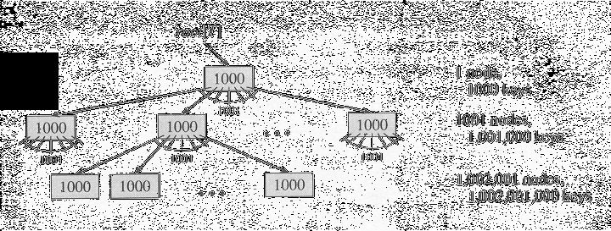
B-tree example
Consider a database of one billion (10^9) elements
A (balanced) binary tree would have log₂10⁹ ≈ 30 levels
A B-tree with 1,000 children per node would have log₁₀₀₀10⁹ ≈ 3 levels

Slide 5
B-trees on hard drives
Consider a hard drive
It takes 10 ms to read data, whether one byte or one (4k) block
If the data is kept on a hard drive, we want to minimize the number of levels (i.e. 10 ms accesses)
So we make each B-tree node take up exactly one block on the hard drive
Assume 4-byte key, a 4-byte value, and a 4-byte child pointer
Modern disk drive sectors are 4 Kb
So a B-Tree on such a disk would have 341 keys per node

Slide 6
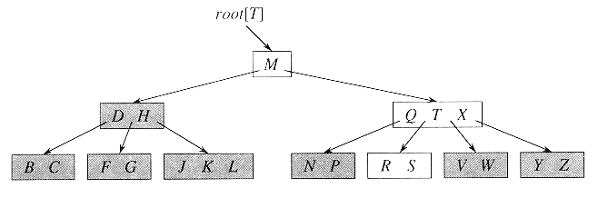
B-tree example
A B-tree where the nodes are the English constants
The white nodes are accessed in the search for ‘R’

Slide 7
What uses B-trees?
Databases
Just about any modern relational database
Major modern filesystems, such as:
Apple’s HFS+
Microsoft’s NTFS
Linux’s btrfs and ext4

Slide 8
B-tree properties
Every node has:
x.n, the number of keys currently in x
The x.n keys themselves (x.key₁, x.key₂, …, x.key_{x.n})
x.leaf, a boolean flag if the node is a leaf or an internal node
Each internal node also has x.n+1 child pointers (x.c₁, …, x.c_{x.n+1})
The sub-trees and the keys are sorted, just like binary trees: subtree₁ ≤ x.key₁ ≤ subtree₂ ≤ … ≤ x.key_{x.n} ≤ subtree_{x.n+1}
All leaves have the same depth
Nodes have upper and lower bounds on the number of keys. We define an integer t≥2 (called the minimum degree) such that:
Except the root, each node must have at least t-1 keys
Each node may have at most 2t-1 keys

Slide 9
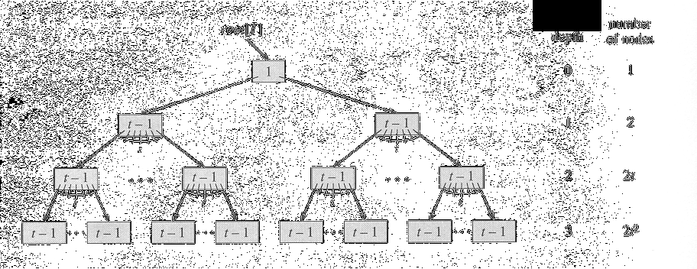
B-tree height with the fewest elements

Slide 10
B-tree operations
We assume that we have the following operations available to us:
Disk-Read(x): reads the node x from disk
Disk-Write(x): writes the node x to disk
Allocate-Node(x): allocates a disk block in O(1) time
And we make the following assumptions:
The root node is always in memory
Any node passed as a parameter has already had Disk-Read called on it, so it’s currently in memory

Slide 11
B-Tree-Search
Recursively, in each node:
Search through the (sorted) keys until either:
You find the droid you are looking for
Or you find two that it is between
At which point you recursively go down the sub-tree between them
B-Tree-Search(x,k):
while i ≤ x.n and k > x.key_{i}
i = i + 1
if i ≤ x.n and k == x.key_{i}
return (x,i)
elseif x.leaf
return NIL
else
Disk-Read (x.c_{i})
return B-Tree-Search(x.c_{i}, k)

Slide 12
B-Tree-Create
We will, not surprisingly, need this for the insert operations
This creates a tree with an empty root node
B-Tree-Create(t)
x = Allocate-Node()
x.leaf = true
x.n = 0
Disk-Write(x)
T.root = x

Slide 13
Insertion
Normally quite easy: just stick into the node where it fits, moving everything beyond up by one
But what if the node is full?
We then have to split the node
We make the following assumption:
An insert will happen into a full child of a non-full parent node
We will see shortly that we can make this assumption hold

Slide 14
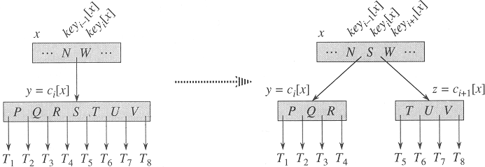
Node splitting
To split a node, we take the median value and move it up to the (non-full) parent node
And split the node into two parts
Before the split, the child has the max of 2t-1 values
After the split, each child has t-1values
This is the only way to “insert” a value into a non-leaf node

Slide 15
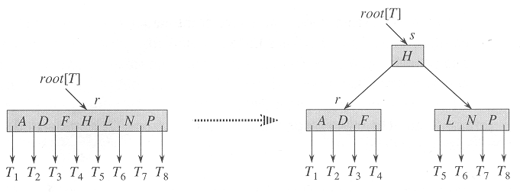
Root node splitting
If the root node is full, a new root node is created
Note that the root node is allowed to have less than t-1 values

Slide 16
B-Tree-Split-Child
The algorithm:
Allocates the new node (the “right” sub-node)
The original full node is the “left” sub-node
Copies the second half of the full node into the right sub-node
And the child pointers, if not a leaf
In the parent, moves all nodes (and their child pointers) up by 1
Writes everything to disk
(algorithm is in the text book)

Slide 17
B-Tree-Insert
This works on a single pass down the tree
and splits nodes that are full, thus guaranteeing that no parent node will be full
Note that an inserted element is always in a leaf
Only by a split does an internal node “gain” a value

Slide 18
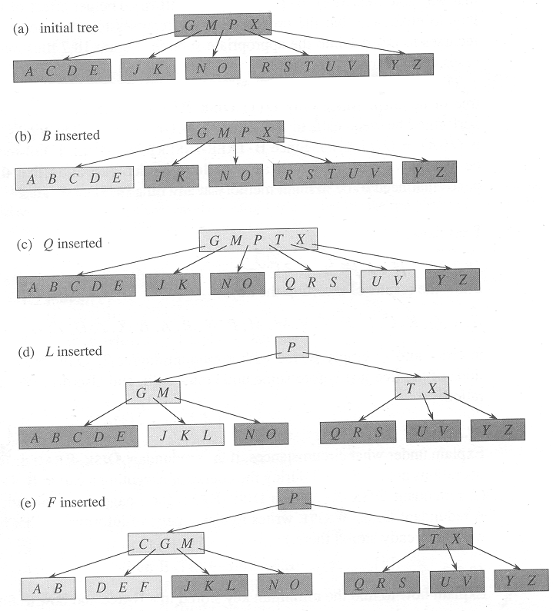
Insert cases
t=3
Any node (other than the root) can have 2-5 keys
Initial tree:

Slide 19
Insert, case 1
We insert B: a simple insertion into a leaf

Slide 20
Insert, case 2
We insert Q: the node RSTUV splits into two (T moves up), and Q inserts into the left-most of the split nodes

Slide 21
Insert, case 3
We insert L: the root splits immediately (since it’s full, this is done on a downward traversal). L is inserted into the leaf containing JK

Slide 22
Insert, case 4
We insert F: the node ABCDE splits into two (C moves up), and F is inserted into the right-most of the split nodes

Slide 23
B-Tree-Delete
Harder than insert!
This works on a single pass down the tree
and combines nodes that are at the minimum size, thus guaranteeing that no parent node will be at the minimum size
Note that an inserted element is always in a leaf
Only by a split does an internal node “gain” a value

Slide 24
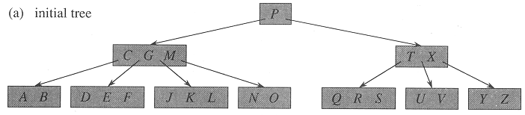
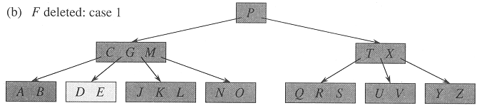
B-Tree-Delete, case 1
Delete F: case 1: if the key is in a leaf, delete it from the leaf (remember, we always assume that no node is at the minimum size – this is handled by later cases)

Slide 25
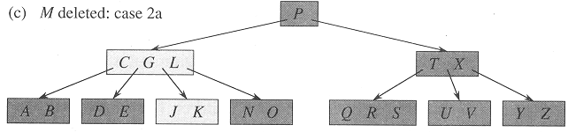
B-Tree-Delete, case 2a
Delete M: case 2a: if internal node, and predecessor child (of M) has at least t keys, delete predecessor (L), and move it up to that node (internal nodes can have t-1 keys)

Slide 26
B-Tree-Delete, case 2b
The same as case 2a, but…
If the predecessor node is at the minimum size (t-1)
Then look at the successor node
If that node is not at the minimum size, then do the same thing as in 2a, but with the successor node

Slide 27
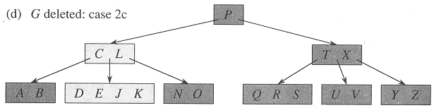
B-Tree-Delete, case 2c
Delete G: case 2c: if internal node, and both the predecessor and successor child nodes are of minimum size (t-1), combine the child nodes into one node

Slide 28
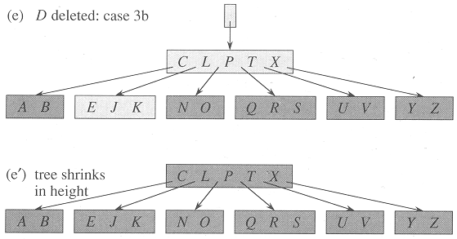
B-Tree-Delete, case 3b
Delete D: case 3b: if the child we are going to recurse down and both immediate siblings are of minimum size, combine them (moving one key down) into an new node; recurse down

Slide 29
B-Tree-Delete, case 3b, part 2
Delete D: case 3b: this may require removing the root node, if the key moved down is the last key in the root; at this point, the tree looses one level of height

Slide 30
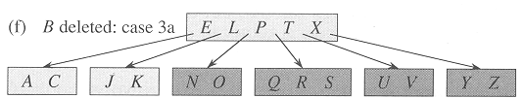
B-Tree-Delete, case 3a
Delete B: case 3a: if the child we are going to recurse down is of minimum size, but an immediate sibling is not, then “take” a key from that sibling (and move it up to the parent, and move the parent key down); recurse down

Slide 31
B-Tree-Delete analysis
Most deletes will be in leaf nodes, so most will be case 1
At most h disk operations are necessary (h = height of B-tree)
(and this is one of the ‘easier’ data structures in the ‘Advanced Data Structures’ section of Cormen’s text!)

Slide 32
Disjoint Sets

Slide 33
Disjoint sets
We often need to represent sets of ‘things’
And, typically, any ‘think’ is in only one of our sets
Hence the ‘disjoint’ part of ‘disjoint sets’
The ‘representative’ is a single element that somehow represents the entire set
The lowest-valued element, for example
We can use this representative to refer to the entire set

Slide 34
Disjoint sets example: Kruskal code
void Graph::kruskal(){
int edgesAccepted = 0;
DisjSet s(NUM_VERTICES);
while (edgesAccepted < NUM_VERTICES – 1){
e = smallest weight edge not deleted yet;
// edge e = (u, v)
uset = s.find(u);
vset = s.find(v);
if (uset != vset){
edgesAccepted++;
s.unionSets(uset, vset);
}
}
}
|E| heap ops
2|E| finds
|V| unions

Slide 35
Disjoint set operations
Make-Set(x): creates a set with a single element x
Union(x,y): creates a combined set from the (disjoint) sets that contain x and y
Find-Set(x): returns a pointer to a representative of the (unique) set containing x

Slide 36
Implementation: linked list
A simple implementation, but not very efficient
A ‘Set’ object will have to have a head and a tail node
but the list itself can be singly-linked
And each node will have to point back to the ‘Set’ object
The ‘representative’ will be the first element in the set (i.e. the ‘head’ element)

Slide 37
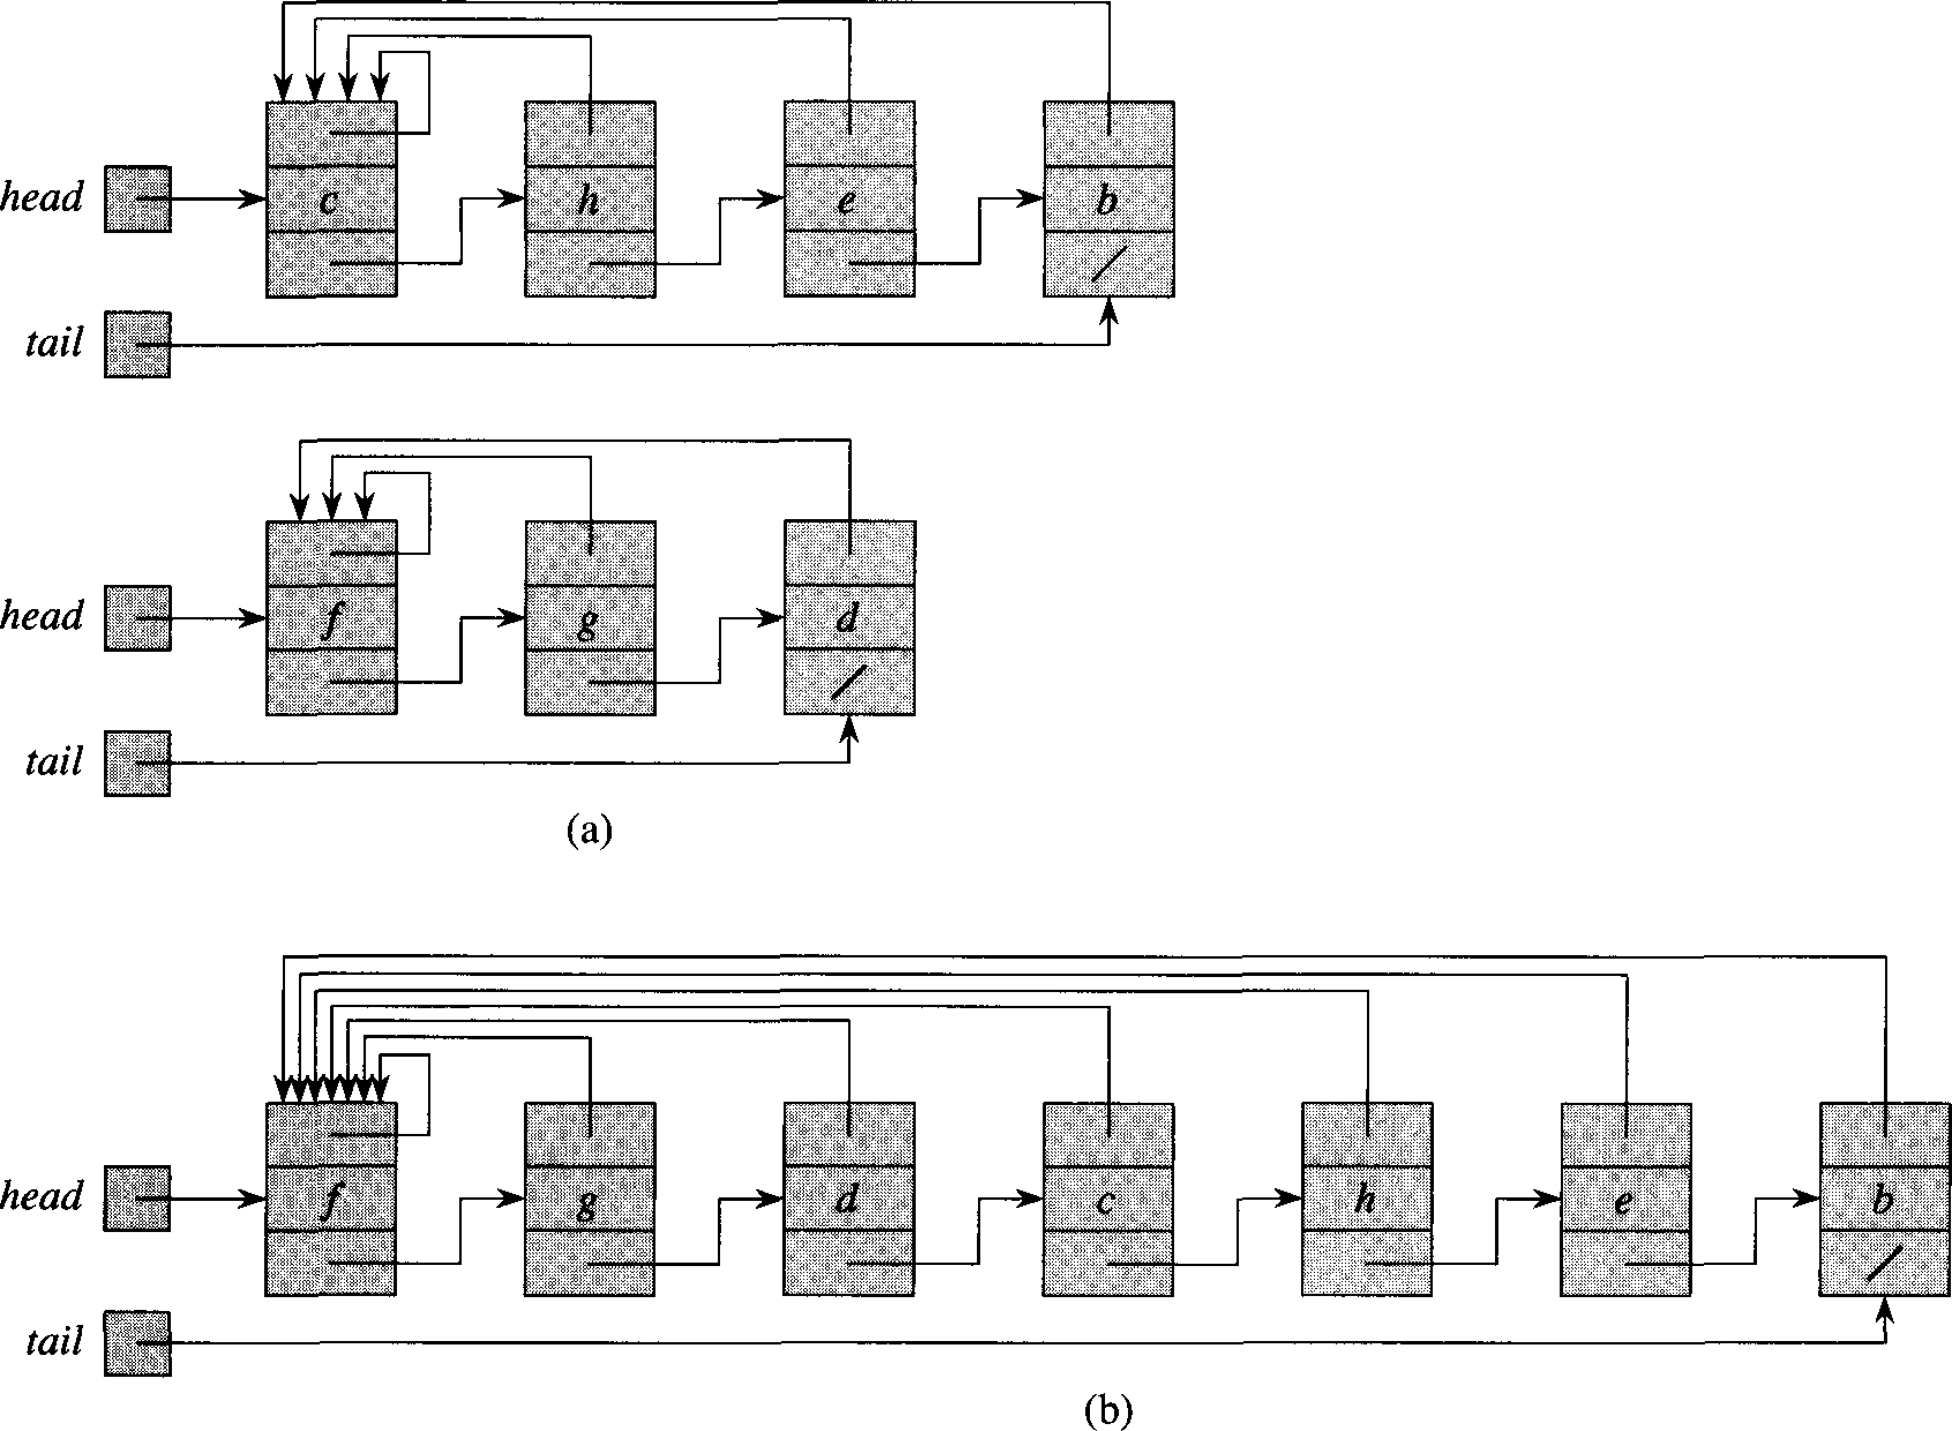
Implementation: linked list

Slide 38
Implementation: linked list
Make-Set(x): create a ‘Set’ object and a ‘Element’ object, and re-arrange a few points
Θ(1) operation
Union(x,y): combining two lists is just moving many pointers around
But each ‘Element’ in one of the lists has to point back to the other ‘Set’ object
So it’s a Θ(n) operation
But if we keep track of the set size, we can always iterate through the smaller of the two sets
Find-Set(x): must iterate through each ‘Element’ object to find which set it belongs to
Θ(n) again!

Slide 39
Implementation: disjoint-set forests
A somewhat more complicated implementation, and can be made much more efficient
A ‘Node’ object will have a pointer to it’s parent
And each node can have any number of children
We will also have to keep a list of all the elements somewhere (a vector, etc.)
The ‘representative’ will be the root element in each tree

Slide 40
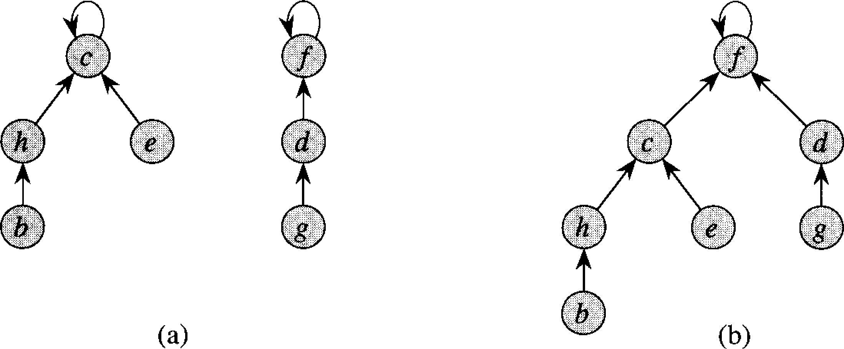
Implementation: disjoint-set forests

Slide 41
Implementation: disjoint-set forests
Make-Set(x): create a ‘Node’ object and re-arrange a few points
Θ(1) operation
Union(x,y): combining two lists is making one tree be the sub-tree of the other
Θ(1) operation
Find-Set(x): must move up to the root to find the representative
But this can be a Θ(n) operation if the tree is unbalanced!

Slide 42
Optimization: path compression
In Find-Set(x), we traverse up a tree from a given node
So once we find the root node…
We traverse up the same path, making each of those nodes point to the root
In a given set, the first Find-Set(x) on a given element will be linear
Each additional one (on that same element, or those above it) will be constant time
Of course, if a the set is unionized, then it may not be constant time…

Slide 43
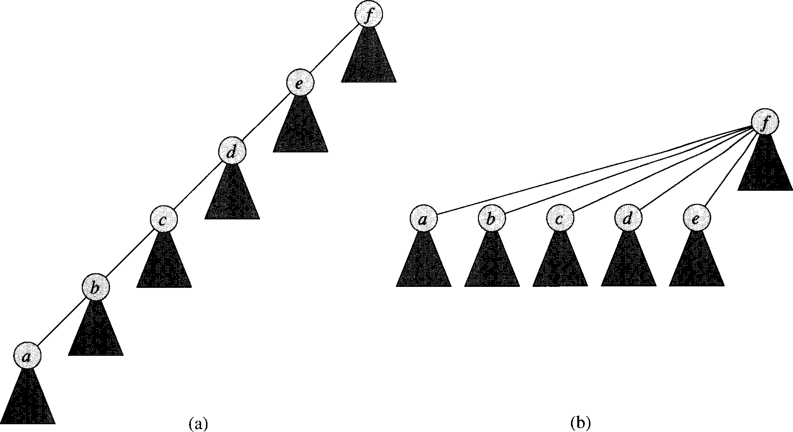
Optimization: path compression

Slide 44
Optimization: union by rank
When unionizing, we make one set’s root node by a sub-tree of the other set’s root node
In union by rank, we make the ‘smaller’ set’s root node be the sub-tree of the ‘larger’ set’s root node
But keeping track of the size of a set is such a pain
So we keep track of an upper bound of the the height of the union tree

Slide 45
Running time with those optimizations
When using both path compression and union by rank, the running time of Find-Set(x), is:
O(n • α(n)) amortized time
Where α(n) is a very slowly growing function
For all practical purposes, α(n) ≤ 4
Which means, in practice, Find-Set(x) is linear
But technically, is super-linear
The proof of this is in the textbook (section 21.4), and takes up 10 full pages
We won’t go over it here

