Slide 1
Sorting
CS 4102: Algorithms
Spring 2011
Aaron Bloomfield

Slide 2
Reminder: Common Forms of Recurrence Equations
Remember these?
Divide and conquer: Like Mergesort T(n) = bT(n/c) + f(n)
Solve directly or apply master theorem
Chip and conquer: T(n) = T(n-c) + f(n)
Note: One sub-problem of lesser cost!
Insertion sort will be like this.
Chip and Be Conquered: T(n) = b T(n-c) + f(n) where b > 1
Like Towers of Hanoi
Exponential! See recursion tree argument on p. 140

Slide 3
Insertion Sort

Slide 4
Insertion Sort
The strategy:
First section of list is sorted (say i-1 items)
Increase this partial solution by…
Shifting down next item beyond sorted section (i.e. the i^{th} item) down to its proper place in sorted section. (Must shift items up to make room.)
Since one item alone is already sorted, we can put steps 1-3 in a loop going from the 2nd to the last item.
Note: Example of general strategy: Extend a partial solution by increasing its size by one. (Possible name: decrease and conquer)

Slide 5
Insertion Sort: Pseudocode
insertion_sort(a) {
n = a.last
for i = 2 to n {
val = a[i] // save a[i] so it can be inserted
j = i – 1 // into the correct place
// if val < a[j],move a[j] right to make room for a[i]
while (j ≥ 1 && val < a[j]) {
a[j + 1] = a[j]
j = j - 1
}
a[j + 1] = val // insert val
}
}

Slide 6
Insertion sort in Python
def insertion_sort(list):
n = len(list)
for i in range(1,n):
val = list[i]
j = i-1
while j >= 0 and val < list[j]:
list[j+1] = list[j]
j = j-1
list[j+1] = val
return

Slide 7
Properties of Insertion Sort
Easy to code
In-place
What’s it like if the list is sorted?
Or almost sorted?
Fine for small inputs
Why?

Slide 8
Insertion Sort: Analysis
Worst-Case:
Average Behavior
Average number of comparisons in inner-loop?
So for the ith element, we do roughly i/2 comparisons
To calculate A(n), we note i goes from 2 to n-1
Best-case behavior? One comparison each time

Slide 9
Insertion Sort: Best of a breed?
We know that other I.S. is one of many quadratic sort algorithms, and that log-linear sorts (i.e. Θ(n lg n) ) do exist
But, can we learn something about I.S. that tells us what it is about I.S. that “keeps it” in the slower class?
Yes, by a lower-bounds argument on a restricted set of sort algorithms
BTW, this is another example to show you how to make arguments about lower-bounds

Slide 10
Removing Inversions
Define an inversion in a sequence: A pair of elements that are out of order
E.g. { 2, 4, 1, 5, 3 } not sorted and has 4 inversions: pairs (2,1) (4,1) (4,3) (5,3)
To sort, we must fix each of these
What’s the maximum possible number of inversions? n(n-1)/2: all possible pairs
This really can occur, e.g. { 5, 4, 3, 2, 1 }
Insertion sort only swaps adjacent elements
This can only remove at most one inversion!
Insertion sort only removes at most one inversion for each key comparison

Slide 11
Lower-bounds and Insertion Sort
Theorem
Any algorithm that sorts by comparison of keys and removes at most one inversion after each comparison must do at least n(n-1)/2 comparisons in the worst case and at least n(n-1)/4 comparisons on the average (for n elements)
Conclusion: Insertion Sort is optimal for algorithms that works “locally” by interchanging only adjacent elements.
These include BubbleSort, SelectionSort
And, for any algorithm to be o(n²) it must swap elements that are not adjacent!

Slide 12
Mergesort

Slide 13
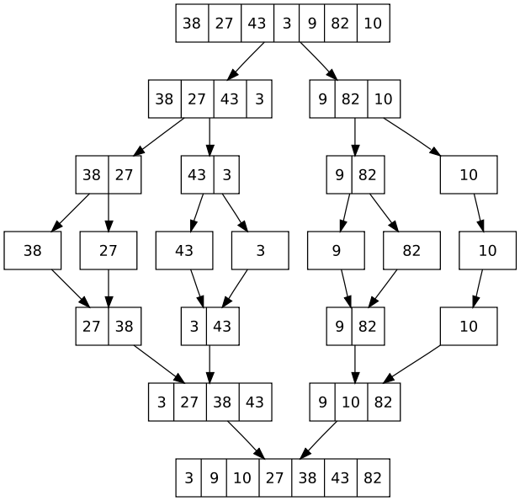
Mergesort is Classic Divide & Conquer
Strategy

Slide 14
Algorithm: Mergesort
Specification:
Input: Array list and indexes first, and Last, such that the elements list[i] are defined for first <= i <= last.
Output: list[first], …, list[last] is sorted rearrangement of the same elements
Algorithm:
def mergesort(list, first, last):
if first < last:
mid = (first+last)/2
mergesort(list, first, mid)
mergesort(list, mid+1, last)
merge(list, first, mid, last)
return

Slide 15
Exercise: Trace Mergesort Execution
Can you trace MergeSort() on this list? A = {8, 3, 2, 9, 7, 1, 5, 4};

Slide 16
Efficiency of Mergesort
Cost to divide in half? No comparisons
Two subproblems: each size n/2
Combining results? What is the cost of merging two lists of size n/2
Soon we’ll see it’s n-1 in the worst-case
Recurrence relation: W(1) = 0 W(n) = 2 W(n/2)+ merge(n) = 2 W(n/2) + n-1 You can now show that this W(n) ∈ θ(n log n)

Slide 17
Merging Sorted Sequences
Problem:
Given two sequences A and B sorted in non-decreasing order, merge them to create one sorted sequence C
Input size: C has n items, and A and B each have n/2
Strategy:
determine the first item in C: It is the minimum between the first items of A and B. Suppose it is the first items of A. Then, rest of C consisting of merging rest of A with B.

Slide 18
Algorithm: Merge
Merge(A, B, C) // where A, B, and C are sequences
if (A is empty)
rest of C = rest of B
else if (B is empty)
rest of C = rest of A
else if (first of A <= first of B)
first of C = first of A
merge (rest of A, B, rest of C)
else
first of C = first of B
merge (A, rest of B, rest of C)
return
W(n) = n – 1

Slide 19
More on Merge, Sorting,…
See textbook for a more detailed code for merge
Python example available soon on the course website
In-place merge is possible
What’s “in-place” mean?
Space usage is constant, or Θ(1)
When is a sort stable?
If duplicate keys, their relative order is the same after sorting as it was before
Sometimes this is important for an application
Why is mergesort stable?

Slide 20
Java’s Collections.sort()
Uses mergesort (a slightly modified version)
Guaranteed to be Θ(n log n)
Guaranteed to be stable

Slide 21
QuickSort

Slide 22
Quicksort: Introduction
Developed by C.A.R. (Tony) Hoare (a Turing Award winner)
http://www.wikipedia.org/wiki/C._A._R._Hoare
Published in 1962
Classic divide and conquer, but…
Mergesort does no comparisons to divide, but a lot to combine results (i.e. the merge) at each step
Quicksort does a lot of work to divide, but has nothing to do after the recursive calls. No work to combine. (If we’re using arrays. Linked lists? Re-examine later.)
Dividing done with algorithm often called partition
Sometimes called split. Several variations.

Slide 23
Quicksort’s Strategy
Called on subsection of array from first to last
Like mergesort
First, choose some element in the array to be the pivot element
Any element! Doesn’t matter for correctness.
Often the first. Or, we often move some element into the first position (to get better efficiency)
Second, call partition, which does two things:
Puts the pivot in its proper place, i.e. where it will be in the correctly sorted sequence
All elements below the pivot are less-than the pivot, and all elements above the pivot are greater-than
Third, use quicksort recursively on both sub-lists

Slide 24
Quicksort’s Strategy (a picture)
Use first element as pivot (or pick one and move it there)
After call to partition…
Now sort two parts recursively and we’re done!
Note that splitPoint may be anywhere in first..last
Note our assumption that all keys are distinct
pivot
first
last
< pivot (unsorted)
pivot
> pivot (unsorted)
first
split point
last
< pivot (sorted)
pivot
> pivot (sorted)
first
split point
last

Slide 25
Quicksort Code
Input Parameters: list, first, last
Output Parameters: list
def quicksort(list, first, last):
if first < last:
p = partition(list, first, last)
quicksort(list, first, p-1)
quicksort(list, p+1, last)
return

Slide 26
Partition Does the Dirty Work
Partition rearranges elements
How? How many comparisons? How many swaps?
How? Two algorithms
Lomuto’s and Hoare’s
Important: Both are in-place!

Slide 27
Strategy for Lomuto’s Partition
Invariant:
h indexes the right-most element <pivot
k indexes the right-most element >= pivot
first
last
pivot
< pivot
>= pivot
unexamined
h
k
Strategy:
Increment k and look at next item a[k]
If that item >= pivot, all is well!
If that item < pivot, increment h and then swap items at positions h and k
When done, swap pivot with item at position h

Slide 28
Lomuto’s Partition: Code
Input Parameters: list, first, last
Output Parameters: list. Return value: the split point
def partition(list, first, last):
val = list[first]
h = first
for k in range(first+1,last+1):
if list[k] < val:
h = h+1
(list[h],list[k]) = (list[k],list[h]) # swap!
(list[first],list[h]) = (list[h],list[first]) # swap!
return h

Slide 29
Strategy for Hoare’s Partition
Hoare’s strategy: “Burn the candle from both ends!”
Move items bigger than pivot to the end
Move items smaller than pivot to beginning
Items still to be examined are in the middle
Keep two indexes pointing into the array to separate the 3 sections
These indexes move towards each other. Done when they meet.

Slide 30
Strategy for Hoare’s Partition
Invariant:
low indexes the right-most element <= pivot
high indexes the left-most element >= pivot
first
last
pivot
<= pivot
unexamined
>= pivot
low
high
Strategy:
Move low up until we find element >pivot
Move high down until we find element < pivot
Swap them to restore invariant

Slide 31
Code for Hoare’s Partition
int Partition( Key E[], Key pivot, int first, int last ) {
int low = first;
int high = last+1;
int tmp;
while (true) {
while ( pivot < E[--high] ) ; // see Note A next slide
while ( E[++low] < pivot )
if ( low == last ) break; // see Note B next slide
if ( low >= high ) break;
tmp = E[low]; E[low] = E[high]; E[high] = tmp; // swap
}
tmp = E[high]; E[high] = E[first]; E[first] = tmp; // swap
return high;
}

Slide 32
Python Code for Hoare’s Partition
def partition2(list, first, last):
i = first # used like low in previous code
j = last+1 # used like high in previous code
pval = list[first]
while True:
while True:
i = i+1
if i > last or list[i] >= pval: break
while True:
j = j-1
if list[j] <= pval: break
if i < j: (list[i],list[j]) = (list[j],list[i]) # swap
else: break
(list[first],list[j]) = (list[j],list[first]) # swap
return j

Slide 33
Notes on Partition Code
Note low-section contains elements <= pivot and high-section contains elements >= pivot
Note A: two inner while-loops move indexes, skipping over elements already in correct section
Stops when hits elements that need swapping

Slide 34
Notes on Partition Code (cont’d)
Convince yourself this version works!
It’s easy to goof up this code. Have we?
What does it do in extreme cases? E.g. pivot is max or min, or all values equal
Self-test exercise: use an example in text, and do one call to Partition on entire array.
Draw array and show values for high, low at start of outer while-loop
Duplicate values
Some variants of partition handle this better
Common situation (E.g. sort all students by major)
See other texts (e.g. Sedgewick’s algorithms text) for more analysis

Slide 35
Efficiency of Quicksort
Partition divides into two sub-lists, perhaps unequal size
Depends on value of pivot element
Recurrence for Quicksort:
T(n) = partition-cost + T(size of 1st section) + T(size of 2nd section)
If divides equally, T(n) = 2 T(n/2) + n-1
Just like mergesort
Solve by substitution or master theorem T(n) ∈ Θ(n lg n )
This is the best-case. But…

Slide 36
Worst Case of Quicksort
What if divides in most unequal fashion possible?
One subsection has size 0, other has size n-1
T(n) = T(0) + T(n-1) + n-1
What if this happens every time we call partition recursively?
Uh oh. Same as insertion sort.
“Sorry Prof. Hoare – we have to take back that Turing Award now!”
Not so fast…

Slide 37
Quicksort’s Average Case
Good if it divides equally, bad if most unequal.
Remember: when sub-problems size 0 and n-1
Can worst-case happen?
Sure! Many cases. One is when elements already sorted. First element is min, pivot around that.
What’s the average?
Much closer to the best case
To prove this, fun with recurrences
Result: If all permutations are equal, then:
A(n) ≅ 1.386 n lg n (for large n)
So very fast on average.
And, we can take simple steps to avoid the worst case!

Slide 38
Avoiding Quicksort’s Worst Case
Make sure we don’t pivot around max or min
Find a better choice and swap it with first element
Then partition as before
Recall we get best case if divides equally
Could find median. But this costs Θ(n). Instead…
Choose a random element between first and last and swap it with the first element
Or, estimate the median by using the “median-of-three” method
Pick 3 elements (say, first, middle and last)
Choose median of these and swap with first. (Cost?)
If sorted, then this chooses real median. Best case!

Slide 39
Tuning Quicksort’s Performance
In practice quicksort runs fast
A(n) often runs in log-linear time, and the “constants” are smaller than mergesort and heapsort
Often used in software libraries
So worth tuning it to squeeze the most out of it
Always do something to avoid worst-case
Sort small sub-lists with (say) insertion sort
For small inputs, insertion sort is fine
No recursion, function calls
Variation: don’t sort small sections at all. After quicksort is done, sort entire array with insertion sort
It’s efficient on almost-sorted arrays!

Slide 40
Quicksort’s Space Complexity
Looks like it’s in-place, but recursion stack
Depends on your definition: some people define in-place to not include stack space used by recursion
E.g. the algorithms textbook by Cormen et. al.
How much goes on the stack?
If most uneven splits, then Θ(n).
If splits evenly every time, then Θ(lg n).
Ways to reduce stack-space used due to recursion
Various books cover the details (not ours, though)
First, remove 2nd recursive call (tail-recursion)
Second, always do recursive call on smaller section

Slide 41
Summary: Quicksort
In worst-case, efficiency is Θ(n²)
But easy to avoid the worst-case
On average, efficiency is Θ(n lg n)
Better space-complexity than mergesort.
In practice, runs fast and widely used
Many ways to tune its performance
Can be combined effectively
Various strategies for Partition
Some work better if duplicate keys
See Sedgewick’s algorithms text for more details
He’s the expert! PhD on this under Donald Knuth
Note that efficient implementations are often not stable

Slide 42
Heapsort

Slide 43
Review from CS 2150
I know you were all taught about heaps in CS 2150, so I assume you know the material well…

Slide 44
Reminders, Terminology
ADT priority queue
What’s an ADT?
What’s high priority?
Operations?
How is data stored?
Heap data structure
The heap structure: an almost-complete binary tree
The heap condition or heap order property:
At any given node j, value[j] has higher priority than either of its child nodes’ values
Heaps are weakly sorted
Higher priority: large or small?
Max-heap vs min-heap

Slide 45
Storing Heaps in Lists
Heap structure allows us to store heaps in lists (arrays, vectors) effectively
Indexing in our text: v[1] is the root. v[n] is the last item
parent of node j is at j/2
left-child of node j is at:
2*j
right-child of node j is at:
2*j + 1
“first leaf” is
n/2 + 1

Slide 46
Basic Heap Algorithms
Let’s work with max-heaps for now
Define a set of simple heap operations
Traverse tree, thus logarithmic complexity
Highest item?
At the root. Just return it.
Insert an item?
Add after the nth item (end of list)
Out of place? Swap with parent. Repeat, pushing it up the tree until in proper place
Remove an item?
Hmm...

Slide 47
Insert Algorithm
This algorithm inserts the value val into a heap containing n elements.
The array v represents the heap.
Input Parameters: val,v,n
Output Parameters: v,n
heap_insert(val,v,n) {
i = n = n + 1
// i is the child and i/2 is the parent.
// If i > 1, i is not the root.
while (i > 1 && val > v[i/2]) {
v[i] = v[i/2]
i = i/2
}
v[i] = val
}

Slide 48
Siftdown: Fix a Heap if Root Wrong
Algorithm
Also known as “Fixheap” and “heapify” (ugh)
Called at a given index (often root, but perhaps not)
Assumption:
The left and right subtrees of node i are heaps.
The element at node i may violate heap condition
Strategy:
Find larger of two children of current node
If current node is out-of-place, then swap with largest of its children
Keep pushing it down until in the right place or it’s a leaf

Slide 49
// Input Parameter: v,i,n Output Parameters: v
siftdown(v,i,n) {
temp = v[i]
// 2 * i ≤ n tests for a left child
while (2 * i ≤ n) {
child = 2 * i
// if there is a right child and it is
// bigger than the left child, move child
if (child < n && v[child + 1] > v[child])
child = child + 1
// move child up?
if (v[child] > temp)
v[i] = v[child]
else
break // exit while loop
i = child
}
// insert original v[i] in correct spot
v[i] = temp
}

Slide 50
Delete Algorithm
This algorithm deletes the root (the item with largest value) from a heap containing n elements. The array v represents the heap.
Input Parameters: v,n
Output Parameters: v,n
heap_delete(v,n) {
v[1] = v[n]
n = n - 1
siftdown(v,1,n)
}

Slide 51
How to Build a Heap
Option 1:
Repeatedly Insert() a new item, start with a heap of 1 item
Cost: Θ(n lg n) (Can you do the sum?)
Option 2:
Take an unordered list, build the heap in place
Heapify() algorithm
Strategy:
Work bottom up, starting with lowest sub-heaps
Call Siftdown() on each
Note: This often called “BuildHeap” etc.
We called it that in CS 2150
Cormen et. al. calls Siftdown() “heapify”

Slide 52
Heapify Algorithm
This algorithm rearranges the data in the array v, indexed from 1 to n, so that Heapsort it represents a heap.
Input Parameters: v,n
Output Parameters: v
heapify(v,n) {
// n/2 is the index of the parent of the last node
for i = n/2 downto 1
siftdown(v,i,n)
}
Complexity? Θ(n log n)

Slide 53
Heapify Algorithm
This algorithm rearranges the data in the array v, indexed from 1 to n, so that Heapsort it represents a heap.
Input Parameters: v,n
Output Parameters: v
heapify(v,n) {
// n/2 is the index of the parent of the last node
for i = n/2 downto 1
siftdown(v,i,n)
}
Complexity? Θ(n log n)

Slide 54
Heapsort: the Strategy
We can sort in-place by
Putting large items at the end of the list
Keeping a heap in the space in front of those
So, to start off:
Put the largest item in the last position
Make sure items 1 through n-1 are a heap of size n-1
Repeat, moving the 2nd largest into the n-1 position, etc.

Slide 55
Heapsort Algorithm
This algorithm sorts the array v[1], ... , v[n] in nondecreasing order. It uses the siftdown and heapify algorithms
Input Parameters: v,n
Output Parameter: v
heapsort(v,n) {
// make v into a heap
heapify(v,n)
for i = n downto 2 {
// v[1] is the largest among v[1], ... , v[i].
// Put it in the correct cell.
swap(v[1],v[i])
// Heap is now at indexes 1 through i - 1.
// Restore heap.
siftdown(v,1,i - 1 )
}
}

Slide 56
Heapsort’s Complexity
Constructing the heap: Θ(n log n)
Each call to Siftdown()
No greater than lg n, so O(lg n)
There are n-1 of these, so
Overall, O(n lg n)
We know it’s Θ(n lg n) because of the lower-bound proof done earlier
Can prove directly it’s Θ(n lg n) but our book doesn’t (so let’s not bother)
In practice, slower then randomized Quicksort
But truly in-place, and guaranteed log-linear

Slide 57
Radix Sort

Slide 58
Radix sort
An in-place sort that can be run in linear time (well, almost)
It assumes:
That the values to sort can be represented as integer-like (strings okay)
Thus, it is NOT a general-purpose sort

Slide 59
The algorithm
Iterate over each digit spot (the 1’s, the 10’s, the 100’s) in increasing order
This is the LSD version – there is also a MSD version
Group the values into buckets based on the digit
Can be done in one pass
Iterate on the next highest digit

Slide 60
Example
This example is from Wikipedia
Original, unsorted list:
170, 45, 75, 90, 2, 24, 802, 66
Sorting by least significant digit (1s place) gives:
170, 90, 2, 802, 24, 45, 75, 66
Note the stable-ness of the sort positions of 2 & 802
Sorting by next digit (10s place) gives:
2, 802, 24, 45, 66, 170, 75, 90
Sorting by most significant digit (100s place) gives:
2, 24, 45, 66, 75, 90, 170, 802

Slide 61
Running time
It requires one pass per digit in the input
Running time is Θ(kn)
k is the average number of digits/bits per number
n is number of values to sort
If we are sorting 32-bit (or 64-bit) integers, or words of not longer than 20 characters, then k becomes a constant
And the running time becomes linear

Slide 62
Python code
#python2.6 <
from math import log
def getDigit(n, b, k):
return (n // b ** k) % b # pulls the selected digit
def mkBlanks(k):
return [ [] for i in range(k) ] # create a list of empty lists to hold the split by digit
def split(l, b, k):
x = mkBlanks(b)
for i in l:
x[getDigit(i, b, k)].append(i) # append the number to the list selected by the digit
return x
def merge(x): # concatenate the lists back in order for the next step
l = []
for sublist in x:
for item in sublist:
l.append(item)
return l
def maxAbs(l):
return max(abs(x) for x in l) # largest abs value element of a list
def radixSort(l, b):
passes = int(log(maxAbs(l), b) + 1) # there are as many passes as there are digits in the longest number
t = list(l)
for i in range(passes):
t = merge(split(t, b, i))
return t

Slide 63
LSD vs. MSD
The MSD version sorts from the most significant digit first
Used for lexicographic (i.e. alphabetic) ordering

Slide 64
Sorting Comparisons

Slide 65
Lower Bounds for Sorting by Comparison of Keys
What’s the best possible sorting algorithm?
Lower Bound for Worst Case and for Average Behavior
We’ll use another kind of decision tree for analyzing the class of all sorting algorithms that compare keys
Each internal node represents one comparison for keys x_{i} and x_{j}; labeled i:j
Leaf nodes are different: they represent a particular result. I.e. a permutation of the original sequence
The action of Sort on a particular input corresponds to following one path in its decision tree from the root to a leaf.
(We assume the keys in the array to be sorted are distinct.)
What can we say about such trees?
Since a correct sort must handle all permutations of n items, there must be at least n! leaves

Slide 66
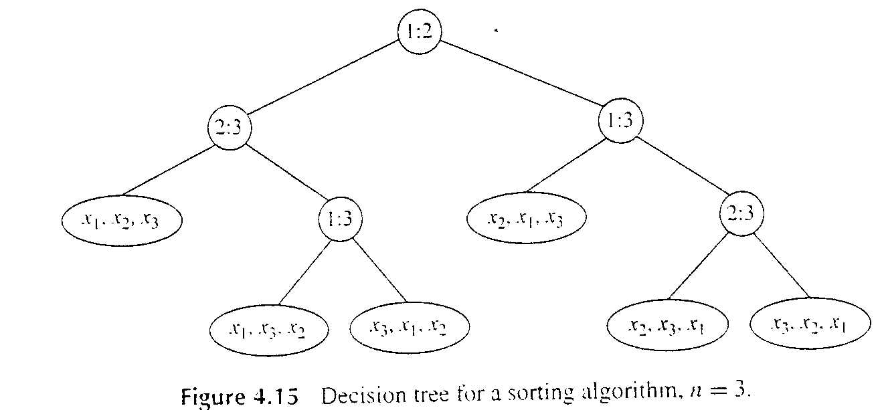
Decision tree for sorting algorithms
Remember, the action of sort on a particular input corresponds to following one path in its decision tree from the root to a leaf.
Some sort, for n = 3

Slide 67
Lower Bound for Worst Case
Reminder: a tree’s height is number of “levels” minus 1
Height of this decision tree is the W(n) number of comparisons
Theorem:
Let L be the number of leaves in a binary tree and let h be its height.
Then L ≤ 2^{h} (Number of leaves is no more than 2^{h})
Therefore h ≥ |lg L| (Height is not less than…)
For a correct sorting algorithm, L >= n!
Therefore, h ≥ |lg L| ≥ |lg n!|
Thus, for any algorithm that sorts by comparison of keys, W(n) is at least |lg n!|

Slide 68
Formula for the Lower Bound
Can we lose that factorial? Sure.
Stirling’s formula: (n/e)^{n} sqrt(2πn)
Take the log of this approximation of n! and you’ll see that it’s Θ(n lg n)
Better to re-write, use integrals, and…
See me or a textbook for details (but not ours)
Result:
which is of course Θ(n lg n)
Mergesort is very close to optimal
But not for all values of n

Slide 69
Lower Bound for Average Behavior
How would you find the L.B. for A(n)?
Consider all paths through the decision tree. (Messy, huh?)
We won’t prove this, but it’s in many textbooks (not ours)
This Theorem has been shown:
The average number of comparisons done by an algorithm to sort n items by comparison of keys is at least lg n!
or approximately n lg n – 1.443 n
The only difference from the worst-case lower bound is that there is no rounding up to an integer
the average needs not be an integer,
but the worst case must be.
Note: LB for average-case is close to LB for worst-case
This tells us that Mergesort can’t be much better on average than it is in the worst-case

Slide 70
Summing Up So Far
Our lower-bound proof shows any algorithm must be Ω(n lg n) in the worst-case if it works by comparing keys
More precisely,
Algorithms that can sort any type do key-comparisons
Mergesort and Quicksort are in this order-class
Mergesort is very close to the L.B. (but not in-place)
But quicksort will run faster generally
Why? Constants and lower-order terms are smaller. In other words, the overhead per comparison is less.
But Quicksort really could be Θ(n²) at its worst
It does use stack space for recursion
One more sort: Heapsort! In-place and Θ(n lg n)

