Slide 1
Graphs
CS 4102: Algorithms
Spring 2011
Aaron Bloomfield

Slide 2
Graph Basics

Slide 3
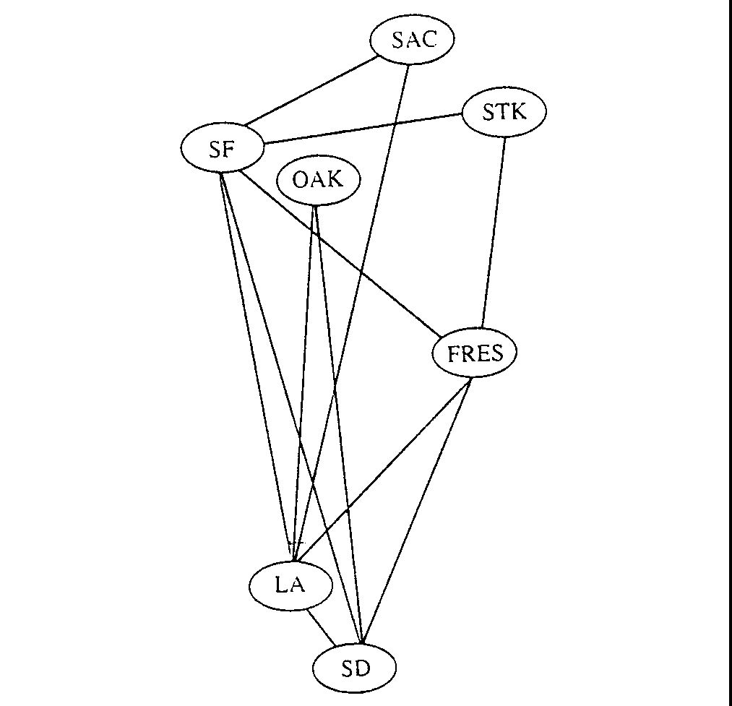
Problems: e.g. Airline Routes

Slide 4
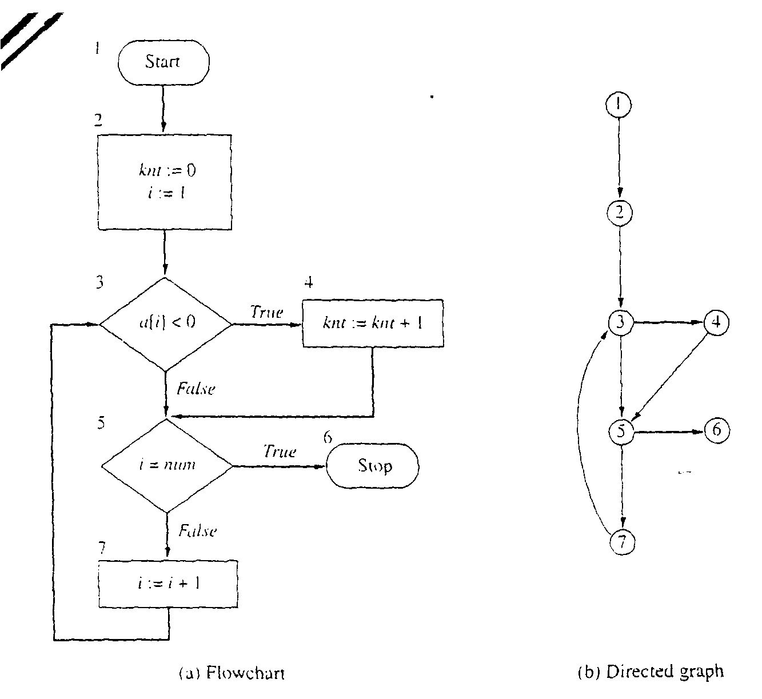
Problems: e.g. Flowcharts

Slide 5
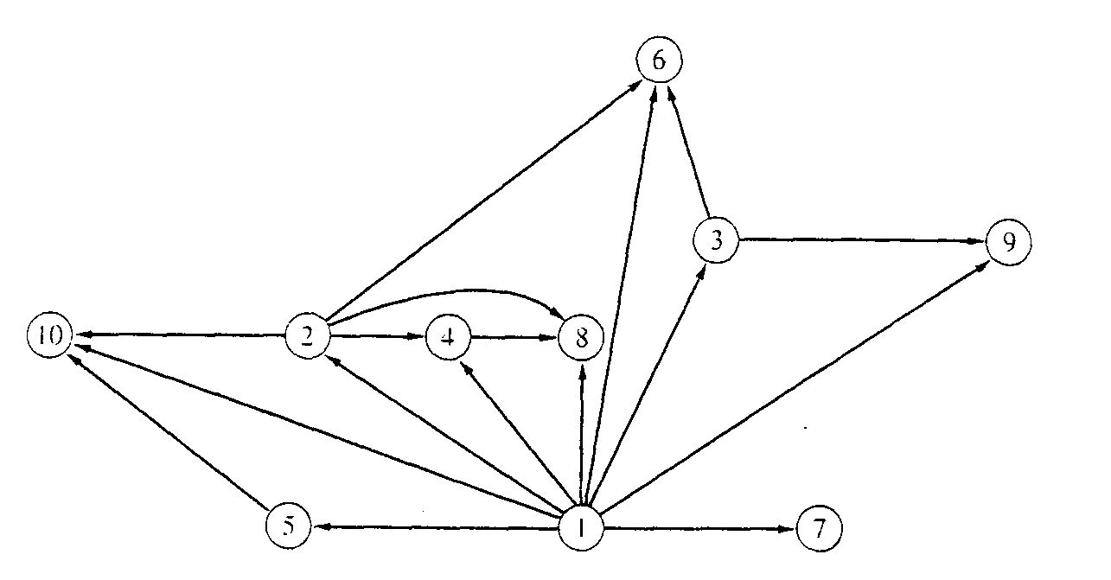
Problems: e.g. Binary relation
x is a proper factor of y

Slide 6
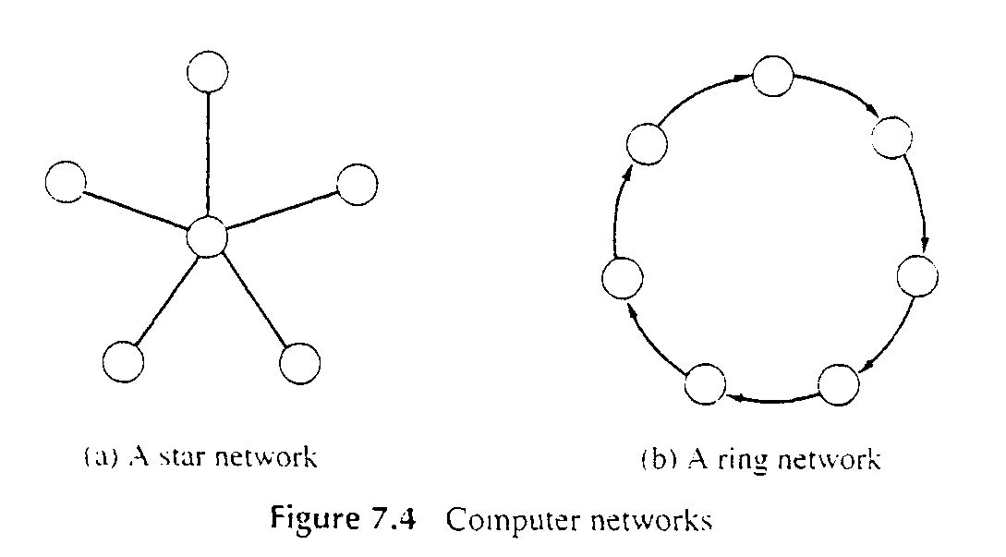
Problems: e.g. Computer Networks

Slide 7
Terms You Should Know or Learn Now
Vertex (plural vertices) or Node
Edge (sometimes referred to as an arc)
Note the meaning of incident
Degree of a vertex: how many adjacent vertices
Digraph: in-degree (num. of incoming edges) vs. out-degree
Graphs can be:
Directed or undirected
Weighted or not weighted
weights can be reals, integers, etc.
weight also known as: cost, length, distance, capacity,…
Undirected graphs:
Normally an edge can’t connect a vertex to itself
A directed graph (also known as a digraph)
“Originating” node is the head, the target the tail
An edge may connect a vertex to itself

Slide 8
Terms You Should Know or Learn Now
Size of graph? Two measures:
Number of nodes. Usually n
Number of edges: usually m
Dense graph: many edges
Maximally dense?
Undirected: each node connects to all others, so m = n(n-1)/2 Called a complete graph
Directed: m = n(n-1) why?
Sparse graph: fewer edges
Could be zero edges…

Slide 9
Terms You Should Know or Learn Now
Path vs. simple path
One vertex is reachable from another vertex
A connected graph
undirected graph, where each vertex is reachable from all others
A strongly connected digraph:
direction affects this!
node u may be reachable from v, but not v from u
Strongly connected means both directions
Connected components for undirected graphs

Slide 10
Terms You Should Know or Learn Now
Cycle
Directed graph: non-empty path with same starting and ending node
An edge may appear more than once (but why?)
Simple cycle: no node repeated except start and end
Undirected graph: same idea
If an edge appears more than once (I.e. non-simple) then we traverse it in the same direction
Acyclic: no-cycles
A connected, acyclic undirected graph: free tree
If we specificy a root, it’s a rooted tree
Acyclic but not connected? a undirected forest
Directed acyclic graph: a DAG

Slide 11
Self-test: Understand these Terms?
Subgraph
Symmetric digraph
complete graph
Adjacency relation
Path, simple path, reachable
Connected, Strongly Connected
Cycle, simple cycle
acyclic
undirected forest
free tree, undirected tree
rooted tree
Connected component

Slide 12
Definition: Directed graph
Directed Graph
A directed graph, or digraph, is a pair
G = (V, E)
where V is a set whose elements are called vertices, and
E is a set of ordered pairs of elements of V.
Vertices are often also called nodes.
Elements of E are called edges, or directed edges, or arcs.
For directed edge (v, w) in E, v is its tail and w its head;
(v, w) is represented in the diagrams as the arrow, v -> w.
In text we simple write vw.

Slide 13
Definition: Undirected graph
Undirected Graph
A undirected graph is a pair
G = (V, E)
where V is a set whose elements are called vertices, and
E is a set of unordered pairs of distinct elements of V.
Vertices are often also called nodes.
Elements of E are called edges, or undirected edges.
Each edge may be considered as a subset of V containing two elements,
{v, w} denotes an undirected edge
In diagrams this edge is the line v---w.
In text we simple write vw, or wv
vw is said to be incident upon the vertices v and w

Slide 14
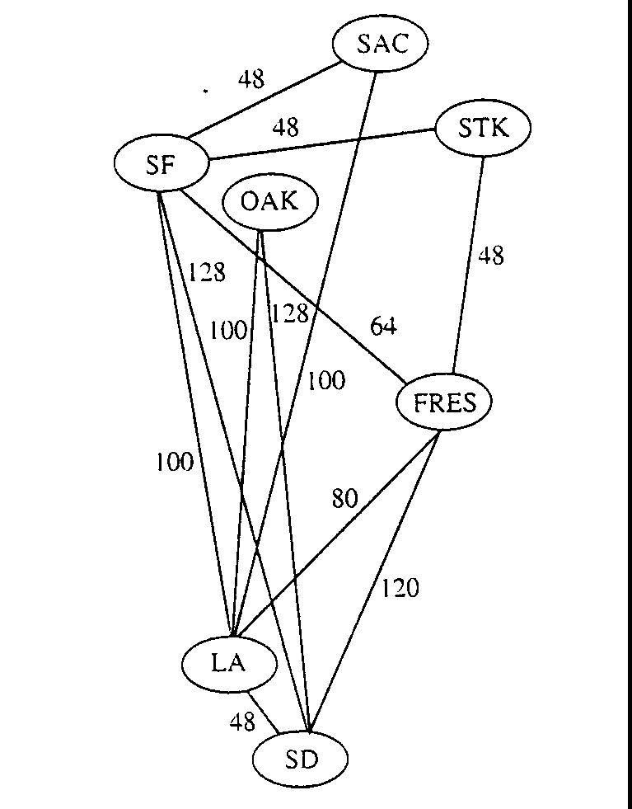
Definitions: Weighted Graph
A weighted graph is a triple (V, E, W)
where (V, E) is a graph (directed or undirected) and
W is a function from E into R, the reals (integer or rationals).
For an edge e, W(e) is called the weight of e.

Slide 15
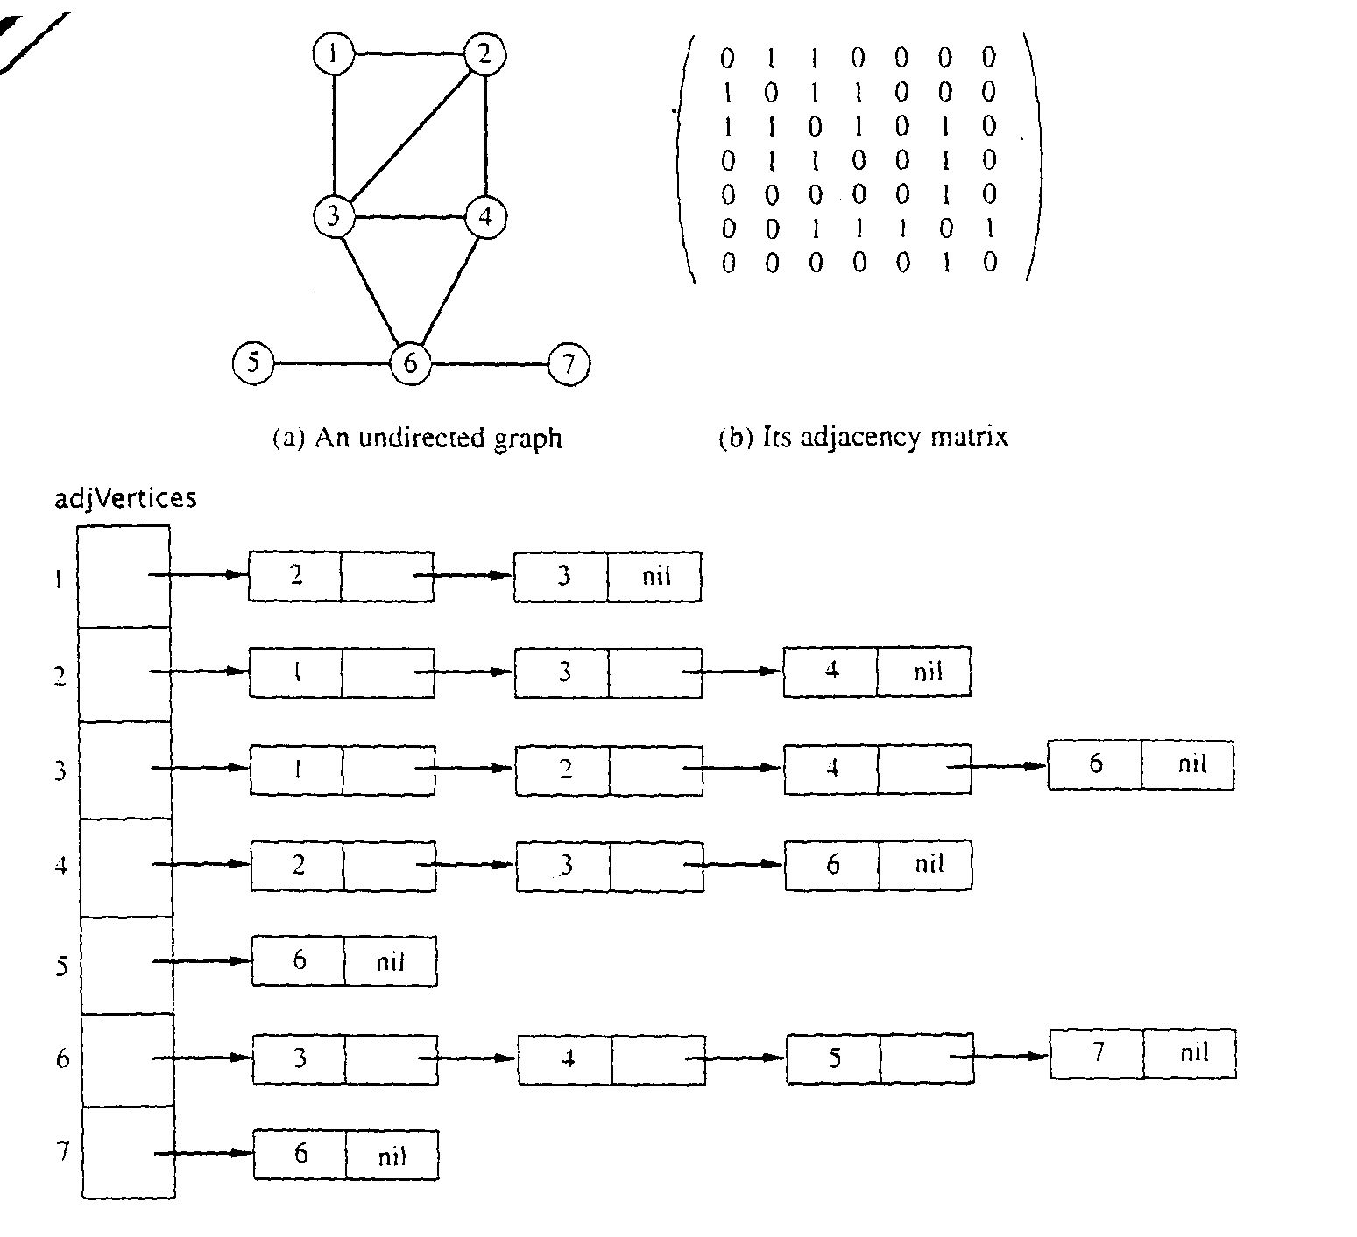
Graph Representations using Data Structures
Adjacency Matrix Representation
Let G = (V,E), n = |V|, m = |E|, V = {v1, v2, …, vn)
G can be represented by an n × n matrix

Slide 16
Array of Adjacency Lists Representation

Slide 17
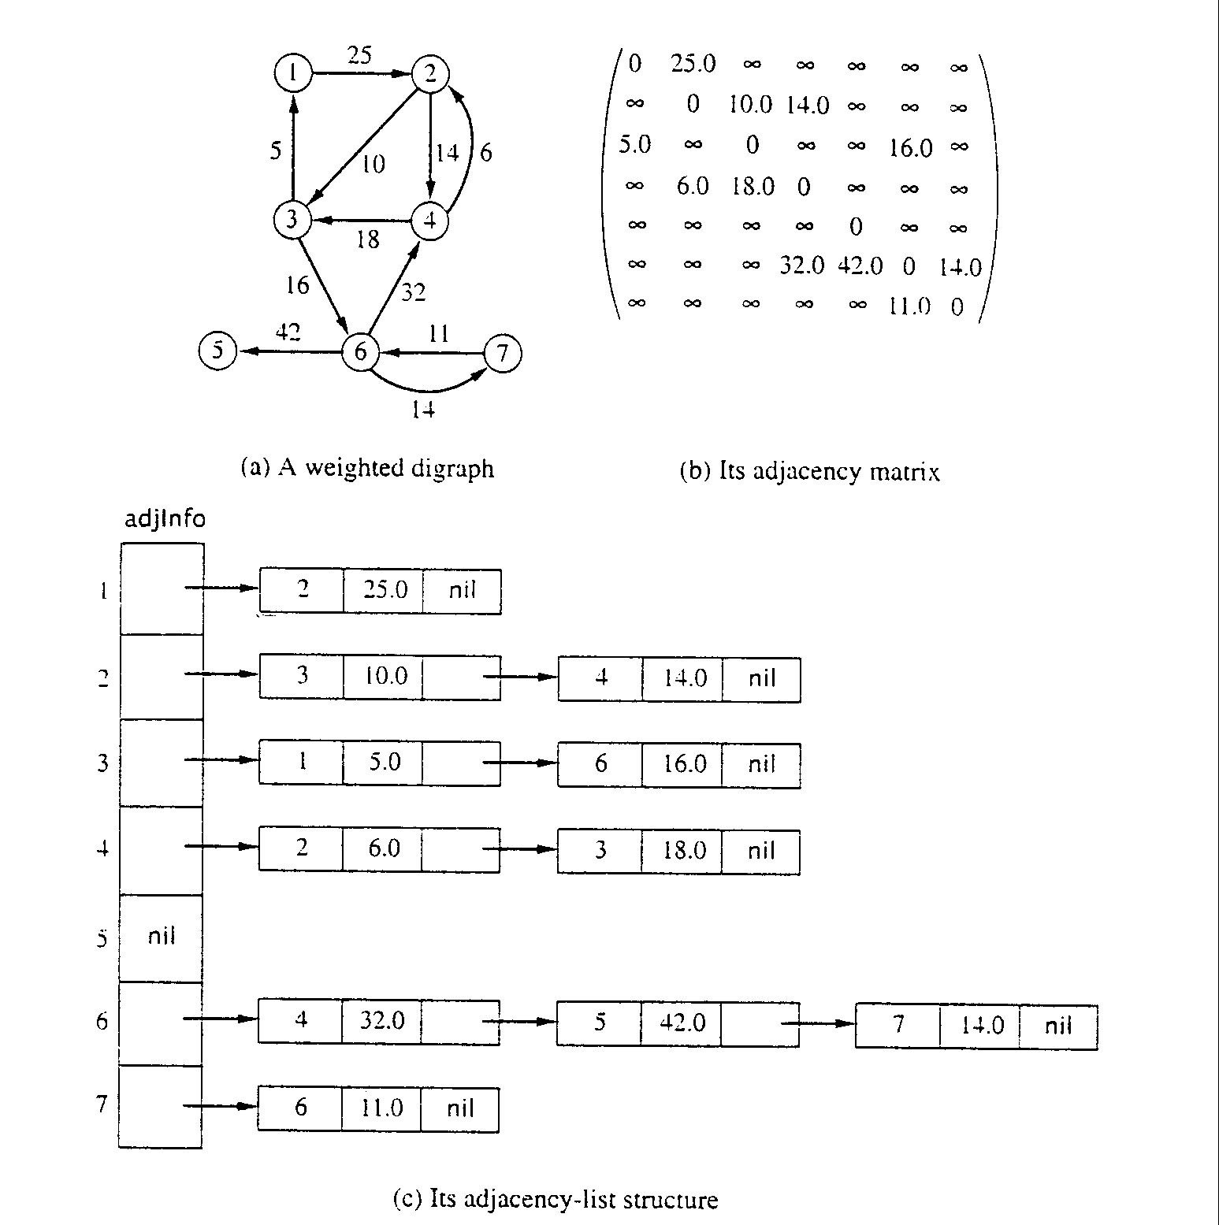
Adjacency Matrix for weight digraph

Slide 18
Array of Adjacency Lists Representation
from -> to, weight

Slide 19
Breadth-First Search

Slide 20
Traversing Graphs
“Traversing” means processing each vertex edge in some organized fashion by following edges between vertices
We speak of visiting a vertex. Might do something while there.
Recall traversal of binary trees:
Several strategies: In-order, pre-order, post-order
Traversal strategy implies an order of visits
We used recursion to describe and implement these
Graphs can be used to model interesting, complex relationships
Often traversal used just to process the set of vertices or edges
Sometimes traversal can identify interesting properties of the graph
Sometimes traversal (perhaps modified, enhanced) can answer interesting questions about the problem-instance that the graph models

Slide 21
Traversal Strategies
Note: traversal algorithms start at some vertex
Which? Trees have a root, but graphs don’t.
Might matter, might not.
Breadth-first search and depth-first search
efficient way to “visit” each vertex and edge exactly once.
Later we’ll see exhaustive search
Can visit vertices and edges more than once
Exhaustively finds… (wait and see!)
We’ll see that BFS will tell us something about distances between a vertex and other vertices
We’ll see that DFS will be a generally useful approach for solving many graph problems.

Slide 22
BFS Strategy
Breadth-first search: Strategy (for digraph)
choose a starting vertex, distance d = 0
vertices are visited in order of increasing distance from the starting vertex,
examine all edges leading from vertices (at distance d) to adjacent vertices (at distance d+1)
then, examine all edges leading from vertices at distance d+1 to distance d+2, and so on,
until no new vertex is discovered

Slide 23
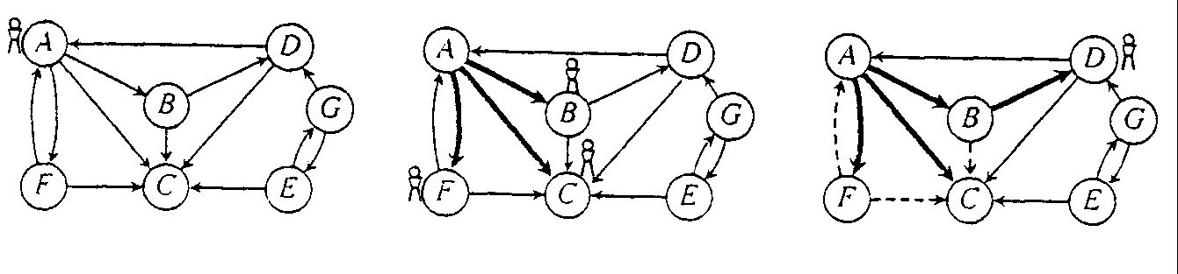
Breath-first search, e.g.
e.g. Start from vertex A, at d = 0
visit B, C, F; at d = 1
visit D; at d = 2
e.g. Start from vertex E, at d = 0
visit G; at d = 1

Slide 24
BFS in Python
def bfs(graph, start):
parent = {}
color = {}
for v in graph:
color[v] = "white"
pending = Queue()
parent[start] = None
color[start] = "gray"
pending.add(start)
ctr = 0
while len(pending) > 0:
v = pending.remove()
ctr = ctr + 1
alist = graph.get_adjlist(v)
for w in alist:
if color[w] == "white":
color[w] = "gray"
pending.add(w)
parent[w] = (v, ctr)
color[v] = "black”
return parent
# Note: stores parent and “discovery” counter in parent

Slide 25
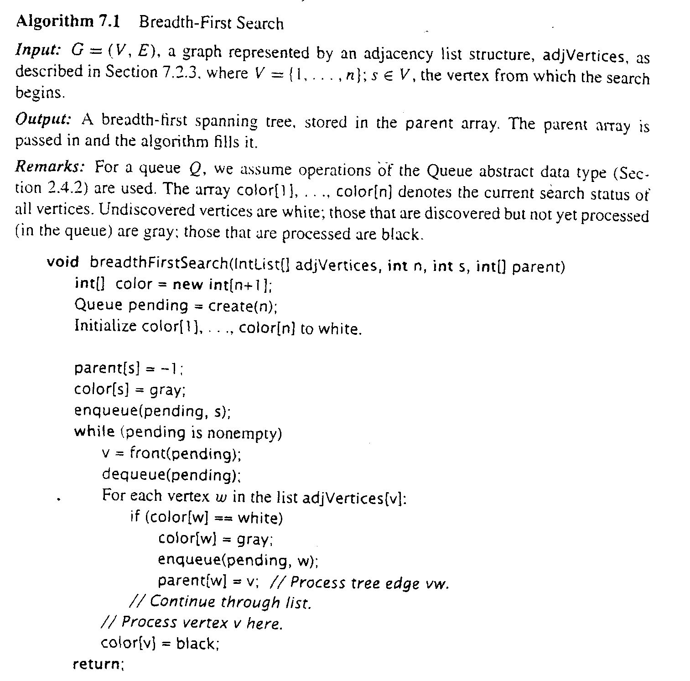
Breadth- first search: Algorithm

Slide 26
Breadth-first search: Analysis
For a digraph having n vertices and m edges
Each edge is processed once in the while loop for a cost of θ(m)
Each vertex is put into the queue once and removed from the queue and processed once, for a cost θ(n)
Extra space is used for color array and queue, there are θ(n)
From a tree (breadth-first spanning tree)
the path in the tree from start vertex to any vertex contains the minimum possible number of edges
Not all vertices are necessarily reachable from a selected starting vertex

Slide 27
Bipartite Graphs

Slide 28
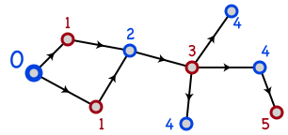
Bipartite Graphs
A graph is bipartite if node set V can be split into sets X and Y such that every edge has one end in X and one end in Y
X and Y are typically colored red and blue
Or Boolean true/false

Slide 29
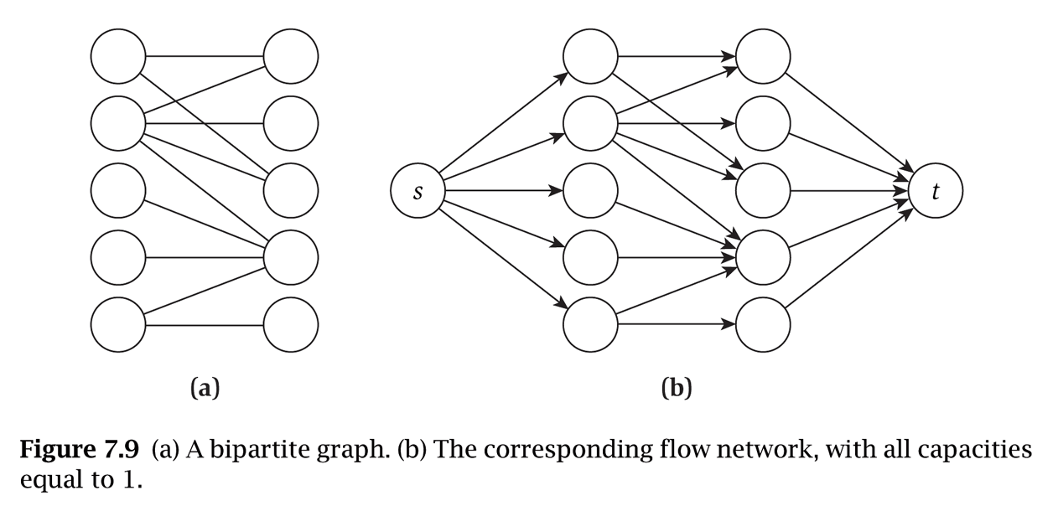
Notes and assumptions
We assume the graph is connected
Otherwise we will only look at each connected component individually
A triangle cannot be bipartite
In fact, any graph with an odd length cycle cannot be bipartite

Slide 30
Bipartite Determination Algorithm
Pick a starting vertex, color it red
Color all adjacent nodes blue
And all nodes adjacent to that red
Etc.
If you ever try coloring a red node blue, or a blue node red, then the graph is not bipartite
Does this algorithm sound familiar?

Slide 31
Depth-First Search

Slide 32
DFS: the Strategy in Words
Depth-first search: Strategy
Go as deep as can visiting un-visited nodes
Choose any un-visited vertex when you have a choice
When stuck at a dead-end, backtrack as little as possible
Back up to where you could go to another unvisited vertex
Then continue to go on from that point
Eventually you’ll return to where you started
Reach all vertices? Maybe, maybe not
Things are a bit different for directed vs. undirected graphs
It’s not really that different, until you get interested in using DFS to find cycles

Slide 33
Observations about the DFS Strategy
Note: we must keep track of what nodes we’ve visited
DFS traverses a subset of E (the set of edges)
Creates a tree, rooted at the starting point: the Depth-first Search Tree (DFS tree)
Each node in the DFS tree has a distance from the start. (We often don’t care about this, but we could.)
At any point, all nodes are either:
Un-discovered
Finished (you backed up from it), or
Discovered (I.e. visited) but not finished
On the path from the current node back to the root
We might back up to it
(Later we’ll call these states: white, black and gray)

Slide 34
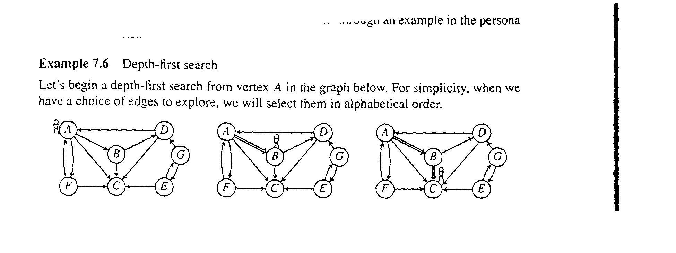
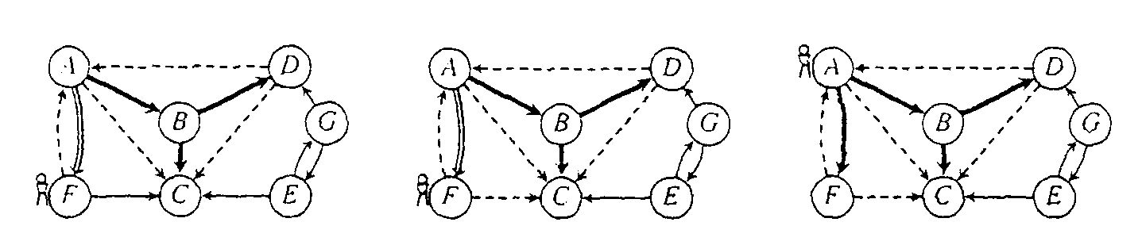
An Example of DFS
and so on…

Slide 35
Depth-first Search, e.g. trace it, in order
Vertex status: undiscovered, discovered, finished
Edge status: part of DFS tree or not?

Slide 36
Basic DFS in Python
def dfs0(graph, start):
visited = {}
dfs_recurs0(graph, start, visited)
def dfs_recurs0(graph, curnode, visited):
visited[curnode] = True
alist = graph.get_adjlist(curnode)
for v in alist:
if v not in visited:
print " dfs traversing edge:", curnode, v
dfs_recurs0(graph, v, visited)
# end for-all adj vertices
return

Slide 37
Recursive DFS visit function
dfs_recurs(adj,start) {
// reached node “start”; do something?
visit[start] = true
trav = adj[start]
while (trav != null) {
v = trav.ver
if (!visit[v])
dfs_recurs(adj,v)
trav = trav.next
}
// about to leave “start”; do something?
}
Sometimes called dfs_visit().

Slide 38
Calling Function for DFS
Purpose: do all required initializations, then call dfs_recurs() at a given node (just one call)
Input Parameters: adj, start
Output Parameters: None
dfs(adj,start) {
// do any initializations
n = adj.last
for i = 1 to n
visit[i] = false
// one call to recursive function at start
dfs_recurs(adj,start)
}

Slide 39
DFS to Process all Vertices in a Graph
Purpose: do all required initializations, then call dfs_recurs() as many times as needed to visit all nodes. May create a DFS forest.
dfs_sweep(adj) {
n = adj.last
// do any initializations
for i = 1 to n
visit[i] = false
// loop called on any unvisited node
for i = 1 to n
if (!visit[i]) dfs_recurs(adj, i)
}

Slide 40
Notes on dfs_recurs() function
Often called “dfsVisit” (or something like that)
Creates one DFS tree from a given start node
Must be called by some caller function
May not visit all nodes in a the graph G
Assumes that all nodes have been initialized as “undiscovered”
Sometimes an “else” clause that does something to nodes not visited (or edges to those)

Slide 41
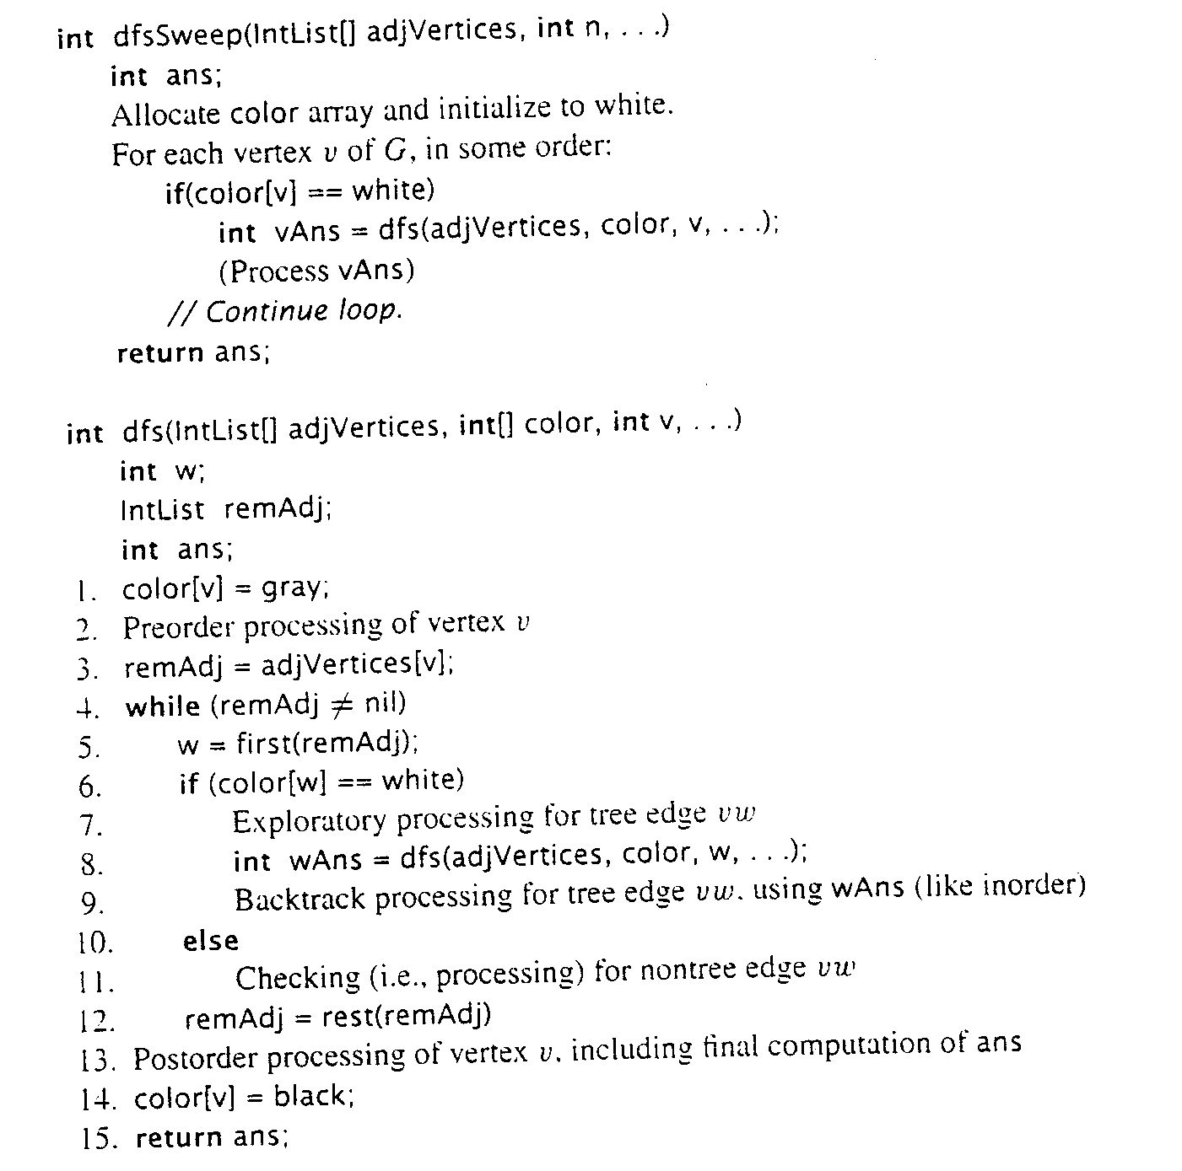
General Skeleton Similar to DFS_recurs (Cormen)

Slide 42
Using DFS to Find if a Graphic is Acyclic
Does a graph have a cycle?
DFS is great for this
But, slightly harder if graph is undirected
Use DFS tree: classify edges and nodes as you process them
Nodes:
White: unvisited
Black: done with it, backed up from it (never to return)
Gray: Have reached it; exploring it’s adjacent nodes; but not done with it
Also, have a “time counter”, say, ctr
Set d[v] = ctr++ as discovery time
Set f[v] = ctr++ as finish time

Slide 43
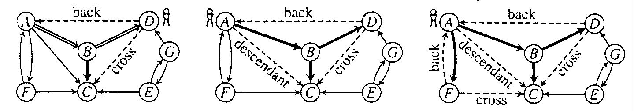
Depth-first search tree
edges classified:
tree edge, back edge, descendant edge, and cross edge

Slide 44
Using Non-Tree Edges to Identify Cycles
From the previous graph, note that:
Back edges (indicates a cycle)
dfs_recurs() sees a vertex that is gray
This back edge goes back up the DFS tree to a vertex that is on the path from the current node to the root
Cross Edges and Descendant Edges (not cycles)
dfs_recurs() sees a vertex that is black
Descendant edge: connects current node to a descendant in the DFS tree
Cross edge: connects current node to a node in another subtree – not a descendant of current node

Slide 45
Non-tree Edges in DFS
Question 1: Finding back edges for an undirected graph is not quite this simple:
The parent node of the current node is gray
Not a cycle, is it? It’s the same edge you just traversed
Question: how would you modify our code to recognize this?
Question 2:
In digraph, how could you modify the code to distinguish cross edges from descendant edges?
Hint: use discovery and finish times

Slide 46
Time Complexity of DFS
For a digraph having n vertices and m edges
Each edge is processed once in the while loop of dfs_recurs() for a cost of θ(m)
Think about adjacency list data structure.
Traverse each list exactly once. (Never back up)
There are a total of 2m nodes in all the lists
The dfs_sweep() algorithm will do θ(n) work even if there are no edges in the graph
Thus over all time-complexity is θ(n+m)
Remember: this means the larger of the two values
Note: This is considered “linear” for graphs since there are two size parameters for graphs.
Extra space is used for color array.
Space complexity is θ(n)

Slide 47
Topological Sort

Slide 48
Directed Acyclic Graphs
A directed acyclic graph or DAG is a directed graph with no directed cycles:

Slide 49
Topological Sort
Topological sort of a DAG:
Linear ordering of all vertices in graph G such that vertex u comes before vertex v if edge (u, v) ∈ G
Real-world example: getting dressed

Slide 50
Getting Dressed
Underwear
Socks
Watch
Pants
Shoes
Shirt
Belt
Tie
Jacket

Slide 51
Getting Dressed
Underwear
Socks
Pants
Shoes
Watch
Shirt
Belt
Tie
This is the same graph with a different layout.
Jacket
Socks
Underwear
Pants
Shoes
Watch
Shirt
Belt
Tie
Jacket

Slide 52
Topological Sort Algorithm
Topological-Sort() {
Run DFS_recurs()
When a vertex is finished, output it
Vertices are output in reverse topological order (or add to stack/list)
}
Can stack/store vertices as found to store them in topologically sorted order
Time: O(n+m)

Slide 53
Topologoical Sort, Recursive Function
top_sort_recurs(adj, start, ts) {
visit[start] = true
trav = adj[start]
while (trav != null) {
v = trav.ver
if (!visit[v])
top_sort_recurs(adj,v,ts)
trav = trav.next
}
ts[k] = start
k = k – 1
}

Slide 54
Topological Sort: Driver
top_sort(adj, ts) {
n = adj.last
// k is the index in ts where the next vertex is to be
// stored in topological sort. k is assumed global.
k = n
for i = 1 to n
visit[i] = false
for i = 1 to n
if (!visit[v])
top_sort_recurs(adj, i, ts)
}
}

Slide 55
Forward vs. Reverse
Topological sort is a type of sort
Implies an ordering
Can sort backwards, of course
Forward topological order
If edge vw in graph, then topo[v] < topo[w]
Reverse topological order
If edge vw in graph, then topo[v] > topo[w]
And, every directed graph has a transpose, which means… (see next slide)

Slide 56
What’s an Edge Mean?
What’s our graph model?
Edge uv means do u first, then v. Or, …
Edge uv means task u depends on v (I.e. v must be done first)
The latter called a dependency graph
“forward in time” vs. “depend on this one”
Big deal? No, we can order vertices in reverse topological order if needed
Underwear
Underwear
Shoes
Shoes
Pants
Pants

Slide 57
Sort this!
3
2
4
1
5
6
9
7
8

Slide 58
Maximal Flow

Slide 59
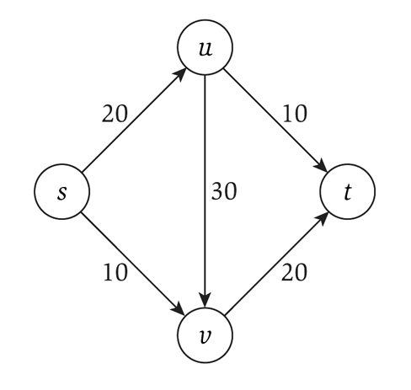
Flow networks
Consider a flow network, which is a specialized directed graph with:
A single source node s
A single terminus node t
Capacities on each edge
That must be integer!
What is the maximum flow you can send from s to t?

Slide 60
Applications
Transportation networks
How many people can be routed?
Computer networks
Electrical distribution
Water distribution
Note that all these applications have multiple sources and multiple sinks!
Whereas the flow networks we study do not, yet

Slide 61
Algorithm overview
Consider the residual capacities
Meaning how much capacity is left after taking into account how much flow is going through that edge
Find a path from s to t such that the minimum residual capacity is greater than zero
Since everything is integer, it must be 1 or more
Update the residual capacities after taking into account this new flow
Repeat until no more such paths are found

Slide 62
Backflow
Each edge has forward flow and backflow
The two must always be inverses of each other!
This allows for modeling of flow “returning” along a given edge

Slide 63
Algorithm notation
Graph G has vertices V and edges E
s ∈V is the source
t ∈V is the sink (terminus)
f(u,v): the flow on the edge from u to v
f(v,u): the backflow on the edge from v to u
c(u,v): the capacity on the edge from u to v
c_{f}(u,v): the residual capacity on the edge from u to v
G_{f} is the graph where the edges weights are the residual capacities

Slide 64
Ford-Fulkerson Algorithm
f(u,v) = 0 for all edges (u,v)
While there is an “augmenting” path p from s to t in G_{f} such that c_{f}(u,v) > 0 for all edges (u,v) ∈ p
Find c_{f}(p) = min{c_{f}(u,v) | (u,v) ∈ p}
For each edge (u,v) ∈ p
f(u,v) = f(u,v) + c_{f}(p) send flow along the path
f(v,u) = f(v,u) - c_{f}(p) send backflow the other way

Slide 65
Running time
Is O(mf)
m is the number of edges
Maximum time to find an augmenting path via depth-first search
Can also use breadth-first search!
f is the maximum flow of the final graph
Minimum flow on an augmenting path is 1, so the maximum number of steps is thus f

Slide 66
What type of search?
“While there is a path p from s to t in G_{f}”
A depth-first search is the Ford-Fulkerson algorithm
Each augmenting path can be found in O(m) time
And there can be f paths
So the running time is O(mf)
Will not terminate with irrational edge values
A breadth-first search is the Edmonds-Karp algorithm
Runs in O(nm²)
Total number of augmentations is O(nm)
And finding each augmentation takes O(m)
Guaranteed termination with irrational edge values
Run-time is independent of the maximum flow of the graph

Slide 67
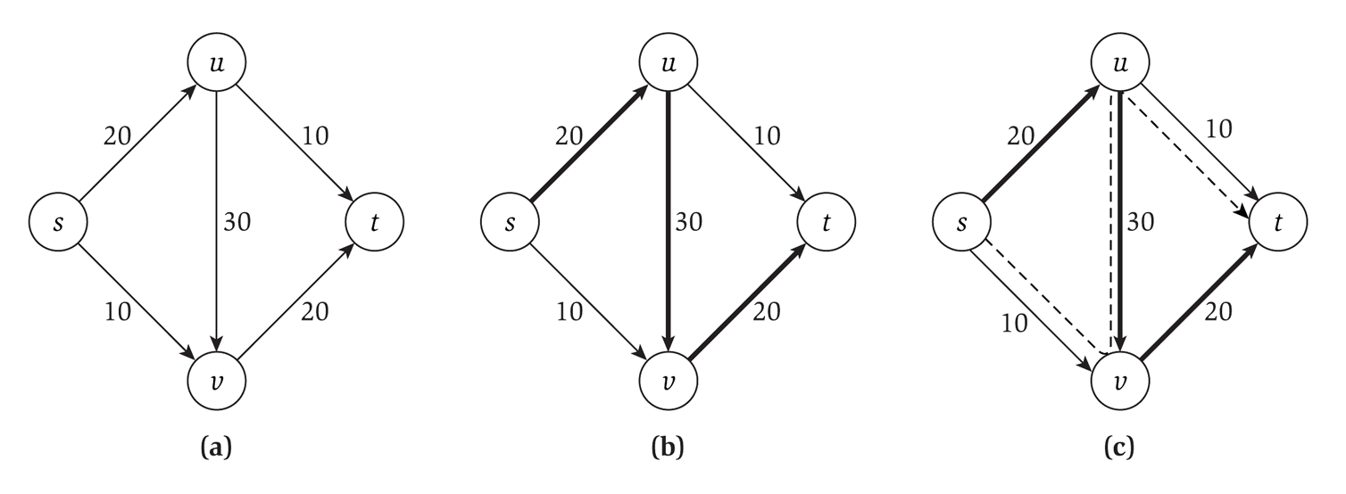
Our example

Slide 68
Minimum Cut

Slide 69
Minimum Cut
Given a flow network, we want to cut edges…
Really, just reduce their capacities, possibly to zero
… such that no flow can progress from s to t
And we want the cut to be as minimum as possible
Given a flow network, how do we determine the minimum cut?

Slide 70
Max-flow min-cut theorem
The max-flow min-cut theorem states that the maximum value of an s-t flow is equal to the minimum capacity of an s-t cut

Slide 71
How to determine the min cut?
Use the Ford-Fulkerson algorithm to determine max flow
Time is O(mf)
Worst case is each edge needs a cut
So we can determine the min cut in O(m) additional time
O(mf) + O(m) = O(mf)

Slide 72
Reductions

Slide 73
Algorithm for min-cut
Imagine that I presented you with a new algorithm to determine min-cut
Everybody uses max-flow to determine min-cut, but imagine it anyway
What could you tell me about that algorithm?
About it’s running time?

Slide 74
Max-flow vs. min-cut
These two problems are “equivalent”
Specifically, if you can solve one, you can solve the other
Alternatively, we can say that one problem reduces to the other
The problem of finding min-cut reduces to the problem of finding max-flow (plus a polynomial time conversion)

Slide 75
Reduction
A reduction is a transformation of one problem into another problem
Min-cut is reducible to max-flow because we can use max-flow to solve min-cut
Formally, problem A is reducible to problem B if we can use a solution to B to solve A
We note that the reduction happens in polynomial time
And signify it with a ≤_{p}

Slide 76
Reducing both ways
We know that:
Min-cut ≤_{p} max-flow
Max-flow ≤_{p} min-cut
Because they reduce both ways, they are polynomial-time equivalent
Often times you can’t directly compare algorithms
So you show that they reduce both ways

Slide 77
Bipartite Matching

Slide 78
Bipartite Matching
Given a bipartite graph G, can we find a matching M in G such that M ⊆ E and each node appears on exactly one of M
In other words, find a subset of edges that connect every node on the left to one (and only one!) node on the right
Since the graph is bipartite, all edges connect one on the left with one on the right

Slide 79
Reduction!
To solve this, we reduce it to a maximal flow problem by creating a graph G’:
Direct all edges from the left to the right
Add a source node, with edges to every node on the left side
Add a terminus node, with edges to every node on the right side
Compute maximal flow!
The maximal flow in G’ is the maximum matching in G

Slide 80
Reduction, diagrammatically

Slide 81
Why does this work?
Each node on the left can be in at most one matching
This is enforced by the edge of capacity one leading into it
Likewise for each node on the right
The bottleneck will be how it flows across the bipartite “barrier”

Slide 82
Reduction details
We have transformed (in polynomial time) a bipartite matching problem into a maximal flow problem
Specifically, bipartite-matching ≤_{p} max-flow
Because we can transform bipartite matching to max-flow in polynomial time
But is it the case that max-flow ≤_{p} bipartite-matching?
Not so much: a solution to bipartite matching does not help us with a non-bipartite graph

Slide 83
Running time
Max flow runs in O(mf)
But the max flow is (at most) n/2
If every node in the graph has flow through it, then there are n/2 units of flow moving through the graph
So the running time is equivalent to O(mn)

Slide 84
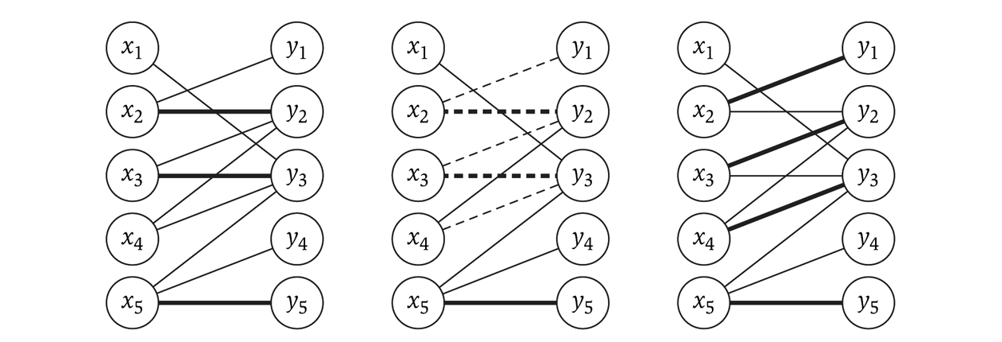
Imperfect bipartite matchings
These exist, and the algorithm may produce them, depending on the graph
The following shows an augmenting path (in the middle) used to achieve the maximal flow on the right

Slide 85
Max-flow variations

Slide 86
Finding a Circulation
Real world applications don’t have just one source and sink
Instead there are multiple ones: power production / consumption, etc.
We designate a set S to be all the nodes that are sources
We can also view them has having negative demand
Likewise, we designate a set T to be all the nodes that are sinks
They have positive demand
Networks with multiple sources and sinks (modeled using demand) are called circulation networks

Slide 87
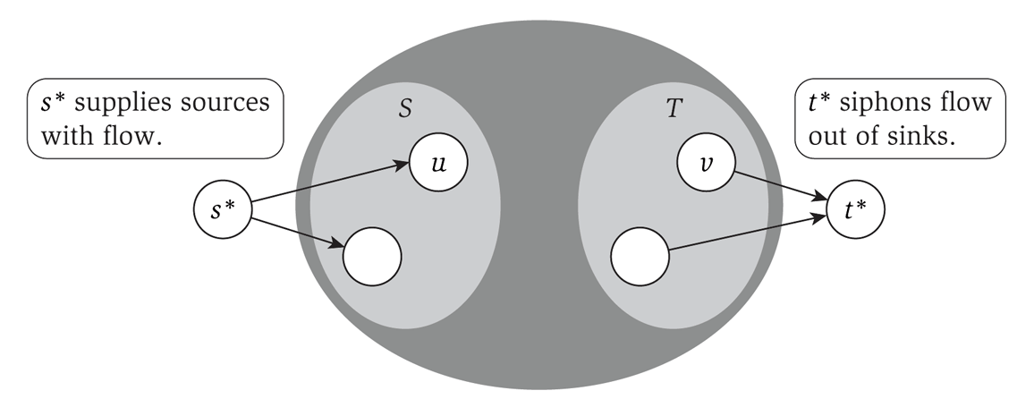
Reduction to max-flow
With a few modifications, we can make this a max-flow problem:
Create a ‘super source’ s* with edges to each node in S
The capacity of that edge is the size of the source of the node in S
Likewise with the set T

Slide 88
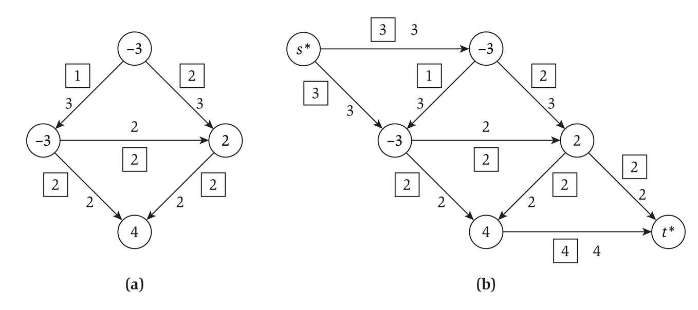
Conversion example
Converting a graph with multiple sources and sinks to a single-source-single-sink max-flow problem:

Slide 89
Circulation notes
A circulation problem is aiming for feasibility, not max flow
But we use max flow to solve it
We set each edge from the super-source to each individual source to be the absolute value as the individual source’s demand
Max-flow is then run
If the total amount leaving the single-source is the SAME as the capacity of each outgoing edge, then the circulation is feasible

Slide 90
Edge lower bounds
So far, we have considered only the capacity of an edge: the upper bound on the flow
We also want to consider a lower bound on the flow on an edge
i.e. forcing a certain amount of flow through an edge
We will reduce this to a circulation problem
Which can then be reduced to a max-flow problem

Slide 91
Handling lower bounds
A lower bound forces flow across an edge
Which increases demand at the start of the edge (to compensate for the flow across the edge)
And decreases demand at the terminus of the edge (as some flow is fulfilling the demand)

Slide 92
Solving a flow with lower bounds
Given a circulation network G, construct a new graph G’ such that for each edge e from u to v with a lower bound l_{e}:
We decrease the capacity on that edge by l_{e}
As that is the flow that is moving through the edge
We increase the demand at u by l_{e}
We decrease the demand at v by l_{e}
Then solve G’ as a circulation problem
i.e. add a super-sink and super-terminus, and solve as a max-flow problem

Slide 93
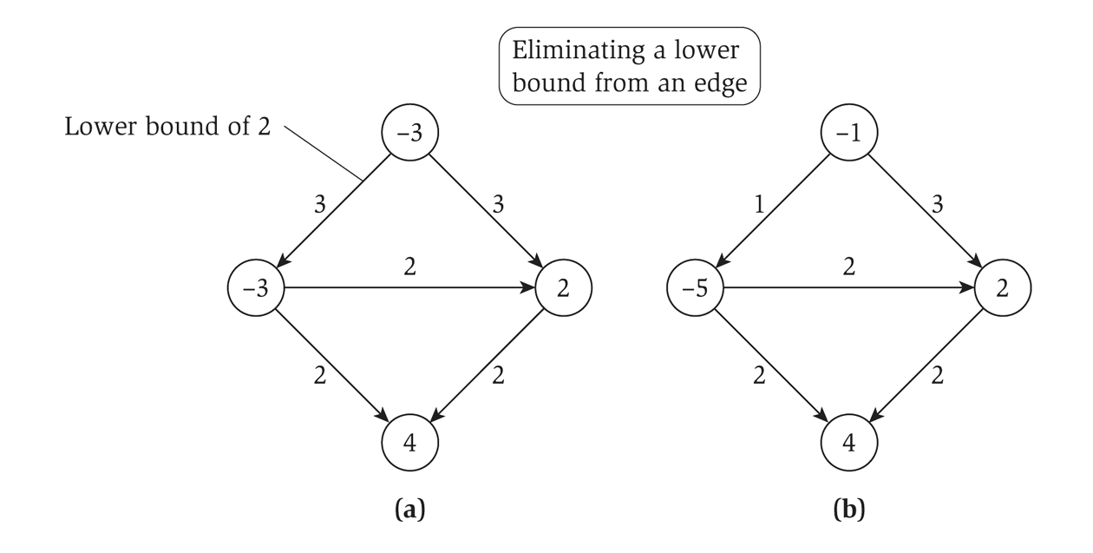
Eliminating a lower bound
Diagrammatically…

Slide 94
More applications of Max-Flow

Slide 95
Survey Design
Data is available on multiple customers who have bought various products
This is why you have ‘shoppers cards’ at various stores

Slide 96
Survey guidelines
Each customer will receive questions on products s/he has purchased
Don’t ask too may questions (nobody will respond): ask between c_{i} and c’_{i} questions
To get enough information, we need to ask a certain number of customers: ask between p_{j} and p’_{j} customers

Slide 97
Solving the design problem
We create a bipartite graph
On the left are the customers (the multiple sources), on the right are the products (the multiple sinks)
Edges connect customers with products they have bought
A super-source s has edges to each customer
The lower bound the minimum questions to ask; the upper bound is the most questions to ask
A super-sink has edges from each product
The lower bound is the minimum number of questions to be asked on that product; probably no need for an upper bound

Slide 98
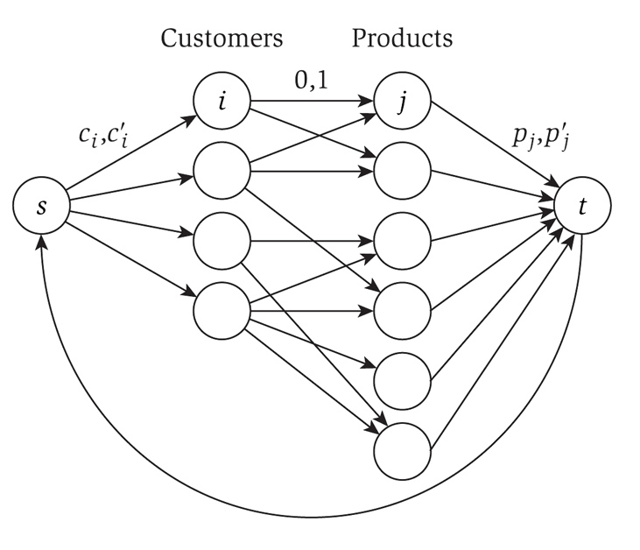
Solving the design problem
Note the edge from t to s
The total number of questions asked
The edges between customers and products have bounds of 0 & 1
We set all demands to zero
This bipartite graph is not meant to be 1:1!

Slide 99
Solving the design problem
At this point, it reduces to a the circulation problem
We can worry about the edge from t to s later, and just set s and t to very low/high demands
Ultimately, the flow out of s will equal the flow into t

Slide 100
Summary

Slide 101
Graph algorithms we know
From CS 2150, and discussed in the Greedy notes
Dijkstra’s shortest path
Prim’s MST
Kruskal’s MST
Traveling salesperson (NP-complete)
BFS & DFS search
Topological sort
Maximal flow / minimal cut
And variations on these: circulation, lower bounded max-flow, bipartite matching, survey design

