Slide 1
CS 4501: Game Design
Pathfinding
Section 5.4
Aaron Bloomfield

Slide 2
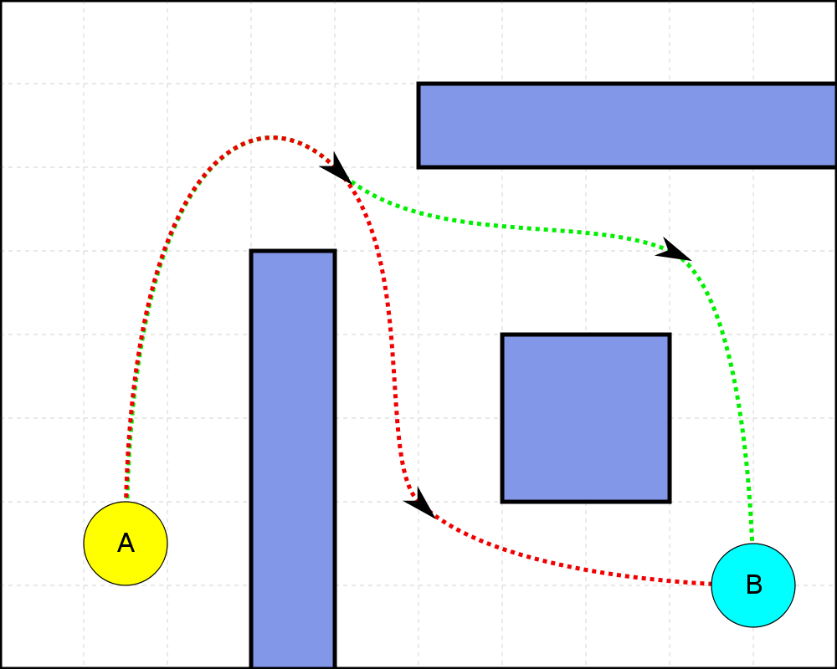
Introduction

Slide 3
Topics we’ll cover
Map types
Grids
Waypoint graphs
Navigation meshes
Algorithms
Random-trace
Breadth-first
Best-fit
Dijkstra
A*

Slide 4
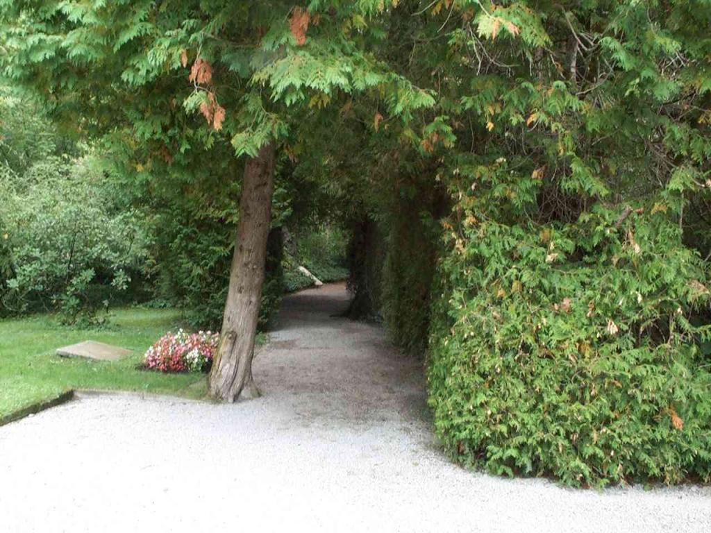
Representing the Search Space

Slide 5
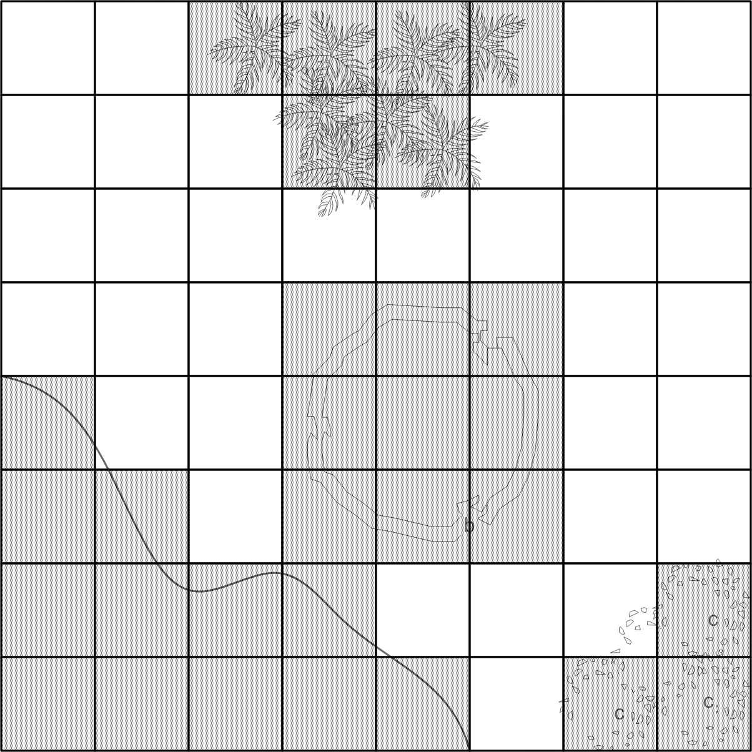
Grids

Slide 6
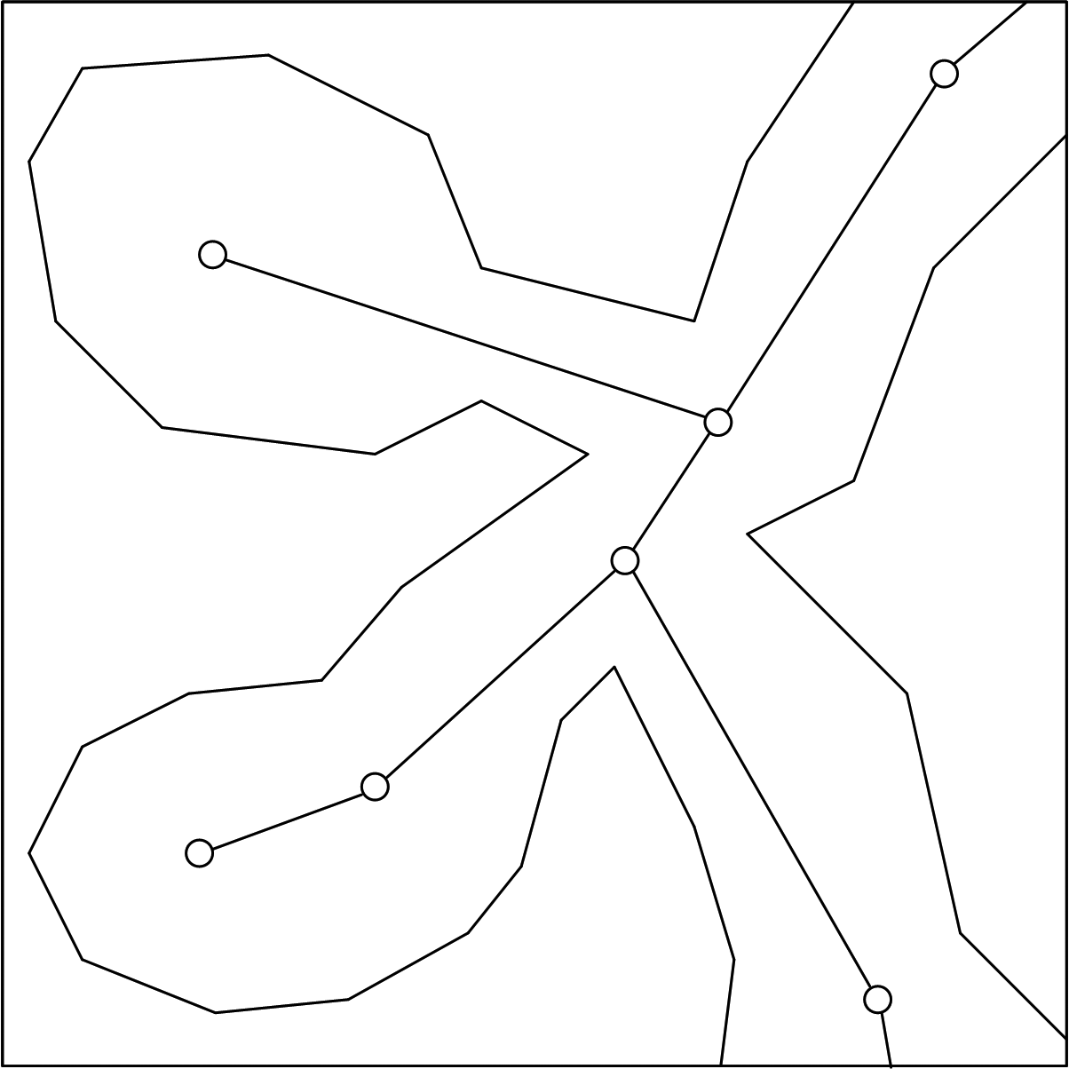
Waypoint Graph | Characteristics of

Slide 7
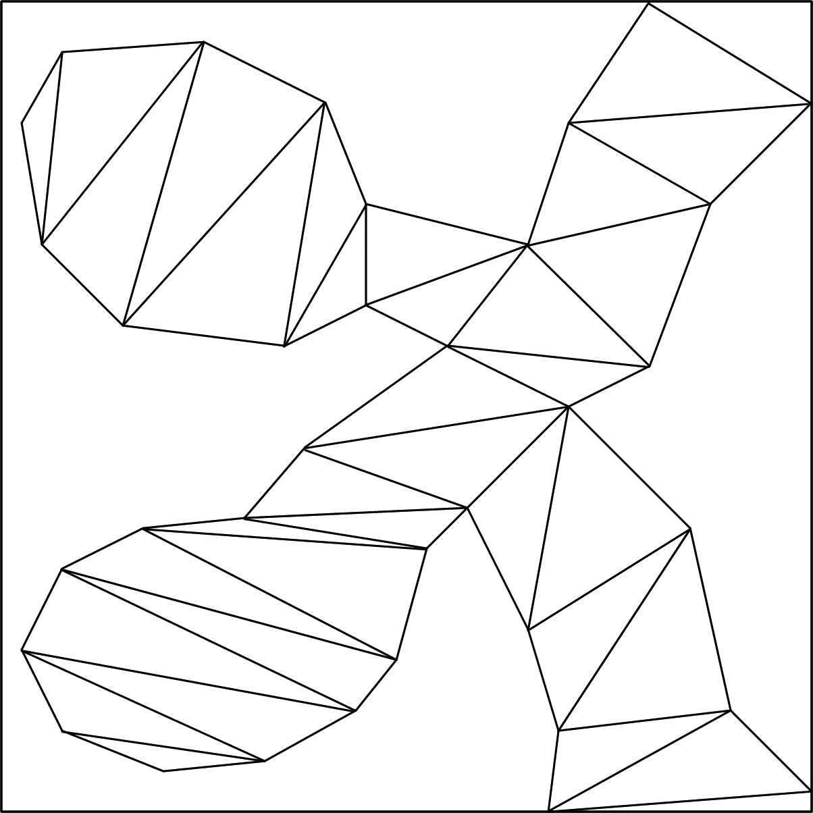
Navigation Meshes | Characteristics of

Slide 8

Searching for a Path | Criteria for Evaluating Pathfinding Algorithms

Slide 9
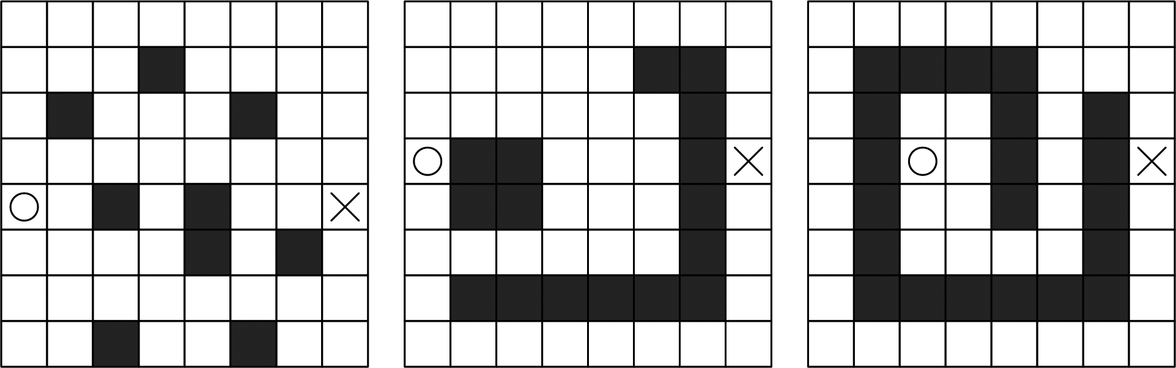
Random Trace

Slide 10
Understanding A*
class PlannerNode {
public:
PlannerNode *m_pParent;
int m_cellX, m_cellY;
...
};

Slide 11
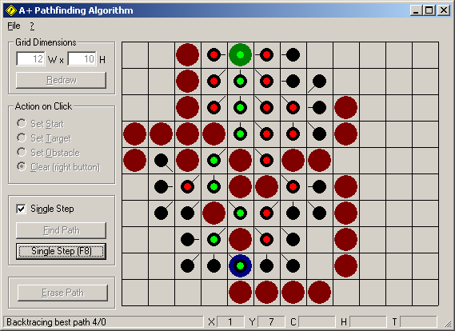
Understanding A*

Slide 12

Overall Structure of the Algorithms

Slide 13
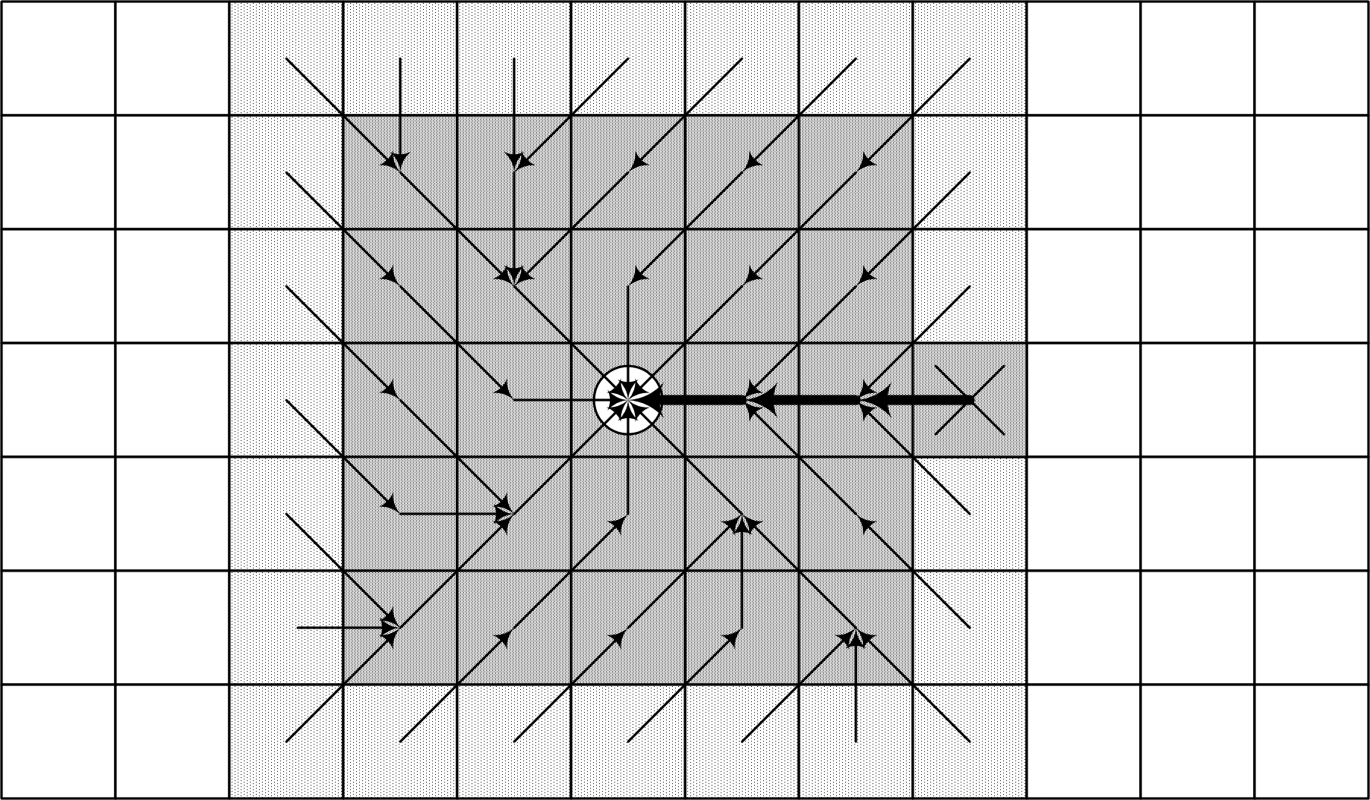
Breadth-First

Slide 14
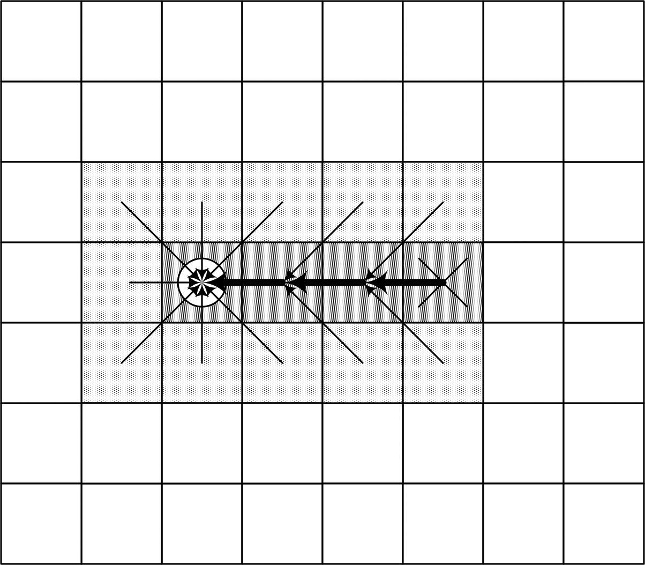
Best-First

Slide 15
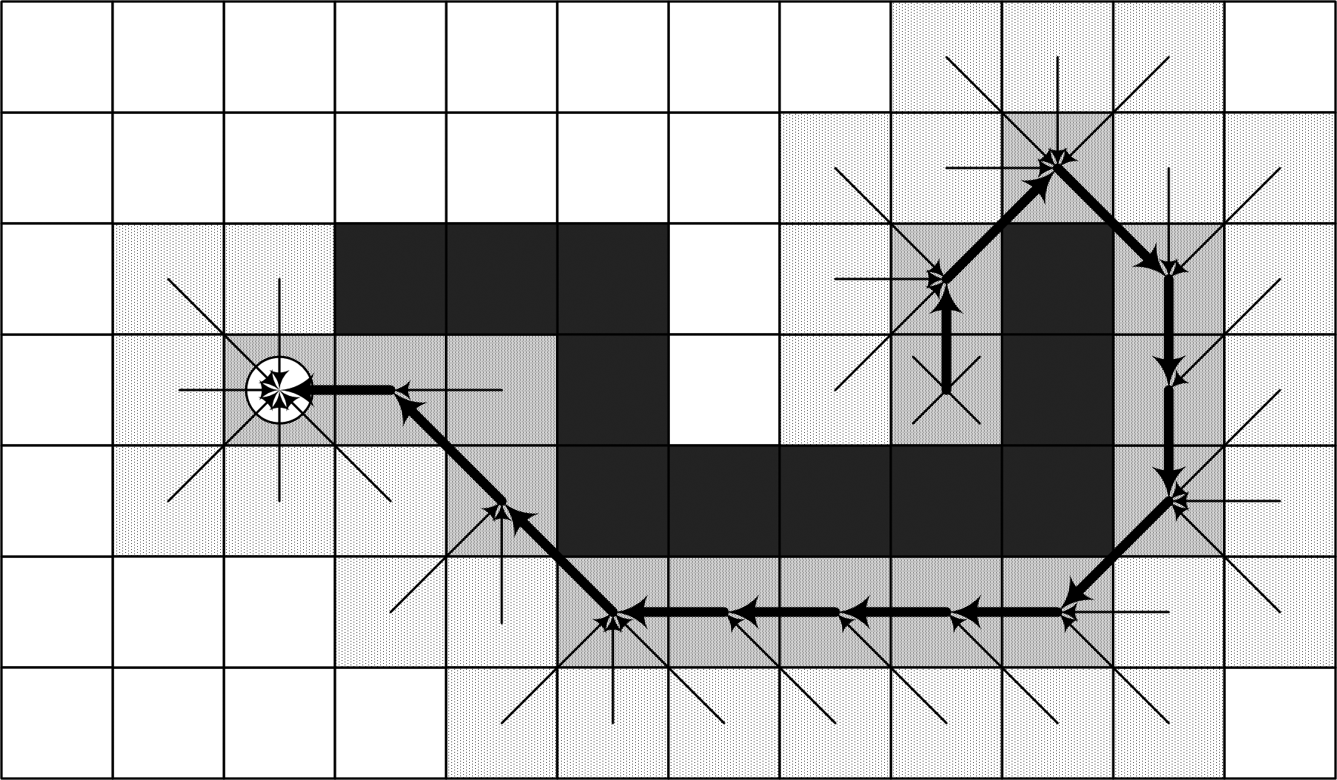
Best-First

Slide 16

Dijkstra | Characteristics of

Slide 17
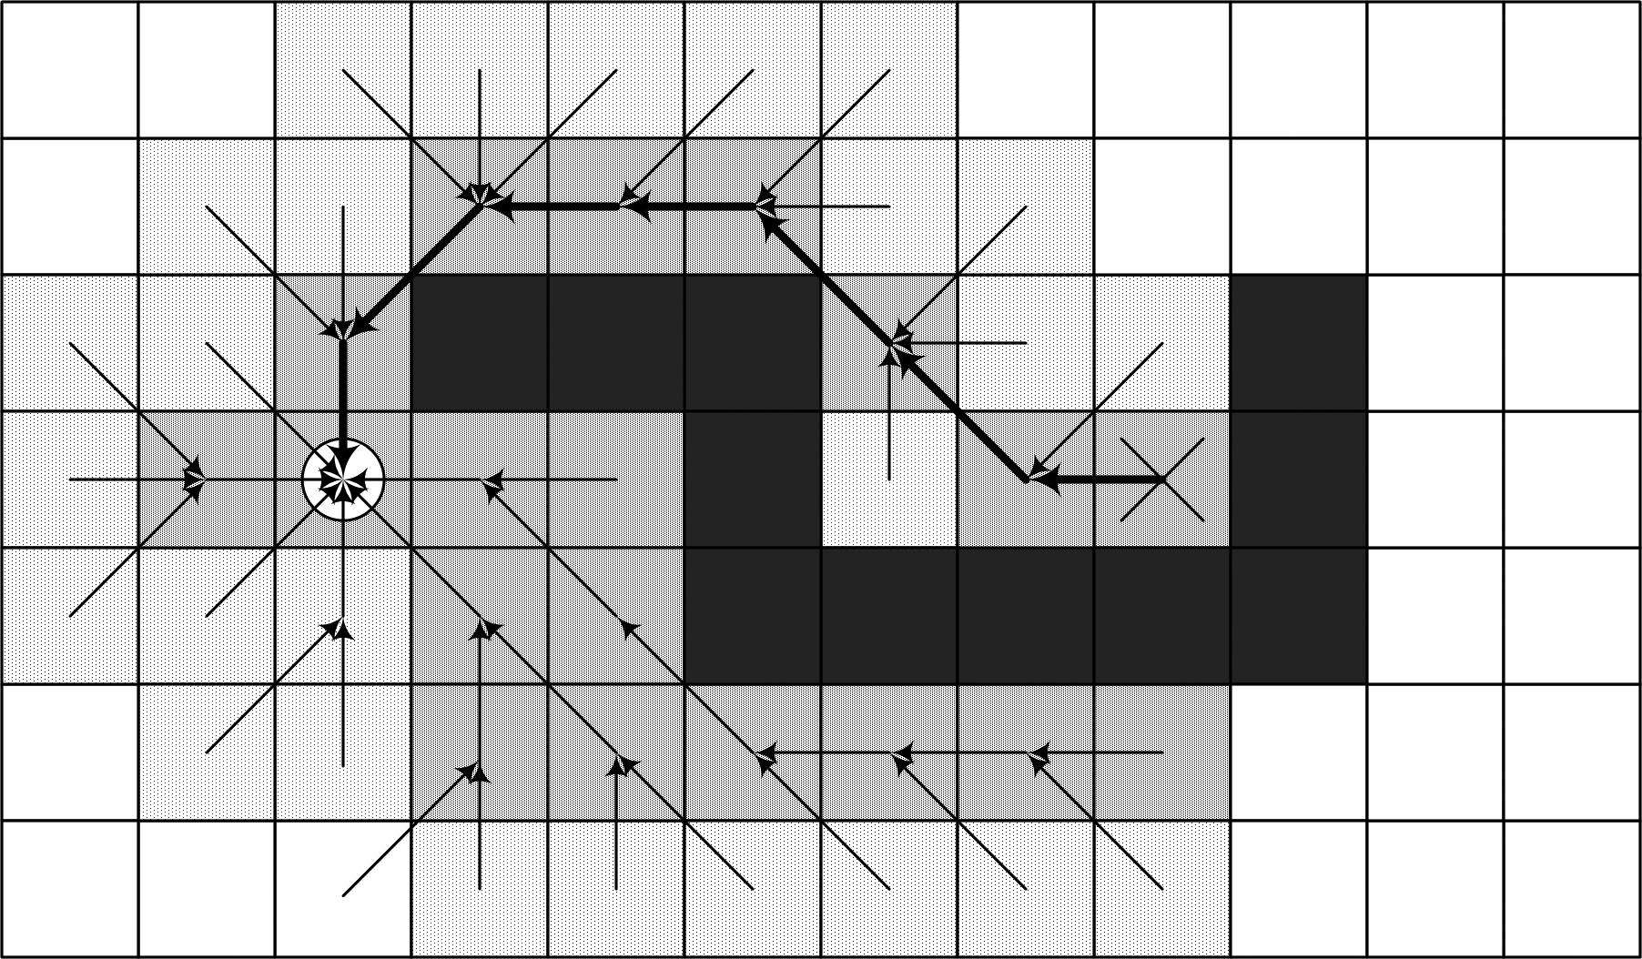
A*

Slide 18
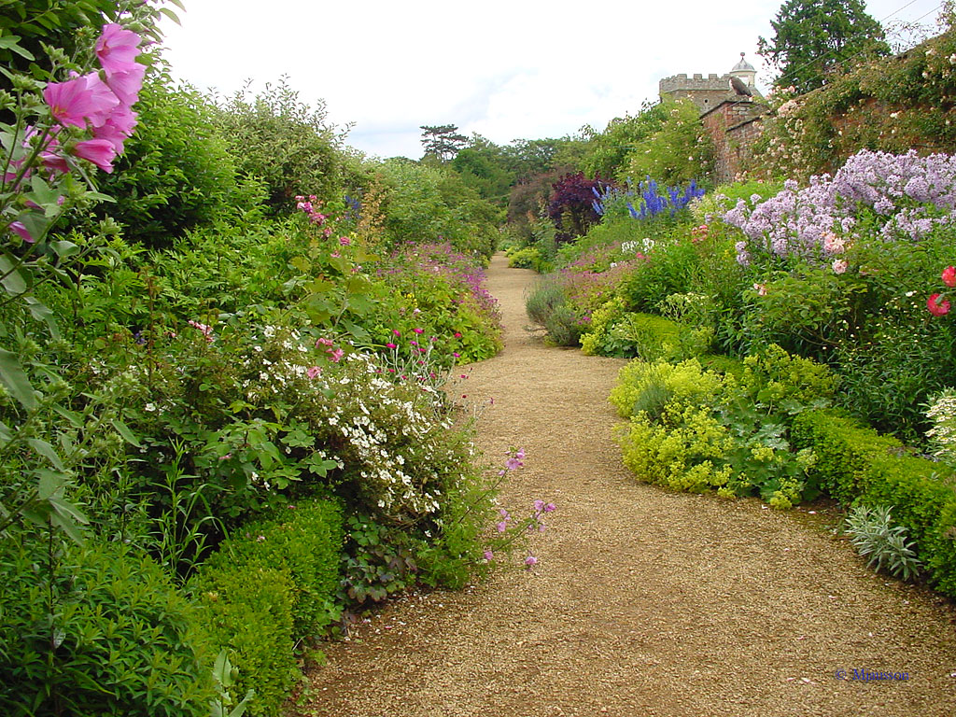
Summary

