Slide 1





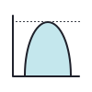



My new reproducible project
Data
Code
Figures
Documentation
Report/webpage

