Slide 1

Anatomy of GPU Memory System for
Multi-Application Execution
Adwait Jog¹
Onur Kayiran², Tuba Kesten³, Ashutosh Pattnaik³,
Evgeny Bolotin⁴, Nil Chatterjee⁴, Steve Keckler^{4,5},
Mahmut Kandemir³, Chita Das³
William and Mary¹, AMD Research², Penn State³
NVIDIA⁴, UT Austin⁵,
MEMSYS 2015

Slide 2
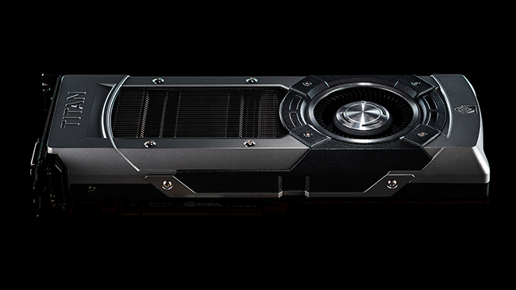
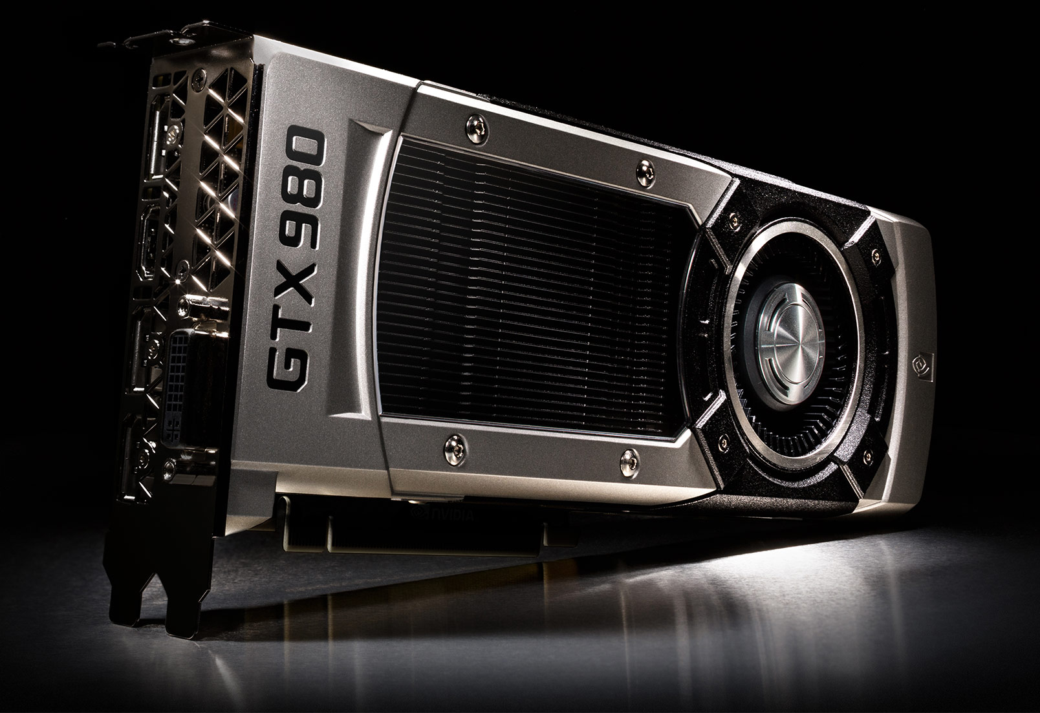
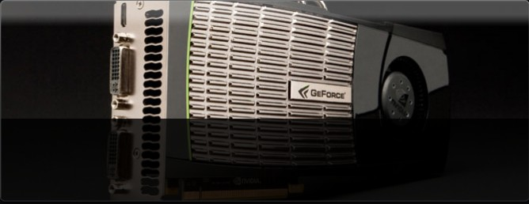
Era of Throughput Architectures
GPUs are scaling: Number of CUDA Cores, DRAM bandwidth
GTX 480
(Fermi)
448 cores
(139 GB/sec)
GTX 680
(Kepler)
1536 cores
(192 GB/sec)
GTX 980 Ti
(Maxwell)
2816 cores
(336 GB/sec)
Notes:
As we know GPU are scaling both in terms of number of CUDA cores as well peak DRAM
Bandwidth. For example, the latest NVIDIA GPU GTX 980 Ti has more than 2000 cores.
Given such powerful GPUs, the question is -- Are we “still” using them efficiently?

Slide 3
Prior Approach (Looking Back)
Execute one kernel at a time
Assumes that kernel has enough parallelism
Single Application
SM-1
SM-2
SM-30
SM-31
SM-32
SM-X
Interconnect
Cache
Memory
Notes:
Well, we “were”, when application/kernel had enough parallelism to fill the whole GPU.
But as newer GPUs are growing and applications are not scaling enough,
it is more and more challenging to do so.

Slide 4
Current Trend
What happens when kernels do not have enough parallelism?
Execute multiple kernels (from same application/context) concurrently
CURRENT ARCHITECTURES SUPPORT THIS FEATURE
Fermi
Kepler
Maxwell
4
Notes:
When applications/kernels don’t have enough parallelism, current architectures
Actually allow execution of multiple kernels on the same GPU hardware. Technically,
They come from same context/applications. Fermi and Kepler architectures support
This feature.

Slide 5
Future Trend (Looking Forward)
We study execution of
multiple kernels from
multiple applications (contexts)
Application-1
Application-2
Application-N
SM-1
SM-A
SM-A+1
SM-B
SM-B+1
SM-X
Interconnect
Cache
Memory
Notes:
In our work, we take a step forward and study the impact of executing multiple kernels originating from
Multiple applications. The goal is to understand what are inefficiencies of current GPUs that prevent
Fair and performance efficient execution of applications concurrently.

Slide 6
Why Multiple Applications (Contexts)?
Can improve overall GPU throughput
Can improve portability of multiple old apps (with limited thread-scalability) on newer scaled GPUs
Supports consolidation of multiple-user requests on to the same GPU
Notes:
As concurrent execution of kernels helped in improving GPU throughput, this technique also does, because
The resources that otherwise are not able to be utilized, now can put to use by additional concurrent kernels.
Secondly, this feature also allows porting of multiple old legacy CUDA codes that probably cannot be parallelized otherwise.
Instead of improving parallelism, we can concurrently executing multiple of those. Thirdly, this feature also allows consolidation
Of multiple user requests on to the same GPU, thereby improving GPU hardware efficiency.

Slide 7
Outline
Introduction and motivation
Positives and negatives of co-scheduling multiple applications
Limitation of Current Memory Schedulers
GPU Performance model driven Memory Scheduler
Infrastructure Setup and Evaluation
Conclusions

Slide 8
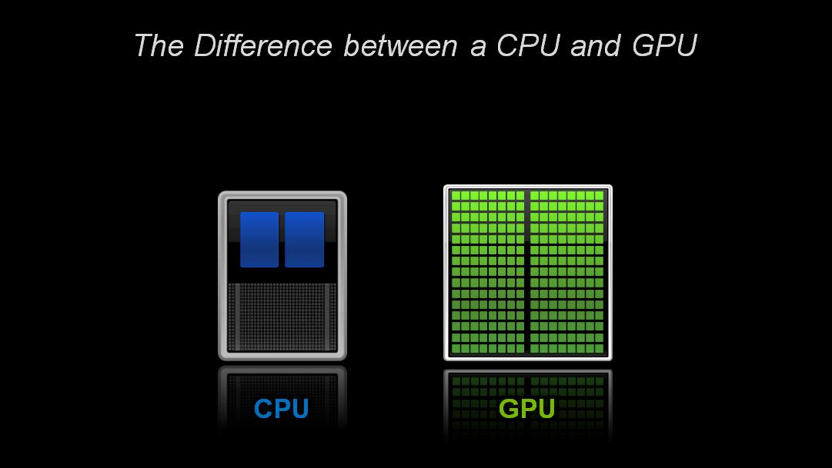
System Throughput (Jobs/sec)
HIST
DGEMM
HIST+DGEMM: 40% improvement in
System throughput, over running alone

Slide 9
Primary Sources of Inefficiencies
Application Interference at many levels
L2 Caches
Interconnect
DRAM (Primary Focus of this work)
Application-1
Application-2
Application-N
SM-1
SM-A
SM-A+1
SM-B
SM-B+1
SM-X
Interconnect
Cache
Memory

Slide 10
Bandwidth Distribution
1st Application
2nd Application
Bandwidth intensive applications (e.g., GUPS) takes majority of memory bandwidth
GPGPU@ASPLOS2014
Notes:
Alone_30 has same configuration as Alone_60, except that it application runs on 30SMs instead of 60

Slide 11
System Throughput (Jobs/sec)
GUPS
GAUSS
GAUSS+GUPS: Only 2% improvement in
System throughput, over running alone

Slide 12
Fairness
GUPS
HIST
DGEMM
Unpredictable performance impact
Fairness problems in the system
Unequal performance impact
Notes:
GUPS degradation is less

Slide 13
Outline
Introduction and motivation
Positives and negatives of co-scheduling multiple applications
Limitation of Current Memory Schedulers
GPU Performance model driven Memory Scheduler
Infrastructure Setup and Evaluation
Conclusions

Slide 14
Current Memory Scheduling Schemes
Agnostic to different requirements of memory requests coming from different applications
Leads to
Unfairness
Sub-optimal performance
Primarily focus on improving DRAM efficiency

Slide 15
Commonly Employed Memory Scheduling Schemes
Request to
Row-1
Row-2
Row-3
App-1
App-2
R1
R2
R3
Time
Time
R3
R3
Row Switch
Row Switch
R2
R2
R2
R2
Row Switch
R1
R2
Row Switch
Row Switch
R2
R1
Row Switch
R1
R1
R1
R1
Bank
Bank
Simple FCFS
Out of order (FR-FCFS)
Low DRAM Page Hit Rate
High DRAM Page Hit Rate
Both schedulers are application agnostic! (App-2 suffers)
Notes:
There are two commonly employed memory schedulers – FCFS (in-order) and FR-FCFS (out-of-order). I am showing 7 memory requests served in FCFS order on the left-hand side. Out of 7 requests, 6 of them are from App-1, and the last one is from App-2. In FCFS, we basically observe two problems: First, there are many row-switches because requests are served in the order they are received. This leads to low DRAM Page Hit Rate. Secondly, the app-2 request is starved for long time. To solve
The first problem, out-of-order FR-FCFS is used, where requests to the opened row are served first. In this case, although row-switches are reduced; thereby improving page hit rate, app-2 request is again served because green application occupies the memory request queue. Therefore both schedulers are unable to serve app-2 in fair manner → both schedulers are app agonsitc

Slide 16
Recently proposed Application-Aware Scheduler
As an example of adding application-awareness
Instead of FCFS, schedule requests in Round-Robin Fashion
Preserve the page hit rates
Our Prior Proposal (GPGPU@ASPLOS 2014):
FR-FCFS (Baseline) → FR-(RR)-FCFS (or simply RR)

Slide 17
Proposed Application-Aware FR-(RR)-FCFS Scheduler
Request to
Row-1
Row-2
Row-3
App-1
App-2
R1
R2
R3
Time
Time
R3
R2
Row Switch
R2
R2
R2
R2
Row Switch
R2
R3
Row Switch
Row Switch
R1
R1
R1
R1
R1
R1
Bank
Bank
Baseline FR-FCFS
Proposed FR-(RR)-FCFS
App-2 is scheduled after App-1 in Round-Robin order

Slide 18
Improvement in Fairness
Lower is Better
r1 = Speedup(app1)
Speedup(app2)
r2 = Speedup(app2)
Speedup(app1)
Fairness = max (r1, r2)
Index
On average 7% improvement (up to 49%) in fairness
Significantly reduces the negative impact of BW sensitive applications (e.g. GUPS) on overall fairness of the GPU system
GPGPU@ASPLOS2014

Slide 19
System Throughput
Limited Improvement
in System Throughput with FR-RR-FCFS
Observation: However, *always* prioritizing one of the apps over another has better system throughput
Question: Which app should be prioritized?

Slide 20
Outline
Introduction and motivation
Positives and negatives of co-scheduling multiple applications
Limitation of Current Memory Schedulers
GPU Performance model driven Memory Scheduler
Infrastructure Setup and Evaluation
Conclusions

Slide 21

GPU Performance Modeling
Attained Bandwidth (BW)
GPU IPC
Misses Per Instruction (MPI)
1. Misses Per Instruction (MPI) Metric is not a good proxy for GPU performance
2. Attained Bandwidth (BW) and Misses Per Instruction (MPI) metrics can drive memory scheduling decisions for better throughput and fairness.

Slide 22
GPU Performance Modeling
Model is not so accurate
Model is fairly accurate
Use
ScratchpadMemory
How can we utilize this model to develop better memory scheduler?
Also, on real hardware (NVIDIA K20), absolute relative error is less than 10% averaged across 22 applications

Slide 23
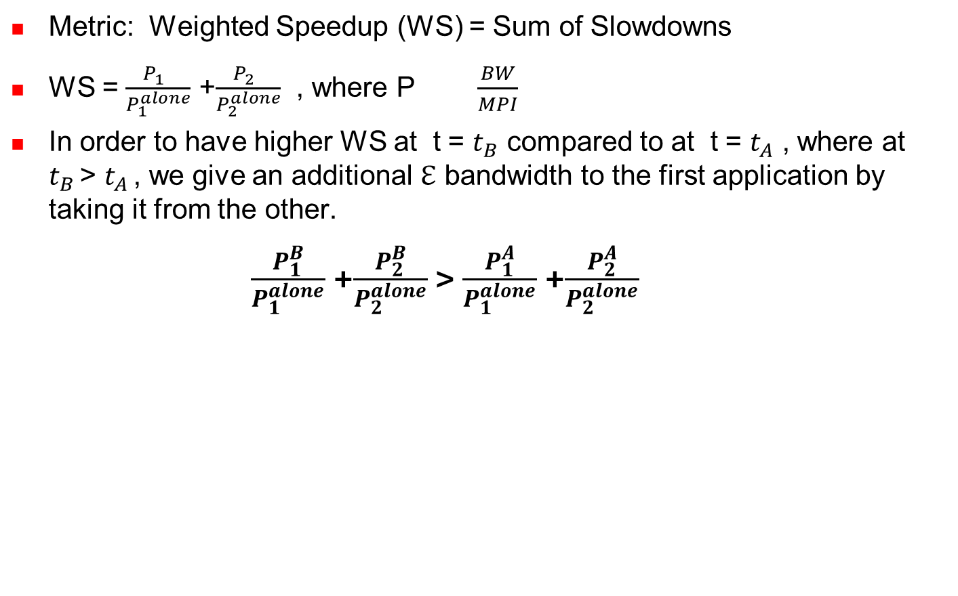




Weighted Speedup Targeted Scheme (WEIS)
$$\frac{\frac{{BW}_{1 }+\text{ℇ}}{{MPI}_{1}}}{\frac{{BW}_{1}^{alone}}{{MPI}_{1}}}$$
$$\frac{\frac{{BW}_{2 }\text{- }\text{ℇ}}{{MPI}_{2}}}{\frac{{BW}_{2}^{alone}}{{MPI}_{2}}}$$
$$\frac{\frac{{BW}_{1 }}{{MPI}_{1}}}{\frac{{BW}_{1}^{alone}}{{MPI}_{1}}}$$
$$\frac{\frac{{BW}_{2 }}{{MPI}_{2}}}{\frac{{BW}_{2}^{alone}}{{MPI}_{2}}}$$
+
>
+
Prioritize the application with the least BW (alone) to optimize for weighted speedup
In the paper, we show that prioritizing the application with the least attained bandwidth can improve weighted speedup
Notes:
Consistent with that fact that priortizing a job with least attained service would lead to a schedule that also prefers jobs with shortest
Processing Remaining time, which is the best way to improve system throughput (jobs/sec)

Slide 24
Weighted Speedup Targeted Scheme (WEIS)
Periodically calculate the amount of data transferred over the DRAM bus for each application locally at each memory partition
Prioritize the memory requests generated by the application with lowest attained BW
We still preserve the DRAM locality as previously done for RR scheme.

Slide 25
Outline
Introduction and motivation
Positives and negatives of co-scheduling multiple applications
Limitation of Current Memory Schedulers
GPU Performance model driven Memory Scheduler
Infrastructure Setup and Evaluation
Conclusions

Slide 26
Infrastructure Development
Current GPU simulators are not capable of simulating multiple applications
Many existing CUDA benchmarks do not employ “CUDAStreams” to enable multi-programmed execution
Extended GPGPU-Sim v3.x (Simulator) and developed GPU concurrent application framework (GCA) to enable multi-programming in GPUs
Available here (beta version) : https://github.com/adwaitjog/mafia

Slide 27
Simulation Setup
Kernels from multiple applications are issued to different concurrent CUDA Streams
100 two-application and 10 three-application workloads considered with varying memory demands
Baseline configuration similar to scaled-up version of GTX480
30 SMs, 32-SIMT lanes, 32-threads/warp
16KB L1 (4-way, 128B cache block) + 16KB SharedMem per SM
6 partitions/channels (Peak Bandwidth: 177.6 GB/sec)

Slide 28
System Throughput with WEIS (Normalized to FR-FCFS)
Difference in attained BW among applications in the workload
Class_A (High), Class_B (Medium), Class_C (Low)
14%, 8%, and 5% improvement in Weighted speedup over FR-FCFS respectively

Slide 29
Harmonic Speedup (Normalized to FR-FCFS)
Harmonic Speedup Metric balances Fairness and System Throughput
8% improvement in Harmonic Speedup for 100 workloads
Other results in the paper:
Scalability results
Sensitivity to Core Partitioning Mechanisms
Comparisons related to other schemes and metrics

Slide 30
Take Away Messages
Naïve coupling of applications is probably not a good idea
Co-scheduled applications interfere in the memory-subsystem
Sub-optimal Performance and Fairness
Current DRAM schedulers are agnostic to applications
Treat all memory request equally
Application-aware memory system is required for enhanced performance and superior fairness
Attained Bandwidth (BW) and Misses Per Instruction (MPI) metrics can drive memory scheduling decisions for better throughput and fairness.
WEIS provides 14% improvement in weighted speedup for 2-app workloads with high difference in attained BW.
Notes:
To conclude, we show that naïve coupling for applications is probably not a good idea, because
Co-scheduled applications significantly interfere in the memory sub-system, and an application-unaware
Memory hierarchy will lead to sub-optimal performance and fairness. In this context, the current DRAM
Schedulers are application-agnostic, and treat all memory requests equally and assume that they are
Coming from same application/kernel. Therefore, we claim that adding application-awareness is important for better performance and fairness. We showed one example case, where application-awareness actually works. As part of future work, we can design more sophisticated application aware mechanisms.

Slide 31
Thank You!
Questions?
Notes:
Thanks, and I will be happy to take any questions.

