Slide 1



Managing GPU Concurrency in Heterogeneous Architectures
Onur Kayıran, Nachiappan CN, Adwait Jog, Rachata Ausavarungnirun, Mahmut T. Kandemir, Gabriel H. Loh, Onur Mutlu, Chita R. Das

Slide 2
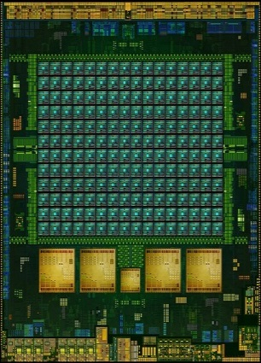

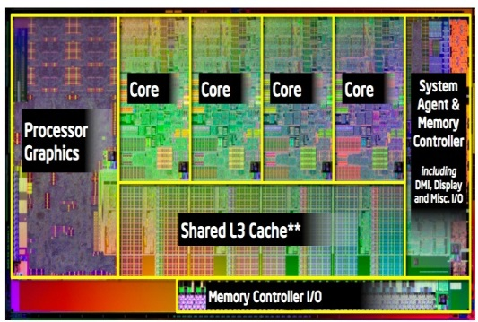
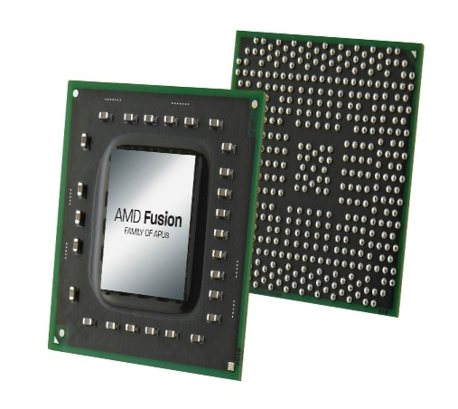
Era of Heterogeneous Architectures
NVIDIA Denver
NVIDIA Echelon
AMD Fusion
Intel Haswell

Slide 3
Executive Summary
When sharing the memory hierarchy, CPU and GPU applications interfere with each other
GPU applications significantly affect CPU applications due to multi-threading
Existing GPU Thread-level Parallelism (TLP) management techniques (MICRO12, PACT13)
Unaware of CPUs
Not effective in heterogeneous systems
Our Proposal:
Warp scheduling strategies to
Adjust GPU TLP to improve CPU and/or GPU performance

Slide 4
Executive Summary
CPU-centric Strategy
Memory Congestion
CPU Performance

Slide 5
Executive Summary
CPU-centric Strategy
Memory Congestion
CPU Performance
IF Memory Congestion
GPU TLP

Slide 6
Executive Summary
CPU-centric Strategy
Memory Congestion
CPU Performance
IF Memory Congestion
GPU TLP
Results Summary:
+24% CPU & -11% GPU

Slide 7
Executive Summary
CPU-centric Strategy
CPU-GPU Balanced Strategy
Memory Congestion
CPU Performance
IF Memory Congestion
GPU TLP
Results Summary:
+24% CPU & -11% GPU
GPU TLP
GPU Latency Tolerance

Slide 8
Executive Summary
CPU-centric Strategy
CPU-GPU Balanced Strategy
Memory Congestion
CPU Performance
IF Memory Congestion
GPU TLP
Results Summary:
+24% CPU & -11% GPU
GPU TLP
GPU Latency Tolerance
IF Latency Tolerance
GPU TLP

Slide 9
Executive Summary
CPU-centric Strategy
CPU-GPU Balanced Strategy
Memory Congestion
CPU Performance
IF Memory Congestion
GPU TLP
Results Summary:
+24% CPU & -11% GPU
GPU TLP
GPU Latency Tolerance
IF Latency Tolerance
GPU TLP
Results Summary:
+7% both CPU & GPU

Slide 10
Outline
Summary
Background
Motivation
Analysis of TLP
Our Proposal
Evaluation
Conclusions

Slide 11
Many-core Architecture
CPU Cores
SIMT Cores
CTA Scheduler
ALUs
L1 Caches
L2 Caches
ROB
Warp Scheduler
Throughput optimized cores
L1 Caches
ALUs
Interconnect
Latency optimized cores
LLC cache
DRAM

Slide 12
Outline
Summary
Background
Motivation
Analysis of TLP
Our Proposal
Evaluation
Conclusions

Slide 13
Application Interference
Up to 20%
Up to 85%
GPU applications are affected moderately due to CPU interference
CPU applications are affected significantly due to GPU interference

Slide 14
Latency Tolerance in CPUs vs. GPUs
High GPU TLP -> memory system congestion
High GPU TLP -> low CPU performance
GPU cores can tolerate latencies due to multi-threading
Problem:
TLP management strategies for GPUs are not aware of the latency tolerance disparity between CPU and GPU applications
Higher performance potential at low TLP
DYNCTA (PACT 2013)

Slide 15
Outline
Summary
Background
Motivation
Analysis of TLP
Our Proposal
Evaluation
Conclusions

Slide 16
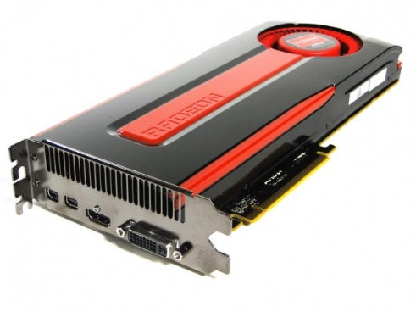
Effect of GPU Concurrency on GPU Performance
Reduction in GPU TLP
GPU performance

Slide 17
Effect of GPU Concurrency on CPU Performance
Reduction in GPU TLP
CPU performance

Slide 18
Effect of GPU Concurrency on CPU Performance
?
2 metrics:
Memory congestion
Network congestion
Change in CPU performance
:
CPU performance
congestion

Slide 19
Outline
Summary
Background
Motivation
Analysis of TLP
Our Proposal
Evaluation
Conclusions

Slide 20
Our Approach
Improved GPU performance
Improved CPU performance
Existing works
☑
×
CPU-centric Strategy
×
☑
CPU-GPU Balanced Strategy
☑
☑
+ control the trade-off

Slide 21
CM-CPU: CPU-centric Strategy
Categorize congestion: low, medium, or high
network
memory
L
M
H
GPU-unaware TLP management:
Insufficient GPU latency tolerance
L
M
H
Increase # of warps
No change in # of warps
Decrease # of warps

Slide 22
CM-BAL: CPU-GPU Balanced Strategy
Latency tolerance of GPU cores:
stall_{GPU}: scheduler stalls @ GPU cores
Overrides CM-CPU
can only increase TLP
same strategy as CM-CPU
Low latency tolerance
High memory congestion
stall_{GPU}
×
GPU TLP

Slide 23
CM-BAL: CPU-GPU Balanced Strategy
Latency tolerance of GPU cores:
stall_{GPU}: scheduler stalls @ GPU cores
Overrides CM-CPU
can only increase TLP
same strategy as CM-CPU
Low latency tolerance
High memory congestion
stall_{GPU}
×
GPU TLP

Slide 24
CM-BAL: CPU-GPU Balanced Strategy
Latency tolerance of GPU cores:
stall_{GPU}: scheduler stalls @ GPU cores
Overrides CM-CPU
can only increase TLP
same strategy as CM-CPU
Low latency tolerance
High memory congestion
stall_{GPU}
☑
GPU TLP

Slide 25
CM-BAL: CPU-GPU Balanced Strategy
Latency tolerance of GPU cores:
stall_{GPU}: scheduler stalls @ GPU cores
Overrides CM-CPU
can only increase TLP
same strategy as CM-CPU
Low latency tolerance
High memory congestion
stall_{GPU}
Control the triggering of the condition
=
Control the trade-off between CPU or GPU benefits
GPU TLP

Slide 26
Outline
Summary
Background
Motivation
Analysis of TLP
Our Proposal
Evaluation
Conclusions

Slide 27
Evaluated Architecture
LLC/
MC
CPU
GPU
CPU
GPU
LLC/
MC
GPU
GPU
LLC/
MC
GPU
CPU
GPU
CPU
LLC/
MC
GPU
GPU
CPU
GPU
CPU
GPU
CPU
GPU
GPU
GPU
GPU
GPU
CPU
GPU
CPU
GPU
CPU
GPU
GPU
GPU
LLC/
MC
CPU
GPU
CPU
GPU
LLC/
MC
GPU
GPU
LLC/
MC
GPU
CPU
GPU
CPU
LLC/
MC
GPU
GPU
Tile-based design

Slide 28
Evaluation Methodology
Evaluated on an integrated platform with an in-house x86 CPU simulator and GPGPU-Sim
Baseline Architecture
28 GPU cores, 14 CPU cores, 8 memory controllers, 2D mesh
GPU: 1400MHz, SIMT Width = 16*2, Max. 1536 threads/core, GTO Sch.
CPU: 2000 MHz, OoO, 128-entry instr. win., max. 3 inst./cycle
8MB, 128B Line, 16-way, 700MHz
GDDR5 800MHz
Workloads:
13 GPU applications
34 CPU applications, 6 CPU application mixes
36 diverse workloads
1 GPU application + 1 CPU mix

Slide 29
GPU Performance Results
7%
2%
-11%
-11%
All 36 workloads

Slide 30
CPU Performance Results
24%
19%
7%
2%
All 36 workloads

Slide 31
System Performance
OSS = (1 − α) × WS_{CPU} + α × SU_{GPU} (ISCA 2012)
α is between 0 and 1
Higher α -> higher GPU importance
CM-CPU
CM-BAL

Slide 32
More in the Paper
Motivation
Analysis of the metrics used by our algorithm
Scheme
Detailed hardware walkthrough of our scheme
Results
Analysis over time
Change in GPU TLP
Change in the metrics used by our algorithm
Comparison against static approaches
Lower number of LLC accesses

Slide 33
Outline
Summary
Background
Motivation
Analysis of TLP
Our Proposal
Evaluation
Conclusions

Slide 34
Conclusions
Sharing the memory hierarchy leads to CPU and GPU applications to interfere with each other
Existing GPU TLP management techniques are not well-suited for heterogeneous architectures
We propose two GPU TLP management techniques for heterogeneous architectures
CM-CPU reduces GPU TLP to improve CPU performance
CM-BAL is similar to CM-CPU, but increases GPU TLP when it detects low latency tolerance in GPU cores
TLP can be tuned based on user’s preference for higher CPU or GPU performance

Slide 35
Thanks!

Slide 36
Managing GPU Concurrency in Heterogeneous Architectures
Onur Kayıran, Nachiappan CN, Adwait Jog, Rachata Ausavarungnirun, Mahmut T. Kandemir, Gabriel H. Loh, Onur Mutlu, Chita R. Das

