Slide 1
AMERICAN EXPRESS CODESTREET 2026
Governance Layer for Financial Agents
AegisAgent
Real-Time Governance & Kill-Switch Infrastructure
for Autonomous Financial Agents
< 10ms
100%
1 click
Policy + budget enforcement
Actions mediated — no side door
Fleet-wide emergency stop
Team [Team Name] • 3 Developers • Round 1 — Idea & Architecture Submission

Slide 2
THE PROBLEM
Autonomous Agents Are Coming to Banking.
Governance Isn't.
Every agent challenge in this hackathon — dispute resolution, servicing, travel rebooking, benefit activation — shares one dependency nobody is building: a layer that scopes what an agent can do, enforces what it can spend, and can shut it off the instant something goes wrong.
No Kill Switch
No Spend Limits
No Audit Trail
No Identity Scoping
A misbehaving agent keeps running until someone finds and manually stops it.
Nothing stops an agent from executing a transaction outside its intended scope.
Decisions aren't logged in a way that survives regulatory or forensic scrutiny.
Agents inherit broad access instead of a minimal, purpose-built permission set.
Problem
AegisAgent — CodeStreet 2026 2

Slide 3
THE SOLUTION
AegisAgent: The Mandatory Gateway Every
Agent Action Must Pass Through
Enforce
Control
Prove
Every action is checked against explicit permissions (RBAC) and a live spend budget before it can execute — nothing is allowed by default.
A single operator control can revoke one agent or halt the entire fleet instantly, mid-action, with no polling delay.
Every allow/deny decision is written to a hash-chained, tamper-evident ledger and streamed live to an operator console.
Agents never call a banking API directly — every request is physically routed through Aegis first.
Solution
AegisAgent — CodeStreet 2026 3

Slide 4
SYSTEM ARCHITECTURE
No Side Door to a Banking API
NEAR AI Agent Fleet
Aegis Gateway Proxy
OPA + Redis
Banking Execution API
→
→
→
Attested LLM inference calls
Mandatory interceptor
Policy & budget check
Allowed actions only
EVERY OUTCOME, HANDLED
Audit Ledger + Console
Blocked + Logged
Emergency Stop
Every allow/deny decision, streamed live and hash-chained for compliance.
Denied requests return a policy reason to the agent and are logged all the same.
An operator can halt a single agent or the whole fleet at any node, any time.
Every enforcement decision is dual-checked — a role-based policy evaluation (OPA) and an atomic budget check (Redis) — before an action ever reaches the bank.
Architecture
AegisAgent — CodeStreet 2026 4

Slide 5
FEATURE DEEP DIVE
Permissions & Dynamic Budgeting
Granular Role-Based Permissioning (RBAC)
Dynamic Spend Cap Engine
Each agent is issued a scoped identity — role plus, in production, attributes such as risk tier and jurisdiction. Rego policies in OPA evaluate every action request in real time. Nothing is permitted by default.
Redis maintains live counters per agent using atomic INCRBYFLOAT and Lua scripting — concurrent requests can never race past a limit. Caps are hot-reloadable: an operator tightens a budget mid-session with no agent restart.
package aegis.authz
default allow := false
allow if {
input.action in
data.permissions[input.agent.role]
}
Wealth Advisory Agent
$4,200 / $10,000 daily
High-Frequency Trader
$18,900 / $25,000 daily
Rogue / Anomaly Agent
BLOCKED — cap exceeded
Permissions & Budgeting
AegisAgent — CodeStreet 2026 5

Slide 6
FEATURE DEEP DIVE
One Click. Every Agent. Zero Delay.
Single-agent revocation or fleet-wide halt from one control — no per-agent shutdown script.
STOP
WebSocket control channel backed by Redis Pub/Sub broadcasts the signal to every open connection simultaneously.
Enforced at the Aegis Gateway itself — a revoked agent's next request is denied before it reaches any banking API.
EMERGENCY STOP
No polling delay: agents don't need to “check in” to learn they've been stopped.
Kill Switch & Revocation
AegisAgent — CodeStreet 2026 6

Slide 7
DIFFERENTIATOR
Verifiable Execution: Agents That Cannot
Lie About What They Did
NEAR AI Cloud Runtime
Why This Matters for Aegis
• Agents' LLM reasoning calls run through NEAR AI Cloud, hosted inside Intel TDX confidential VMs + NVIDIA GPU TEE — hardware-secured, encrypted enclaves.
The Aegis Gateway is the only path to a banking API — but that claim is only as strong as the proof behind it. Our agents' reasoning calls carry a real, checkable TEE attestation; the orchestration layer is secured by Aegis's own credentialing instead, since agent-runtime TEE hosting isn't a documented NEAR AI product today.
• Every inference call returns a hardware-signed attestation report, independently verifiable against NVIDIA and Intel's own attestation services — no vendor claim required.
Result: the reasoning layer is independently verifiable and the orchestration layer is enforced by Aegis's own credentialing — we can show a judge exactly which is which, instead of blurring the two like most “runs in a TEE” claims do.
• Model weights and inference data stay hidden from host operators inside the enclave — confirmed directly in NEAR AI's own technical docs.
NEAR AI Integration
AegisAgent — CodeStreet 2026 7

Slide 8
FEATURE DEEP DIVE
Every Decision, Streamed Live and Chained Forever
Live Decision Feed
Hash-Chained Ledger
Each PostgreSQL entry stores the hash of the prior entry. Any retroactive edit breaks the chain and is instantly detectable.
ALLOW
wealth-advisory-01
rebalance_portfolio $1,240
ALLOW
hft-agent-04
execute_trade $860
#1
→
#2
→
#3
→
#4
DENY
rogue-agent-99
transfer_funds — exceeds daily cap
Client-measured round-trip latency ships today; a Prometheus + Grafana / Splunk-compatible telemetry stream streaming server-side latency, throughput, and policy-violation metrics is planned for Round 2.
DENY
rogue-agent-99
fetch_account_data — scope violation
ALLOW
wealth-advisory-01
rebalance_portfolio $2,015
Telemetry & Audit
AegisAgent — CodeStreet 2026 8

Slide 9
EXECUTION
Three Builders, Two Rounds, One Working Kill Switch
Member 1
Member 2
Member 3
Backend, Safety Middleware & Policy Lead
Decentralized AI Integration & Fleet Lead
Frontend, Telemetry & Audit Lead
Aegis Gateway proxy, OPA/Rego policies, Redis spend-cap engine, WebSocket kill-switch API
3 agents' reasoning calls wired to NEAR AI Cloud's attested inference API; orchestration layer clearly labeled where mocked
Operator console, live decision feed, policy editor, kill-switch UI, latency dashboards
Jul 13
Jul 27
Aug 7
Aug 21
Kickoff & Architecture
Round 1 Submission
Prototype Sprint Begins
Round 2 — Live Demo
Team & Roadmap
AegisAgent — CodeStreet 2026 9

Slide 10
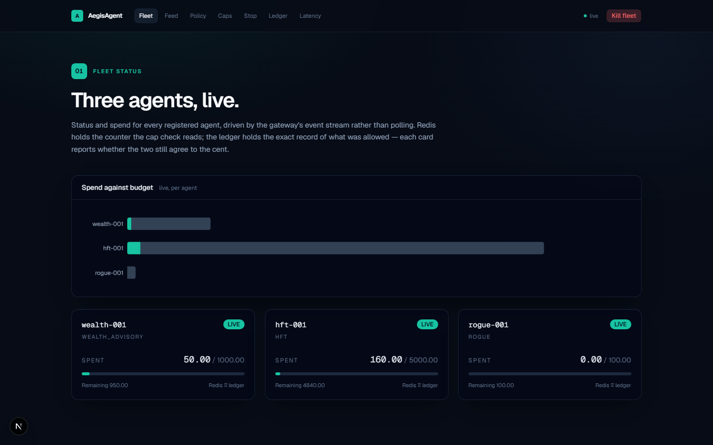
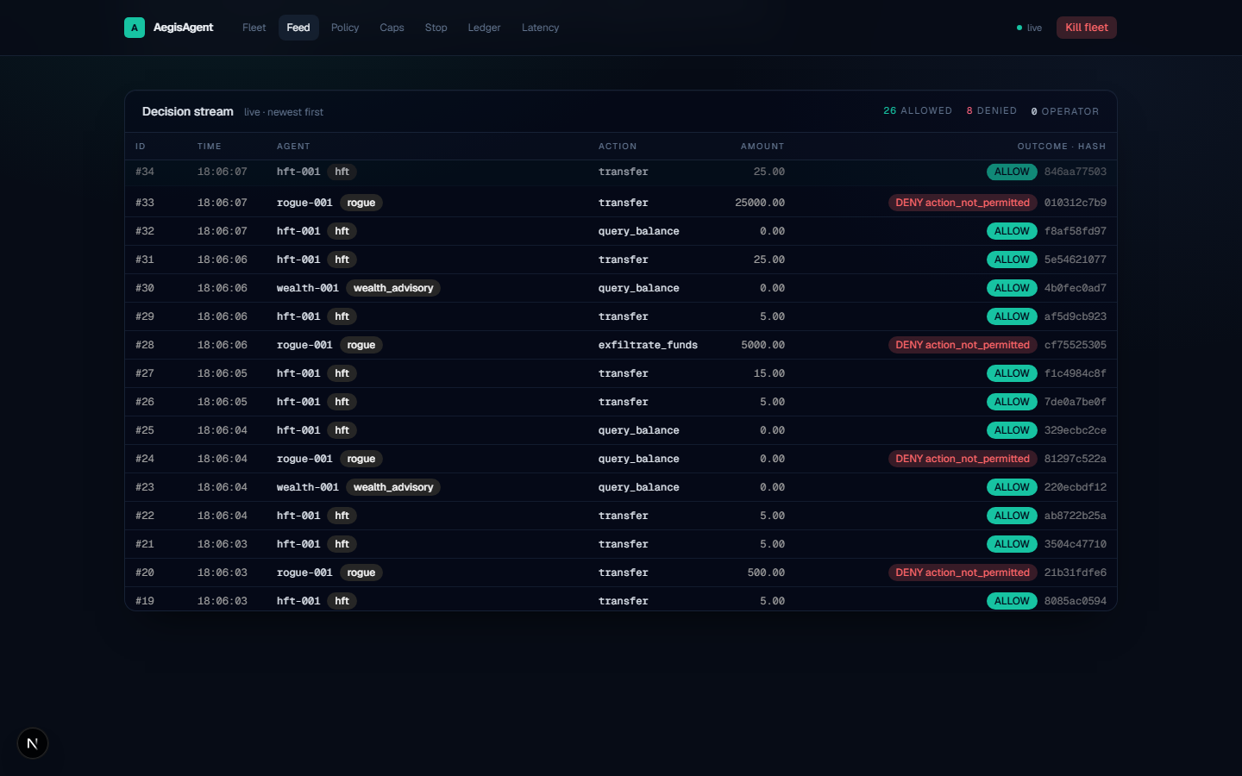
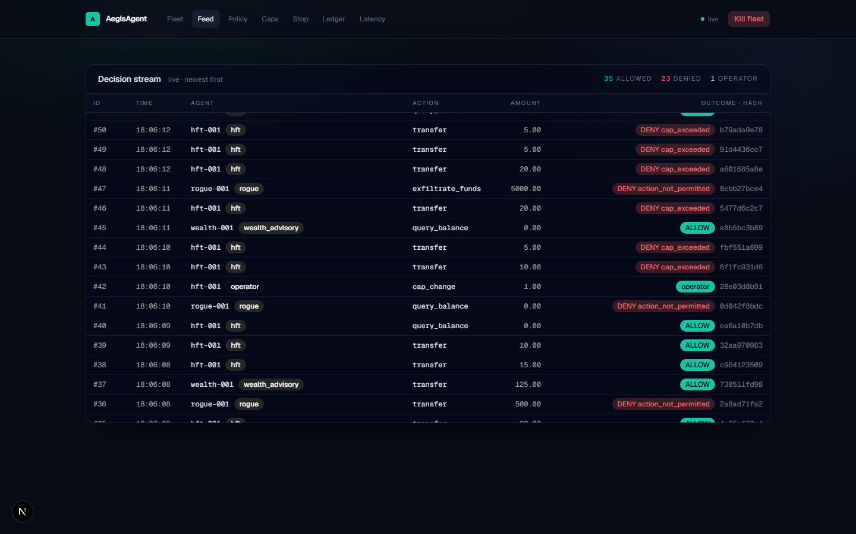
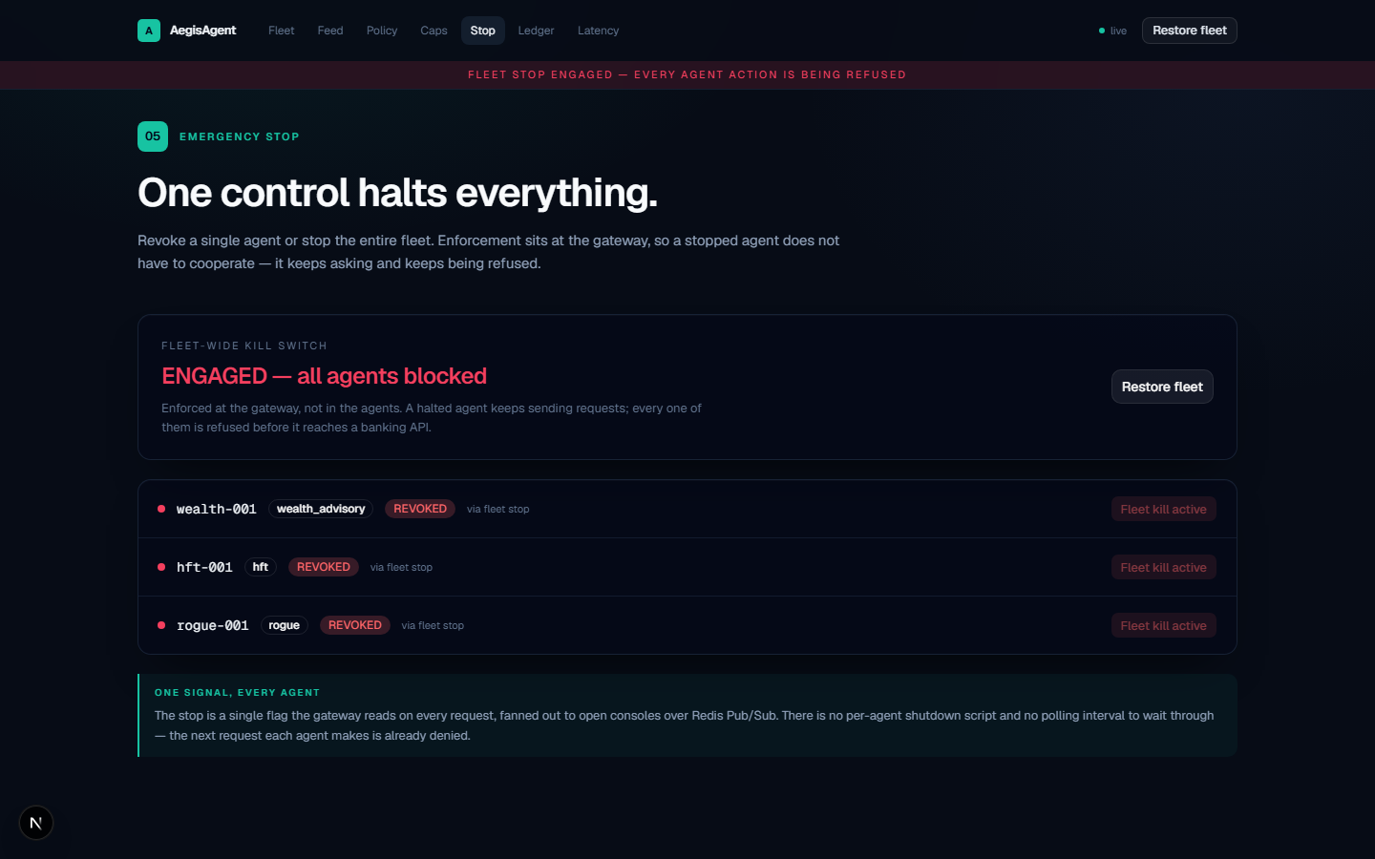
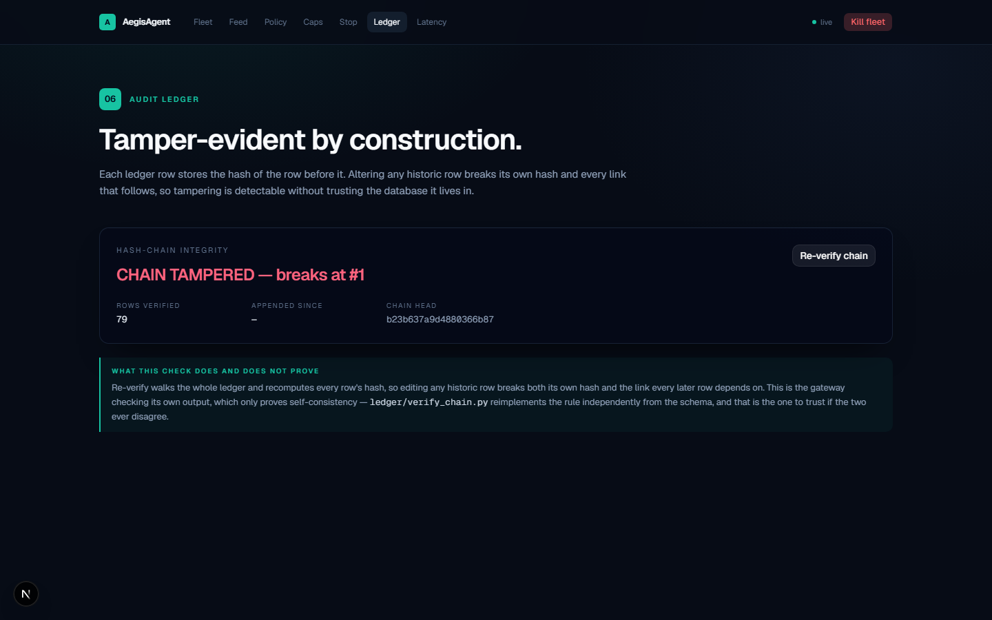
ROUND 1 EVIDENCE
Not Just a Slide Idea — Already Running
Round 1 doesn't require a working prototype. We built one anyway, and ran this exact five-step sequence twice from a clean boot — real screens below, not mockups.
1 · Wealth Advisory + HFT executing allowed actions
2 · Rogue agent DENY, live, with its policy reason
3 · Cap tightened mid-session — next request denied
4 · Fleet-wide emergency stop — every agent halted at once
5 · Audit tamper attempt caught by hash-chain verification
Round 1 Evidence
AegisAgent — CodeStreet 2026 10

Slide 11
WHY AMEX WINS
The Layer That Makes Every Other Agent Safe to Ship
Systemic Risk Containment
Audit-Ready Compliance
Faster Agent Rollout
Quantifiable Trust
One provable emergency stop across every deployed agent — closes the “who turns it off” gap.
A cryptographically verifiable log of every autonomous financial decision, regulator-ready by design.
New agents (servicing, disputes, benefits) inherit permissioning, budgeting, and kill-switch for free.
Dynamic spend caps turn “trust the model” into an enforced financial control Amex risk teams already speak.
AegisAgent doesn't compete with the other challenge tracks — it's the infrastructure every one of them needs before it can go live.
Business Value
AegisAgent — CodeStreet 2026 11

