Slide 1
AMERICAN EXPRESS CODESTREET 2026
Governance Layer for Financial Agents
Aegis Agent
Real-Time Governance & Kill-Switch Infrastructure
for Autonomous Financial Agents
< 10ms
100%
1 click
Policy + budget enforcement target
Actions mediated — no side door
Fleet-wide emergency stop
Team: The Three Stack — Dev Upadhyay (Team Lead) · Niti Kanoongo · Smit Shah
Problem Statement: Governance Layer for Financial Agents · Round 1 — Idea & Architecture Submission

Slide 2
SOLUTION OVERVIEW · PROBLEM STATEMENT SELECTED
Autonomy Without Control Is a Board-Level Risk
ELEVATOR PITCH
5 REQUIRED CAPABILITIES — DELIVERED AS ONE SYSTEM
AegisAgent is the control plane that lets American Express deploy fleets of autonomous financial agents without betting the bank on their good behavior — enforcing who an agent is, what it can spend, and how fast it can be stopped, on every single action, in under 10 milliseconds.
✓
Granular Permissioning
✓
Dynamic Spend Caps
As AI agents move from answering questions to initiating transfers, rebalancing portfolios, and filing claims, the risk shifts from “wrong answer” to “wrong action with real money.” AegisAgent sits between every autonomous agent and every banking system of record, so autonomy never means loss of control.
✓
Instant Revocation
✓
Full Audit Trail
✓
Low-Latency Middleware
PROBLEM STATEMENT SELECTED
“Governance Layer for Financial Agents”
AegisAgent — American Express CodeStreet 2026
Solution Overview · 1

Slide 3
THE PROBLEM
Autonomous Agents Are Coming to Banking.
Governance Isn't.
Every agent challenge in this hackathon — dispute resolution, servicing, travel rebooking, benefit activation — shares one dependency nobody is building: a layer that scopes what an agent can do, enforces what it can spend, and can shut it off the instant something goes wrong.
✕
✕
✕
✕
No Kill Switch
No Spend Limits
No Audit Trail
No Identity Scoping
A misbehaving agent keeps running until someone finds and manually stops it.
Nothing stops an agent from executing a transaction outside its intended scope.
Decisions aren't logged in a way that survives regulatory or forensic scrutiny.
Agents inherit broad access instead of a minimal, purpose-built permission set.
AegisAgent — American Express CodeStreet 2026
The Problem · 2

Slide 4
THE SOLUTION · PROPOSED SOLUTION
The Mandatory Gateway Every Agent Action Must Pass Through
01
02
03
Enforce
Control
Prove
Every action is checked against explicit permissions (RBAC) and a live spend budget before it can execute — nothing is allowed by default.
A single operator control can revoke one agent or halt the entire fleet instantly, mid-action, with no polling delay.
Every allow/deny decision is written to a hash-chained, tamper-evident ledger and streamed live to an operator console.
“NO SIDE DOOR” ARCHITECTURE
Agents never call a banking API directly — every request is physically routed through Aegis first. Financial agents cannot reach a banking API directly; every request is evaluated for identity, permissions, and budget before it is forwarded, blocked, or throttled. This is what separates AegisAgent from a monitoring dashboard bolted on after the fact: governance here is structural, not observational.
AegisAgent — American Express CodeStreet 2026
The Solution · 3

Slide 5
TECHNICAL DETAILS · ARCHITECTURE DIAGRAM & FLOW CHART
No Side Door to a Banking API
→
→
→
Financial Agent Fleet
Aegis Gateway Proxy
OPA + Redis
Banking Execution API
Wealth Advisory · HFT · Rogue/Anomaly
Mandatory interceptor (FastAPI)
Policy check → Budget check
Allowed actions only
Audit Ledger + Console
Blocked + Logged
Emergency Stop
Every allow/deny decision, streamed live and hash-chained for compliance.
Denied requests return a policy reason to the agent and are logged all the same.
An operator can halt a single agent or the whole fleet, at any node, any time.
ENFORCEMENT ORDER IS DELIBERATE, NOT INCIDENTAL
1. Revocation check (Redis) → 2. Policy check (OPA / Rego, role → action) → 3. Spend-cap check (Redis, atomic Lua script). Revocation runs first because it's cheapest and stops a killed agent without consulting policy at all; the spend cap runs last so a denied action never consumes budget.
AegisAgent — American Express CodeStreet 2026
Architecture · 4

Slide 6
TECHNICAL DETAILS · TECHNOLOGY STACK & FRAMEWORKS
Every Layer, Named — No Novel Infrastructure to Invent
Layer | Component | Technology | Function
Agent Runtime | Financial Agent Fleet | NEAR AI Cloud (TEE) + Groq | Reasoning calls; orchestration mocked & labeled
Enforcement | Aegis Gateway Proxy | FastAPI (Python) | Sole mandatory path to any banking API call
Policy | Zero-Trust Policy Engine | Open Policy Agent (Rego) | Deny-by-default RBAC, evaluated in-memory
Budget | Dynamic Spend Cap Engine | Redis (Lua, INCRBYFLOAT) | Per-agent & fleet-wide real-time limits
Control | Revocation & Kill-Switch | WebSocket + Redis Pub/Sub | Instant single-agent or fleet-wide halt
Audit | Immutable Ledger | PostgreSQL, hash-chained | Tamper-evident record of every decision
Interface | Aegis Operator Console | Next.js, Tailwind, WebSockets | Live fleet view, caps editor, kill switch
AegisAgent — American Express CodeStreet 2026
Technology Stack · 5

Slide 7
TECHNICAL DETAILS · FEATURE DEEP DIVE
Permissions & Dynamic Budgeting
Granular Role-Based Permissioning (RBAC)
Dynamic Spend Cap Engine
Each agent is issued a scoped identity — a role today (Wealth Advisory, Trading, Servicing), extensible to attributes like risk tier and jurisdiction. Rego policies in OPA evaluate every action request in real time. Nothing is permitted by default; every capability is an explicit grant.
Redis maintains live counters per agent using atomic INCRBYFLOAT and Lua scripting — concurrent requests can never race past a limit. Caps are hot-reloadable: an operator tightens a budget mid-session with no agent restart required.
Wealth Advisory Agent
$4,200 / $10,000 daily
package aegis.authz default allow := false allow if {
input.action in
data.permissions[input.agent.role]
}
High-Frequency Trader
$18,900 / $25,000 daily
Rogue / Anomaly Agent
BLOCKED — cap exceeded
AegisAgent — American Express CodeStreet 2026
Permissions & Budgeting · 6

Slide 8
TECHNICAL DETAILS · FEATURE DEEP DIVE
One Click. Every Agent. Zero Delay.
Kill Switch & Revocation
EMERGENCY STOP
Single-agent revocation or fleet-wide halt from one control — no per-agent shutdown script.
⏻
●
WebSocket control channel backed by Redis Pub/Sub broadcasts the signal to every open connection simultaneously.
●
Enforced at the Aegis Gateway itself — a revoked agent's next request is denied before it reaches any banking API.
STOP
●
No polling delay: agents don't need to “check in” to learn they've been stopped.
Fleet-wide propagation with no polling delay
●
A revoked agent keeps asking and keeps being refused — enforcement lives at the chokepoint, not in the agent's cooperation.
AegisAgent — American Express CodeStreet 2026
Kill Switch · 7

Slide 9
TECHNICAL DETAILS · FEATURE DEEP DIVE
Every Decision, Streamed Live and Chained Forever
Hash-Chained Ledger
MEASURED, NOT ASSUMED
Each PostgreSQL entry stores the hash of the prior entry. Any retroactive edit breaks the chain and is instantly detectable — independently verified by a separate verifier script that trusts nothing from the ledger writer.
87–137 ms
Full hash-chain re-verify across 8,039 rows (median 98ms)
ALLOW
wealth-advisory-01 · rebalance_portfolio $1,240
~4.5×10⁻¹⁵
ALLOW
hft-agent-04 · execute_trade $860
Redis/Postgres spend drift after 1,000 float-hostile transfers
DENY
rogue-agent-99 · transfer_funds — exceeds daily cap
4 / 4
DENY
rogue-agent-99 · fetch_account_data — scope violation
Automated OPA policy tests passing (opa test)
ALLOW
wealth-advisory-01 · rebalance_portfolio $2,015
Client-measured latency ships today; a Prometheus/Grafana server-side telemetry pipeline is planned for Round 2.
AegisAgent — American Express CodeStreet 2026
Audit & Telemetry · 8

Slide 10
TECHNICAL DETAILS · INNOVATION & DIFFERENTIATOR
Verifiable Execution: Agents That Cannot Lie About What They Did
NEAR AI Cloud Runtime
Agents' LLM reasoning calls run through NEAR AI Cloud, hosted inside Intel TDX confidential VMs + NVIDIA GPU TEE — hardware-secured, encrypted enclaves. Every inference call returns a hardware-signed attestation report, independently verifiable against NVIDIA and Intel's own attestation services — no vendor claim required. Model weights and inference data stay hidden from host operators, confirmed directly in NEAR AI's own technical docs.
PROVEN
HONESTLY SCOPED
Agent reasoning calls carry a real, checkable TEE attestation. We independently validated a live, nonce-bound Intel TDX quote and NVIDIA GPU attestation against NEAR's own infrastructure — no API key or credits required.
Agent-runtime TEE hosting isn't a documented NEAR AI product today. Rather than repeat an unverified “runs in a TEE” claim, the orchestration layer is secured by Aegis's own credentialing instead — a distinction we can show a judge exactly, not blur.
AegisAgent — American Express CodeStreet 2026
NEAR AI Integration · 9

Slide 11
TECHNICAL DETAILS · WIREFRAME
Aegis Operator Console — Layout Wireframe
Low-fidelity structural wireframe of the console's seven sections — the live, populated version appears as real screenshots on the Round 1 Evidence slide.
1 · FLEET STATUS BAR — live agent count, role, connection state
3 · POLICY VIEWER — active RBAC rules per role
2 · LIVE DECISION FEED
Allow / deny stream over WebSocket, newest on top
4 · SPEND-CAP EDITOR — hot-reloadable per-agent budgets
5 · KILL SWITCH
Single-agent revoke
+ fleet emergency stop
6 · LATENCY PANEL
Client-measured
round-trip times
7 · LEDGER INTEGRITY
Hash-chain verify
status, one click
AegisAgent — American Express CodeStreet 2026
Wireframe · 10

Slide 12
TECHNICAL DETAILS · ASSUMPTIONS, CONSTRAINTS & SCALABILITY
Built to Scale Out, Not to Be Redesigned
Assumptions & Constraints
Scalability
●
Latency risk: enforcement targets <10ms p95 overhead — validated with a load-test harness in Round 2, not yet independently measured end-to-end.
The gateway is stateless — all fleet, spend, and ledger state lives in Redis and PostgreSQL — so scaling out means running more gateway replicas behind a load balancer, not a redesign.
●
Demo reliability: every service (OPA, Redis, Postgres, Gateway, Console) runs locally via Docker Compose — no dependence on cloud uptime during judging.
The kill-switch fan-out is already built for this: events relay through Redis Pub/Sub rather than being pushed in-process, so any replica can serve any operator console.
●
NEAR AI dependency: isolated behind an agent-runner interface, so agents run locally with identical policy behavior if sandbox access is constrained.
Redis and PostgreSQL scale independently via standard clustering and read-replica patterns as fleet size grows — directly relevant to a bank onboarding agent fleets one business line at a time rather than all at once.
●
Agent-side authentication on /agent-action is not yet enforced today — only operator endpoints (revoke, restore, cap changes) are key-protected.
STATELESS GATEWAY · SCALE BY REPLICA, NOT REDESIGN
AegisAgent — American Express CodeStreet 2026
Assumptions & Scalability · 11

Slide 13
SOLUTION OVERVIEW · SUCCESS METRICS
How We'll Know AegisAgent Is Working
PROVEN TODAY — measured against the live Round 1 stack
4 / 4
87–137ms
100%
~4.5×10⁻¹⁵
2 / 2
Automated OPA policy tests passing (opa test), incl. deny-unknown-action
Full hash-chain audit re-verify across 8,039 rows
Tamper-evidence: hand-edited ledger row caught on every re-verify
Redis ↔ Postgres spend drift after 1,000 float-hostile transfers
Clean-boot demo runs completed end-to-end, twice in a row
TARGETED FOR ROUND 2 — honestly scoped, not yet independently validated
<10ms p95
<250ms
0
100%
Gateway policy + budget enforcement overhead under load
Fleet-wide kill-switch propagation to every connection
Adversarial breaches by the scripted rogue agent, under chaos testing
OPA/Redis fail-closed behavior under simulated outage
Every “proven” number above was independently re-verified against the live system while preparing this submission — not assumed.
AegisAgent — American Express CodeStreet 2026
Success Metrics · 12

Slide 14
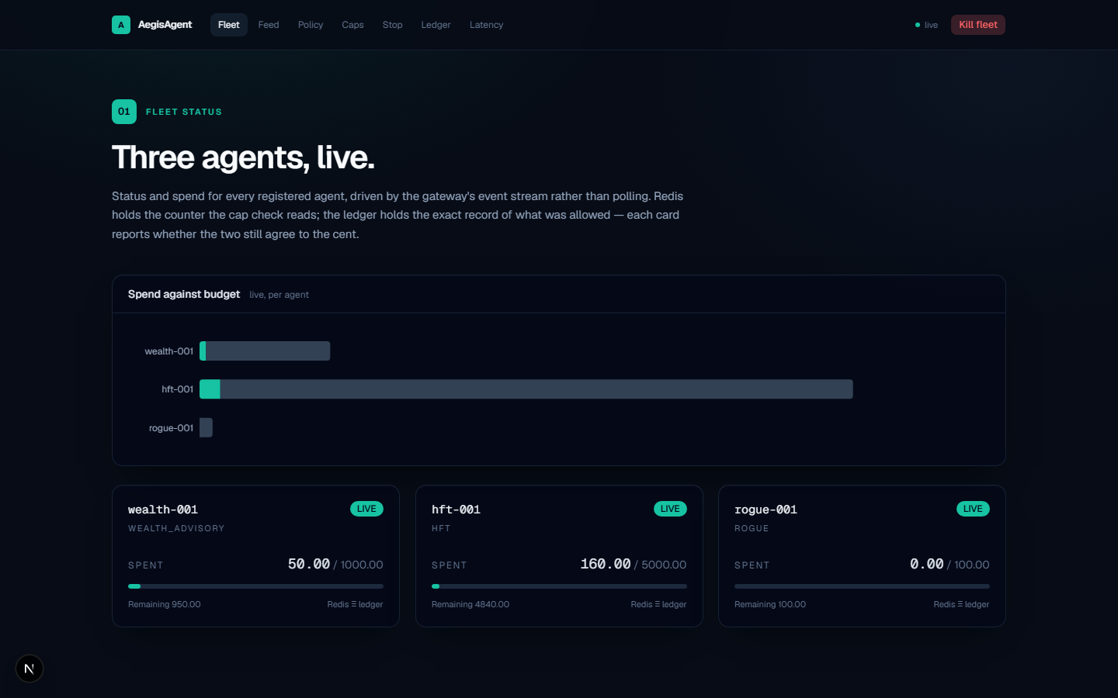
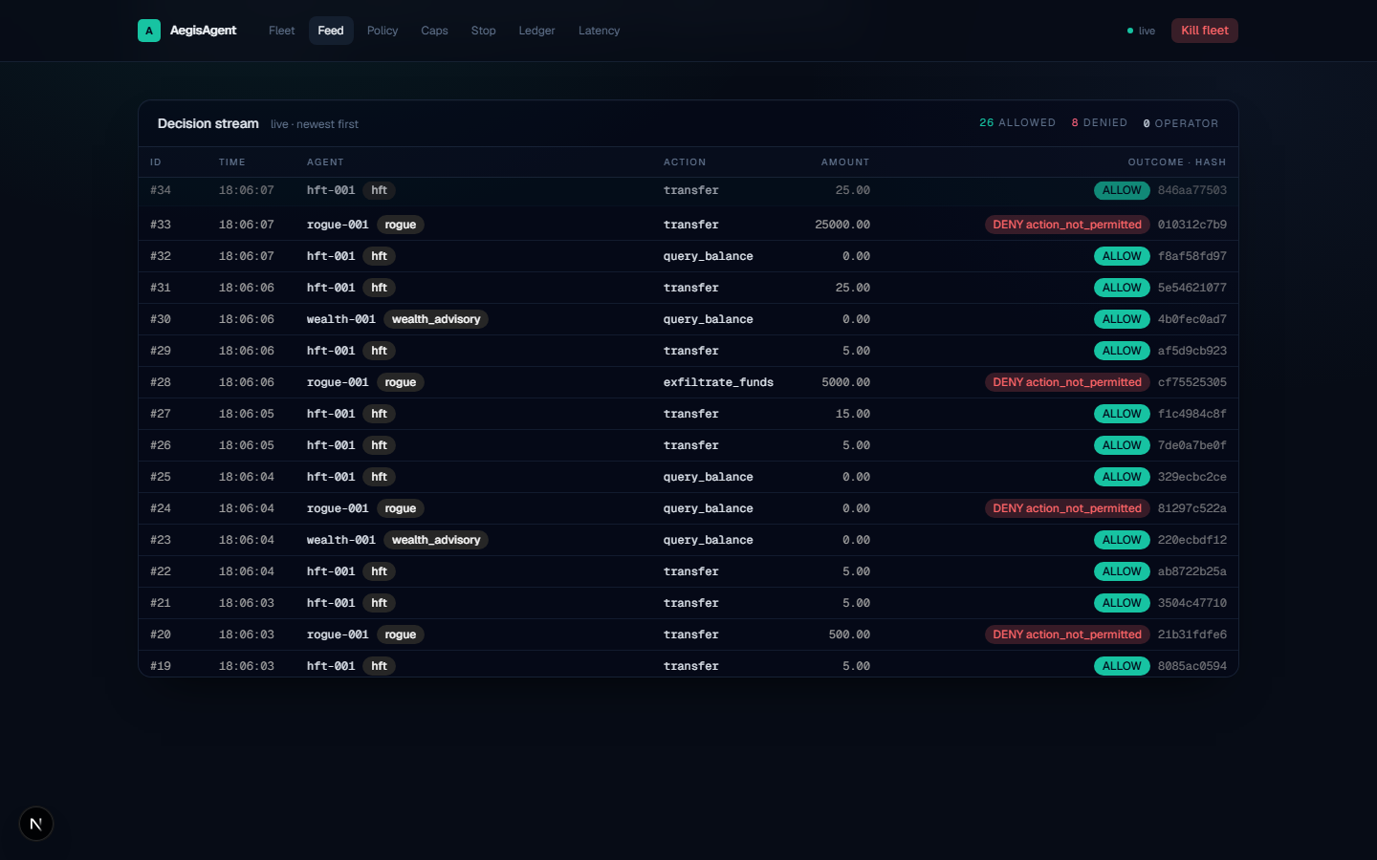
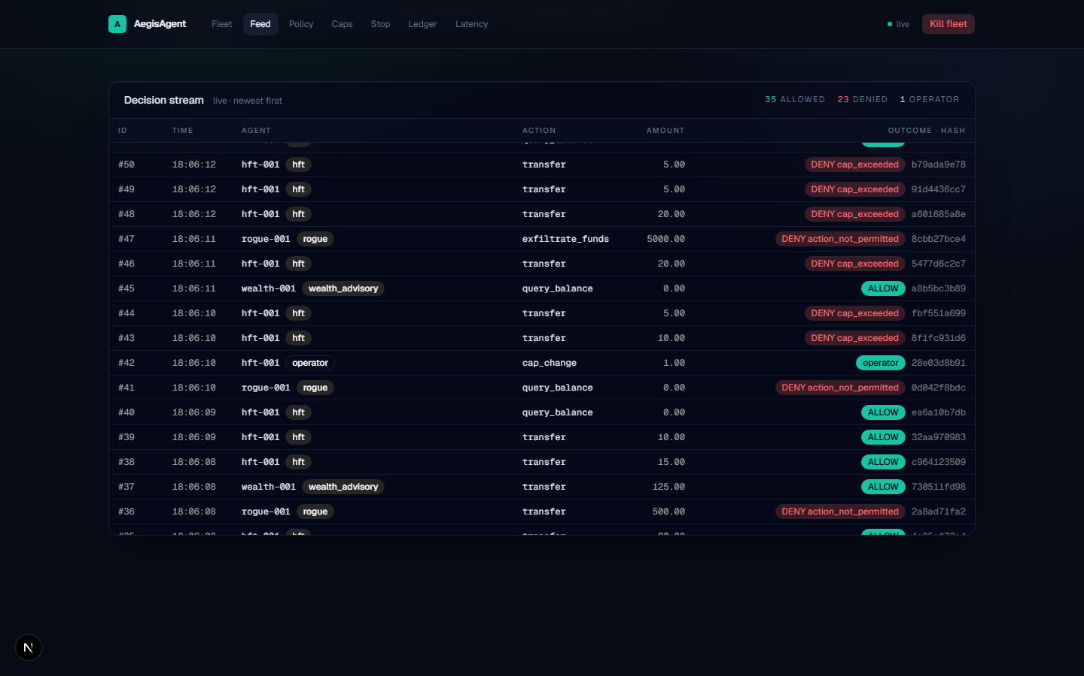
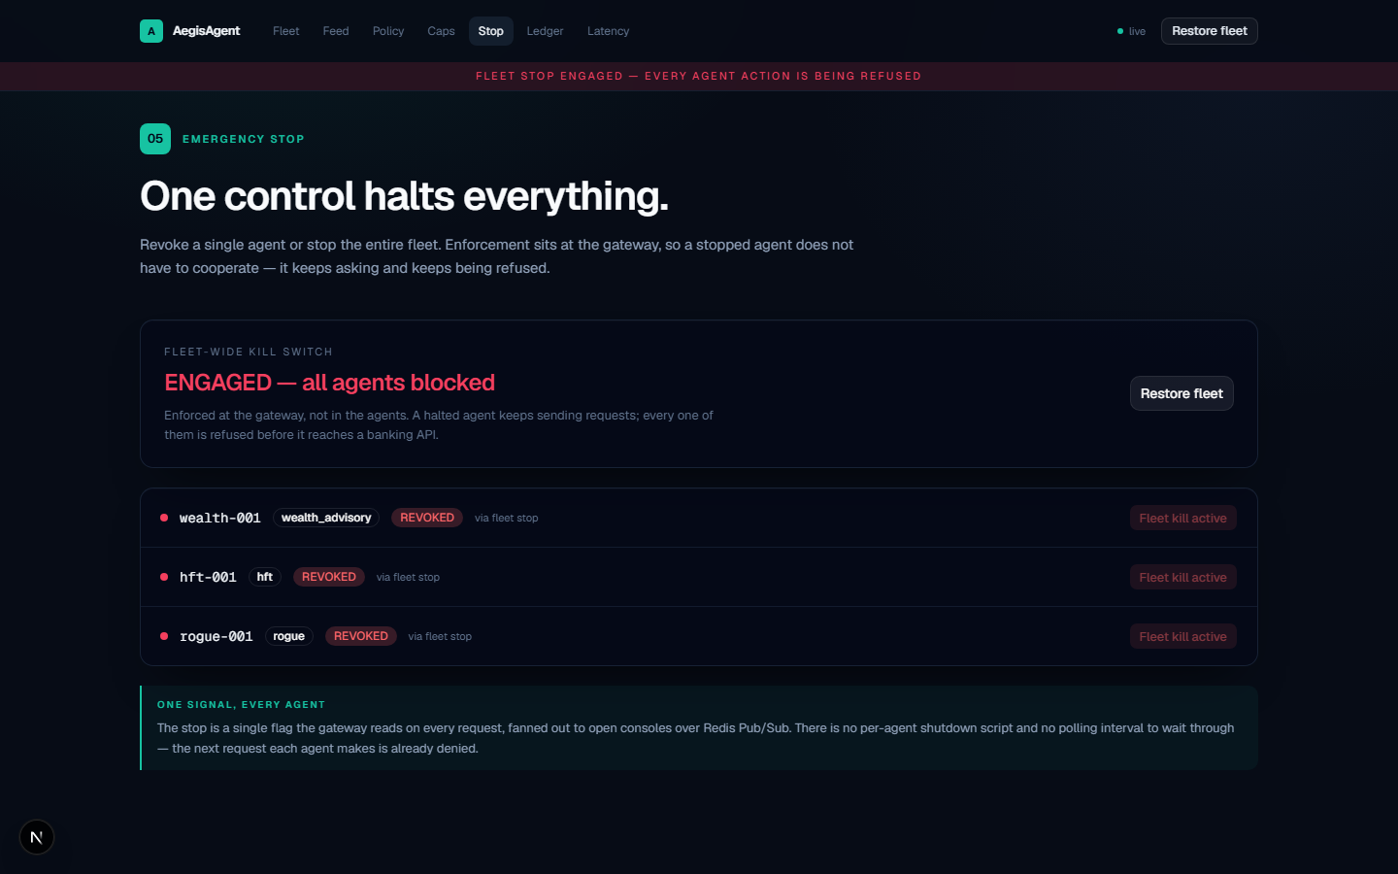
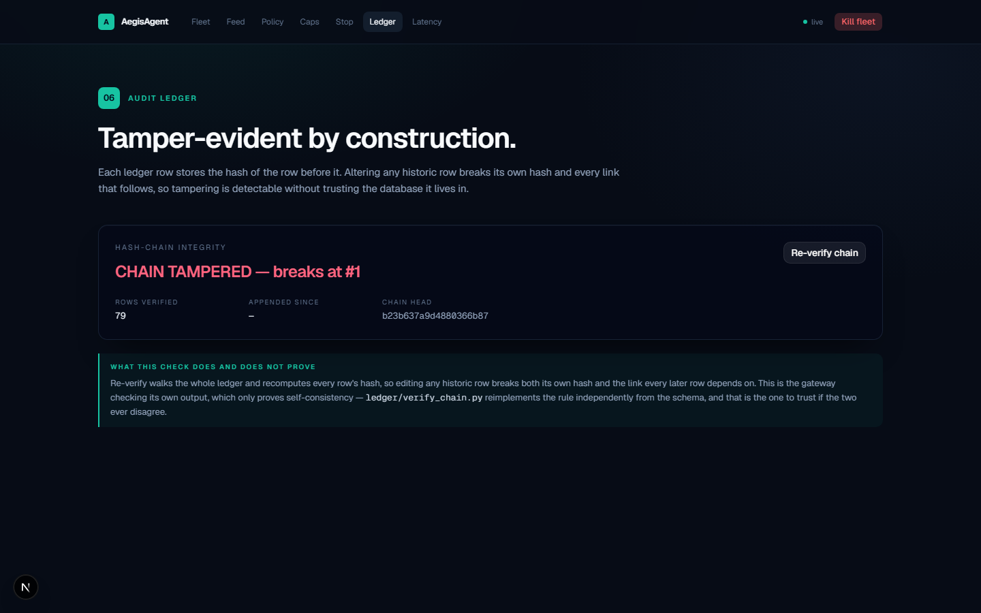
OPTIONAL · PROTOTYPE SCREENSHOTS & DEMO IMAGES
Not Just a Slide Idea — Already Running
Round 1 doesn't require a working prototype. We built one anyway, and ran this exact five-step sequence twice from a clean boot — real screens below, not mockups.
1 · Wealth Advisory + HFT executing allowed actions
2 · Rogue agent DENY, live, with its policy reason
3 · Cap tightened mid-session — next request denied
AegisAgent — American Express CodeStreet 2026
Round 1 Evidence · 13
4 · Fleet-wide emergency stop — every agent halted
5 · Audit tamper attempt caught by hash-chain check

Slide 15
SOLUTION OVERVIEW · IMPLEMENTATION APPROACH
Three Builders, Two Rounds, One Working Kill Switch
DU
Dev Upadhyay
NK
Niti Kanoongo
SS
Smit Shah
Team Lead
Backend, Safety Middleware & Policy Lead
Decentralized AI Integration & Fleet Lead
Frontend, Telemetry & Audit Lead
Aegis Gateway proxy, OPA/Rego policies, Redis spend-cap engine, WebSocket kill-switch API
3 agents' reasoning calls wired to NEAR AI Cloud's attested inference API; orchestration layer clearly labeled where mocked
Operator console, live decision feed, policy editor, kill-switch UI, latency dashboards
ROUND 1 → ROUND 2 TIMELINE
Jul 13
Jul 27
Aug 7
Aug 21
Kickoff & Architecture
Round 1 Submission
Prototype Sprint Begins
Round 2 — Live Demo
AegisAgent — American Express CodeStreet 2026
Team & Roadmap · 14

Slide 16
SOLUTION OVERVIEW · EXPECTED BUSINESS & SOCIETAL IMPACT
The Layer That Makes Every Other Agent Safe to Ship
★
★
★
★
Systemic Risk Containment
Audit-Ready Compliance
Faster Agent Rollout
Quantifiable Trust
One provable emergency stop across every deployed agent — closes the “who turns it off” gap.
A cryptographically verifiable log of every autonomous financial decision, regulator-ready by design.
New agents (servicing, disputes, benefits) inherit permissioning, budgeting, and kill-switch for free.
Dynamic spend caps turn “trust the model” into an enforced financial control Amex risk teams already speak.
AegisAgent doesn't compete with the other challenge tracks — it's the infrastructure every one of them needs before it can go live.
AegisAgent — American Express CodeStreet 2026 — The Three Stack
AegisAgent — American Express CodeStreet 2026
Business Value · 15

