Slide 1
The Watchtower: Behavioural Anomaly Detection for Cybersecurity
Problem Statement ID – Q4
Problem Statement Title – AI-Powered Behavioural Anomaly Detection for Cybersecurity
Theme – Cybersecurity | AI & Machine Learning
PS Category – Software
Student Name – Niti Ashish Kanoongo
Student ID – 23BAI10955
VIT Bhopal University Project repository
github.com/okayniti/The-Watchtower — full source, synthetic data generator, evaluation harness and analyst dashboard
THE WATCHTOWER
A detector an analyst can trust.
87.8%
precision within the top 1% of events an analyst can actually review
12.5× the best rule-based detector
Working prototype · github.com/okayniti/The-Watchtower

Slide 2
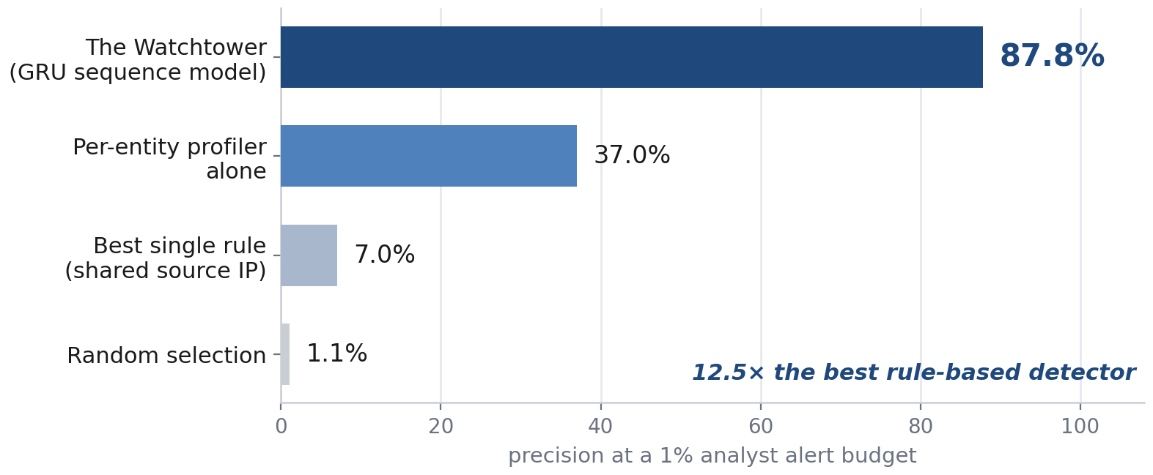
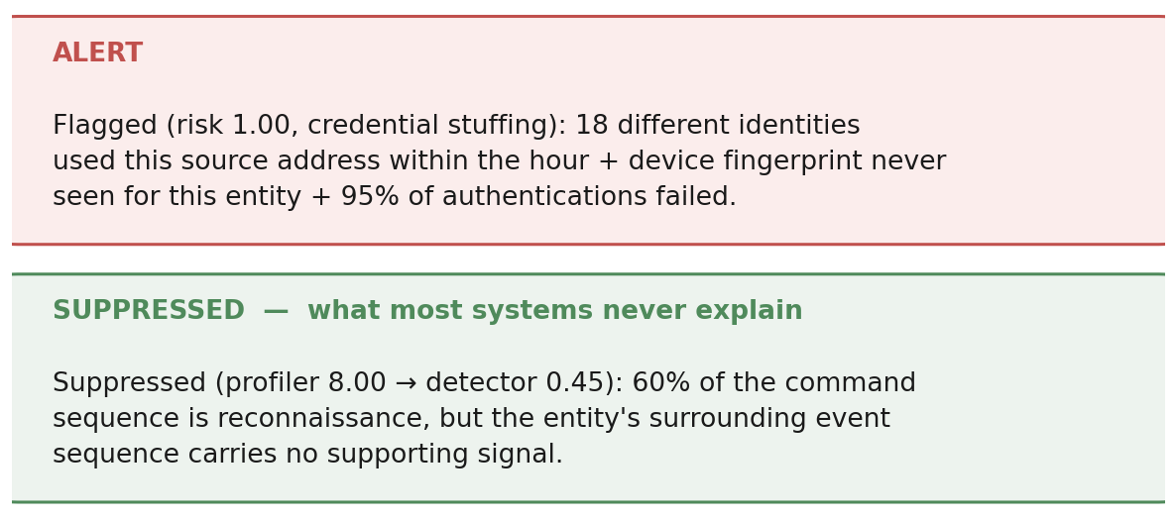
THE WATCHTOWER
Proposed Solution (Describe your Idea/Solution/Prototype)
Detailed explanation of the proposed solution
– Learns every user, service account and device's own behavioural normal — hours, locations, resources, hardware, commands
– A GRU sequence model risk-scores each access event; a classifier names which of six attack types it resembles
How it addresses the problem
– Signature rules miss novel and slow intrusions — naive single-feature rules reach only 1.1–7.0% precision on our data
– Analysts can review ~1% of events; The Watchtower puts real attacks in that 1% instead of noise
Innovation and uniqueness of the solution
– Explains what it did NOT flag — 769 near-misses suppressed with reasons, so analysts trust the threshold instead of lowering it
– Learns that a legitimate role change is the new normal: false alarms fall 0.78% → 0.19% once it settles
Precision at a 1% analyst alert budget

Slide 3
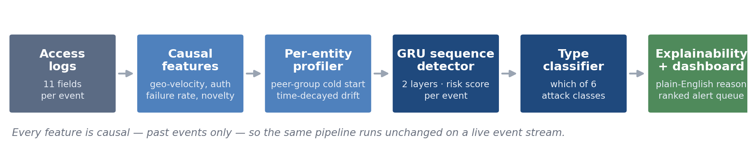
TECHNICAL APPROACH
Technologies to be used (e.g. programming languages, frameworks, hardware)
– Python · PyTorch (2-layer GRU) · scikit-learn · pandas / NumPy · Streamlit analyst dashboard · Faker
– CPU-only training · fully deterministic under a fixed seed · no proprietary data required
Methodology and process for implementation (Flow Charts/Images/ working prototype)
– Synthetic corpus: 90,495 events · 500 entities · 30 days · 1.4% attack rate, with each attack deliberately overlapping a legitimate behaviour (business travel, VPN egress, hardware refresh, mistyped passwords)
– Time-based train / validation split · labels held in a separate file so they can never reach the inference path

Slide 4
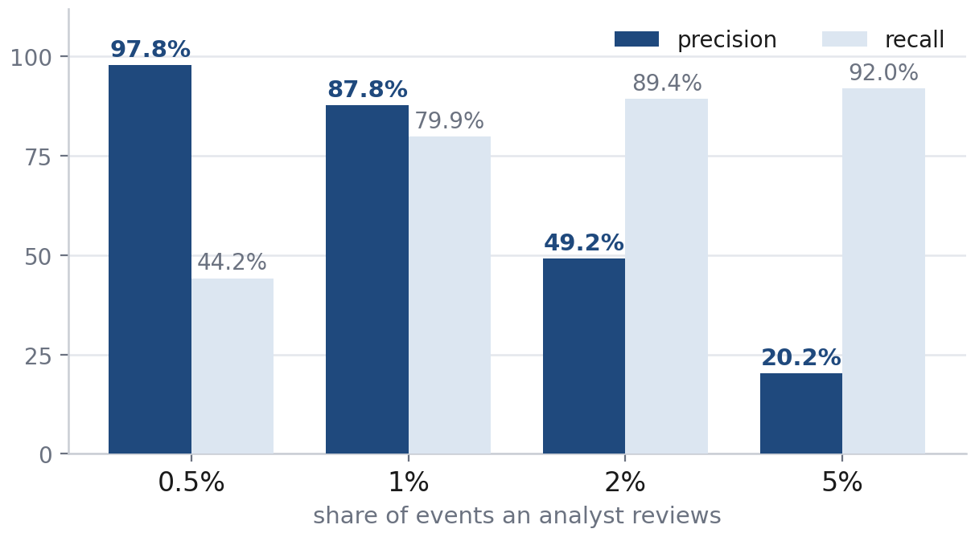
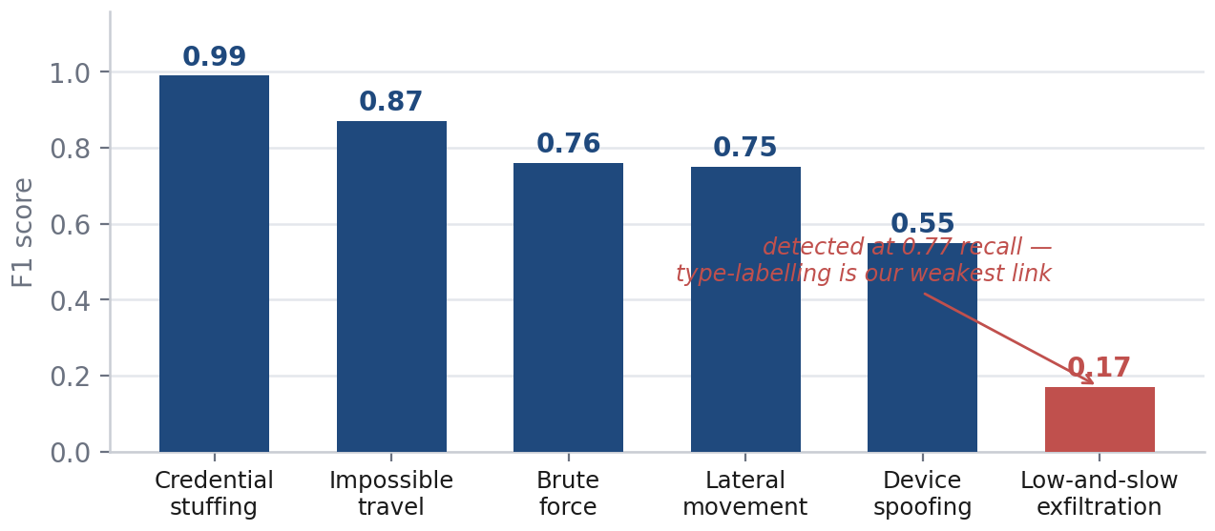
FEASIBILITY AND VIABILITY
Analysis of the feasibility of the idea
– End-to-end prototype already working: generator → profiler → detector → classifier → explainer → dashboard
– Trains on CPU in minutes; every feature is causal, so the batch pipeline moves to a live stream unchanged
Potential challenges and risks
– Extreme class imbalance (1.4%) · concept drift · cold-start entities with no history
– Attacks that hide inside normal ranges — low-and-slow exfiltration is detected (0.77 recall) but hardest to label (0.17 F1)
Strategies for overcoming these challenges
– Class-weighted loss · time-decayed baselines · peer-group scoring for entities with no history
– Alerting tuned to analyst capacity rather than a fixed threshold, so the queue stays reviewable

Slide 5
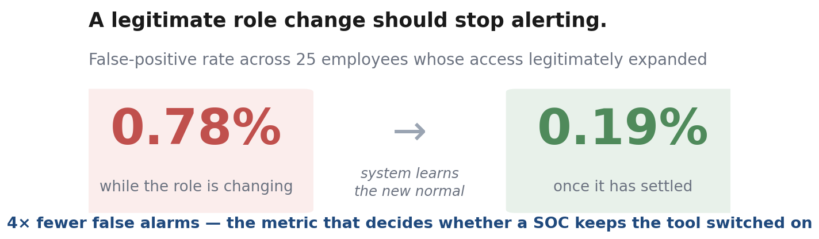
ARTIFACTS
Relevant artifacts, such as :
Copy of the Code Embedded
– github.com/okayniti/The-Watchtower
– 7 modules · generator, features, profiler, GRU detector, classifier, explainer, dashboard — reproducible byte-for-byte from a fixed seed
Snaps of the solution proposal
– Every alert carries a plain-English reason, and every suppression carries one too — shown right
Dashboard snaps
– Ranked alert queue with an adjustable analyst budget; moving the slider shows precision move 97.8% → 20.2% live
– Alert detail, contributing factors, entity timeline, trust panel, cold-start badges
DASHBOARD SCREENSHOT
Replace this box with a screenshot of the running Streamlit dashboard — the ranked alert queue with the budget slider visible makes the strongest single image.
streamlit run dashboard/app.py

Slide 6
RESEARCH AND REFERENCES
Details / Links of the reference and research work
– MITRE ATT&CK Framework — adversary tactics and techniques used to define the six attack behaviours modelled · attack.mitre.org
– NIST SP 800-94 — Guide to Intrusion Detection and Prevention Systems — alert-handling and analyst-workload guidance
– Chandola, Banerjee & Kumar (2009) — “Anomaly Detection: A Survey”, ACM Computing Surveys 41(3) — taxonomy underpinning the profiler design
– Malhotra et al. (2015) — “Long Short Term Memory Networks for Anomaly Detection in Time Series”, ESANN — basis for the sequence-model approach
– CMU SEI CERT Insider Threat Dataset — reference behaviour for modelling gradual, legitimate privilege expansion (insider drift)
– Verizon Data Breach Investigations Report — prevalence of credential abuse and stolen-credential intrusions, informing class priors
Project repository
github.com/okayniti/The-Watchtower — full source, synthetic data generator, evaluation harness and analyst dashboard

