Slide 1
COMS 7840 project
Parameter estimation of
FitzHugh-Nagumo Model
Kayode Olumoyin

Slide 2
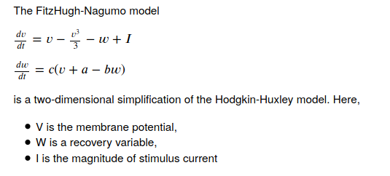
Introduction

Slide 3
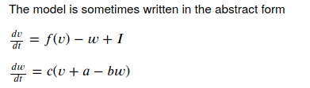

Introduction

Slide 4
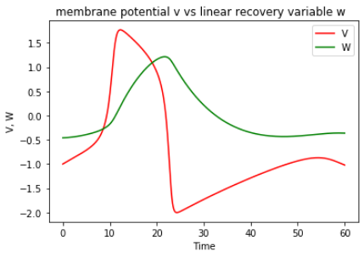
Solving the FHN with known parameters
Known parameters

Slide 5
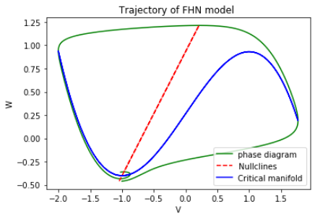
Phase diagram of the FHN using known parameters

Slide 6
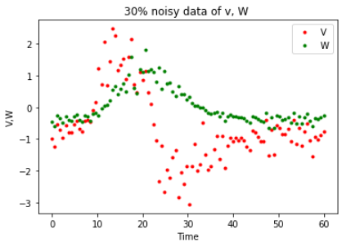
Synthetic data generated from the solution to the FHN model using 30% noise

Slide 7
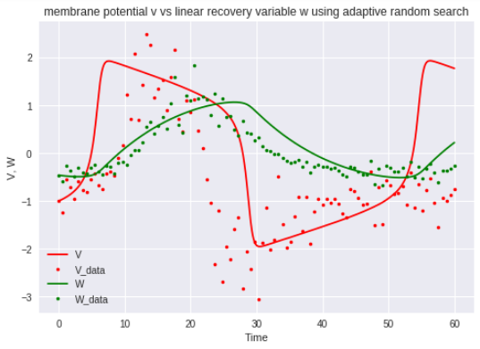
Using adaptive random search to estimate the parameters, solving the FHN model with the new parameters
Estimated parameters after 7 epochs
Known parameters

Slide 8
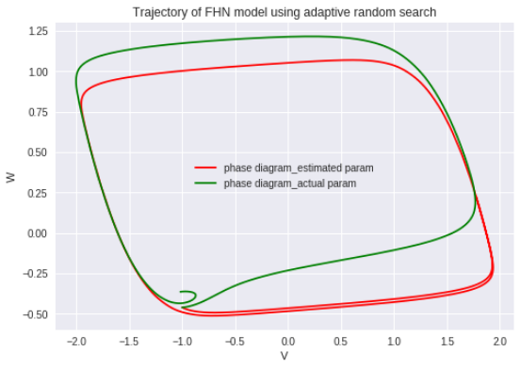
phase diagram using parameters from the adaptive search vs phase diagram using the known parameters

Slide 9
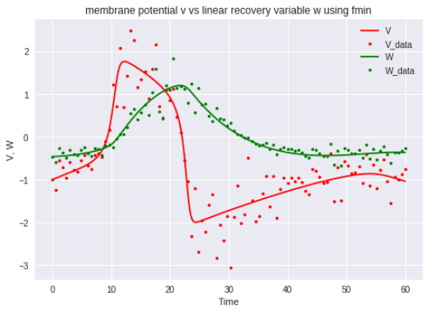
Using fmin to improve the parameters estimated from the adaptive random search, solving the FHN model with the new parameters
Estimated parameters
Known parameters

Slide 10
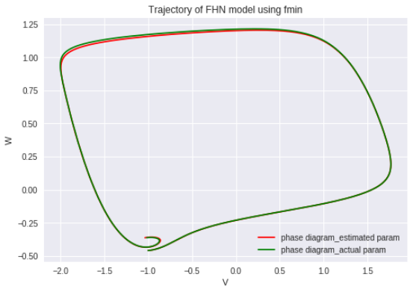
phase diagram using parameters from the fmin vs phase diagram using the known parameters

Slide 11
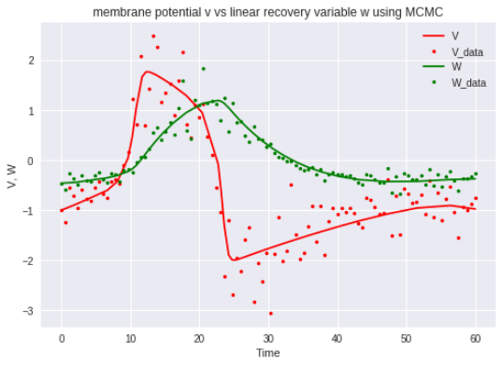
Using MCMC to estimate the parameters, solving the FHN model with the new parameters
Estimated parameters after 2 Epochs
Known parameters

Slide 12
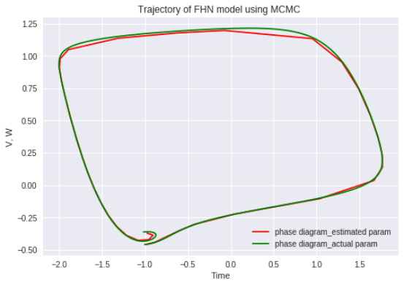
phase diagram using parameters from the MCMC vs phase diagram using the known parameters

Slide 13
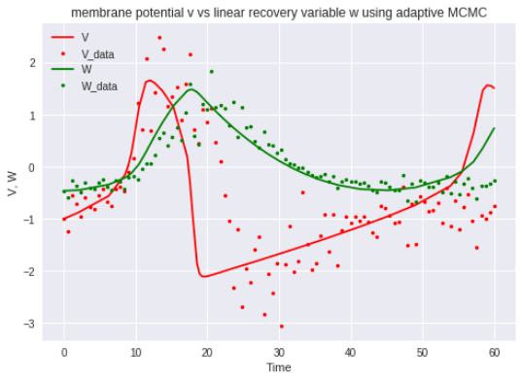
Using adaptive MCMC to estimate the parameters, solving the FHN model with the new parameters
Estimated parameters after 7 Epochs
Known parameters

Slide 14
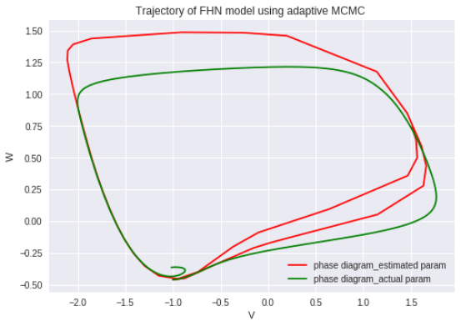
phase diagram using parameters from adaptive MCMC vs phase diagram using the known parameters

Slide 15
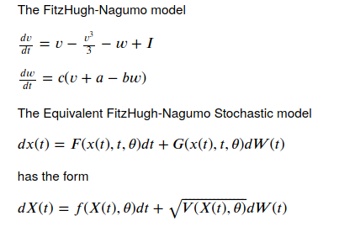
using Extended Kalman Filter and MCMC in the SDE obtained from the FHN to estimate the parameters

Slide 16
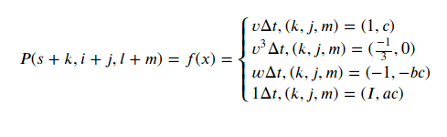
using Extended Kalman Filter and MCMC in the SDE obtained from the FHN to estimate the parameters

Slide 17
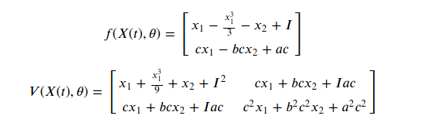
using Extended Kalman Filter and MCMC in the SDE obtained from the FHN to estimate the parameters

Slide 18
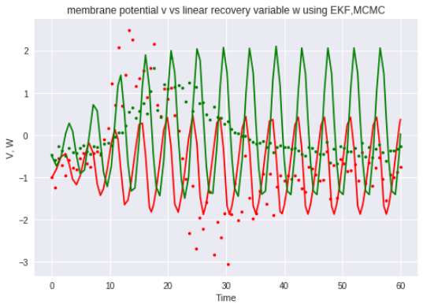
using Extended Kalman Filter and MCMC in the SDE obtained from the FHN to estimate the parameters
Estimated parameters after 1 Epoch
Known parameters

Slide 19
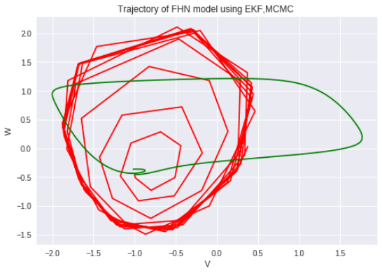
phase diagram using parameters from the Extended Kalman Filter and MCMC applied to the SDE obtained from the FHN vs phase diagram using the known parameters

Slide 20
Conclusion
In this project, I demonstrated the computational benefits of using algorithms such as the Adaptive Random Search, fmin, Metropolis-Hastings Algorithm (MCMC) and Adaptive Metropolis-Hastings Algorithm to estimate parameters in a FitzHugh-Nagumo (FHN) model. I also demonstrate how to estimate parameters of a Stochastic Differential equation model obtained from the FHN model, and then using Extended Kalman Filter to compute the negative loglikelihood, which I used in the MCMC sampler. This negative loglikehood was computationally expensive, on my machine it took more than 5 hours to complete one Epoch of 10000 iterations. Running more epochs would have improved the estimated parameters as was the case when I did not use Extended Kalman Filter to compute the negative loglikelihood for the MCMC sampler and the Adaptive MCMC sampler.
One way to improve this will be to parallelize the negative loglilekihood function obtained from the Extended Kalman Filter.

