Slide 1
Backdoor ATtack
Presented by:
Berrag Ayoub
El Baghdadi Mohamed
Supervised by:
Pr Ismail Berrada

Slide 2

Outline
What’s a Backdoor
How does it work?
Packaging-Creating Trojan
Backdoor Features
Demonstration
Conclusion

Slide 3
What’s a Backdoor ?
Interactive program that gives access to a system that is executed on.
Command execution.
Access file system.
Upload/download files.
Run keylogger.
…..etc

Slide 4
How Does Backdoors Work ?
System Command
Hacker
Victim
Result

Slide 5
Bind / Direct Connection
System Command
Hacker
Victim
Result

Slide 6
Reverse Connection
System Command
Hacker
Victim
Result

Slide 7
Reverse Connection
Hacker
Victim
Listening for incoming connections on a specific port

Slide 8
Reverse Connection
Hacker
Victim

Slide 9
Persistence Idea
Persistence backdoor start when the system starts.
Backdoor→ maintain our access.

Slide 10

Packaging -Creating Trojan
We used Pyinstaller to :
→ Combine evil file with normal file (image, book, song ...etc).
→ Configure evil file to run silently in the background.
→ Change file icon.
→ Change file extension.

Slide 11

Packaging -Creating Trojan
Package front file with evil file.
Extract front file at run time.
Run front file from evil code.

Slide 12

Packaging -Creating Trojan
All programs we wrote are pure python programs
They do not depend on an OS specific resource.
Result:
When packaged, they will work on any OS even if python is NOT installed.

Slide 13
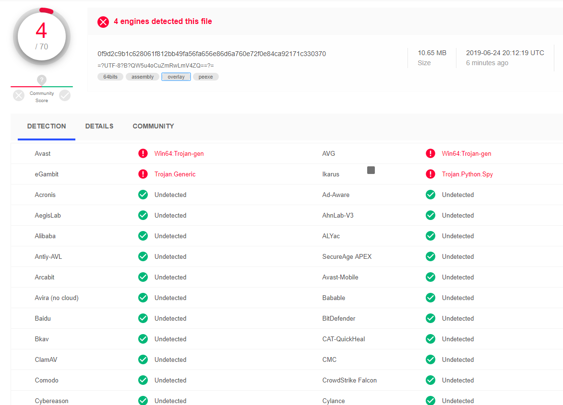

Slide 14

Backdoor Features
Command execution.
dir
Access file system.
cd DirectoryName
Upload files.
upload filename
Download files.
Download filename
Take screenshots.
Screenshot

Slide 15
Backdoor Features
Shut down computer.
Shutdown -s
Restart computer.
Shutdown -r
Run keylogger.
Keylogger mail password
Run malicious software(Lazagne).
Get_passwords
Send messages.
Message head contenu

Slide 16
Demonstration

Slide 17
Conclusion

Slide 18

Thank YOU

