Slide 1

Creation a DW of Sales Financial dataset
Realised by:
Ayoub Berrag
Supervised by:
Mr.Mhaouach Mohamed
http://www.free-powerpoint-templates-design.com

Slide 2
01
Data model
02
General architecture
03
Staging Area
04
Operational Data Store
05
Loading the DW
Summary
06
QlikView Reporting

Slide 3
Introduction
Business Intelligence

Slide 4
Data Model
DIM_Branch
-Brunch_Code -Address1 -City -Postal_zone …
DIM_Product
-Product_Number -Introduction_Date -Cross_margin -Product_Image …
Fact_Ventes
-ID_FACT_TABLE -Product_Number -Brunch_Code -Retailer_contact_code -ID_Temps -Quantity -Unit_Cost -Unit_Price -Unit_Sale_Price
DIM_Retailer
-Retailer_contact_code -First_Name -Last_Name -Job_Position_fr -Phone_Number -Fax -Email …
DIM_Temps
-ID_Temps -year -Trimestre -month -day …

Slide 5
General architecture
Collect
Integrate
Aggregate
Analytics
ETL (Talend)
Staging Area
Stockage
ODS
Data WareHouse
(DataMart)
File
GOVENTES
Analyses Multi dimensionnelles
Administration

Slide 6
Collect
GOVENTES

Slide 7
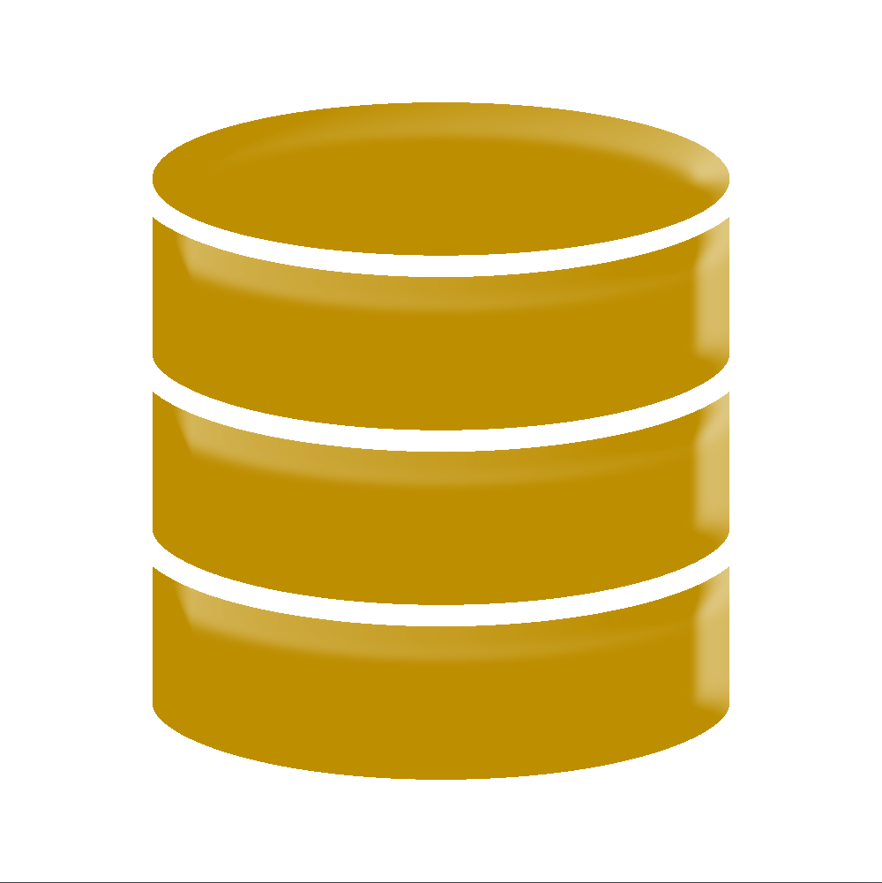
Architecture Générale
Intégrer
Organiser
Restituer
ETL (Talend)
Staging Area
Stockage
ODS
Data WareHouse
(DataMart)
Fichiers
Analyses Multi dimensionnelles
Collect
Administration
GOVENTES
SQL

Slide 8
General architecture
Collect
Integrate
Aggregate
Analytics
ETL (Talend)
Staging Area
Stockage
ODS
Data WareHouse
(DataMart)
File
GOVENTES
Analyses Multi dimensionnelles
Administration

Slide 9
ETL (Talend)
Staging Area
Stockage
ODS
Data WareHouse
(DataMart)

Slide 10
Staging Area
Staging Area

Slide 11
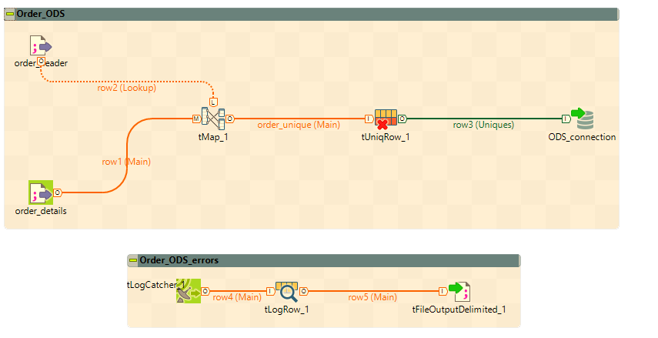
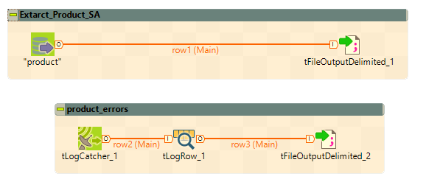
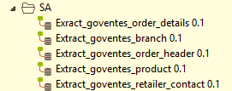
Order Table
Staging Area

Slide 12
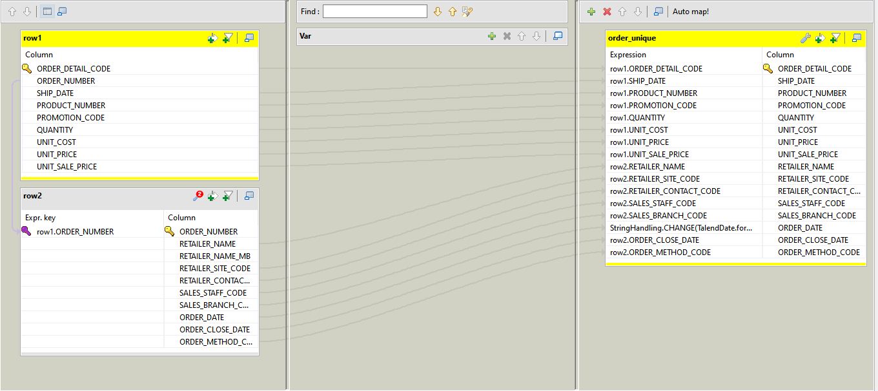
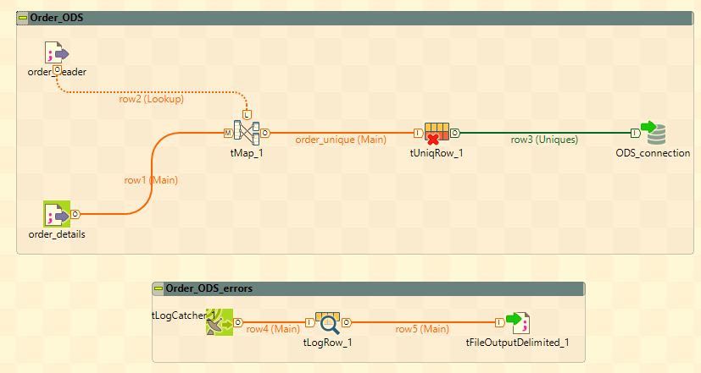
Order Table
(ODS)
Staging Area

Slide 13
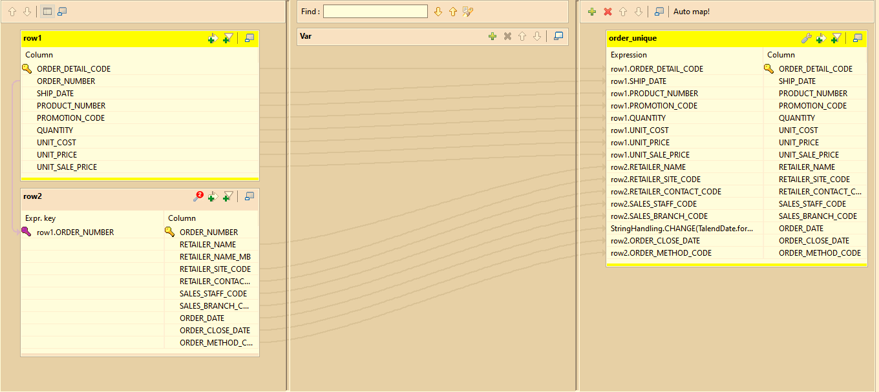

Slide 14
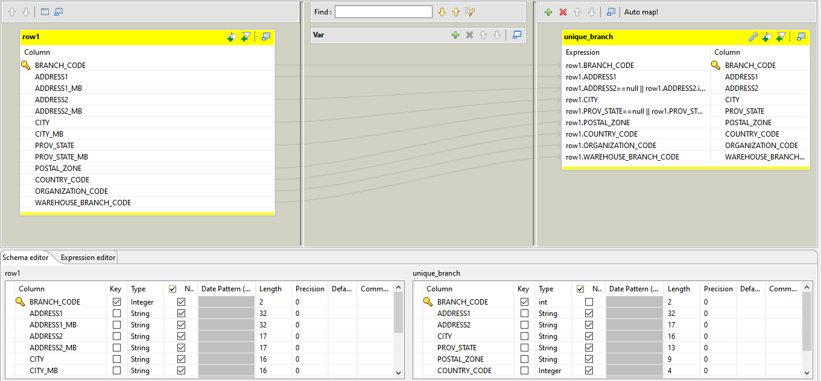
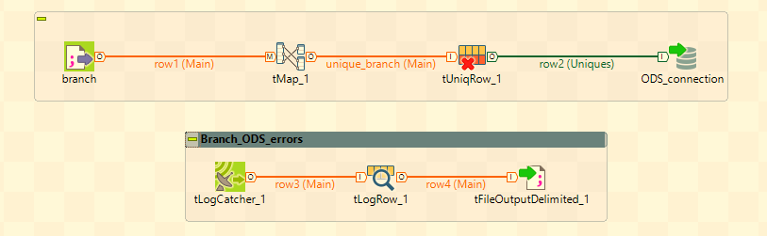
Branch Table
(ODS)

Slide 15
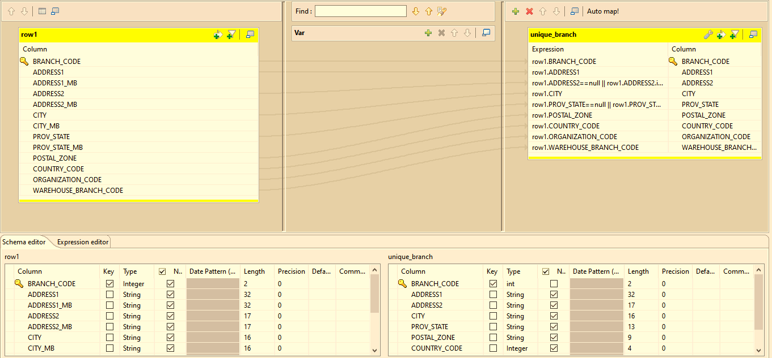

Slide 16
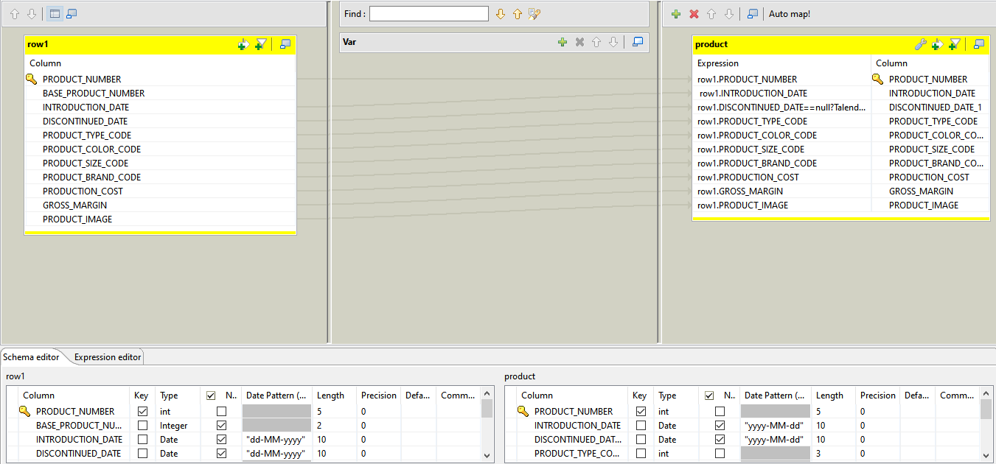
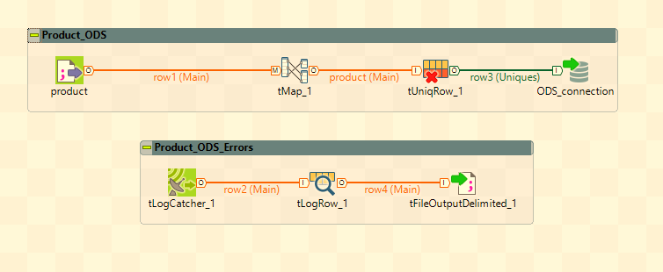
Product Table
(ODS)

Slide 17
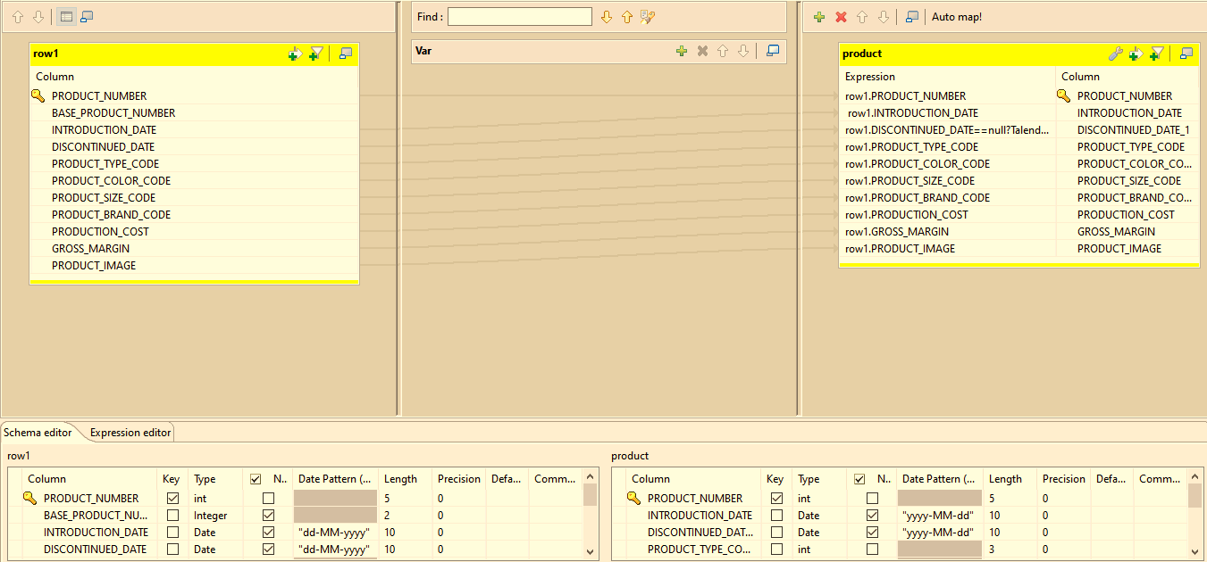

Slide 18
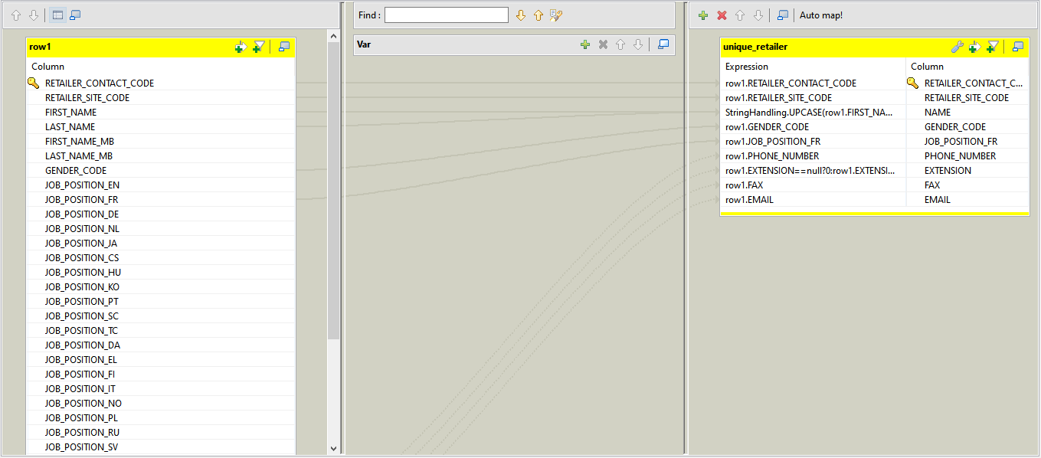
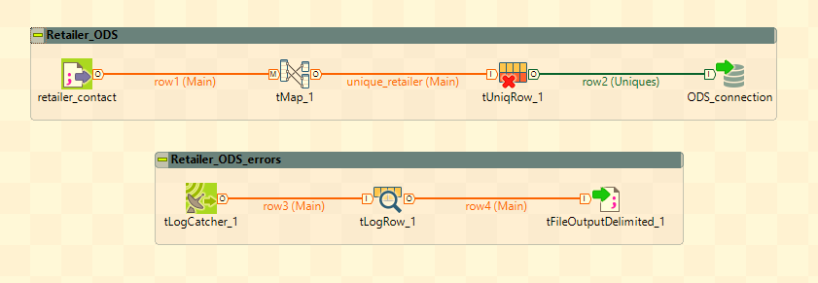
Retailer Table
(ODS)

Slide 19
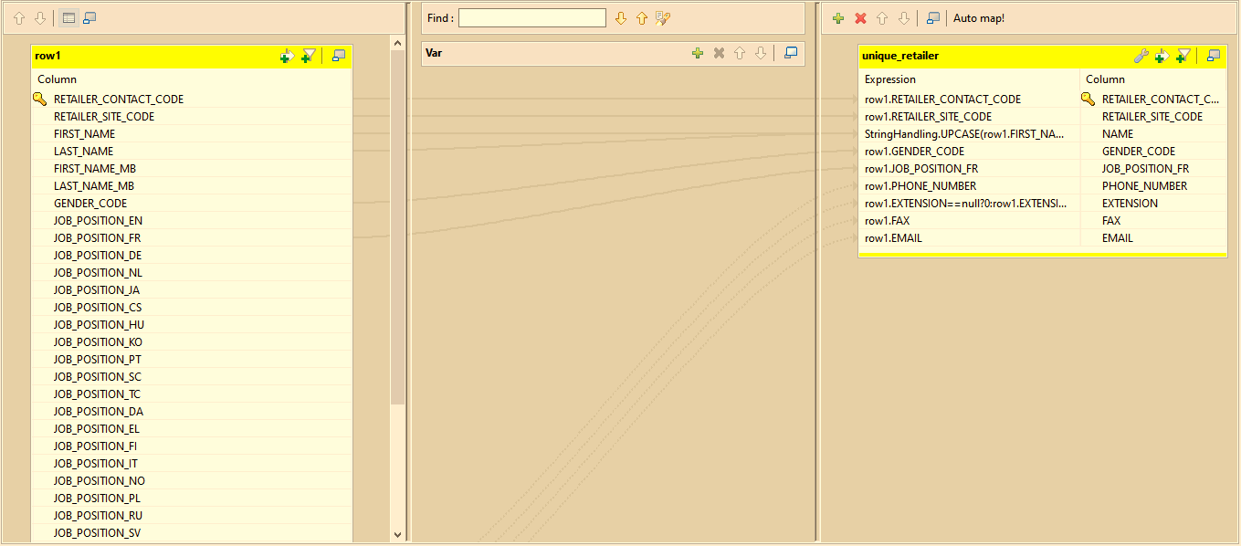

Slide 20
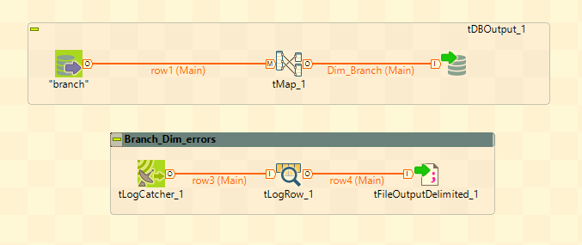
Loading Dimensions

Slide 21
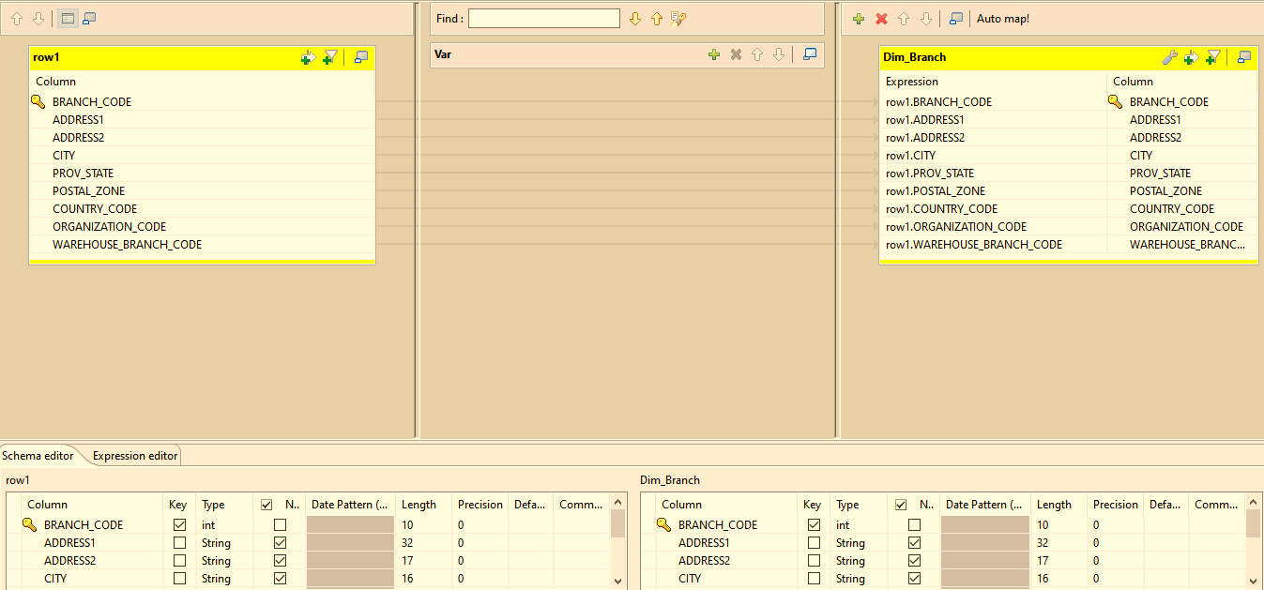

Slide 22
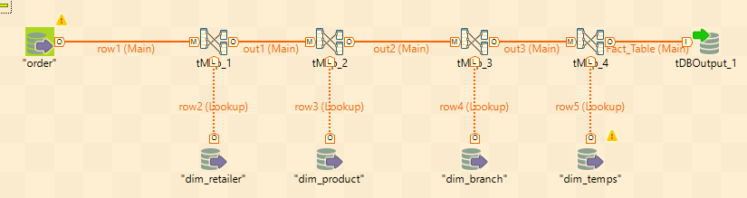
Fact Table Loading

Slide 23
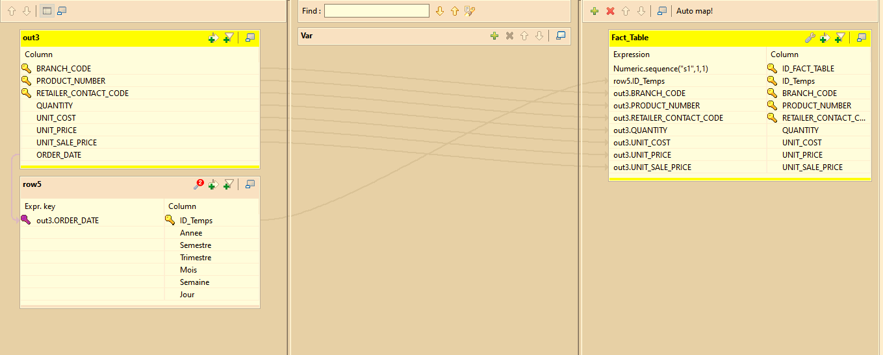

Slide 24
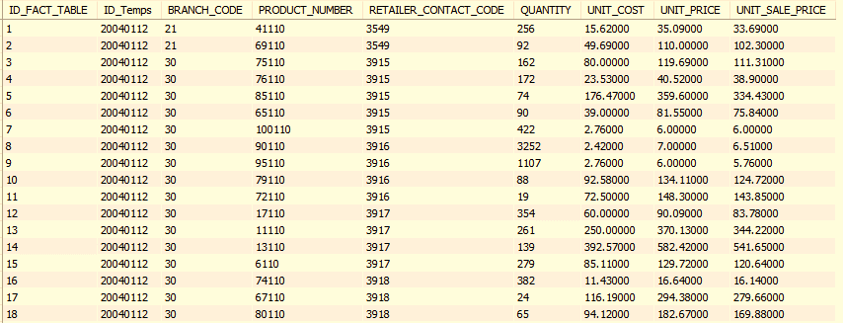

Slide 25
General architecture
Collect
Integrate
Aggregate
Analytics
ETL (Talend)
Staging Area
Stockage
ODS
Data WareHouse
(DataMart)
File
GOVENTES
Analyses Multi dimensionnelles
Administration

Slide 26
Analytics
File
Analyses Multi dimensionnelles
QlikView Reporting

