Slide 1
@Open-Ones Group
Software Development in Practice
Duration:
Presenter: Lê Ngọc Thạch

Slide 2
Objectives
Ddfsfs
  Dfsdf
  dfgsdf

Slide 3
Contents
Software development Life-cycle (SDLC), CMMI
Create requirement, solution, detailed design for software product
Perform code review, create unit test case, write unit test code, perform unit test
Perform cause analysis for improvement

Slide 4
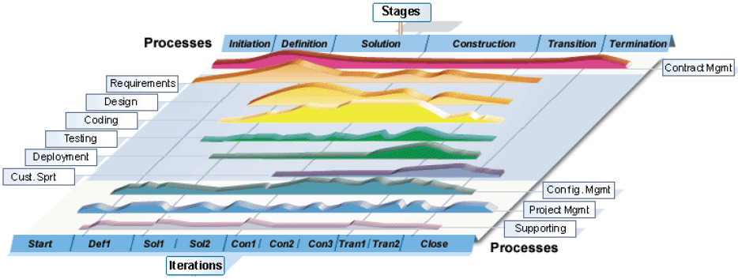
SDLC combination with Process

Slide 5
Initiation stage
Purpose
Main activities:
  Identify project objectives
  Identify project controlling and monitoring mechanism
  Define project plans: master schedule, major milestones, critical dependencies
Output:
  Project plan
  Work order

Slide 6
Definition stage
Purpose: aims at defining user requirements for software packages
Activities
  Studying and translating the user requirement User Requirement Document (URD)
  Analyze the SRS; Acceptance Test Criteria.
Output
  User requirement document
  Software requirement document
  Project plan
  Project report

Slide 7
Solution stage
Purpose:
Activities
Output

Slide 8
Construction stage
Purpose:
Activities
Output

Slide 9
Transition stage
Purpose:
Activities
Output

Slide 10
Termination stage
Purpose:
Activities
Output

Slide 11
