Slide 1
@Open-Ones Group
Software Development in Practice
Duration: 1h
Presenter: Open-Ones Group

Slide 2
Objectives
Understand stages, output of each stage in SDLC
  Six stages matrix
  Mandatory work products
Comprehensive roles and responsibilities in a software project

Slide 3
Contents
Software development Life-cycle (SDLC), CMMI
Create requirement, solution, detailed design for software product
Perform code review, create unit test case, write unit test code, perform unit test
Perform cause analysis for improvement

Slide 4
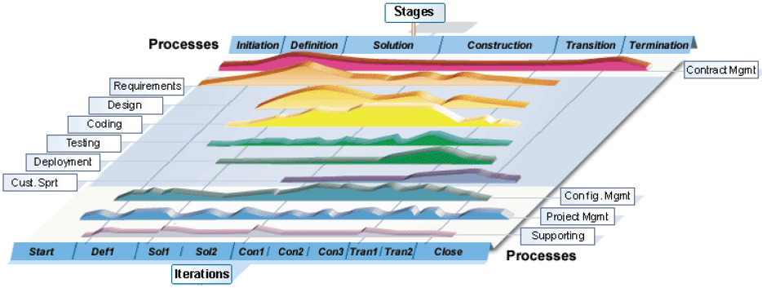
SDLC combination with Process
Notes:
This matrix is customized from RUP
The Rational Unified Process® or RUP® product is a software engineering process. It provides a disciplined approach to assigning tasks and responsibilities within a development organization. Its goal is to ensure the production of high-quality software that meets the needs of its end users within a predictable schedule and budget.
Explain 2 dimensions:
The horizontal axis represents time and shows the lifecycle aspects of the process as it unfolds. This first dimension illustrates the dynamic aspect of the process as it's enacted and is expressed in terms of phases/stage, iteration and milestones.
The vertical axis represents disciplines that logically group activities by nature. This second dimension portrays the static aspect of the process—how it's described in terms of process components, disciplines, activities, workflows, artifacts, and roles
The graph shows how the emphasis varies over time. For example, in early iterations you spend more time on requirements; in later iterations you spend more time on implementation.
From a management perspective, the software lifecycle of the Rational Unified Process (RUP) is decomposed over time into four sequential phases, each concluded by a major milestone; each phase is essentially a span of time between two major milestones. At each phase-end an assessment is performed to determine whether the objectives of the phase have been met. A satisfactory assessment allows the project to move to the next phase.

Slide 5
Initiation stage
Purpose: achieve concurrence among all stakeholders on the life-cycle objectives for the project
Main activities:
  Identify project objectives
  Identify project controlling and monitoring mechanism
  Define project plans: master schedule, major milestones, critical dependencies
Output:
  Project plan
  Work order
Notes:
The primary objectives of the Inception phase include:
• Establishing the project's software scope and boundary conditions, including an operational vision, acceptance criteria and what is intended to be in the product and what is not.
• Discriminating the critical use cases of the system, the primary scenarios of operation that will drive the major design tradeoffs.
• Exhibiting, and maybe demonstrating, at least one candidate architecture against some of the primary scenarios
• Estimating the overall cost and schedule for the entire project (and more detailed estimates for the elaboration phase that will immediately follow)
• Estimating potential risks (the sources of unpredictability) (See ··Concepts: Risk)
• Preparing the supporting environment for the project.
The essential activities of the Inception include:
• Formulating the scope of the project. This involves capturing the context and the most important requirements and constraints to such an extent that you can derive acceptance criteria for the end product.
• Planning and preparing a business case. Evaluating alternatives for risk management, staffing, project plan, and cost/schedule/profitability tradeoffs.
• Synthesizing a candidate architecture, evaluating tradeoffs in design, and in make/buy/reuse, so that cost, schedule and resources can be estimated. The aim here is to demonstrate feasibility through some kind of proof of concept. This may take the form of a model which simulates what is required, or an initial prototype which explores what are considered to be the areas of high risk. The prototyping effort during inception should be limited to gaining confidence that a solution is possible - the solution is realized during elaboration and construction.
• Preparing the environment for the project, assessing the project and the organization, selecting tools, deciding which parts of the process to improve.

Slide 6
Definition stage
Purpose: aims at defining user requirements for software packages
Activities
  Studying and translating the user requirement User Requirement Document (URD)
  Analyze the SRS; Acceptance Test Criteria.
Output
  User requirement document
  Software requirement document
  Project plan
  Project report

Slide 7
Solution stage
Purpose: Define an effective solution to meet customer requirements
Activities
  Analyzing and create a design for the software package
Output
  Architectural Design Document (ADD)
  Detailed Design Document (DDD)
  Test Plan
  Prototype

Slide 8
Construction stage
Purpose: develop the system
Activities
  Coding
  Testing
Output
  Test case and Test data
  Software package
  Reports: Code Review, Test, Project
  Installation manual, User manual (optional)

Slide 9
Transition stage
Purpose: ensure the software is available for end users
Activities
  Deliver the software to customer, Implement the software on customer site
  Conduct test activities for acceptance and supporting
Output
  Accepted software package
  Release note

Slide 10
Termination stage
Purpose: summarize the results of the project
Activities
  Get customer satisfaction survey
  Analysis data of the project
Output
  Customer satisfaction survey
  Acceptance note

Slide 11
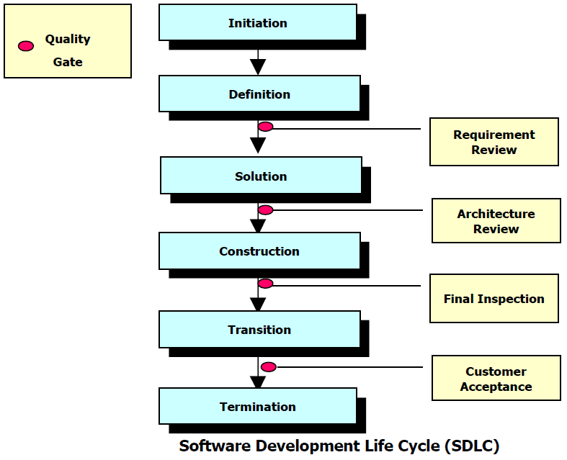
Flow of stages/phages in SDLC

Slide 12
Relax by Q&A

Slide 13
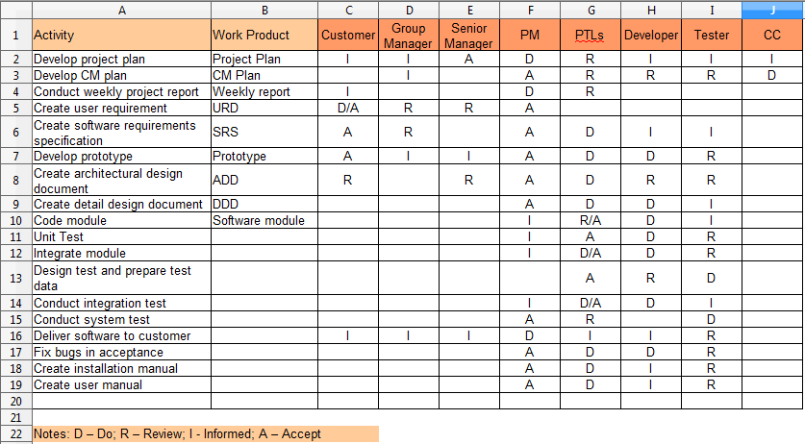
Roles and responsibilities

Slide 14
References
Public FPT Software's CMMi documents
http://ict-industry.gov.vn/Clients/Document/DownloadDocument.aspx?Me=Document&ID=1
Wiki
http://en.wikipedia.org/wiki/Software_development_process
Rational Unified Process

