Slide 1


WELCOME TO
INDONESIAN CATHOLIC FAMILY
BRISBANE - GOLD COAST
[MASS TITLE]
[DD] [MMMM] [YYYY]
Mohon menjaga keheningan dan aktifkan mode diam pada gawai Anda.
Please observe silence and put your devices on silent mode.

Slide 2
Birthdays:
Bagi Mereka yang berulang tahun pada [Monday date] – [Mass date]:
Silahkan disampaikan ke Seksi Liturgi atau ke Pastor bagi yang mempunyai Intensi Khusus.
UMAT DUDUK ALL SIT

Slide 3
LAGU PEMBUKA ENTRANCE HYMN
PS [Numb] [TITLE]
[Lyrics]
UMAT BERDIRI ALL STAND

Slide 4
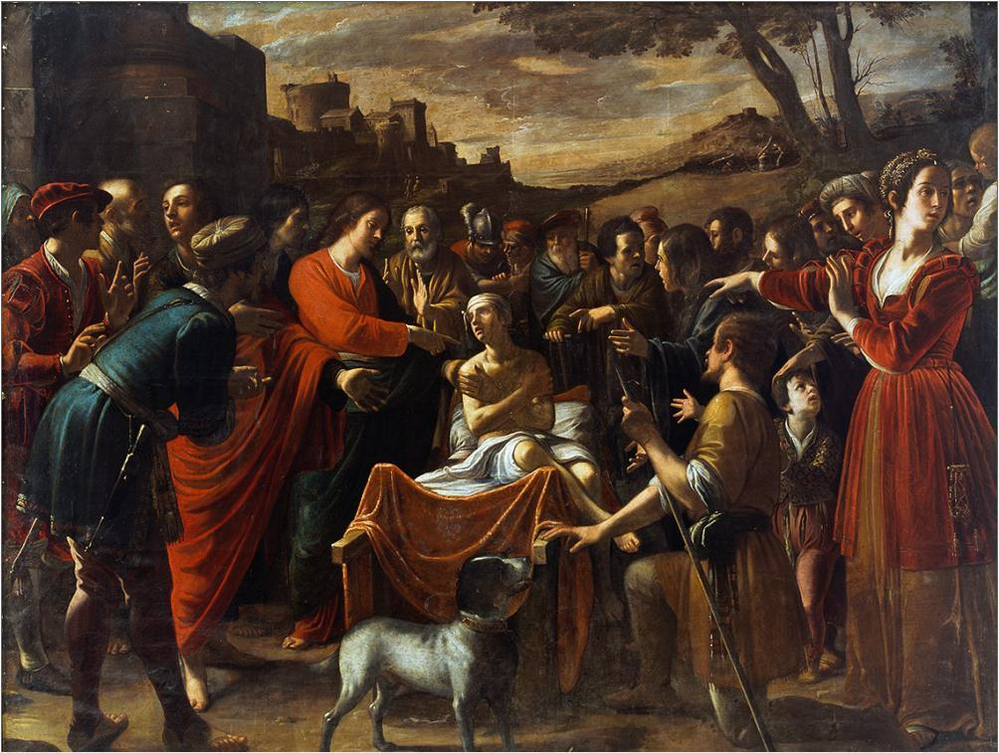


Slide 5
TANDA SALIB DAN SALAM
SIGN OF THE CROSS AND GREETINGS
I
U
I
U
: Dalam nama Bapa, dan
Putera, dan Roh Kudus.
: Amin.
: Rahmat Tuhan kita Yesus
Kristus, cinta kasih Allah,
dan persekutuan Roh Kudus
bersamamu.
: Dan bersama rohmu.
P
A
P
A
: In the name of the Father, and of
the Son, and of the Holy Spirit.
: Amen.
: The grace of our Lord Jesus
Christ, and the love of God,
and the communion of the
Holy Spirit be with you all.
: And with your spirit.
UMAT BERDIRI ALL STAND

Slide 7
TOBAT
PENITENTIAL ACT
Saya mengaku
Kepada Allah yang Mahakuasa, dan kepada Saudara sekalian, bahwa saya telah berdosa, dengan pikiran dan perkataan, dengan perbuatan dan kelalaian.
[Sambil menebah dada sendiri]
Saya berdosa, saya berdosa, saya sungguh berdosa.
I confess
to almighty God and to you, my brothers and sisters, that I have greatly sinned, in my thoughts and in my words, in what I have done and in what I have failed to do.
[While striking the breast]
through my fault, through my fault, through my most grievous fault.
UMAT BERDIRI ALL STAND

Slide 8
TOBAT
PENITENTIAL ACT
Oleh sebab itu, saya mohon kepada Santa Perawan Maria, kepada para malaikat dan orang kudus, dan kepada Saudara sekalian, supaya mendoakan saya pada Allah, Tuhan kita.
Therefore, I ask blessed Mary ever-Virgin, all the Angels and Saints, and you, my brothers and sisters, to pray for me to the Lord our God.
UMAT BERDIRI ALL STAND

Slide 10
TUHAN KASIHANILAH KAMI LORD HAVE MERCY
PS [num]
Tuhan kasihanilah kami,
Tuhan kasihanilah kami.
Kristus kasihanilah kami,
Kristus kasihanilah kami.
Tuhan kasihanilah kami,
Tuhan kasihanilah kami.
Lord have mercy,
Lord have mercy.
Christ have mercy,
Christ have mercy.
Lord have mercy,
Lord have mercy.
UMAT BERDIRI ALL STAND

Slide 11
KEMULIAAN GLORIA
PS [num]
I: Kemuliaan kepada Allah di surga.
Dan damai di bumi, dan damai di bumi kepada orang yang berkenan padaNya.
Kami memuji Dikau.
kami meluhurkan Dikau,
Kami menyembah Dikau,
kami memuliakan Dikau.
P: Glory to God in the highest,
And on earth, and on earth, peace to people of good will.
We praise you,
We bless you,
We adore you,
We glorify you.
UMAT BERDIRI ALL STAND

Slide 12
KEMULIAAN GLORIA
PS [num]
Kami bersyukur padaMu, kar’na kemuliaanMu yang besar.
Ya Tuhan Allah, Raja Surgawi, Allah Bapa yang Maha Kuasa.
Ya Tuhan Yesus Kristus, Putra yang tunggal.
We give thanks for your great glory, for your great glory!
Lord God, heavenly King, O God, almighty father.
Lord Jesus Christ, Only Begotten Son,
UMAT BERDIRI ALL STAND

Slide 13
KEMULIAAN GLORIA
PS [num]
Ya Tuhan Allah, Anak Domba Allah, Putra Bapa.
Engkau yang menghapus dosa dunia, kasihanilah kami.
Engkau yang menghapus dosa dunia, kabulkanlah doa kami.
Engkau yang duduk di sisi Bapa, kasihanilah kami.
Lord God, Lamb of God, Son of the Father.
You take away the sins of the world, have mercy on us;
You take away the sins of the world, receive our prayer;
You are seated at the right hand of the Father, have mercy on us.
UMAT BERDIRI ALL STAND

Slide 14
KEMULIAAN GLORIA
PS [num]
Kar’na hanya Engkaulah kudus,
hanya Engkaulah Tuhan.
Hanya Engkaulah Maha Tinggi, ya Yesus Kristus.
Bersama dengan Roh Kudus, dalam kemuliaan Allah Bapa.
Amin.
For you alone are the Holy One,
you alone are the Lord,
you alone are the Most High, Jesus Christ.
With the Holy Spirit, in the glory of God the Father.
Amen.
UMAT BERDIRI ALL STAND

Slide 16
BACAAN PERTAMA FIRST READING
[BACAANPERTAMA] ([FIRSTREADING]) [Chapter:verses]
[BacaanIndo]
[ReadingEnglish]
UMAT DUDUK ALL SIT

Slide 17
AKLAMASI SETELAH BACAAN
ACCLAMATION AFTER READING
L
U
: Demikianlah Sabda Tuhan.
: Syukur kepada Allah.
L
A
: The word of the Lord.
: Thanks be to God.
UMAT DUDUK ALL SIT

Slide 19
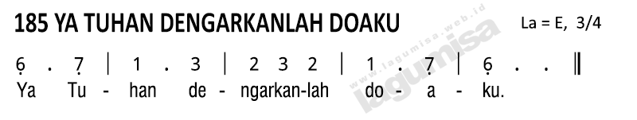
MAZMUR TANGGAPAN RESPONSORIAL PSALM
MAZMUR (PSALM) [Chapter:Verses]
[MazmurIndo]
[PsalmEnglish]
UMAT DUDUK ALL SIT

Slide 21
BACAAN KEDUA SECOND READING
[BACAANKEDUA] ([SECONDREADING]) [Chapter:Verses]
[BacaanIndo]
[ReadingEnglish]
UMAT DUDUK ALL SIT

Slide 22
AKLAMASI SETELAH BACAAN
ACCLAMATION AFTER READING
L
U
: Demikianlah Sabda Tuhan.
: Syukur kepada Allah.
L
A
: The word of the Lord.
: Thanks be to God.
UMAT DUDUK ALL SIT

Slide 24
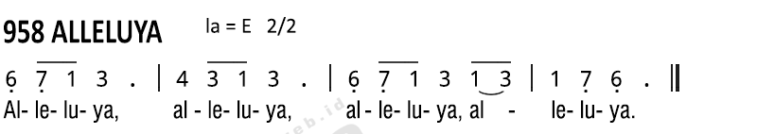
ALLELUIA GOSPEL ACCLAMATION
[Ayat]
[Acclamation]
UMAT BERDIRI ALL STAND

Slide 26
AKLAMASI SEBELUM INJIL
ACCLAMATION BEFORE GOSPEL
I
U
I
U
: Tuhan bersamamu.
: Dan bersama rohmu.
: Inilah Injil Suci menurut
Lukas.
: Dimuliakanlah Tuhan.
P
A
P
A
: The Lord be with you.
: And with your spirit.
: A reading from the Holy
Gospel according to Luke.
: Glory to you, O Lord.
UMAT BERDIRI ALL STAND

Slide 27
BACAAN INJIL GOSPEL
[INJIL] ([GOSPEL]) [Chapter:Verses]
[InjilIndo]
[GospelEnglish]
UMAT BERDIRI ALL STAND

Slide 28
AKLAMASI SETELAH INJIL
ACCLAMATION AFTER GOSPEL
I
U
: Demikianlah Sabda Tuhan.
: Terpujilah Kristus.
P
A
: The Gospel of the Lord.
: Praise to you, Lord Jesus
Christ.
UMAT BERDIRI ALL STAND

Slide 29
HOMILI HOMILY
FR GABRIEL SIMATUPANG OFMCap
UMAT DUDUK ALL SIT

Slide 31
SYAHADAT PARA RASUL
THE APOSTLES’ CREED
Aku percaya akan Allah,
Bapa yang Maha Kuasa, pencipta langit dan bumi.
Dan akan Yesus Kristus, PutraNya yang tunggal, Tuhan kita.
[Semua membungkuk]
Yang dikandung dari Roh Kudus, dilahirkan oleh Perawan Maria.
I believe in God, the Father almighty, Creator of heaven and earth, and in Jesus Christ, his only Son, our Lord,
[All bow]
who was conceived by the Holy Spirit, born of the Virgin Mary,
UMAT BERDIRI ALL STAND

Slide 32
SYAHADAT PARA RASUL
THE APOSTLES’ CREED
Yang menderita sengsara,
dalam pemerintahan Pontius Pilatus, disalibkan, wafat dan dimakamkan; Yang turun ke tempat penantian, pada hari ketiga bangkit dari antara orang mati; Yang naik ke surga, duduk disebelah kanan Allah Bapa yang Maha Kuasa.
suffered under Pontius Pilate, was crucified, died and was buried; he descended into hell; on the third day he rose again from the dead; he ascended into heaven, and is seated at the right hand of God the Father almighty;
UMAT BERDIRI ALL STAND

Slide 33
SYAHADAT PARA RASUL
THE APOSTLES’ CREED
Dari situ Ia akan datang mengadili orang hidup dan mati.
Aku percaya akan Roh Kudus,
Gereja Katolik yang Kudus,
Persekutuan para Kudus, pengampunan dosa, kebangkitan badan, kehidupan kekal.
Amin.
from there He will come to judge the living and the dead.
I believe in the Holy Spirit, the holy Catholic Church, the communion of saints, the forgiveness of sins, the resurrection of the body, and life everlasting.
Amen.
UMAT BERDIRI ALL STAND

Slide 35
DOA UMAT
THE PRAYER OF THE FAITHFUL
L
U
: Marilah kita mohon.
: Kabulkanlah doa kami,
ya Tuhan.
L
A
: Let us pray to the Lord.
: Lord, hear our prayer.
UMAT BERDIRI ALL STAND

Slide 37
LAGU PERSEMBAHAN OFFERTORY SONG
PS [num] [SONGTITLE]
[Lyrics]
UMAT DUDUK ALL SIT

Slide 39
DOA PERSEMBAHAN
OFFERTORY PRAYER
I
U
: Berdoalah Saudara-
saudari, .....Bapa yang
Mahakuasa.
: Semoga persembahan ini
diterima demi kemuliaan
Tuhan dan keselamatan
kita, serta seluruh umat
Allah yang kudus.
P
A
: Pray, brothers and sisters
.....the almighty Father.
: May the Lord accept the
sacrifice at your hands
for the praise and glory
of His name, for our good
and the good of all His
holy Church.
UMAT BERDIRI ALL STAND

Slide 41
PEMBUKA PREFASI
THE EUCHARISTIC PRAYER
I
U
: Tuhan bersamamu.
: Dan bersama rohmu.
P
A
: The Lord be with you
: And with your spirit.
I
U
: Marilah mengarahkan hati
kepada Tuhan.
: Sudah kami arahkan.
P
A
: Lift up your hearts.
: We lift them up to the Lord.
I
U
: Marilah bersyukur kepada
Tuhan Allah Kita.
: Sudah layak dan
sepantasnya.
P
A
: Let us give thanks to the
Lord our God.
: It is right and just.
UMAT BERDIRI ALL STAND

Slide 43
KUDUS HOLY
PS [num]
Kudus, kudus,kuduslah Tuhan
Tuhan Allah segala kuasa
Surga dan bumi penuh kemuliaanMu
Terpujilah Bapa di surga
Diberkatilah yang datang dalam nama Tuhan
Terpujilah Engkau di surga
Holy, Holy, Holy Lord God of Hosts. Heaven and earth are full of your glory. Heaven and earth are full of your glory.
Hosanna in the highest.
Blessed is he who comes in the name of the Lord, in the name of the Lord.
Hosanna in the highest.
UMAT BERDIRI ALL STAND

Slide 45
DOA SYUKUR AGUNG
THE COMMUNION RITE
UMAT BERLUTUT ALL KNEEL

Slide 46
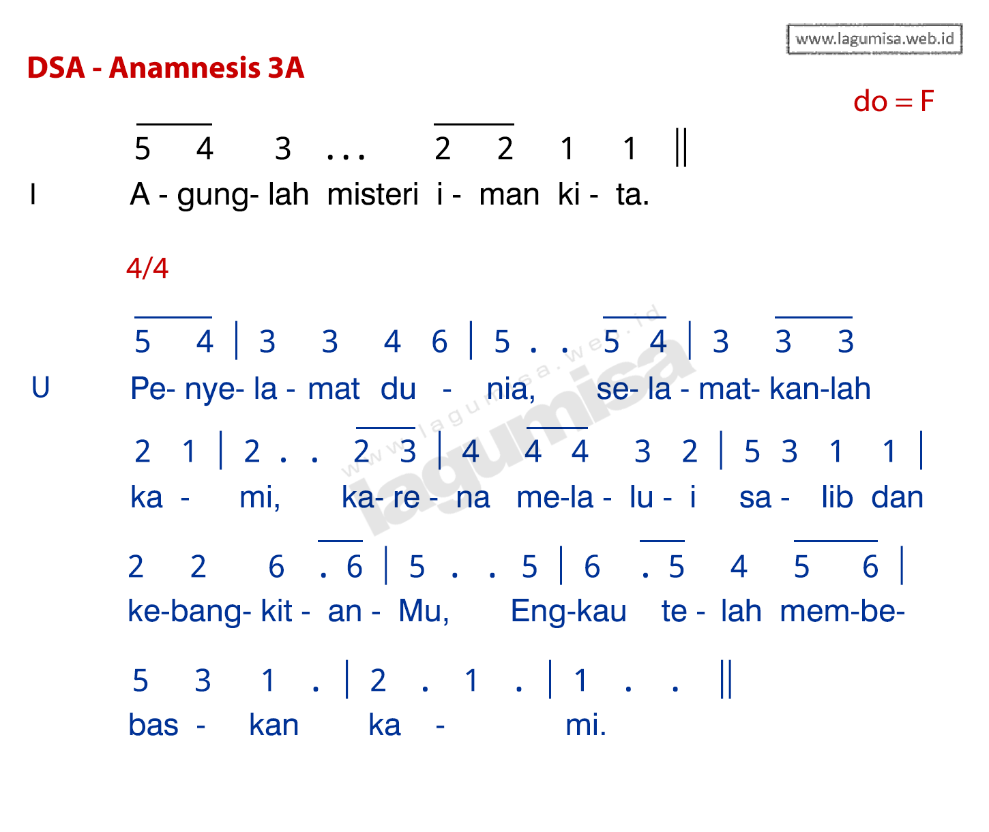
ANAMNESIS ACCLAMATION
3A
UMAT BERLUTUT ALL KNEEL

Slide 47
DOA SYUKUR AGUNG
THE COMMUNION RITE
UMAT BERLUTUT ALL KNEEL

Slide 48

DOA SYUKUR AGUNG
THE COMMUNION RITE
I
: .....segala hormat dan
kemuliaan, sepanjang
segala masa.
P
: .....all glory and honour is
yours, for ever and ever.
U:
UMAT BERLUTUT ALL KNEEL

Slide 50
BAPA KAMI OUR FATHER
[COMPOSER]
Bapa kami yang ada di surga,
dimuliakanlah namaMu
Datanglah kerajaanMu,
jadilah kehendakMu
Diatas bumi seperti di dalam surga.
Berilah kami rejeki pada hari ini
Dan ampunilah kesalahan kami, Seperti kami pun mengampuni yang bersalah kepada kami.
Our Father who art in heaven,
hallowed be thy name;
thy kingdom come,
thy will be done on earth as it is in heaven.
Give us this day our daily bread,
and forgive us our trespasses, as we forgive those who trespass against us;
UMAT BERDIRI ALL STAND

Slide 51
BAPA KAMI OUR FATHER
TOTOK PUJIANTO
Dan janganlah masukkan kami ke dalam pencobaan, tetapi bebaskanlah kami dari yang jahat.
Amin.
and lead us not into temptation
but deliver us from evil.
Amen.
UMAT BERDIRI ALL STAND

Slide 53
BAPA KAMI
OUR FATHER
I
U
: .....kedatangan penyelamat
kami Yesus Kristus.
: Sebab Engkaulah Raja
yang mulia dan berkuasa
untuk selama-lamanya.
P
A
: .....and the coming of our
Saviour, Jesus Christ.
: For the kingdom, the
power and the glory are
yours now and forever.
UMAT BERDIRI ALL STAND

Slide 55
ANAK DOMBA ALLAH BREAKING OF THE BREAD
PS [num]
Anak domba Allah, yang menghapus dosa dunia, kasihanilah kami
Anak domba Allah yang menghapus dosa dunia, kasihanilah kami
Anak domba Allah yang menghapus dosa dunia, berilah kami damai
Lamb of God, you take away the sins of the world,
have mercy on us.
Lamb of God, you take away the sins of the world,
have mercy on us.
Lamb of God, you take away the sins of the world, grant us peace.
UMAT BERLUTUT ALL KNEEL

Slide 57
PERSIAPAN KOMUNI
INVITATION TO COMMUNION
I
U
: .....Berbahagialah Saudara-
Saudari yang diundang ke
perjamuan Anak Domba.
: Tuhan, saya tidak pantas,
Engkau datang kepada
saya, tetapi bersabdalah
saja, maka saya akan
sembuh.
P
A
: .....Blessed are those called
to the supper of the Lamb.
: Lord, I am not worthy
that you should enter
under my roof, but only
say the word and my soul
shall be healed.
UMAT BERLUTUT ALL KNEEL

Slide 59
LAGU KOMUNI COMMUNION HYMN
[SONGTITLE] ([COMPOSER])
[Lyrics]
UMAT DUDUK ALL SIT

Slide 60
LAGU KOMUNI COMMUNION HYMN
[SONGTITLE] ([COMPOSER])
[Lyrics]
UMAT DUDUK ALL SIT

Slide 62
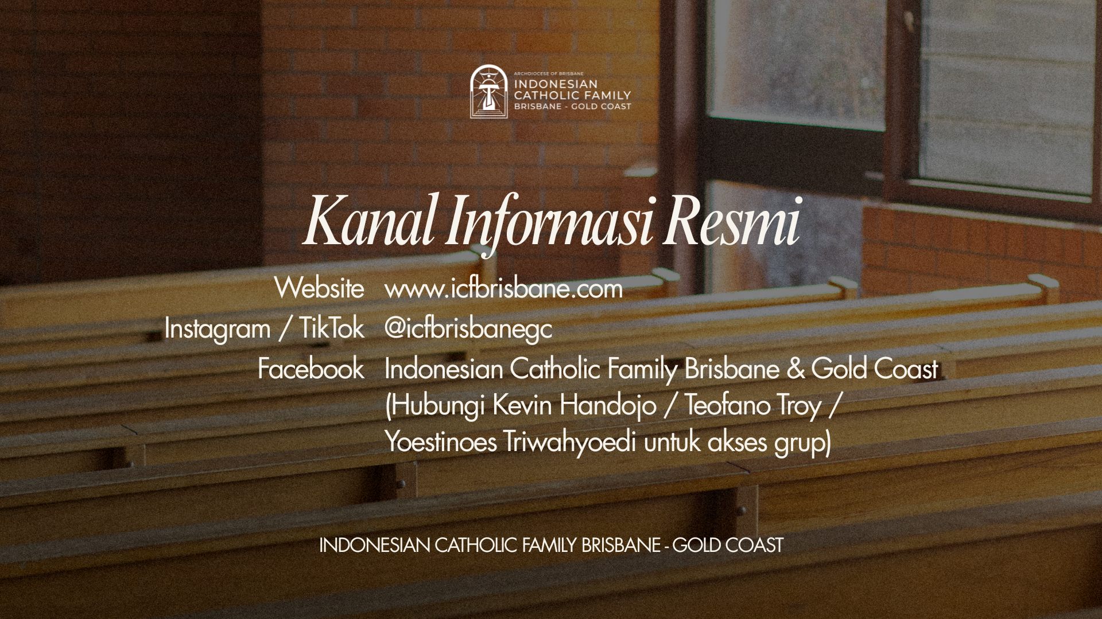

Slide 64
BERKAT PERUTUSAN
CONCLUDING RITES
I
U
I
U
: Tuhan bersamamu.
: Dan bersama rohmu.
: Semoga Allah yang
Mahakuasa memberkati
Saudara sekalian,
Bapa, Putera, dan
Roh Kudus.
: Amin.
P
A
P
A
: The Lord be with you.
: And with your spirit.
: May Almighty God bless you,
the Father, and the Son,
and the Holy Spirit.
: Amen.
UMAT BERDIRI ALL STAND

Slide 65
BERKAT PERUTUSAN
CONCLUDING RITES
I
U
: Saudara-saudari, pergilah
dalam damai, sambil
memuliakan Tuhan
dengan hidupmu.
: Syukur kepada Allah.
P
A
: Go in peace, glorifying the
Lord by your life.
: Thanks be to God.
UMAT BERDIRI ALL STAND

Slide 66
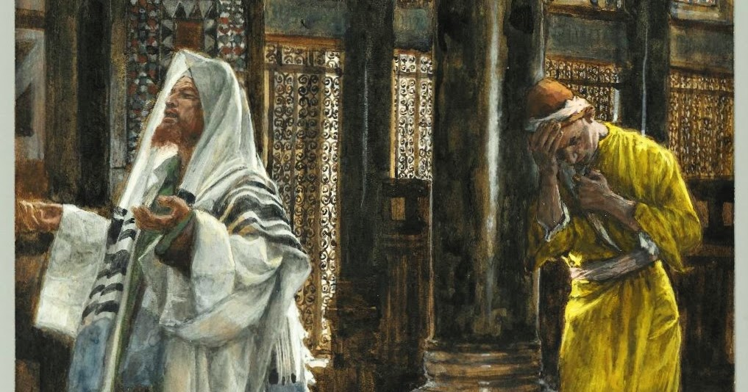

Slide 67
LAGU PENUTUP RECESSIONAL HYMN
PS [num] [SONGTITLE]
[Lyrics]
UMAT BERDIRI ALL STAND

Slide 68
THANK YOU
HAVE A BLESSED SUNDAY
[MASSTITLE]
[DD] [MMMM] [YYYY]
Lagu dipergunakan dengan izin dan dilaporkan ke ONE LICENSE #A-727998.
Music is used with permission and reported to ONE LICENSE when used #A-727998.

Slide 69
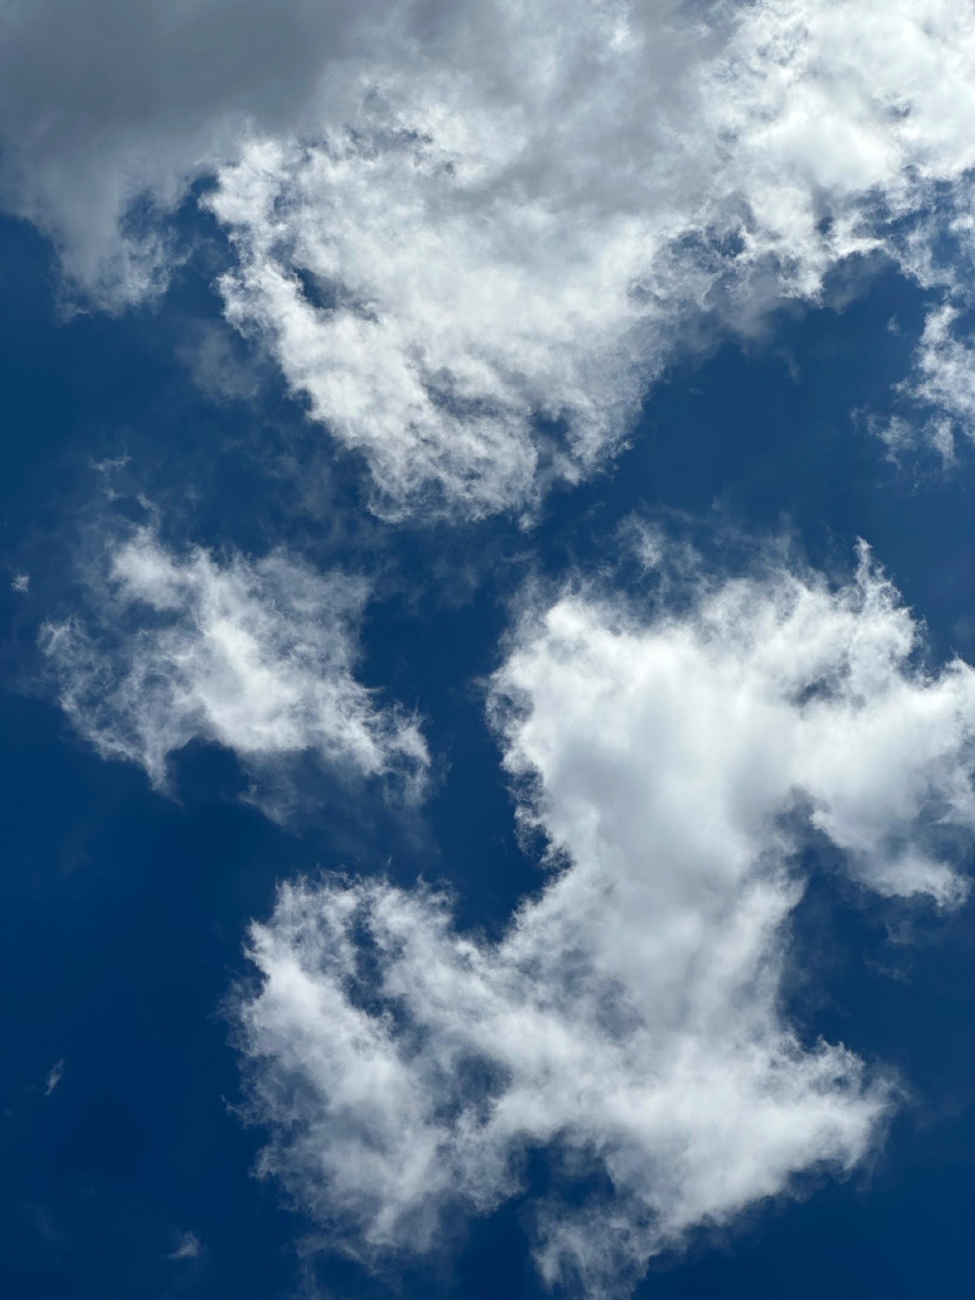



THANK YOU
ORDINARY MASS XXX
26 OCTOBER 2025
Lagu dipergunakan dengan izin dan dilaporkan ke ONE LICENSE #A-727998.
Music is used with permission and reported to ONE LICENSE when used #A-727998.

