Slide 1
Student Grade Prediction
We have 32 attributes for each student
Home life: Family size, whether they live in an urban or rural location, their parents education level
Habits: Daily and weekly alcohol consumption, extra-curricular activities, how often the go out with friends
School life: Did they attend pre-school, do they want to pursue higher education, do they receive grinds
Students have three grades associated with them (first period, second period, final grade)
Final grade is independent of the first two grades
We aim to predict the final grades of each student
We do not want to use the other two grades in our prediction algorithm

Slide 2
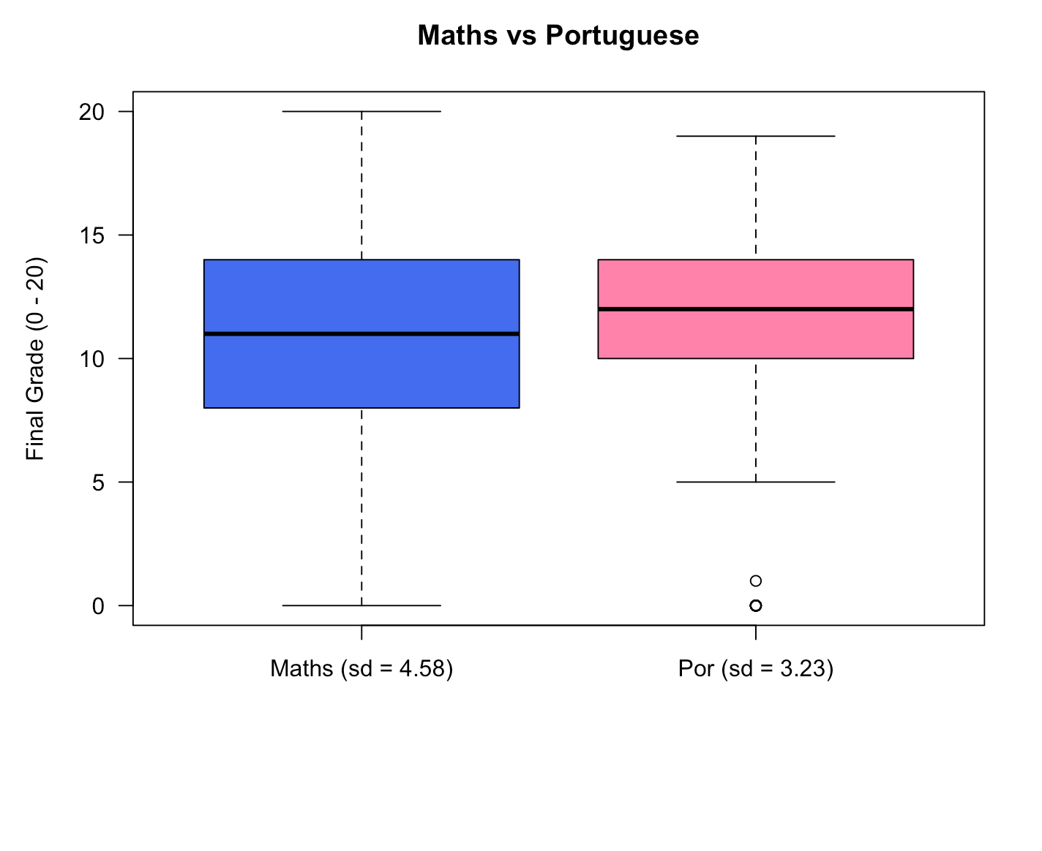

Slide 3
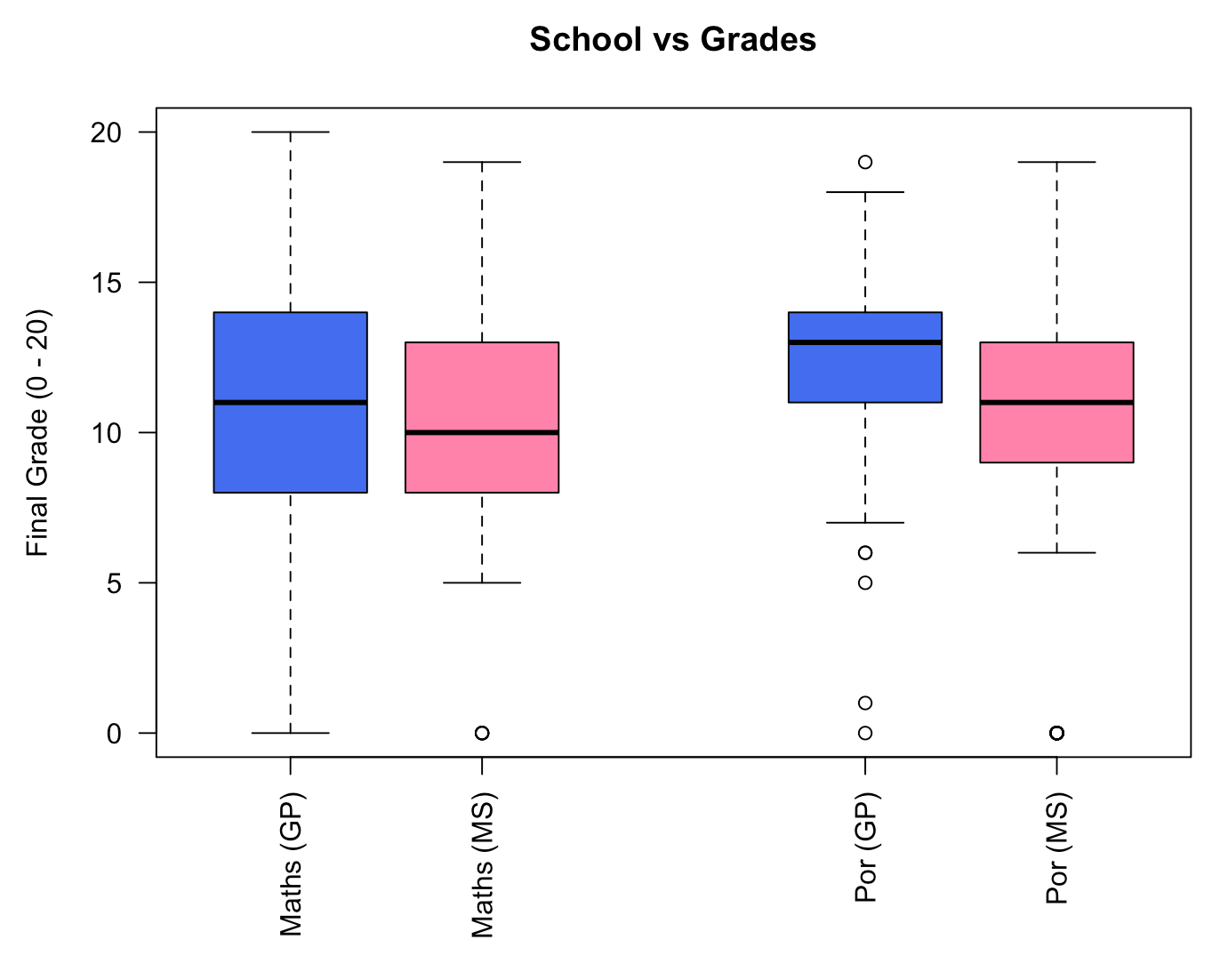

Slide 4
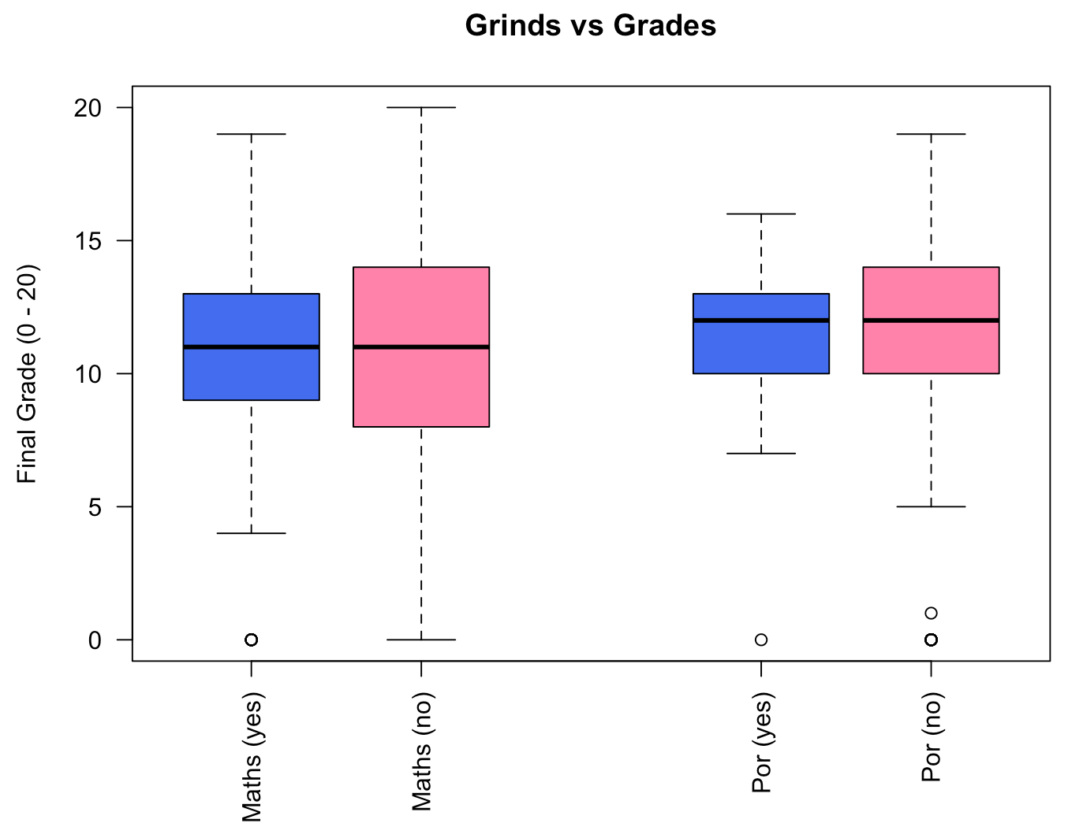

Slide 5
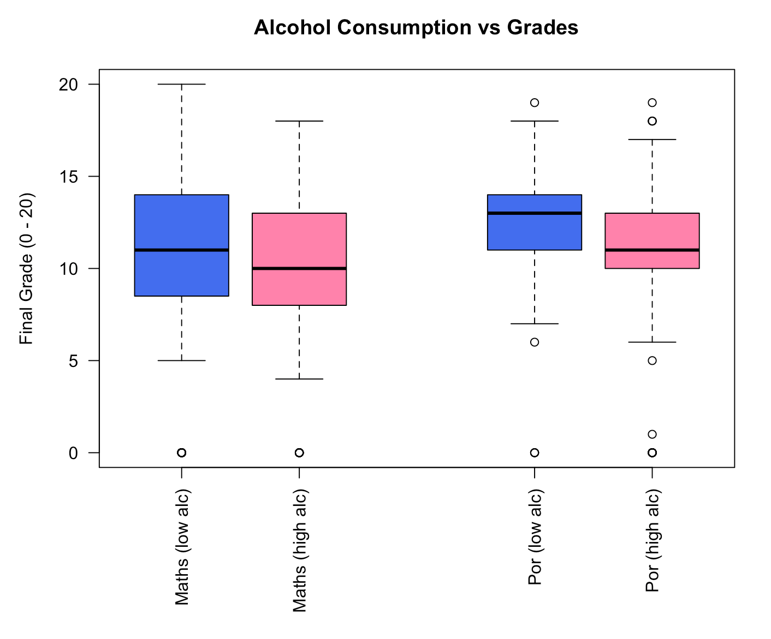

Slide 6
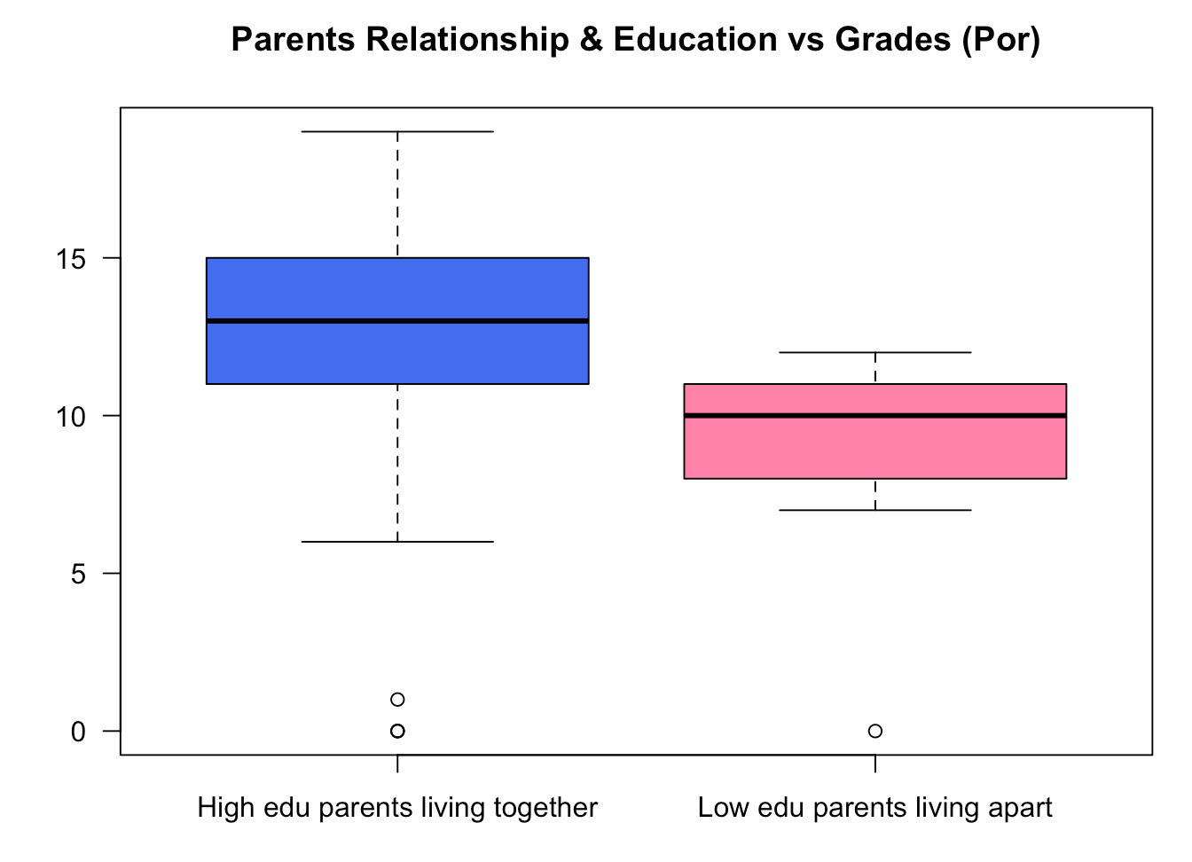

Slide 7
Conclusions
We are aiming to predict the bracket of grades a student will fall into
(0 – 2), (3 – 5), (6 – 8), (9 – 11), (12 – 14), (15 – 17), (18 – 20)
It is much easier to predict a student falling into the 4th and 5th brackets as opposed to the 1st and 7th brackets
Based on our analysis of the dispersion of some of these metrics, we have identified some key attributes which will be central to our prediction algorithm

