Slide 1

[PROJECT NAME]
[ONE-LINE VALUE PROPOSITION]
Team: [TEAM NAME] | Track: [TRACK]
[SPACE FOR YOU TO FILL - ADD LOGOS OR DETAILS HERE]

Slide 2
The Investor-Safety Problem
• Target Audience: First-time retail investors and regional language users.
• Pattern: Scammers use guaranteed returns, urgency, and SEBI impersonation.
• Gap: Existing platforms focus on trading, lacking a safe space to verify claims.
• Statistic: [One verified source or statistic here]

Slide 3
Target Users & Differentiators
Users:
• First-time investors (18-35)
• Regional-language users (TA/HI/TE/ML/KN)
• Senior citizens facing UPI pressure
Differentiators:
• Explainability by construction (no opaque AI decisions)
• Honest uncertainty as UX
• Privacy as default (redacted, consent-gated)

Slide 4
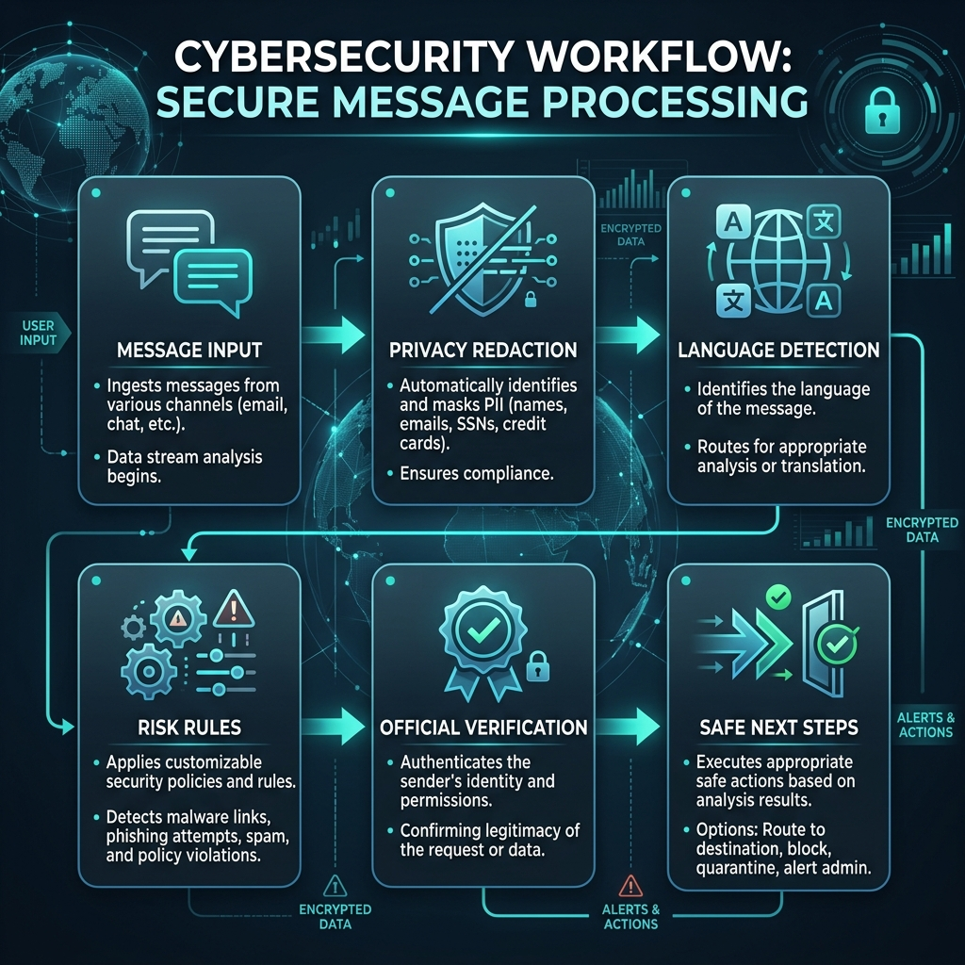
From Suspicious Message to Safer Action

Slide 5

System Architecture & Tech Stack
• Frontend: Next.js, Tailwind CSS
• Backend: FastAPI, Pydantic
• Data: PostgreSQL, ChromaDB
• AI: Hugging Face, IndicBERT

Slide 6
Explainable Detection & Privacy
Detection Engine:
• Deterministic rules for guaranteed returns, urgency, fake regulators.
• No opaque LLM in the critical safety path.
Privacy-First Pipeline:
• Local PII redaction (PAN, Aadhaar, Phone, Email) before processing.
• No raw data hoarding. 72-hour auto-expiry.
• Consent-gated evidence locker.

Slide 7
Education, Pause & Multilingual
Behavioural Pause:
• A 30-second checklist interrupting the psychology of urgency in scams.
Multilingual Education Hub:
• 6+ Languages supported (English, Tamil, Hindi, Telugu, etc.)
• Offline fallback capability for low-bandwidth users.
• Raksha Guide Chatbot: RAG-based multilingual assistance.

Slide 8
Security & Threat Model
• Network-Free URL Checker: Eliminates SSRF risks by analyzing strings without opening sockets.
• Prompt-Injection Resistance: Deterministic rules bypass LLM vulnerabilities.
• Rate Limiting: Strict sliding-window limits per IP.
• Secure Logging: Secret-shaped and identifier-shaped values scrubbed from logs.

Slide 9
Evaluation & Metrics
• Evaluated against a fixed synthetic dataset measuring false positives (FP) and false negatives (FN).
• Current Status: 10/10 evaluation cases pass in backend suite.
• No prohibited advice tokens in API responses.
• Provenance-first verification with checksummed audit trails.
• Metric Placeholders: [Latency], [Precision by Language]

Slide 10
Roadmap & Next Steps
1. Live SEBI intermediaries integration (replacing fixtures).
2. OCR for screenshot analysis expansion.
3. Community-reviewed rule packs.
4. Feature-phone SMS/IVR integrations.
NiveshRaksha: Pause. Verify. Protect.
[Contact details / Demo link]

