Slide 1
UgaJapa Translation
Real-time multilingual chat for Mattermost
Internship project · v2.3.0 · June 2026
Mahamat Abdelrassoul · UgaJapa team
Text · Voice · Video · Auto-translate · Read-aloud
UgaJapa Translation for Mattermost · v2.3.0
2

Slide 2
Agenda
What we will cover in this presentation
Problem
Why multilingual teams need help in chat
Live demo
Same conversation in English and Japanese
Features
Text, voice, video, read-aloud, preview
Quality scoring
How we measure translation accuracy (TransChecker)
Architecture
How the plugin and API work together
Tech stack
Mattermost, Go, React, Node, Google Cloud
Delivery
What we built and how to run the demo
UgaJapa Translation for Mattermost · v2.3.0
3

Slide 3
The Problem
International teams chat in one place — but not one language
Language barrier
Team members speak English, Japanese, French… in the same channel
Broken workflow
Copy-paste into Google Translate kills conversation flow
Voice & video
Audio messages are impossible to understand across languages
No native tool
Mattermost has no built-in per-user translation
Our goal
Chat naturally — each person reads in their own language
UgaJapa Translation for Mattermost · v2.3.0
4

Slide 4
Our Solution
Plugin + API — no changes to Mattermost core
Per-user language
Each person picks their receive language in settings
Auto-translate
Readers see translations; senders keep original text
Voice & video
Record → transcribe → translate for every reader
Modern UI
WhatsApp-style bubbles + language badges
Read-aloud
Speaker icon uses Google Text-to-Speech
Quality check
TransChecker scores translation confidence (text)
UgaJapa Translation for Mattermost · v2.3.0
5

Slide 5
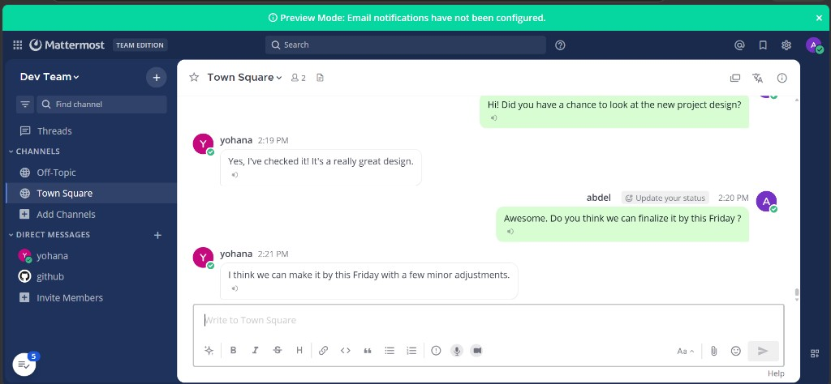
Live Demo — English View
User Abdel reads and writes in English
Key points
▸ Green bubbles on the right = Abdel's messages
▸ White bubbles on the left = Yohana's messages
▸ Conversation feels like normal English chat
▸ Speaker icon reads any message aloud
UgaJapa Translation for Mattermost · v2.3.0
6

Slide 6
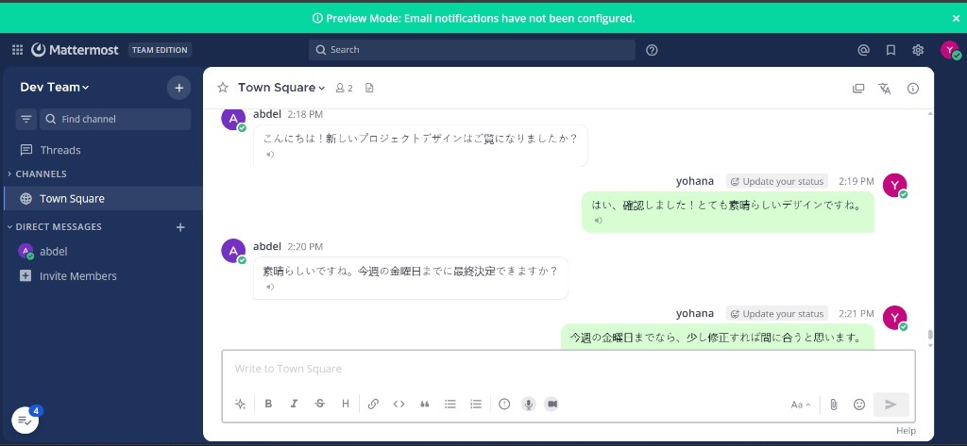
Live Demo — Japanese View
Same chat, same time — Yohana sees Japanese
Key points
▸ This is the proof slide for your presentation
▸ Abdel typed in English — Yohana sees Japanese
▸ No manual re-typing or copy-paste
▸ Each user reads in their own language
UgaJapa Translation for Mattermost · v2.3.0
7

Slide 7
Key Features
Plugin v2.3.0 — everything in one chat experience
Auto-translate
Every new message translated per reader
Pre-send preview
See translation before sending foreign text
Voice messages
Google STT → translate → text under player
Video messages
Audio extracted, same pipeline as voice
Languages panel
Member badges: EN, JA, FR…
Slash commands
/translation-lang and /translate
Chat slang
bjr → bonjour before translating
Usage tracking
Monthly character count for billing
UgaJapa Translation for Mattermost · v2.3.0
8

Slide 8
System Architecture
Three layers — browser, Mattermost plugin, Translation API, Google Cloud
USER
MATTERMOST (Docker)
SERVICES
Browser
Mattermost web UI
Plugin React webapp
WhatsApp-style chat
Mattermost 10.5
Team chat server
PostgreSQL database
Plugin server (Go)
Translation API
Node.js · port 5000
Translate · STT · TTS
Quality scoring
Google Cloud (primary)
Cloud Translation API
Speech-to-Text
Text-to-Speech
Fallback
MyMemory (no Google key)
Whisper (STT backup)
What we built
① mattermost-plugin-translation — UI, auto-translate, voice/video hooks
② translation-api — Google integration, slang, quality scores
③ docker-compose.yml — local Mattermost + PostgreSQL demo
Message flow: User sends text → Mattermost stores original → Plugin calls API per reader → Translation appears in each user's language
UgaJapa Translation for Mattermost · v2.3.0
9

Slide 9
Technology Stack
Built on proven open-source and cloud tools
Chat platform
Mattermost 10.5 · Docker · PostgreSQL 15
Plugin server
Go · Mattermost Plugin API · WebSockets
Plugin UI
React · TypeScript · Redux
Translation API
Node.js · Express · TypeScript
Cloud AI
Google Translate · Speech-to-Text · TTS
UgaJapa Translation for Mattermost · v2.3.0
10

Slide 10
How Text Translation Works
Simple 6-step pipeline — easy to explain to anyone
User sends message
Mattermost stores original
Plugin checks each reader's language
API calls Google Translate
Quality score (text only)
Reader sees translation
1
2
3
4
5
6
Important rule for the audience:
The sender always sees their own original words.
Only readers with a different receive language see a translation.
Example: Abdel writes English → Yohana reads Japanese automatically.
UgaJapa Translation for Mattermost · v2.3.0
11

Slide 11
How We Measure Translation Quality
TransChecker method — automatic, no human reviewer needed
Original text
Translate to target
Translate back
Compare meaning
1
2
3
4
Example: French “Bonjour” → English “Hello” → back to French “Bonjour” → high match = good translation
Character match
Levenshtein
Are letters similar after back-translation?
Word overlap
semantic_score
Do the same important words appear?
AI meaning
embedding_score
MiniLM model — same meaning even if words differ?
Final score
quality_score
Combined % — API picks the best candidate
For tricky short messages, the API may try multiple paths and keep the highest quality_score.
Voice & video use fast mode (one Google call) — no quality scoring, by design for speed.
UgaJapa Translation for Mattermost · v2.3.0
12

Slide 12
Where Can You See Quality?
How to demonstrate scores live during the presentation
/translate command
Type: /translate Hello — shows translation + Quality % + AI semantic % + character match + back-translation
Pre-send preview
When you type in a foreign language, popup shows: AI quality 87% before you send
API response
POST /translate returns quality_score, score, semantic_score, embedding_score (for integrations)
Normal chat messages
No % shown on every bubble — keeps chat clean for daily use
Voice & video
No quality % — fast path only; show transcript translation instead
Health check
GET /health shows google-translate + semantic_embeddings_enabled
Best live demo for your audience tomorrow
1. In Mattermost chat, run: /translate Bonjour tout le monde
2. Show the reply with Quality 85% · AI semantic 90% · Character match 70%
3. Explain: we translate → translate back → compare → combine into one percentage
UgaJapa Translation for Mattermost · v2.3.0
13

Slide 13
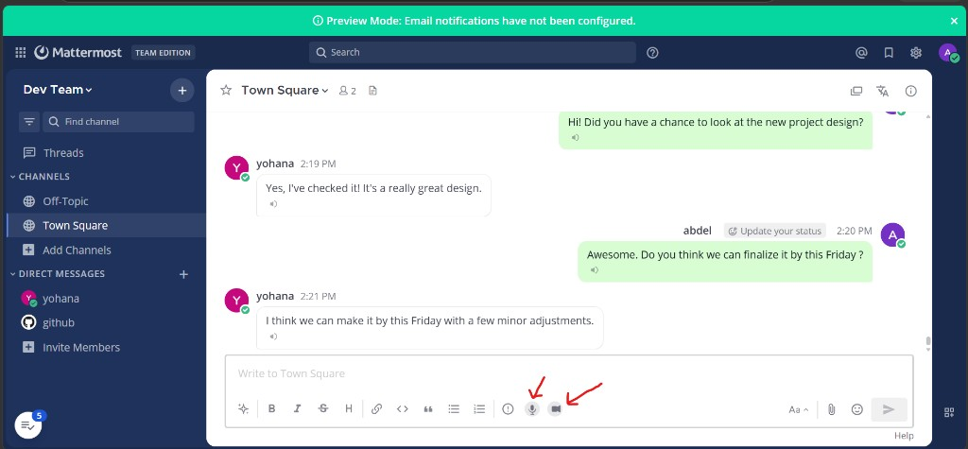
Voice & Video Messages
Microphone and camera buttons in the composer
Key points
▸ User records voice or short video
▸ File uploaded to Mattermost
▸ Server runs Google Speech-to-Text
▸ Fast translate path for speed
▸ Reader sees transcript in their language
UgaJapa Translation for Mattermost · v2.3.0
14

Slide 14
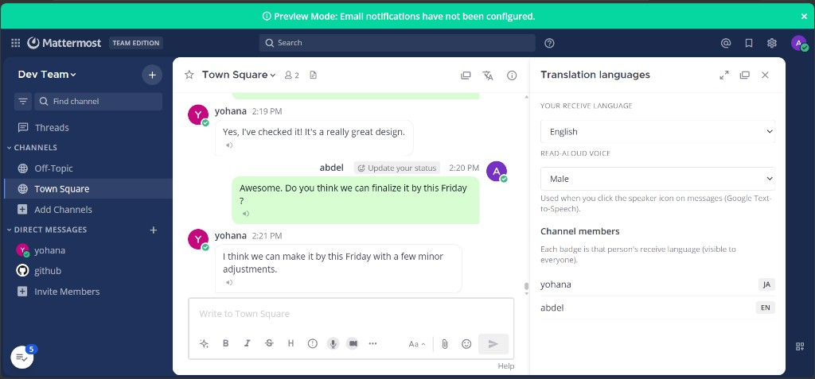
Language Settings
Each user controls their own experience
Key points
▸ Pick receive language (EN, JA, FR…)
▸ Choose read-aloud voice style
▸ See all channel members' languages
▸ Open from translate icon in header
UgaJapa Translation for Mattermost · v2.3.0
15

Slide 15
Challenges We Solved
Real bugs we fixed during development
1
Voice showed wrong language → fixed with server-side STT + detection (v2.3.0)
2
Slow voice processing → fast media path (one Google call)
3
API fetch errors → retries on plugin, API, and Google
4
Pre-send preview missing → fixed mixed-language typing logic
5
Chat UX → WhatsApp-style layout + language badges
UgaJapa Translation for Mattermost · v2.3.0
16

Slide 16
What We Delivered
Complete internship deliverable
Plugin v2.3.0
com.transchecker.translation — upload to Mattermost
Translation API
Standalone Node service with Google Cloud
Documentation
README + full Word guide for non-programmers
GitHub repo
Public repository with setup instructions
Working demo
Two users, two languages, one channel
Quality scoring
TransChecker prototype for confidence
UgaJapa Translation for Mattermost · v2.3.0
17

Slide 17
Running the Demo
5 steps to reproduce locally
1
Start Translation API — npm install, .env, npm run dev (port 5000)
2
Start Mattermost — docker compose up -d → localhost:8065
3
Build plugin — build-bundle.ps1 → upload .tar.gz in System Console
4
Configure plugin — API URL: http://host.docker.internal:5000
5
Set receive languages → open two browsers → start chatting
UgaJapa Translation for Mattermost · v2.3.0
18

Slide 18
Future Work
Next steps after the internship
Production deploy
Server, HTTPS, Dockerize the Translation API
GitHub Release
Ready-to-download plugin .tar.gz bundle
Security
Strong API keys and Google billing controls
UX polish
Speaking-language picker before recording
UgaJapa Translation for Mattermost · v2.3.0
19

Slide 19
Thank you
Questions?
github.com/MahamatAbdelrassoul/MATTERMOST_PLUGIN
UgaJapa Translation for Mattermost · v2.3.0
21

