Slide 1


EXECUTIVE SUMMARY
Ustacky Data Scientist Microdegree Capstone Project
Nigeria C VID-19 Data Analysis Using Python
OKEOWO TUNDE SAMUEL

Slide 2
INTRODUCTION
Ustacky Data Scientist Microdegree Capstone Project
PROBLEM STATEMENT
Coronavirus disease (COVID-19) is an infectious respiratory disease.
It is caused by a newly discovered coronavirus (SARSCOV2).
It affected major countries of the world including Nigeria.
All the 37 states in Nigeria are at the receiving end of the virus
Coronavirus-TorqAid

Slide 3
Ustacky Data Scientist Microdegree Capstone Project
PURPOSE STATEMENT
To analyze the outbreak of the disease in all the states using data from the NCDC official website
To determine the effect of the pandemic on the Nigerian Economy using external dataset such as Real Domestic Gross Product data (RealGDP).
To determine the impact of the pandemic on all Nigerian states using external dataset that provides the community vulnerability index (CCVI), budget data and revenue generated by the states.

Slide 4

Ustacky Data Scientist Microdegree Capstone Project
Results from this analysis can be used to make informed decisions and review policies in case of future outbreak of the disease.

Slide 5

Ustacky Data Scientist Microdegree Capstone Project
PROJECT SUMMARY
Questions answered in this project are:
What are the current total No. of Lab confirmed cases, discharged cases, cases on admission and Death cases.
What are the top 10 states in terms of No. of lab confirmed cases
What are the top 10 states in terms of No. of Discharged Cases
What are the top 10 states in terms of No. of Death Cases

Slide 6
Ustacky Data Scientist Microdegree Capstone Project
More Questions:
For lab cases, discharged and death cases, what is the rate and
max. no. of infection, discharge and death respectively
What relationship does lab cases, and death cases have with the overall community vulnerability index (CCVI)
What relationship does lab cases and death cases have with the population density
What is the relationship between the RealGDP value before Covid-19 and during the pandemic
Relationship between budget reduction in top 10 states with High CCVI and top 10 states with low CCVI

Slide 7
Ustacky Data Scientist Microdegree Capstone Project
DATA OVERVIEW
All the data used for the analysis are in pandas dataframe or table format containing 37 rows which itemized all the states in Nigeria including the capital.
Variable number of columns of data were available for different types of data and include:
Date column for daily cases
No. of Lab confirmed cases
No. of Cases (on admission)
No. of discharge
No. of Deaths etc.

Slide 8
Ustacky Data Scientist Microdegree Capstone Project
DATA COLLECTION
Data used in this project was obtained from three major sources by:
Data Scrapping from website
Data Importation from online Repository
Provided external data
Other data

Slide 9

Ustacky Data Scientist Microdegree Capstone Project
Data Scrapping from Website
Table data was scrapped from the NCDC website using the BeautifulSoup Library.
I achieved this in four steps:
Step 1: I saved the url (NCDC website in this case)
url = "https://covid19.ncdc.gov.ng/"
Step 2: I got html content using request.get()
page = requests.get(url).text
Step 3: I Parse the html content using BeautifulSoup and ‘lxml’ as html parser
soup = BeautifulSoup(page, 'lxml’)
Finally: I find the table in html content using soup.find()
content_table = soup.find("table", id="custom1")
NB: I inspected the table element on NCDC website to get the table ‘id’

Slide 10

Ustacky Data Scientist Microdegree Capstone Project
b. Data Importation from online Repository
Global Covid-19 data were obtained from John Hopkins repository.
John Hopkin Github repository is a public repo and hence does not require Authentication to download content.
I imported this data into my jupyter environment using pandas read function:
pd.read_csv(‘link to the raw csv file on the repo’)
e.g. pd.read_csv(‘https://github.com/CSSEGISandData/COVID-19/raw/master/csse_covid_19_data/csse_covid_19_time_series/time_series_covid19_confirmed_global.csv’)

Slide 11

Ustacky Data Scientist Microdegree Capstone Project
c. Provided external data
Provided External data set were downloaded and imported using
the pd.read_csv(‘filepath’)
d. Other data (optional)
Additional data used in this project is the State Revenue Data for first and second quarter of 2020 (Q1 and Q2) and was obtained from the Nigerian Bureau of statistics website - https://www.nigerianstat.gov.ng/

Slide 12

Ustacky Data Scientist Microdegree Capstone Project
DATA CLEANING AND PREPROCESSING
Data cleaning task carried out in this project include:
Scrapped Table formatting
Renaming
Removal of Unwanted Columns of data
Removal of comma (,) in numerical data
Data Extraction.
Date Formatting

Slide 13
Ustacky Data Scientist Microdegree Capstone Project
Scrapped Table formatting
Table data scrapped from NCDC website is not properly formatted
and needed to be converted to a pandas dataframe.
I carried this formatting out in these steps:
1. I find the row in the head portion of table using .thead.findAll(‘tr’)
table_headers = content_table.thead.findAll("tr")
2. I iterated through the row portion of the table to find the columns in table head
for k in range(len(table_headers)):
data = table_headers[k].find_all("th")
column_names = [j.string.strip() for j in data]
print(column_names) # print column names in the row of table head
3. I find all the row in the body portion of the table using .tbody.findAll(‘tr’)
table_data = content_table.tbody.findAll('tr’)
values = [] # created a list container
keys = [] # created another list container

Slide 14
Ustacky Data Scientist Microdegree Capstone Project
CONTD….
4: I iterated through the rows in the body portion of table
for k in range(len(table_data)):
key = table_data[k].find_all("td")[0].string.strip() # returns the value of the zero index (first column) in k row as key
keys.append(key) # appends key it to the list
value = [j.string.strip() for j in table_data[k].find_all("td")] # returns the value of all columns in k rows
values.append(value) # appends value to the list
print(keys, '\n', '\n', values) # print keys and values

Slide 15
Ustacky Data Scientist Microdegree Capstone Project
CONTD….
5. I created a dictionary by enumerating the values
dataframe_dict = dict(enumerate(values))
print(dataframe_dict)
6. I converted the dictionary datatype to dataframe.
pandas_df = pd.DataFrame(dataframe_dict)
print (pandas_df)
7. I transpose the dataframe
df = pandas_df.T
print (df)
8. I name the columns of the dataframe
df.columns=column_names
print (df)

Slide 16
Ustacky Data Scientist Microdegree Capstone Project
b. Renaming
Appropriate column names were renamed using df.rename()
to allow for merge operation e.g. is the State column in dataframe.
Some state names was also renamed to allow for merge operation
e.g. Cross river to Cross River.
c. Removal of Unwanted Columns of data
Unwanted columns of data in global daily data was removed
using df.drop(column_index)
Columns dropped are Lat, Long, Province/State and Country/Region

Slide 17
Ustacky Data Scientist Microdegree Capstone Project
d. Removal of comma (,) in numerical data
I applied the lambda function to all rows of numerical data to remove the comma by using:
df[‘column’].apply(lambda x: int(re.sub("[^0-9]", "", x)))
e. Data Extraction
I extracted Nigeria daily data as a dataframe from global daily cases.
The columns are Date and Cases (confirmed, recovered, death).
I did this by indexing the row of Nigeria data from the global daily cases
Using:
df[(df(‘Country/Region’)==‘Nigeria’)]
f. Date Formatting
I converted the date column the extracted Nigeria daily dataframe
to datetime format using pd.to_datetime(df[‘date_column’])

Slide 18
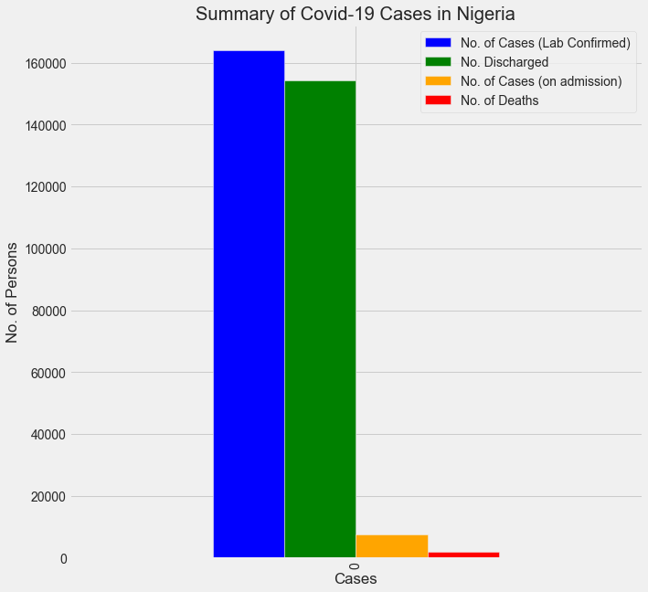
Ustacky Data Scientist Microdegree Capstone Project
ANALYSIS AND INSIGHT
A total of 164,207 No. of Lab confirmed cases
A total of 154, 325 No. of Discharged cases
A total of 7,829 No. of cases on admission
A total of 2,061 Death cases
Nigeria percentage recoveries estimated at 89%
Nigeria experienced very large recovery
with very minimal amount of deaths from
Covid-19.
Fig. 1.0: Summary of Covid-19 cases in Nigeria

Slide 19
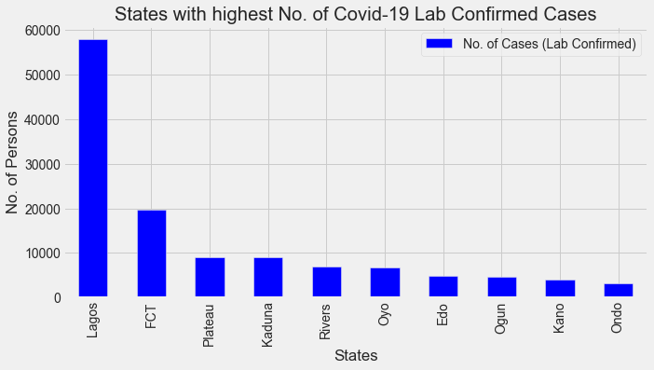
Ustacky Data Scientist Microdegree Capstone Project
Fig. 2.0: States with Highest No. of Covid-19 Lab confirmed Cases
Lagos and Abuja have the highest number of Lab confirmed cases among the top 10 states
Large number of states among the top 10 states had below 10,000 confirmed cases in total.

Slide 20
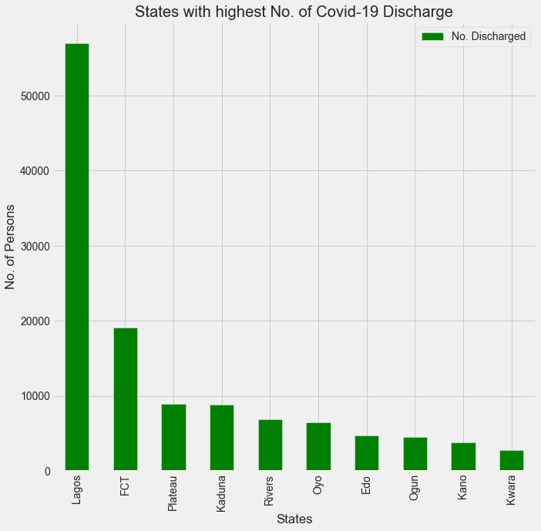
Ustacky Data Scientist Microdegree Capstone Project
Lagos and Abuja also had the highest
number of discharged cases.
All states except Ondo amongst the top 10 states with highest number of Lab confirmed cases also were among the top 10 states with the highest number of discharged cases,
indicating that most of the confirmed cases
recovered from the disease.
Fig. 3.0: States with the highest No. of Covid-19 Recovery

Slide 21
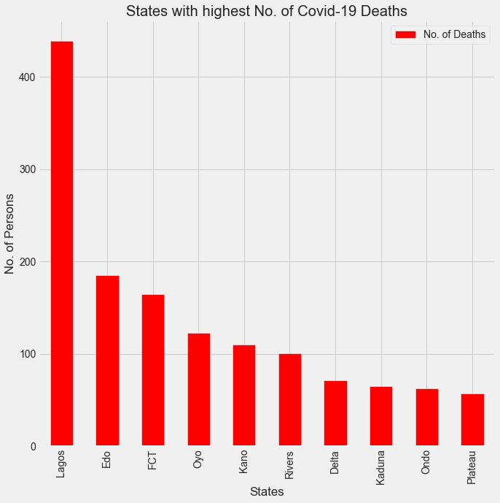
Ustacky Data Scientist Microdegree Capstone Project
Top 10 states with highest lab confirmed and discharged cases had the highest death cases except Ogun state.
Delta wasn't among the top 10 states with highest Lab confirmed cases but nevertheless made it to the list of top 10 state with highest death. An indication that most covid-19 patient in Delta might not have recovered from the disease.
Fig. 4.0: States with the highest No. of Deaths from Covid-19

Slide 22
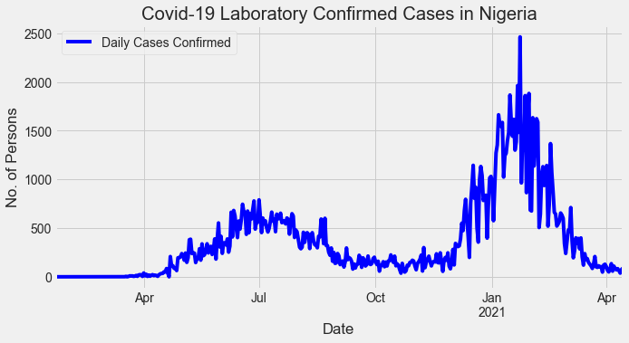
Ustacky Data Scientist Microdegree Capstone Project
The line graph of Nigeria Daily Lab confirmed cases showed there were two waves of the covid-19 pandemic
The first wave was lesser and occurred during Q2 and Q3 of 2020 (April - August)
The Second wave was stronger and occurred during the first late Q4 of 2020 (dec) and Q1 of 2021 (Jan-March).
Fig. 5.0: Timeline of Covid-19 infection in Nigeria
The Nigeria daily infection rate is approximately 367 Persons per day
A maximum of 2,464 Persons were infected on 23rd of January 2021 (the peak of second wave).

Slide 23
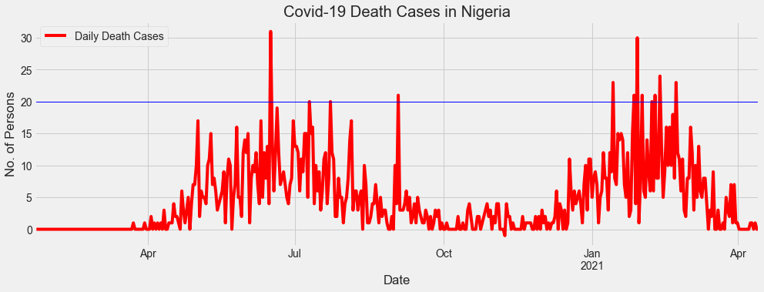
Ustacky Data Scientist Microdegree Capstone Project
Result also shows two waves of covid-19 deaths corresponding to the waves of the infection
Fig. 6.0: Timeline of Covid-19 Deaths in Nigeria
The Nigeria daily Death rate due to Covid-19 is approximately 5 Persons per day
A maximum Death of 31 Persons were recorded on the 6th of June 2020 (during the peak of first wave)

Slide 24
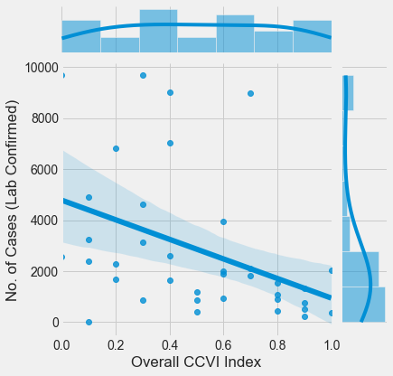
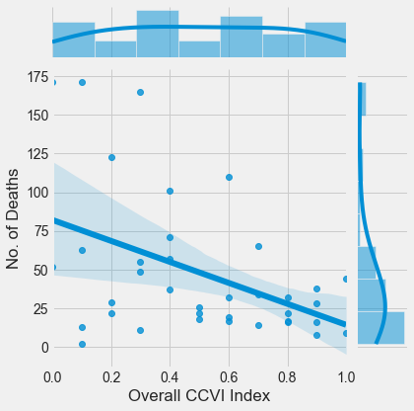
Ustacky Data Scientist Microdegree Capstone Project
Regression plot suggests a linear relationship
between No. of confirmed cases and CCVI
Relationship is negatively correlated and
implies that No. of Lab cases reduces as Overall
CCVI increases
Large no. of data points outside the line of fit
implies that this relationship is significantly poor.
Fig. 7.1: Relationship Between No. of Lab
confirmed Cases and Overall CCVI
The same trend is observed
in the reg plot of death cases
VS CCVI
Fig. 7.1: Relationship Between No. of Deaths and Overall CCVI

Slide 25
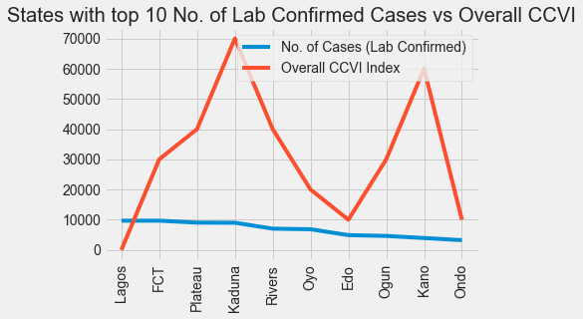
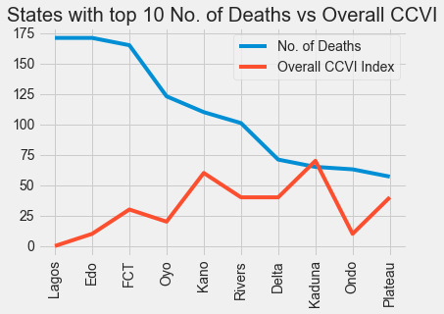
Ustacky Data Scientist Microdegree Capstone Project
Community Vulnerability index (CCVI) Is the measure of the impact of a disease on a community after the disease arrives.
Fig. 8.1: Line graph of Overall CCVI and Lab Confirmed Cases
Kano and Kaduna with very low
No. of confirmed cases is predicted
to have received the greatest
impact based on CCVI
Lagos, Ondo and Edo are predicted
to have received the least impact based on CCVI
Fig. 8.1: Line graph of Overall CCVI and No. of Death Cases

Slide 26
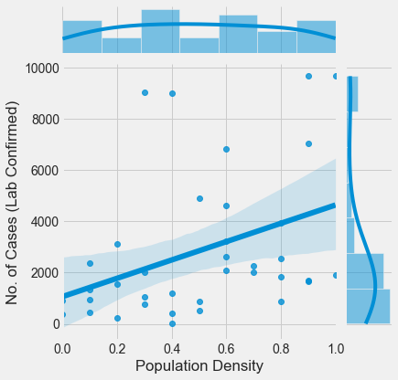
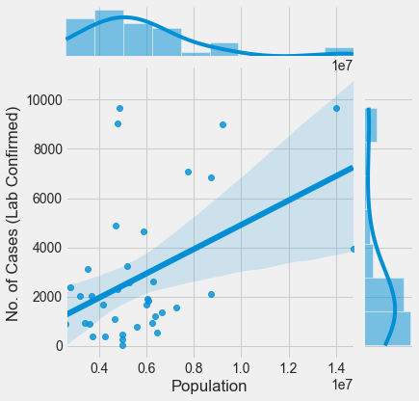
Ustacky Data Scientist Microdegree Capstone Project
Reg plot shows a linear relationship
between No. of Lab cases confirmed
and Population Density
Relationship is positively correlated
and implies that the No. of Lab cases
would increase as the population
Density increases (i.e. No. of Persons
Per SQ.km)
Fig. 9.1: Relationship between No. of Lab Cases Confirmed
and Population Density
Fig. 9.2: Relationship between No. of Lab Cases Confirmed
and Population

Slide 27
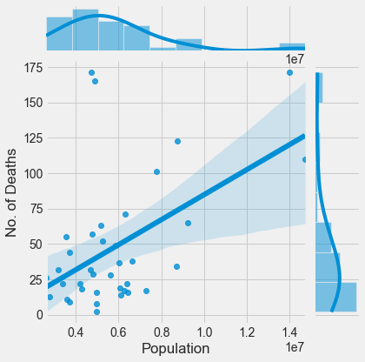
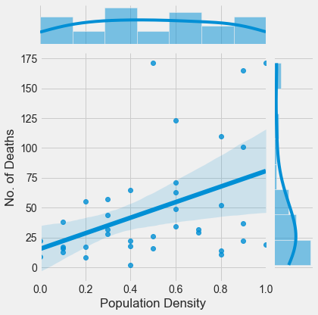
Ustacky Data Scientist Microdegree Capstone Project
Reg plot shows a strong linear relationship
between No. of Covid-19 deaths and population
Relationship is positively correlated and implies
that No. of Covid-19 deaths is much more likely
to increase as population increases
linear relationship
between No. of Covid-19
Deaths and Population
density
Relationship is positively correlated and implies
that No. of Covid-19
Deaths increases with
increase in Pop. Density
(i.e. No. of Persons per
SQ.km)
Fig. 10.1: Relationship Between Population
and No. of Deaths
Fig. 10.2: Relationship Between Population
Density and No. of Deaths

Slide 28
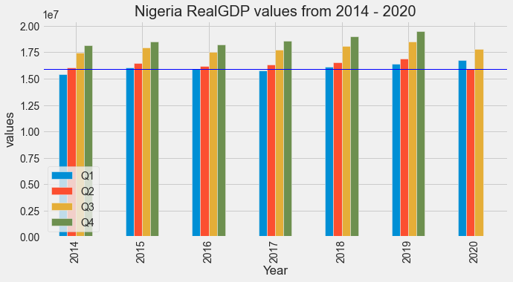
Ustacky Data Scientist Microdegree Capstone Project
Fig. 11: Nigeria Real Gross Domestic Product values before and during Covid-19
Nigeria RealGDP value dropped in the second quatre (Q2) of 2020 as compared against pre-covid period.
This implies that Covid-19 had a Negative impact on the Nigerian Economy especially during the second quarter of 2020 (the first wave of Covid-19 ).

Slide 29
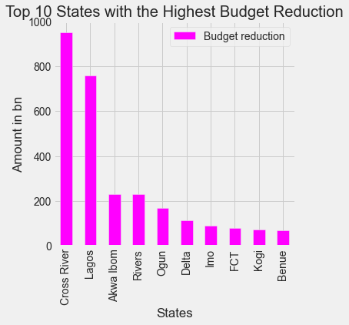
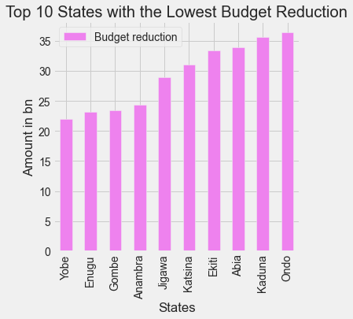
Ustacky Data Scientist Microdegree Capstone Project
Fig. 12.1: Top 10 States with the Lowest Reduction in 2020 Budget
Fig. 12.2: Top 10 States with the Lowest Reduction in 2020 Budget

Slide 30
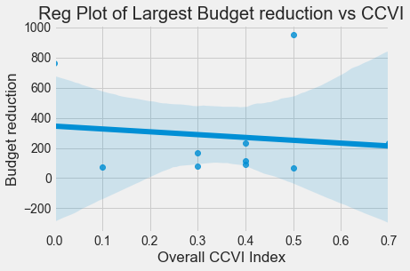
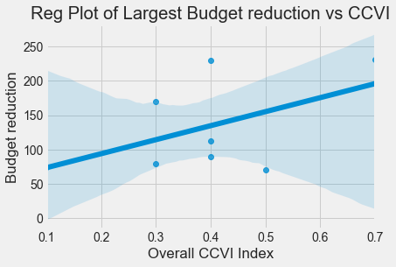
Ustacky Data Scientist Microdegree Capstone Project
With Lagos and Cross River having the
Largest budget reduction (outliers),
the relationship shown here is poorly
correlated
Fig. 13.1: Relationship Between Largest Budget
reduction and CCVI
Relationship becomes linear and positively
correlated after dropping Lagos and Cross River.
Other states with the greatest budget reduction increased their reduction in budget as the CCVI increases
The Mean CCVI of top 10 states with largest
budget reduction (mean=277.071bn) is 0.36
Fig. 13.2: Relationship Between Largest Budget
reduction and CCVI (after dropping Lagos and Cross-Rivers)

Slide 31
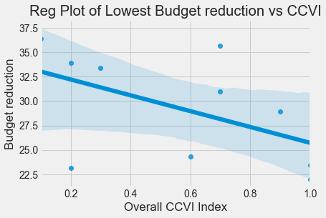
Ustacky Data Scientist Microdegree Capstone Project
Relationship shown is linear and negatively
Correlated.
States with the lowest budget reduction
reduced their reduction in budget as the
CCVI increases.
The Mean CCVI of top 10 states with smallest
budget reduction (mean=29.216bn) is 0.57
Fig. 13.3: Relationship between Lowest Budget reduction
and CCVI

Slide 32
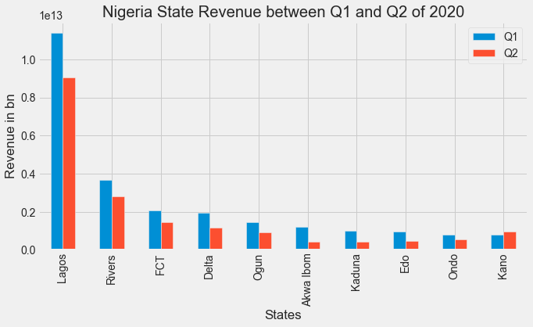
Ustacky Data Scientist Microdegree Capstone Project
Lagos state had the highest drop in revenue at Q2 among the 10 states
All other states except Kano had a drop in revenue at Q2
Fig. 14.0: Top 10 high revenue states and their revenues between
first and second quarter of 2020.
NB: Q2 is the second quarter of 2020 between April and June and signifies the first wave of the Covid-19
Pandemic in Nigeria

Slide 33
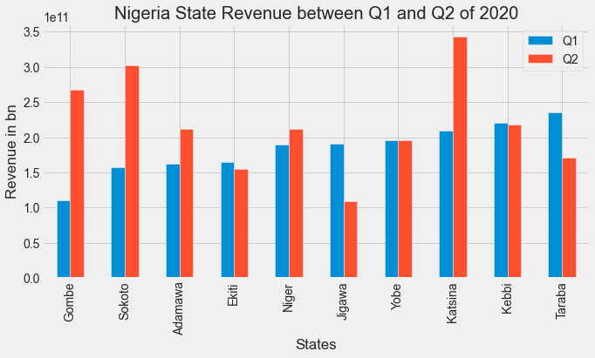
Ustacky Data Scientist Microdegree Capstone Project
Gombe, Sokoto and
Katsina had an increase
In revenue at Q2
Ekiti, Jigawa and Taraba
had a drop in revenue
at Q2
Kebbi and Yobe had little
or No change in revenue.
Fig. 15.0: Top 10 low revenue state and their revenues between first and second
quarter of 2020
NB: Q2 is the second quarter of 2020 between April and June and signifies the first wave of the Covid-19 Pandemic in Nigeria

Slide 34
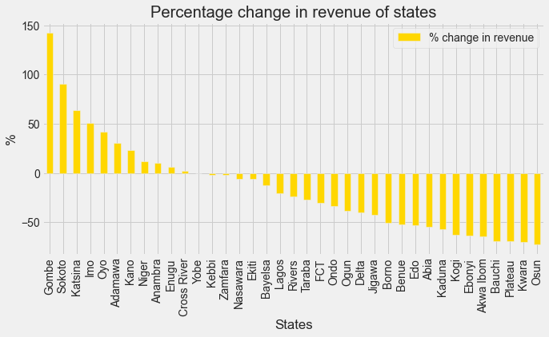
Ustacky Data Scientist Microdegree Capstone Project
Gombe had the highest increase in revenue estimated at about 143%
Osun had the highest drop in revenue estimated at about -72%
A large no. of states
experienced a loss
In revenue at Q2
Fig. 16.0: Percentage (%) change in revenue between Q1 and Q2 of 2020

Slide 35
Ustacky Data Scientist Microdegree Capstone Project
SUMMARY AND CONCLUSION
There are more recoveries from covid-19 than deaths:
Large no of states had below 1000 total Lab confirmed cases
Large no. of states had below 100 total deaths
States with highest number of lab confirmed cases contributed to the highest number of deaths.
There are two waves of the infection, the first wave of infection although lesser, contributed tremendously to the first wave of deaths from the Covid-19 cases.
Nigeria daily infection and death rate is about 367 and 5 persons per day respectively.
Infection and death cases increases with population and population density

Slide 36
Ustacky Data Scientist Microdegree Capstone Project
SUMMARY AND CONCLUSION
Covid-19 had a negative Impact on the Nigerian Economy during the second quarter of 2020 (first wave of Covid-19)
High Income states such as Lagos, Cross River etc. had large budget reduction due to Covid-19
Low Income states like Gombe, Yobe etc. had small reduction in budget due to Covid-19.
Highly vulnerable states also had small budget reduction and vice versa.
High Income states experienced drastic reduction in revenue during the first wave of the Covid-19 pandemic
Low revenue states like Gombe, Sokoto and Katsina experienced sporadic increase in income during the first wave of the pandemic.

Slide 37
Ustacky Data Scientist Microdegree Capstone Project
FUTURE WORKS
Future work would be to answer more questions of the
Covid-19 pandemic in Nigeria such as :
(a.) Is there a relationship between age and susceptibility to the infection?
What is the age with the max. frequency of infection?
What is the age with the min. frequency of infection?
(b.) Is there a relationship between age and recovery from infection?
What are the ages with the max. frequency of recovery?
What are the ages with the min. frequency of recovery?
(c.) Is there a relationship between age and death from the infection?
What are the ages with the max. frequency of discharge?
What are the ages with the min. frequency of discharge?

Slide 38

Ustacky Data Scientist Microdegree Capstone Project

Slide 39
References
https://www.nigerianstat.gov.ng/
https://covid19.ncdc.gov.ng/
https://github.com/CSSEGISandData/COVID-19/blob/master/csse_covid_19_data/csse_covid_19_time_series/time_series_covid19_confirmed_global.csv
https://github.com/CSSEGISandData/COVID-19/blob/master/csse_covid_19_data/csse_covid_19_time_series/time_series_covid19_recovered_global.csv
https://github.com/CSSEGISandData/COVID-19/blob/master/csse_covid_19_data/csse_covid_19_time_series/time_series_covid19_deaths_global.csv

