Slide 1


Predicting IMDb Scores: Unlocking the Secrets Behind Movie Popularity
Join us on a journey to explore the fascinating world of machine learning algorithms and their role in predicting IMDb scores for movies. Discover the key factors that make a movie highly rated and learn how to make better movie selections.

Slide 2


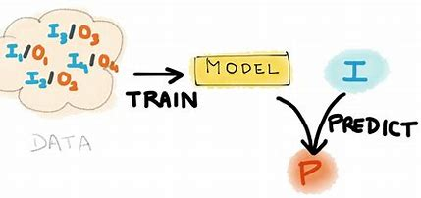
Introduction
Welcome! In this section, we will introduce the problem of predicting IMDb scores and its significance in helping movie enthusiasts find highly rated films. Get ready to dive into the exciting world of machine learning and movie popularity!

Slide 3
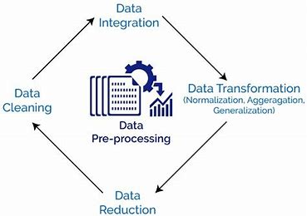

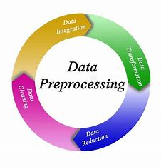
Data Preprocessing
Before we can build our predictive model, we need to preprocess the movie data. In this section, we'll explore techniques for handling missing values, outliers, and categorical variables. Let's clean up the data and make it ready for analysis!

Slide 4
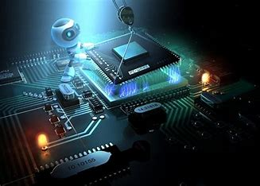
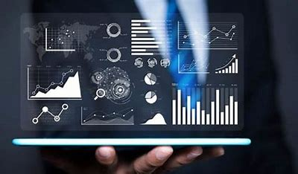
Feature Engineering
Unlocking the secrets of movie popularity requires carefully crafting relevant features. Join us as we delve into the art of feature engineering, exploring different techniques for extracting meaningful information from our movie dataset. Get ready to unleash the power of data!

Slide 5
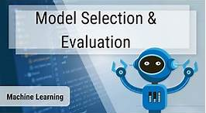

Model Selection
With a plethora of machine learning algorithms available, choosing the right one is crucial. In this section, we'll explore various models and assess their performance using cross-validation techniques. Get ready to find the perfect algorithm to predict IMDb scores!

Slide 6
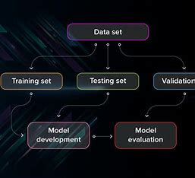
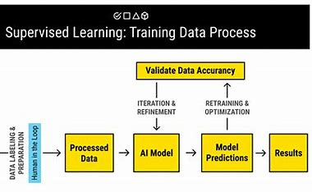
Model Training
Now that we have selected our model, it's time to train it on our movie dataset. In this section, we'll dive into the fascinating world of model training. Join us as we uncover the inner workings of machine learning algorithms and train our model to make accurate predictions.

Slide 7
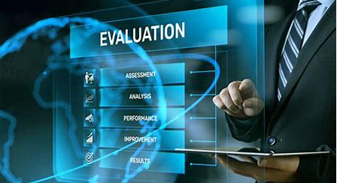
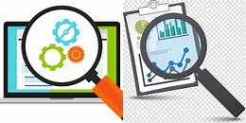

Model Evaluation
We've trained our model, but how well does it actually perform? In this section, we'll evaluate the predictive power of our machine learning model and assess its ability to accurately estimate IMDb scores. Get ready for some data-driven insights!

Slide 8

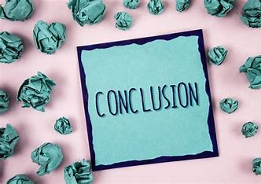
Conclusion
As we reach the end of our journey, let's reflect on what we've learned. In this section, we'll summarize the key takeaways from our exploration of predicting IMDb scores. Join us as we wrap up this exciting adventure and gain a deeper appreciation for the power of machine learning in the world of movies.

