Slide 1
Modelling climate change for producing countries
June 2018
Johnny West

Slide 2
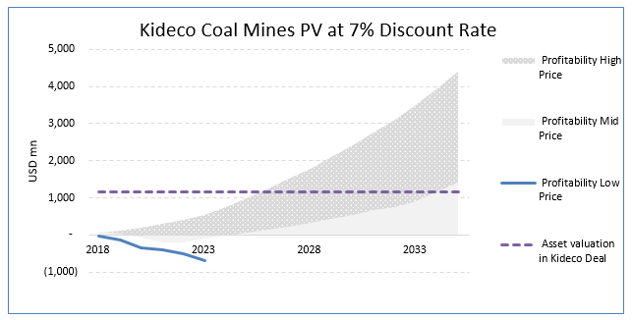
Diagnostic: how long is the plan?

Slide 3
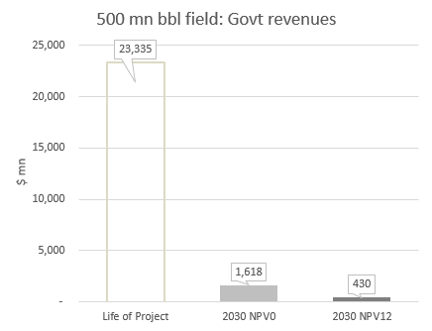
Govt $: less, and later, than you think

Slide 4
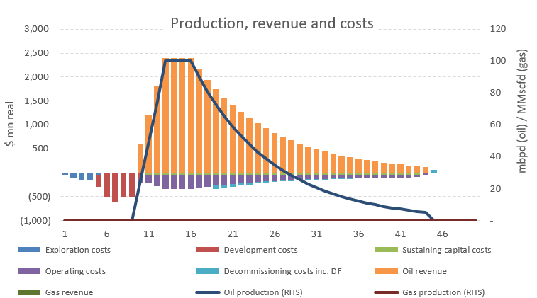
Because of Life of Project Cash Flows

Slide 5
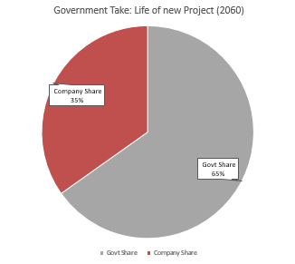
And the government position…
5
Notes:
5

Slide 6
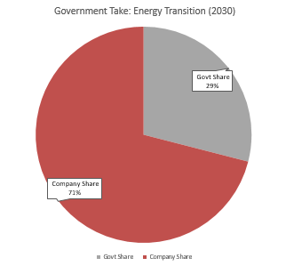
… gets weaker in shorter timeframe
6
Notes:
6

Slide 7
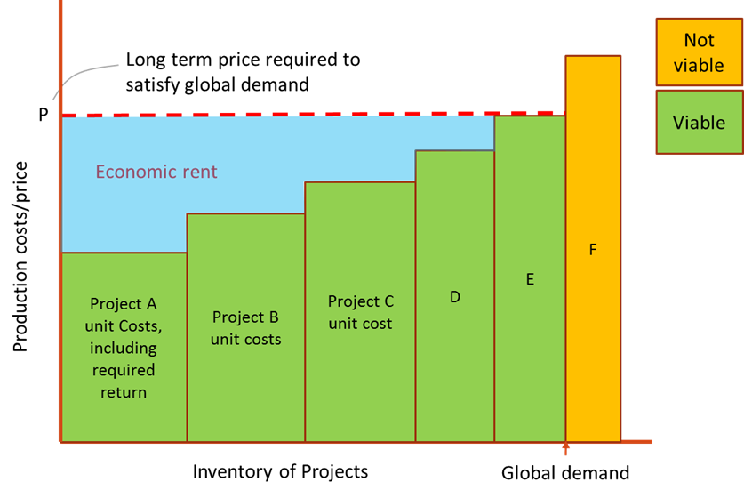
Which projects go first?
7
Notes:
7

Slide 8
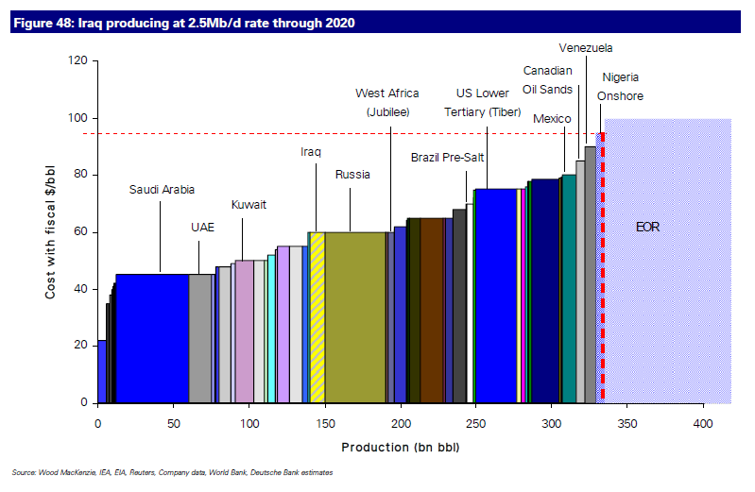
Which projects go first?
8
Notes:
8

Slide 9
Fossil fuel classification: SPE
9
Notes:
9

