Slide 1

reflections on civic data
john sheridan
head of e-services
the office of public sector information
john.sheridan@opsi.x.gsi.gov.uk

Slide 2
the office of public sector information
The Office of Public Sector Information
At the heart of information policy with a public sector wide remit
Responsible for the management of Crown copyright
Responsible for the superintendence of a range of official publishing activities, including all UK primary and secondary legislation and the official Gazettes
Encourages the re-use of public sector information

Slide 3
public sector information is vital
Organisations in the public sector are key suppliers of reliable base information, on which both a knowledge economy and an information society are built
PSI underpins numerous information value chains
This gives us both tremendous leverage and a great responsibility
Technological innovation is driving the re-use agenda forward

Slide 4
a growing debate
There is a growing public debate about the role, importance and potential of PSI. This is a good thing!
The Guardian “Free Our Data” campaign is increasing awareness, but is it a symptom or a cause?
This debate is beginning to reach a wider audience that needs to be informed
The Office of Fair Trading is conducting a market study into Public Sector Information, due for publication soon. OPSI is awaiting the results with interest

Slide 5
transforming legislation
The importance of the web as a medium for publishing legislation
Building on Strengths
  Immediacy
  Accuracy
  Trust
  Reach
  Usability
  Accessibility
Making best use of the information we hold
World class online legislation services from government

Slide 6
building on strengths
Immediacy - legislation is published on internet simultaneously or at least within 24 hours of publication in printed from.
Accuracy - legislation on the OPSI website has the same legal status as the printed version
Trust - a key attribute of the legislation service is that users trust the provenance of the information
Reach – 1 million unique visitors per month, one of the most used government websites
Re-use – legislation can be republished and re-used under waiver Crown copyright
Usability and Accessibility are the main challenges

Slide 7
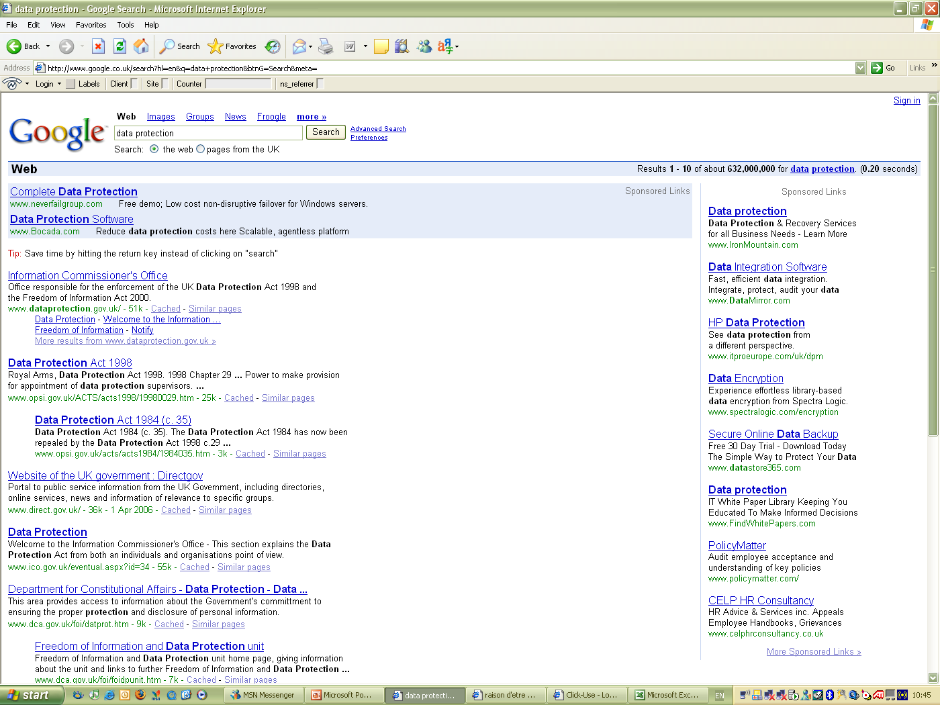
The official version of legislation consistently very easy to find
e.g. search for “data protection”

Slide 8
legislation strategy
Short Term:
  realise immediate improvements & enhancements to the online service. New features, content and formats.
Mid Term:
  strive to implement Single Source Multi Format approach.
Longer Term:
  underpin with comprehensive government XML standard for legislation that others can freely adopt and use.

Slide 9
what is Click-Use
Introduced five years ago, the first version of Click-Use provided an online application process for obtaining a free licence to re-use core Crown information
Extended in August 2005 to provide a licensing solution for the United Kingdom Parliament, making Parliamentary copyright material free to re-use.
In April 2006 OPSI launched the new Click-Use PSI Licence as a shared service for the public sector. Enables any PSIH to license the re-use of their material for free.

Slide 10
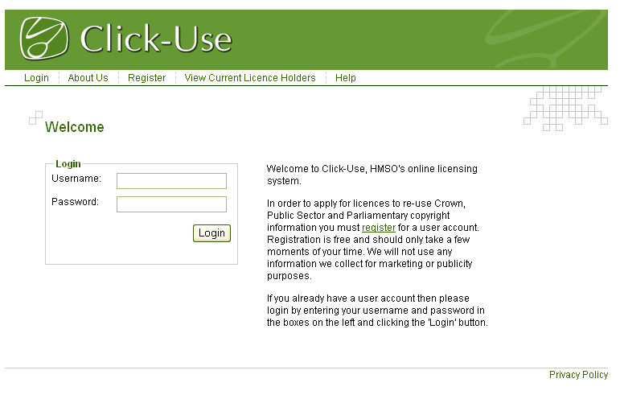

Slide 11
Click-Use strategy
Further extend the scope of material covered by the Click-Use approach.
Enabling Click-Use as a web service to achieve interoperability of licensing systems and allow for easier re-use.
Expressing rights and licensing information in RDF and XML, linking to Click-Use.
We are prepared to let a machine obtain a Click-Use licence.

Slide 12


Slide 13
re-use and the semantic web
Definition: The Semantic Web is the representation of data on the World Wide Web.
The semantic web is about allowing data systems to change by evolution not revolution (Tim Berners-Lee)
An extension of the current Web, providing infrastructure for the integration of data.

Slide 14
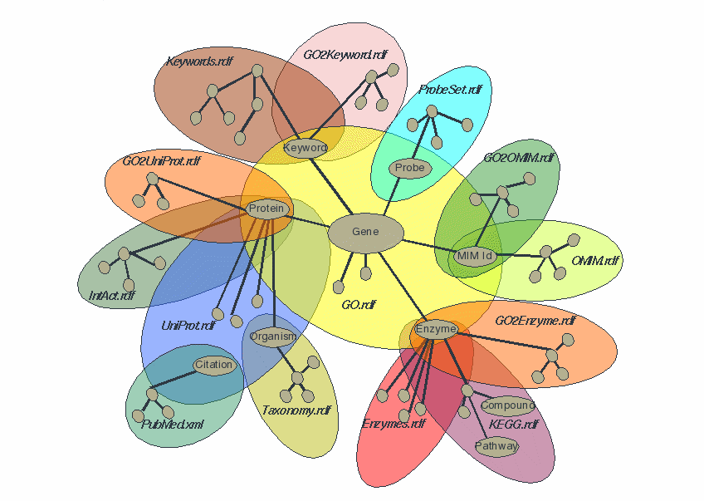
Why? - Science is leading the way
Science used to be
about discovering
as much as possible
about an entity.
Science is now
about discovering
how entities react
in complex systems.
Data sharing is the key to human advancement!

Slide 15
research objectives
Explore the potential for reuse of public sector information to stimulate the broader UK knowledge economy
What is possible with public sector information using recent advances in web technology
Research project without immediate commercial or service delivery drivers
Build up a detailed picture of life in two London Boroughs, using as broad a collection of Public Sector Information as possible

Slide 16
initial observations
Common evolution to bringing information online
Initial phase: Scan historical & publish, capture new information as single entity (pdf, doc) & publish
Current phase: Review information value chain, capture important information chunks in DB to help organise & publish for immediate needs.
Re-use phase: Need to annotate information & publish such that others can use it in ways not imagined by the originator (using standards).

Slide 17
ease of re-use
Re-use inhibited by the internal information management issues
Too many databases, separate schemas, minimal metadata, workflow for capturing metadata not established
Seems to be no benefit to publish in a form for reuse
  if it’s core business there’s no funding for re-use publishing
  if it’s not core (and licensable), then it becomes less important because the organisation focus is not on generating revenue.
Are there simple initiatives that can aid ability to publish for re-use?

Slide 18
aims
Show how information in existing databases can be made available in scalable semantic knowledge bases
  Using latest semantic web languages to represent and query the data
Show how all this data can be linked to create an extended knowledge network
Show how ontologies can represent the given data
Demonstrate examples of added value
Investigate the suitability of IPSV for representing government data
Identify knowledge gaps between existing databases, and how such gaps can be filled

Slide 19
initial conclusions
Small ontologies can do the job
  Ontologies to limited domains
  Can be integrated in various ways
Use of ontologies
  Data mapping and integration made easier
  Helped to understand the data models
  Flexibility of representation
  Overall, we created around 19 million RDF statements
Much can be gained when the data is integrated
  Data about the same place or object is distributed across several databases and organisations
  Data enrichment, consistency checks, better analysis
  Better to integrate data from various sources, rather to duplicate it!
Data access can be made easier
  Mashups can be generated relatively easily
  Search and retrieval across databases
  Data can be published in “machine understandable” formats

Slide 20
developing a re-use agenda
Data sharing to improve the efficiency of government and deliver more efficient and more personalised public services
Evidence based policy – being able to ask and answer bigger questions
Re-use of PSI for commercial exploitation, enhancing economic value
Use of administrative datasets for academic research
All are forms of re-use, all are inhibited by how we structure and share information, all can be furthered through the adoption of the semantic web technology

Slide 21
implications
What is “re-use” in a semantic web world?
How do we license increasing fragmented aggregations of data?
How do we apply the principles of IFTS (in particular transparency) to Crown bodies aggregating their data with large quantities of non-Crown material?
What does this mean for publishing the information OPSI is directly responsible for (Legislation and the Gazettes)?

