Slide 1
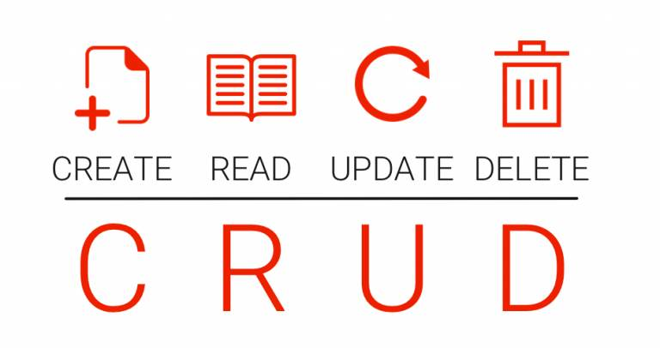

Slide 2
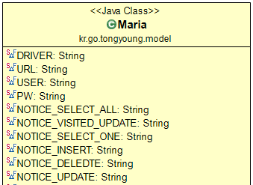
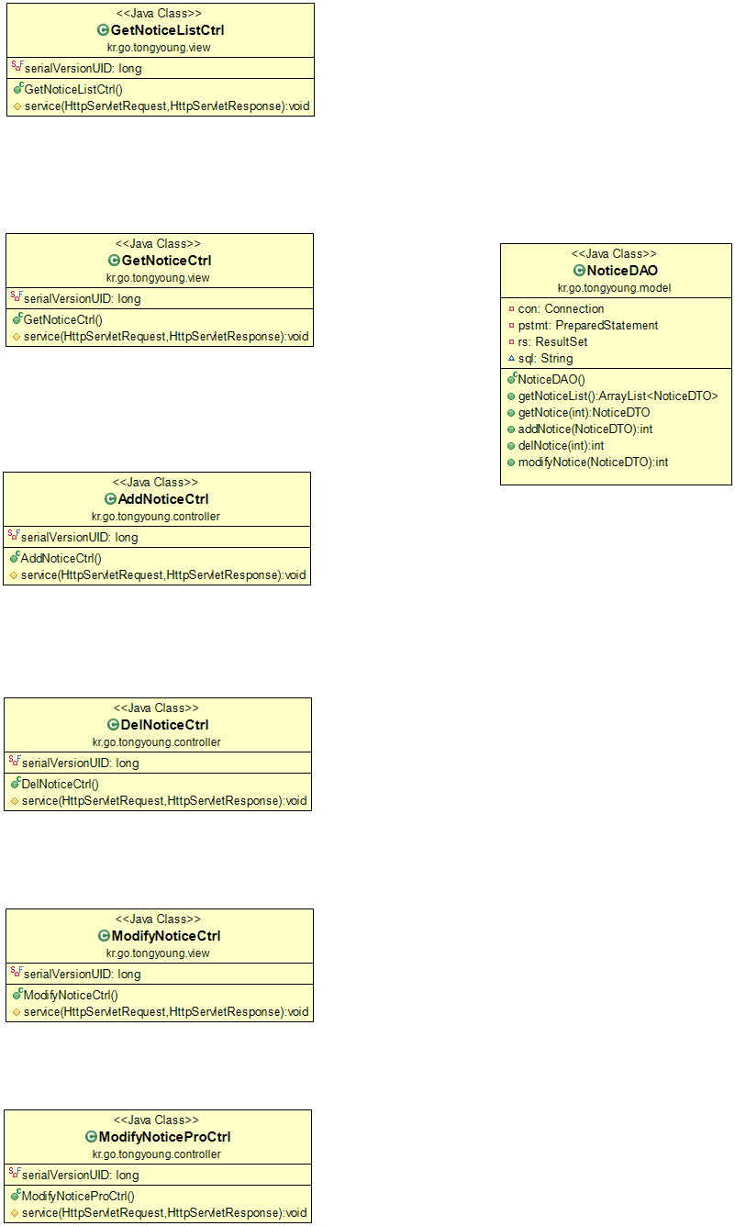

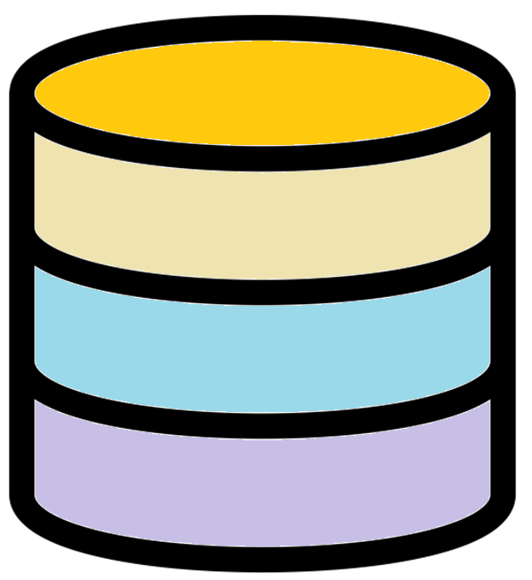
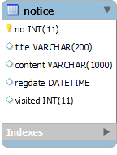
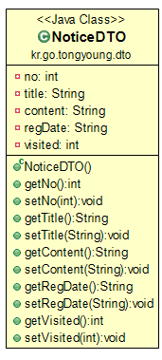
noticeList.jsp
notiList = dao.getNoticeList()
NoticeDAO dao
noticeDetail.jsp
NOTICE_SELECT_ALL
JDBC
notice = dao.getNotice (no)
NOTICE_SELECT_ONE
NOTICE_INSERT
addNotice.jsp
NOTICE_DELETE
NOTICE_UPDATE
cnt = dao.addNotice (dto)
ArrayList<NoticeDTO> notiList
JDBC
NoticeDTO notice
NoticeDTO dto
cnt = dao.delNotice (no)
noticeUpdate.jsp
notice = dao.getNotice (no)
cnt = dao.modifyNotice (dto)

