Slide 1
Inji Interoperability
Playground
Find where a verifiable credential journey succeeds or fails.
Working prototype · 25 October 2026
MOSIP Decode 2026 / 01
Notes:
Show the actual playground before discussing feature count. Source: https://github.com/oki-dokii/mosip. The deck reports recorded behavior through 25 October 2026.

Slide 2
The interoperability problem
A credential can issue correctly and still fail when another wallet presents it.
The failure may sit in the offer, format, proof binding, request profile or verifier policy. A final “invalid” screen rarely names the broken boundary.
Our goal
Record the exact role combination, the observed boundary and the verifier outcome so a team can reproduce the mismatch.
MOSIP Decode 2026 / 02
Notes:
The problem statement asks for an interoperability playground and identification of gaps. This slide describes the engineering problem; it does not claim all standards profiles work.

Slide 3
How the playground works
Issuer
Certify or independent mock
Offer and credential
Wallet
Reference Wallet or Inji wallet
Hold and present
Verifier
Inji Verify or independent mock
Validate and return result
React web + Express BFF + PostgreSQL; redaction before storage.
MOSIP Decode 2026 / 03
Notes:
The automated wallet is the project's Reference Wallet. Inji Web and Android are separate observed paths. Browser capture cannot see Mimoto's server-to-server calls. See submission/ARCHITECTURE.md and CAPTURE.md.

Slide 4
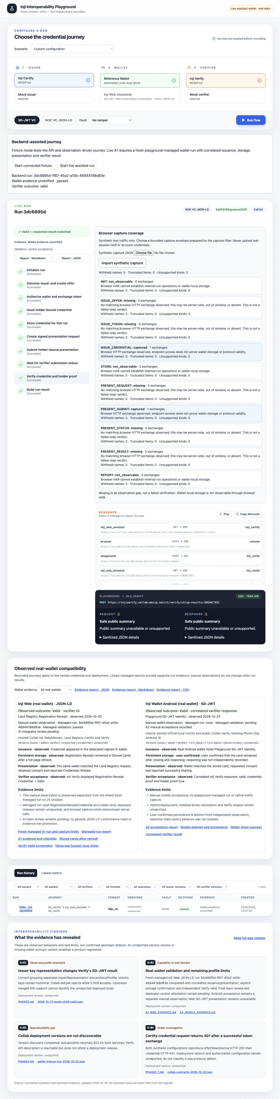
Inspect the actual run
10 steps succeeded
7 sanitized exchanges
Open the timeline, inspect a boundary, then download JSON or Markdown. The committed A1 record remains read only in a fresh demo.
MOSIP Decode 2026 / 04
Notes:
Screenshot source: submission/evidence/person2-managed-a1-2026-10-25/playground-reviewed.png. The A1 managed run ID is 3dc6895d-ff87-45a2-a10b-46844198d83e. The live test used memory storage; the fresh demo presents a read-only projection of the committed sanitized export. The original export has a known wallet version label defect; the API projection shows unreported.

Slide 5
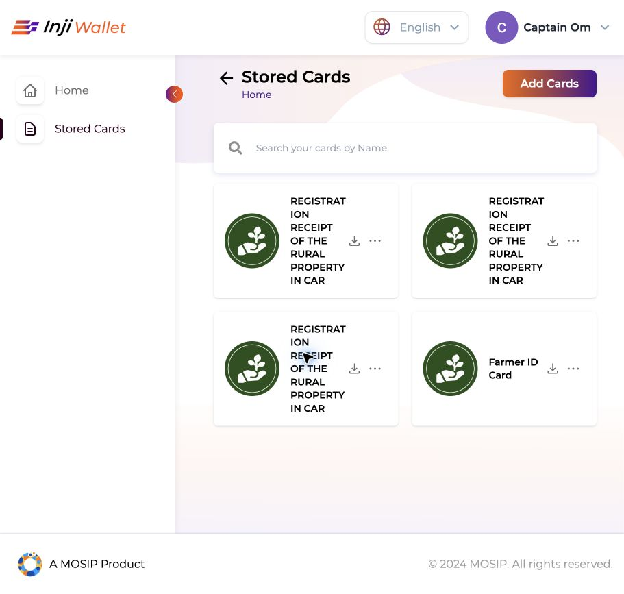
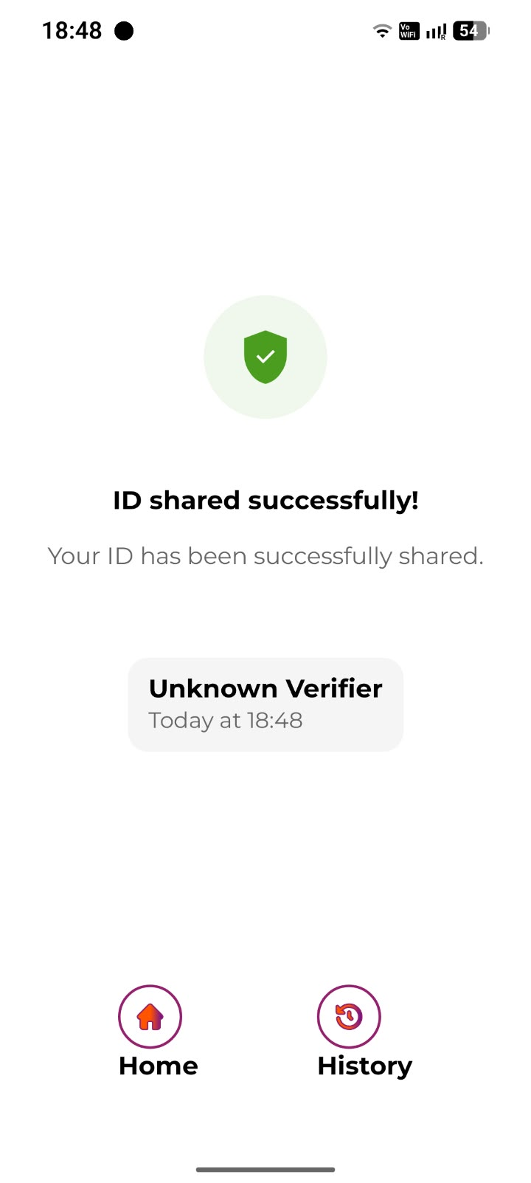
Two real-wallet checkpoints
Inji Web · JSON-LD
Android · SD-JWT
Reload-backed storage; correlated Mimoto presentation; Verify valid.
Official local Certify, real mobile wallet, Collab Verify valid.
MOSIP Decode 2026 / 05
Notes:
Inji Web source: submission/evidence/person2-managed-a1-2026-10-25/README.md. Android source: submission/evidence/person3-a2-mobile-2026-10-23/README.md. The Web capture saw browser to Mimoto, not Mimoto to Certify or Verify. Android is a recorded hybrid profile, not a full local-stack test. Hosted component versions are unreported; binary attestation and final team review remain open.

Slide 6
A demo judges can inspect
6
cross-container mock scenarios
204
BFF tests passing on 25 October
60
web tests passing on 25 October
For MOSIP integrators and QA teams: faster diagnosis of credential failures with a repeatable, sanitized record.
MOSIP Decode 2026 / 06
Notes:
The six-case Docker smoke passed previously in hosted CI; current local Docker daemon was unavailable on 25 October and new CI is running for commit 2e01dfe. BFF full suite: 204 passed, three skipped. Web suite: 59 before the final new link test; the added test passes, making 60 expected. Do not present those tests as live Inji conformance. Source: submission/READINESS.md and GitHub Actions.

