Slide 1
Inji Interoperability
Playground
Find where a verifiable credential journey succeeds or fails.
Bhole Chature
Soham Banerjee (Lead) · Pulkit Pandey · Dayal Gupta
Thrissha Arcot · Harsh Kumar
Working prototype · 26 October 2026
MOSIP Decode 2026 / 01
Notes:
Show the actual playground before discussing feature count. Source: https://github.com/oki-dokii/mosip. The deck reports recorded behavior through 25 October 2026.
Review checkpoint: 26 October 2026. Local managed evidence: submission/evidence/2026-10-26-managed-local-jsonld/README.md. Test checkpoint: submission/evidence/2026-10-26-person1-audit/README.md. Hosted releases remain unreported; Android evidence is hybrid and not a local-Verify claim.
Team: Bhole Chature. Soham Banerjee (Lead), Pulkit Pandey, Dayal Gupta, Thrissha Arcot, Harsh Kumar. Names supplied by user.

Slide 2
The interoperability problem
A credential can issue correctly and still fail when another wallet presents it.
The failure may sit in the offer, format, proof binding, request profile or verifier policy. A final “invalid” screen rarely names the broken boundary.
Our goal
Record the exact role combination, the observed boundary and the verifier outcome so a team can reproduce the mismatch.
MOSIP Decode 2026 / 02
Notes:
The problem statement asks for an interoperability playground and identification of gaps. This slide describes the engineering problem; it does not claim all standards profiles work.
Review checkpoint: 26 October 2026. Local managed evidence: submission/evidence/2026-10-26-managed-local-jsonld/README.md. Test checkpoint: submission/evidence/2026-10-26-person1-audit/README.md. Hosted releases remain unreported; Android evidence is hybrid and not a local-Verify claim.

Slide 3
How the playground works
Issuer
Certify or independent mock
Offer and credential
Wallet
Reference Wallet or Inji wallet
Hold and present
Verifier
Inji Verify or independent mock
Validate and return result
React web + Express BFF + PostgreSQL; redaction before storage.
MOSIP Decode 2026 / 03
Notes:
The automated wallet is the project's Reference Wallet. Inji Web and Android are separate observed paths. Browser capture cannot see Mimoto's server-to-server calls. See submission/ARCHITECTURE.md and CAPTURE.md.
Review checkpoint: 26 October 2026. Local managed evidence: submission/evidence/2026-10-26-managed-local-jsonld/README.md. Test checkpoint: submission/evidence/2026-10-26-person1-audit/README.md. Hosted releases remain unreported; Android evidence is hybrid and not a local-Verify claim.

Slide 4
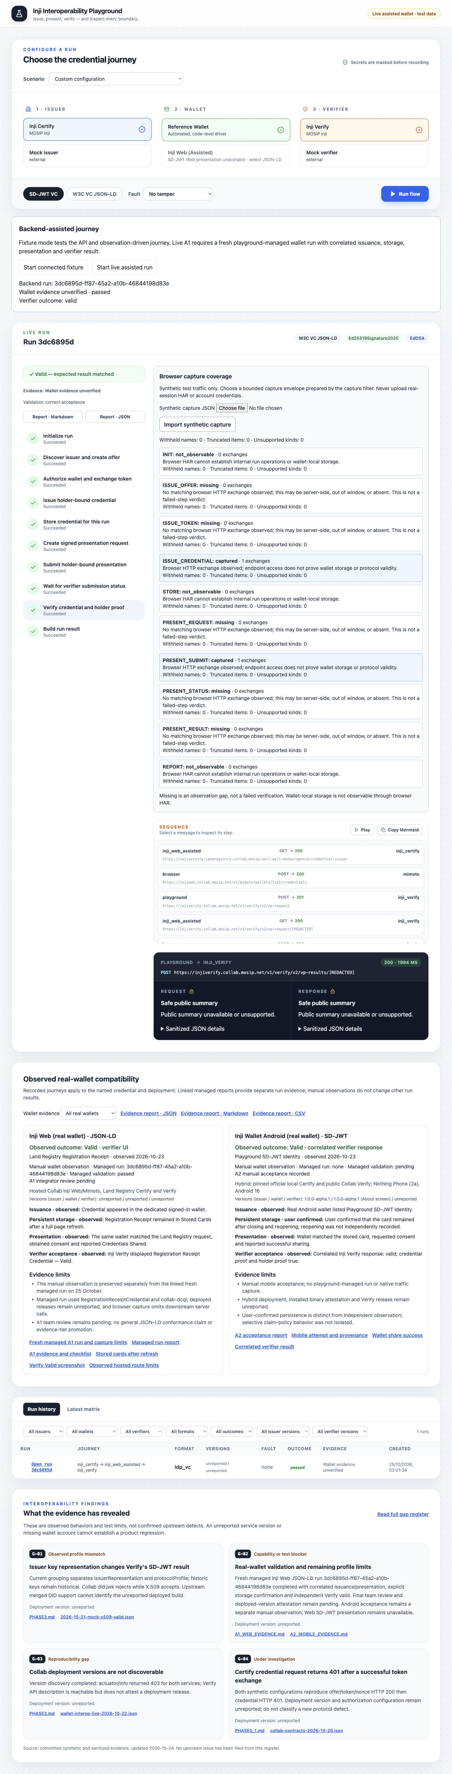
Inspect the actual run
10 steps succeeded
7 sanitized exchanges
Open the timeline, inspect a boundary, then download JSON or Markdown. The committed A1 record remains read only in a fresh demo.
MOSIP Decode 2026 / 04
Notes:
Screenshot source: submission/evidence/person2-managed-a1-2026-10-25/playground-reviewed.png. The A1 managed run ID is 3dc6895d-ff87-45a2-a10b-46844198d83e. The live test used memory storage; the fresh demo presents a read-only projection of the committed sanitized export. The original export has a known wallet version label defect; the API projection shows unreported.
Review checkpoint: 26 October 2026. Local managed evidence: submission/evidence/2026-10-26-managed-local-jsonld/README.md. Test checkpoint: submission/evidence/2026-10-26-person1-audit/README.md. Hosted releases remain unreported; Android evidence is hybrid and not a local-Verify claim.

Slide 5
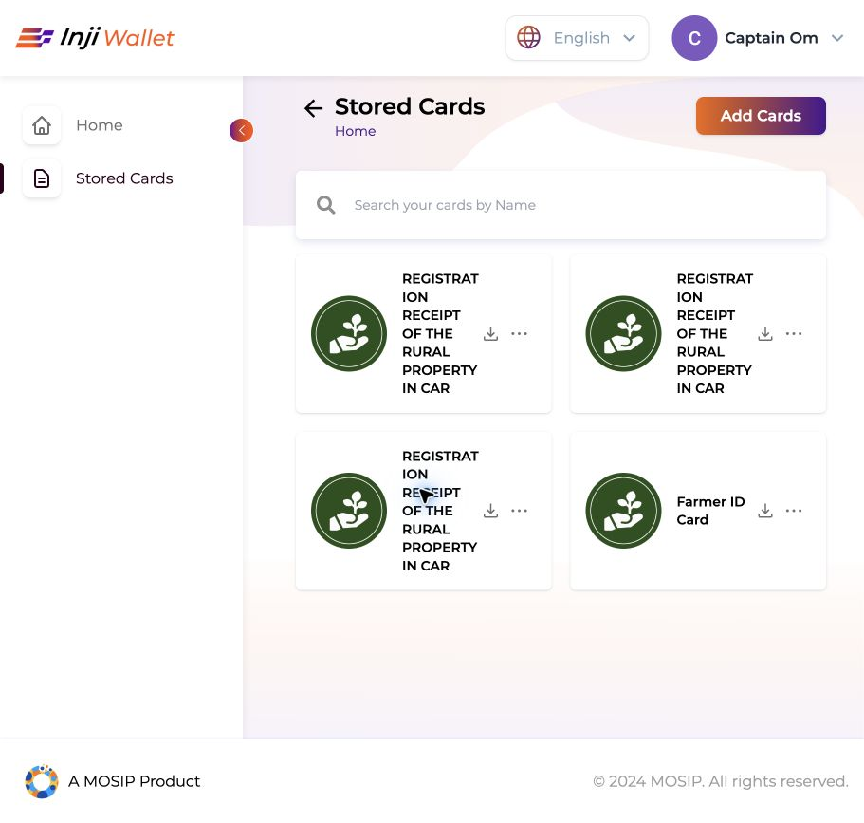
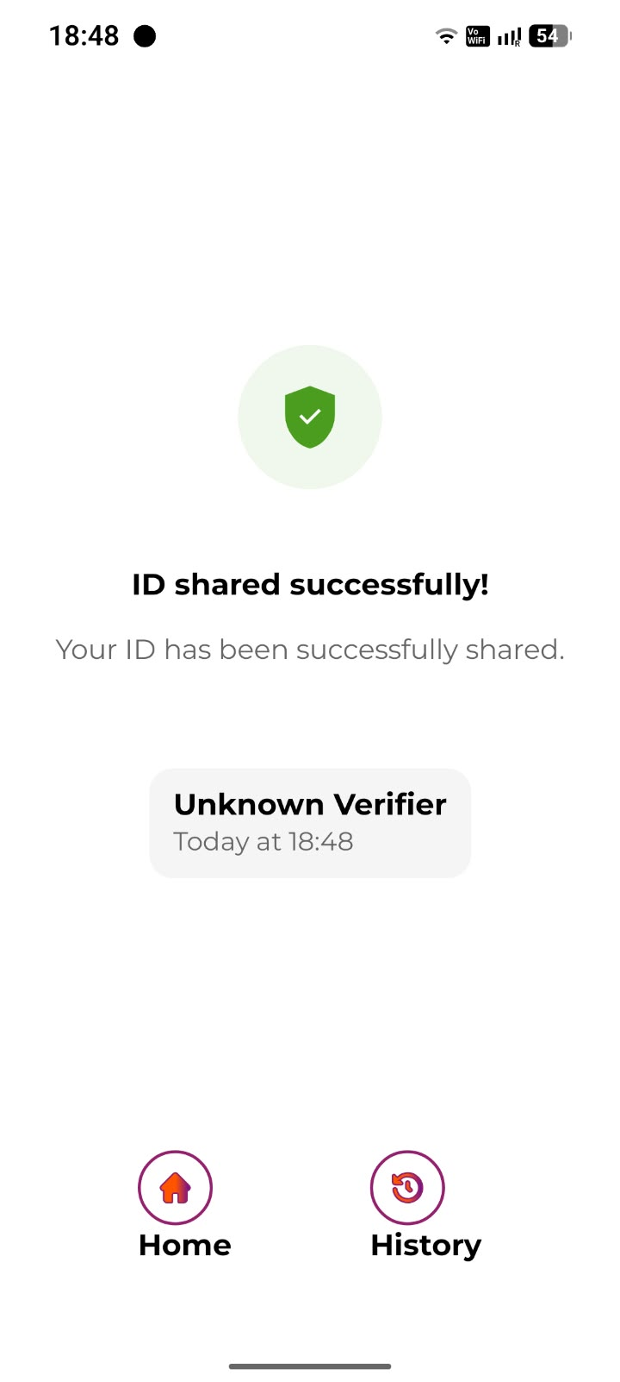
Two real-wallet checkpoints
Inji Web · JSON-LD
Android · SD-JWT
Hosted Collab: reload-backed storage, correlated presentation, Verify valid. Releases unreported.
Local Certify → real Android wallet → Collab Verify valid. Hybrid deployment.
MOSIP Decode 2026 / 05
Notes:
Inji Web source: submission/evidence/person2-managed-a1-2026-10-25/README.md. Android source: submission/evidence/person3-a2-mobile-2026-10-23/README.md. The Web capture saw browser to Mimoto, not Mimoto to Certify or Verify. Android is a recorded hybrid profile, not a full local-stack test. Hosted component versions are unreported; binary attestation and final team review remain open.
Review checkpoint: 26 October 2026. Local managed evidence: submission/evidence/2026-10-26-managed-local-jsonld/README.md. Test checkpoint: submission/evidence/2026-10-26-person1-audit/README.md. Hosted releases remain unreported; Android evidence is hybrid and not a local-Verify claim.

Slide 6
A demo judges can inspect
6
cross-container mock scenarios
435
tests passed at the 26 October audit
17
Chromium browser checks passed
For MOSIP integrators and QA teams: faster diagnosis of credential failures with a repeatable, sanitized record.
MOSIP Decode 2026 / 06
Notes:
The six-case Docker smoke passed previously in hosted CI; current local Docker daemon was unavailable on 25 October and new CI is running for commit 2e01dfe. BFF full suite: 204 passed, three skipped. Web suite: 59 before the final new link test; the added test passes, making 60 expected. Do not present those tests as live Inji conformance. Source: submission/READINESS.md and GitHub Actions.
Review checkpoint: 26 October 2026. Local managed evidence: submission/evidence/2026-10-26-managed-local-jsonld/README.md. Test checkpoint: submission/evidence/2026-10-26-person1-audit/README.md. Hosted releases remain unreported; Android evidence is hybrid and not a local-Verify claim.

Slide 7
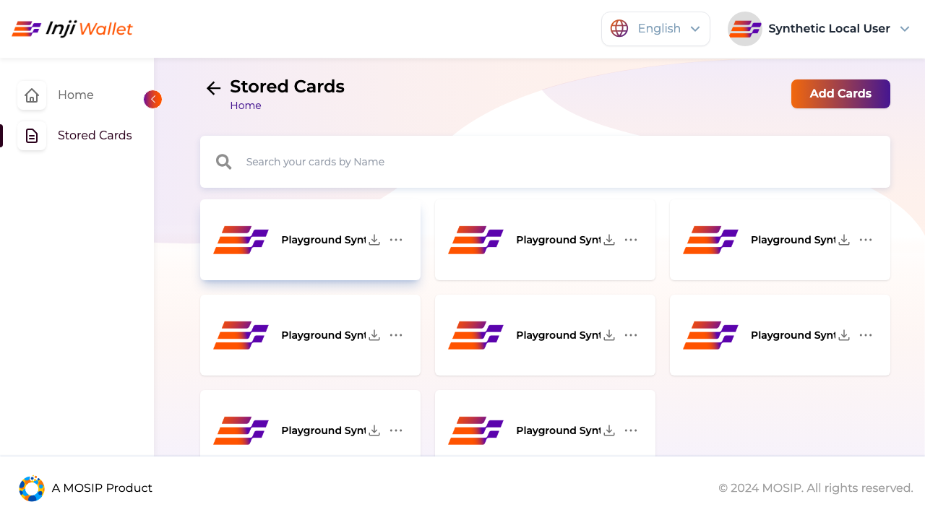
Local same-wallet JSON-LD journey
Certify 0.14.0 → Inji Web 0.17.0 / Mimoto 0.22.0 → Verify 0.18.2
Exact newly issued card survived reload. The same wallet presented that card. Independent Verify returned valid with credential and holder proofs true.
Managed run f5f56b45… links captured token, credential and direct-post exchanges.
Limits: synthetic authorization fixture, declared DID adapter and network-fetched public contexts. Generic evidence tier remains unverified.
MOSIP Decode 2026 / 07
Notes:
Source: submission/evidence/2026-10-26-managed-local-jsonld/README.md, run-report.json, coverage.json, provenance.json and browser-checks.json. The wallet screenshot is from the earlier same-profile direct harness, submission/evidence/2026-10-26-local-web-jsonld/stored-after-reload.png; it is illustrative evidence for that separate run, not a screenshot of f5f56b45. Mimoto request-fetch and browser capture remain unobserved in the managed run. No conformance certification or official stack-only authentication is claimed.

Slide 8
Observed findings and limits
G-05 Local initialization contract
Pinned SQL/configuration behavior needs a reproducible setup adjustment.
G-09 Version-specific JWT proof binding
The alpha SD-JWT issuance profile uses its own proof contract; keep it separate from 0.14.
G-10 DID assertion-method reference
The local JSON-LD route declares its DID adapter rather than concealing it.
Upstream issues and private G-06/G-07 reports are still pending owner submission. No upstream confirmation is claimed.
MOSIP Decode 2026 / 08
Notes:
Sources: docs/GAPS.md, submission/gaps.json, deploy/INJI_WEB_LOCAL.md. Verify G-05/G-09/G-10 wording against their exact version-pinned reproductions. G-06/G-07 sensitive details are intentionally omitted. Reports are not marked sent without actual delivery. Team: Bhole Chature. Members: Soham Banerjee (Lead), Pulkit Pandey, Dayal Gupta, Thrissha Arcot, Harsh Kumar. Confirmed by the team lead.

