Slide 1
Interoperability Playground
Where did the wallet journey stop?
A credential can be issued and stored successfully, yet fail when another verifier requests it. The playground follows that exchange from issuer to wallet to verifier.
Bhole Chature / MOSIP Decode 2026
Notes:
https://github.com/oki-dokii/mosip/blob/main/submission/TEAM.md

Slide 2
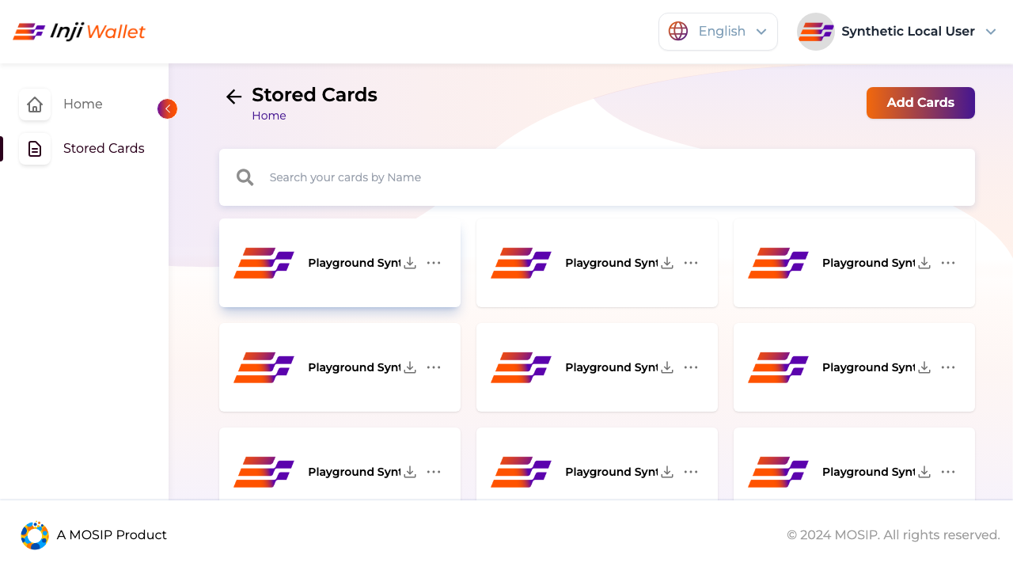
One card, one local wallet
The same card survived reload and verified
Inji Certify 0.14 issued a JSON-LD credential. Inji Web 0.17 and Mimoto 0.22 stored and presented it. Local Verify 0.18.2 accepted the credential and holder proofs.
The local setup uses synthetic authorization and a DID adapter.
Notes:
https://github.com/oki-dokii/mosip/blob/main/submission/evidence/2026-10-26-person2-local-ui/run-report.json

Slide 3
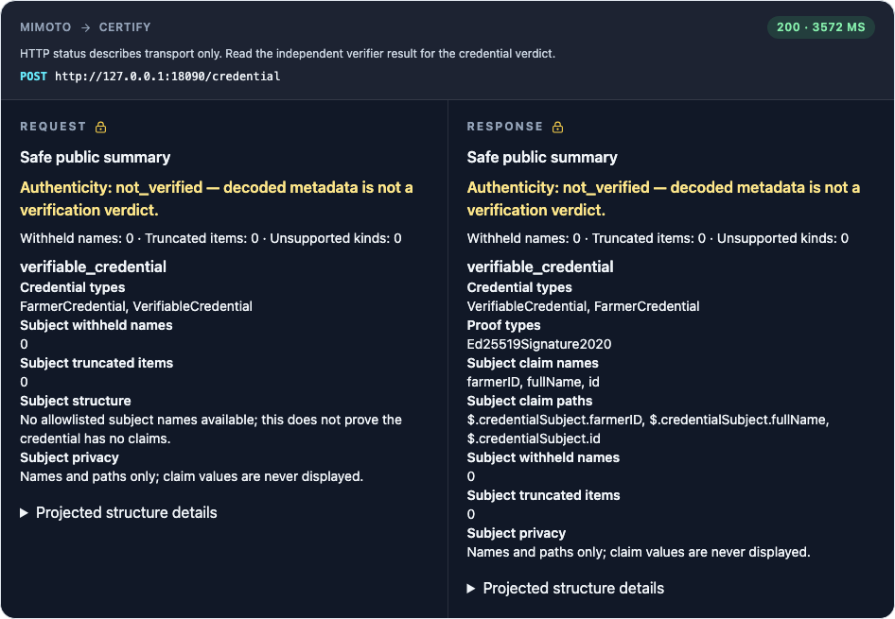
Inspecting an exchange
Developers can see the step, actors and evidence
The React inspector opens sanitized exchanges from the Node orchestrator. A Postgres-backed run keeps the steps and result together. Captured claim names can be displayed while their values are withheld.
Safe capture and run-scoped correlation
Notes:
https://github.com/oki-dokii/mosip/blob/main/submission/evidence/2026-10-26-person2-local-ui/coverage.json

Slide 4
Cross-vendor experiment
Both native controls passed
walt.id 1.2.0 issued, stored and verified an SD-JWT. Inji passed its own control. The same walt.id wallet stopped on Certify offer resolution and Inji request resolution with HTTP 500.
Two fresh sessions reproduced each boundary.
Notes:
https://github.com/oki-dokii/mosip/blob/main/deploy/waltid/README.md

Slide 5
Format coverage
One mDL produced two different observations
Collab issued a synthetic mobile driving licence. Inji Verify returned an unsuccessful check. An independent library validated the issuer signature and all six attribute digests.
Issuer certificate-chain trust and device authentication remain open.
Notes:
https://github.com/oki-dokii/mosip/blob/main/submission/evidence/2026-11-01-formats/collab-mdl.json

Slide 6
Evidence for reviewers
40 protocol cells across three environments
29 local mock cells run in automation. Seven archived local Inji and four Collab cells preserve their observation dates. Android has hybrid evidence. An Android-to-local-Verify run still needs a phone operator.
Open the recorded journeys at oki-dokii.github.io/mosip
Notes:
https://github.com/oki-dokii/mosip/blob/main/submission/protocol-matrix.json

