Slide 1
YouTube Comments Sentiment Analysis
Group 4
Ssentongo George Mugerwa 2023-B071-20461
SIWA LATIFU ALI 2023-B071-20207
Mzuanda Alvin Jude 2022-BO71-10284
LUBEGA JOEL 2023-B071-21372
Kirungi Madrine Majoe 2023-B071-22493
MUTEBI ELVIS 2023-B071-21384

Slide 2
Objective
Perform lexicon-based sentiment analysis on YouTube comments for African culture videos
DATASET
YouTube Comments Dataset (https://www.kaggle.com/datasets/atifaliak/youtube comments-dataset)

Slide 3
Data Processing
: Step 1 - Text Preprocessing (Cleaning)
Why? Raw text data is noisy and must be cleaned to improve analysis quality.
Cleaning Steps Applied:
Convert text to lowercase.
Remove URLs, user mentions (@), and hashtags (#).
Strip out emojis and special characters.
Eliminate extra whitespace.
Raw: "I LOVE this! ❤️❤️❤️ https://example.com“
Cleaned: "i love this"

Slide 4
Step 2 - Text Preprocessing (Tokenization & Filtering)
Why Tokenization and Filtering:
Tokenization - Splits text into individual words/tokens
"I love African culture" → ["I", "love", "African", "culture"]
Needed for word-by-word sentiment analysis
Filtering - Removes unimportant words
Stop words: "the", "and", "is", "in" (don't carry sentiment)
Short words: "a", "I" (usually not meaningful for analysis)
Improves analysis by focusing on content-rich words
Result: Better sentiment accuracy by analyzing only meaningful words like "love", "beautiful", "amazing", "disappointing" instead of noise words.

Slide 5
Step 3 - Feature Engineering with TF-IDF What is TF-IDF?
Term Frequency-Inverse Document Frequency.
A statistical measure that evaluates how important a word is to a document in a collection.
Converts text data into a numerical matrix.
Implementation:
Created a TF-IDF matrix limited to the top 1,000 features (words).
Matrix Shape: (18408, 1000) → 18,408 comments represented by 1,000 unique word scores.
Purpose: This matrix serves as the input for machine learning models and further analysis.

Slide 6
Step 4 - Sentiment Analysis (Dual-Method Approach)
We used two popular lexicons to compare and validate results.
1. TextBlob:
Provides a polarity score between -1 (negative) and +1 (positive).
Categorization:
Positive: polarity > 0
Neutral: polarity = 0
Negative: polarity < 0
2. AFINN:
Assigns words an integer sentiment score (e.g., "good" = +3, "bad" = -2).
Sums the scores for all words in a comment.
Categorization based on the total score (Positive, Neutral, Negative).

Slide 7
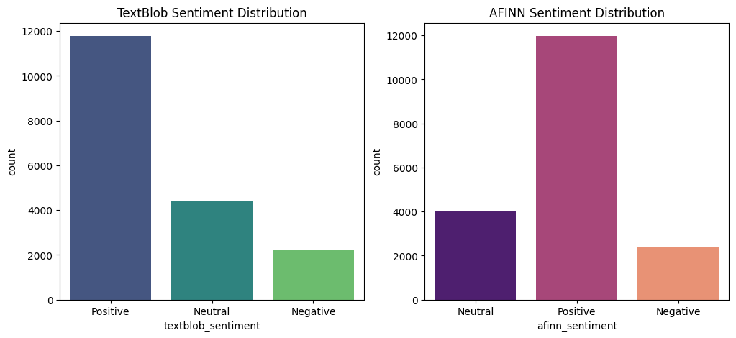
Sample Output
• Most comments show positive or supportive sentiments.
• Fewer negative reactions indicating overall appreciation.
• Bar chart visualization highlights sentiment proportions.

Slide 8
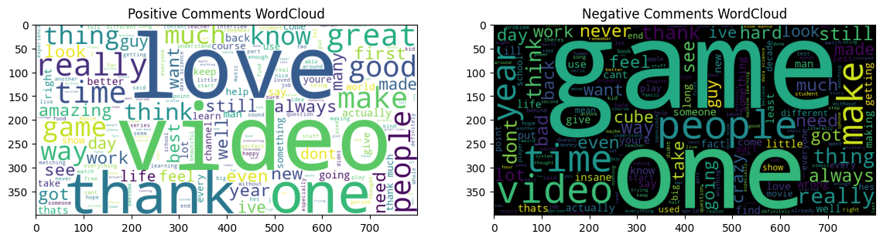
Word Clouds
• Positive WordCloud: Frequent words showing appreciation.
• Negative WordCloud: Words reflecting issues or criticism.
• Useful for discovering thematic patterns.

Slide 9
Interpretation & Insights
• Positive tone dominates, reflecting audience engagement.
• Neutral comments often informational or factual.
• Negative sentiments mostly isolated complaints.
• TextBlob and AFINN show similar but slightly different results.

