Slide 1
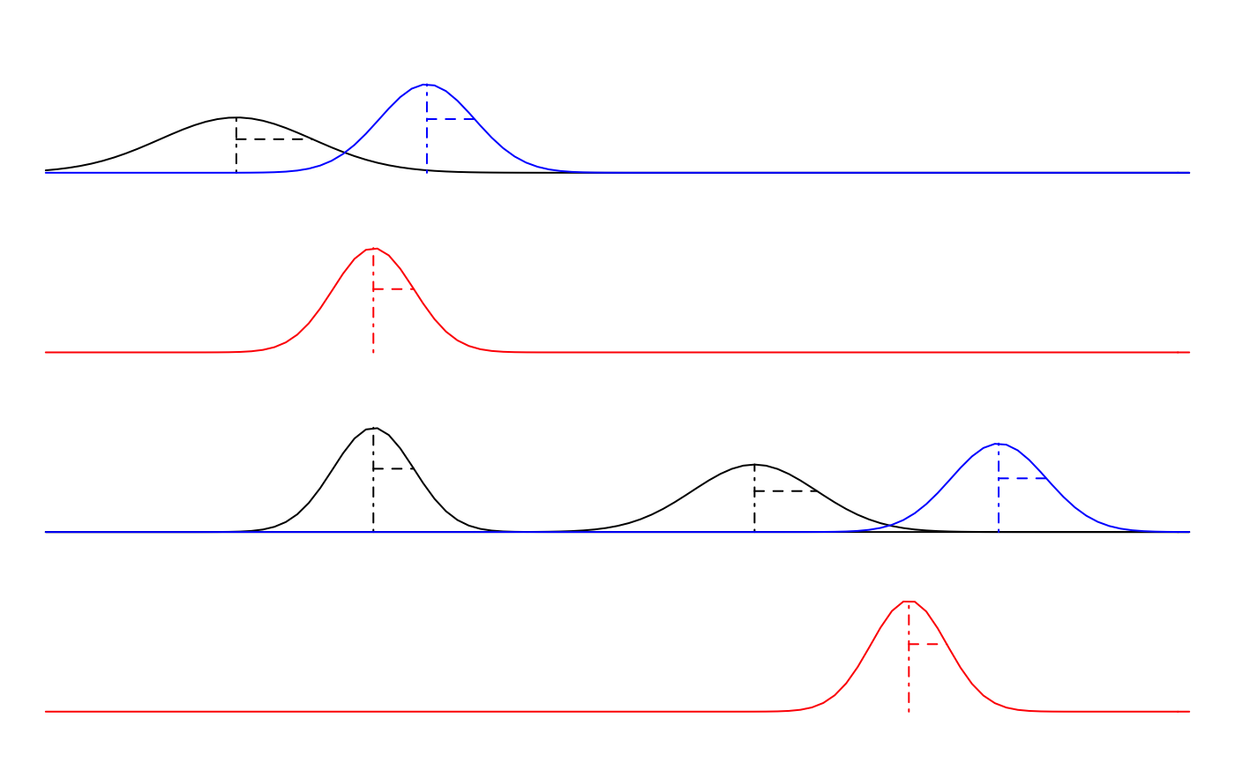
Prior
Likelihood
First Observation
t=1
m₀
y₁
Posterior
m₁
Prior
Likelihood
Next Observation
t=2
m₁
m₁*
y₂
Posterior
m₂
time

